Slide 1
Disciplinary System
OSHA VPP
September 2022
Notes:
This presentation outlines disciplinary system requirements for the purposes of OSHA VPP approval.
The presentation provides information on the background and importance of a disciplinary system, required documentation, and the various levels of employee knowledge.
It concludes with an action checklist and supplemental details to help with OSHA VPP implementation and sustainment efforts.

Slide 2
Objectives
In this presentation, you will learn to:
  Summarize the background and importance of disciplinary systems
  List disciplinary system-related documentation
  Describe the knowledge leadership/management, key personnel, and the workforce should have regarding the disciplinary system
  Identify disciplinary system actions to implement and sustain OSHA VPP
Notes:
This presentation is beneficial to safety professionals, OSHA VPP representatives, human resources personnel overseeing the disciplinary system, and different levels of leadership and management executing the disciplinary system, when needed.

Slide 3
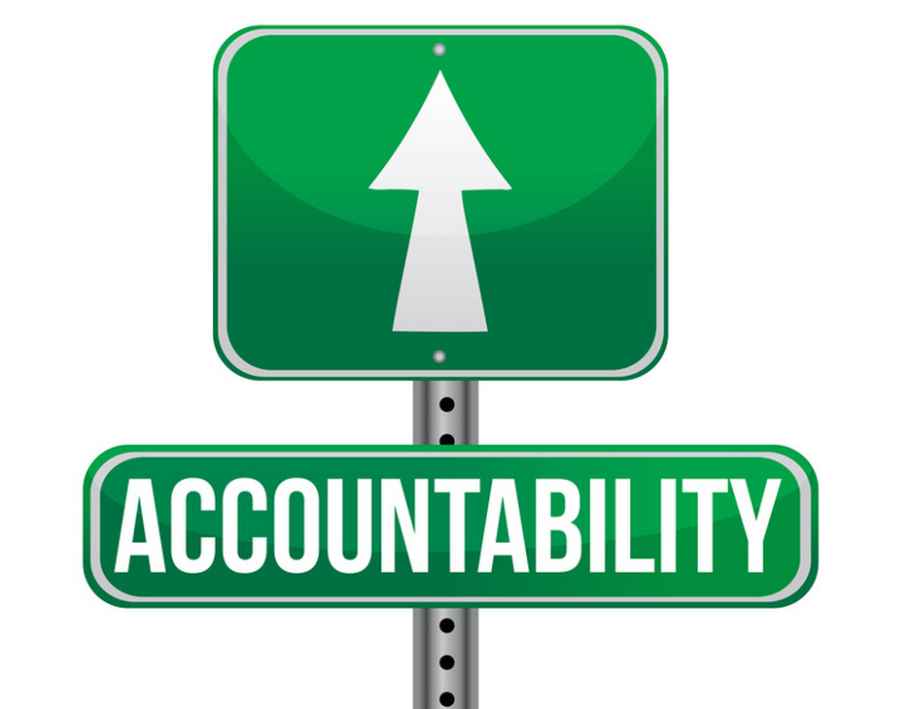
Background & Importance
Included in the HP&C criteria for VPP
Covers the discipline policy for S&H violations or negligence
Serves as an accountability tool for personnel who do not follow S&H policies and procedures
Requires communication of the disciplinary process
Focuses on equitable disciplinary enforcement across all levels
Image retrieved from Bing Images
Notes:
HP&C = hazard prevention and control
S&H = safety and health
A disciplinary system is an important part of a safety management system. It provides guidance and accountability on S&H policies, procedures, and rules to all employees, including management and contractors.
Communicate the disciplinary policy and enforce it equitably across all employees and management. An effective disciplinary system addresses S&H-related infractions by workers as well as by supervision and management.
The disciplinary system for S&H can be a subpart of an all-encompassing disciplinary system.
Image retrieved from Bing Images (Creative Commons).

Slide 4

Documentation
Written disciplinary process and procedures
Communication records and training records on the basics of the disciplinary system
Verification or examples of
disciplinary action taken, if applicable
S&H-related infraction trends
Image retrieved from Bing Images
Notes:
S&H infraction: Non-compliance with written S&H instructions, procedures, posted signage, or other rules can include, but is not limited to, improper use of equipment, not following procedures, or not using required personal protective equipment.
Disciplinary actions: A method for managing job-related behavior not meeting written S&H-related rules and expectations.
It is a good idea to define S&H infractions and the actions taken when an infraction occurs in the written disciplinary process and procedures. This definition is sometimes already done in Service- or Agency-specific guidance. These procedures should also describe the actions taken for multiple infractions.
Examples of communication records and training records include: new employee orientation training, refresher training, email communications, published newsletters, or meeting minutes.
Image retrieved from Bing Images (Creative Commons).

Slide 5
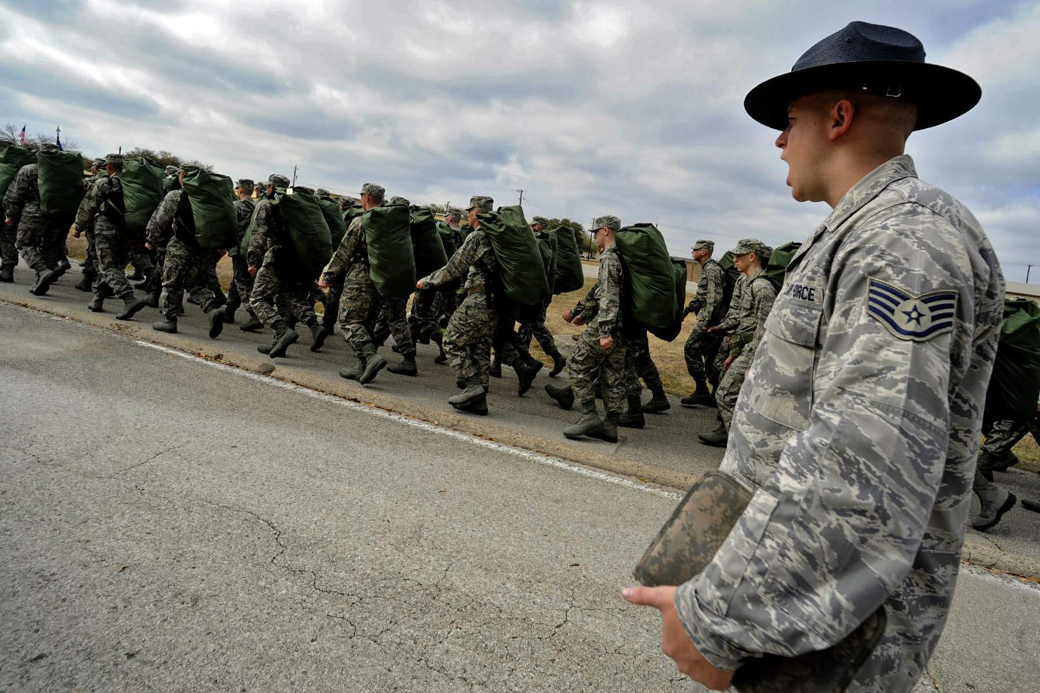
Leadership/Management Knowledge
Leaders and managers should be knowledgeable about:
  Examples of S&H infractions
  The tiered disciplinary process when a
  safety infraction occurs
  Instances when the disciplinary process
  was used, if applicable
  Trends related to disciplinary infractions
Image retrieved from Bing Images
Notes:
Some questions to use to gauge leadership and management knowledge of the disciplinary system include:
What system is in place to hold workers and supervision accountable for S&H-related infractions?
Have you ever had to discipline a worker or supervisor for not following the safety rules?
Are workers and supervisors disciplined equally for S&H-related infractions?
What underlying reason would keep employees from not following safety policies and procedures?
Is accountability the same for management as it is for non-management personnel?
Image retrieved from Bing Images (free to share and use license): https://upload.wikimedia.org/wikipedia/commons/9/96/Air_Force_Basic_Training_March.jpg

Slide 6

Key Personnel Knowledge
Human resources should know:
  Disciplinary program and procedures
  Disciplinary information related to employee job descriptions
  Disciplinary actions taken for S&H infractions, if applicable
  Enforcement of the disciplinary program for all personnel
  Accountability for S&H infractions (e.g., performance appraisals)
Image retrieved from Bing Images
Notes:
Human resource personnel are generally the key personnel responsible for monitoring, implementing, and documenting use of the disciplinary system.
Image retrieved from Bing Images (Creative Commons).

Slide 7

Workforce Knowledge
Employees should know:
  Written disciplinary process and procedures
  Definition and examples of S&H infractions
  Process taken when management
  and/or employees disobey a safety
  rule
  Process for reporting unsafe acts
Image retrieved from Bing Images
Notes:
Employees should feel the discipline system is fair. A good way to comfort employees is to review all S&H infractions with the workforce (leave off sensitive information; focus on the situation) and discuss what could have been done differently going forward.
The image shows employees receiving training on the workplace disciplinary procedures. Image retrieved from Bing Images (Creative Commons).

Slide 8
Action Checklist
Review DoD and Service or Agency-level disciplinary procedures
Communicate the disciplinary procedures
Hold personnel accountable for unsafe/unhealthful actions/behaviors and S&H rule violations
Document cases of disciplinary action taken
Trend disciplinary actions taken
Review the disciplinary program and procedures
Notes:
Follow the action checklist to develop and maintain a VPP-worthy disciplinary system. The action checklist items will be covered in more detail in the following slides.

Slide 9

Review Disciplinary Procedures
Determine if your worksite has defined disciplinary procedures
  Look at DoD Instructions
  Check Service or Agency regulations
  and instructions
  See if procedures are available at the
  worksite level
Read through these procedures
Become familiar with the tiered
disciplinary process(es)
Image retrieved from Bing Images
Notes:
An example of a DoD Instruction (DoDI) related to disciplinary procedures is DoDI 1400.25-M (Civilian Personnel Management). 10 U.S. Code Chapter 47 (Uniform Code of Military Justice) handles disciplinary procedures for uniformed military.
Examples of Service or Agency regulations/instructions related to disciplinary procedures include:
Air Force: AFI 36-704 (Disciplinary and Adverse Actions), AFI 36-2406 (Officer and Enlisted Evaluation Systems), AFI 36-1001 (Managing the Civilian Performance Program)
Army: Army 385-10 (Chapter 3, Accident Investigation and Reporting)
Navy: Department of the Navy Civilian Human Resources Manual (Subchapter 752, Disciplinary Action), SECNAVINST 5100.11K (Enclosure 3), OPNAVINST 5100.23H (Chapter 2)
Marine Corps: Department of the Navy Civilian Human Resources Manual (Subchapter 752, Disciplinary Action), NAVMC Directive 5100.8
Image retrieved from Bing Images (free to share and use license) at: http://www.imperial.ac.uk/ImageCropToolT4/imageTool/uploaded-images/shutterstock_242514907--tojpeg_1448877303120_x2.jpg

Slide 10

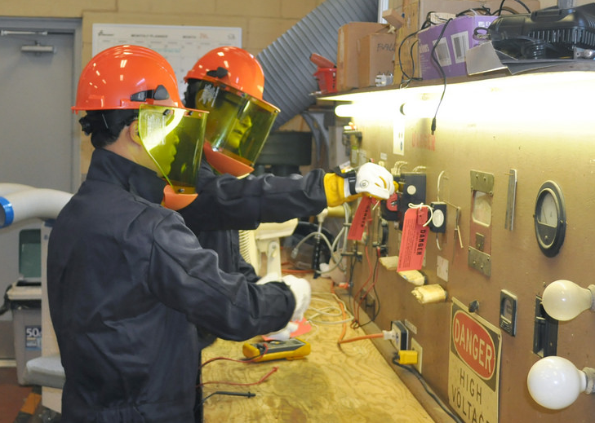
Communicate Disciplinary Procedures
Include the basic disciplinary process in new employee orientation
Train supervisors and employees on the importance of the disciplinary system
Inform supervisors and employees of what comprises a S&H infraction
Images retrieved from Bing Images
Notes:
All employees need to understand the disciplinary system. Consider recording important meetings and briefings to share with new supervisors and employees.
Communication may also include emails, Commander calls, and newsletter articles.
The left image shows an employee sitting through a new employee orientation. Image retrieved from Bing Images (Creative Commons).
The right image represents employees working safely since they understand they must follow safe work rules and procedures, as taught in training. Image retrieved from Bing Images (free to share and use license) at: https://c1.staticflickr.com/3/2923/14853353063_297b7ed5b3_b.jpg

Slide 11
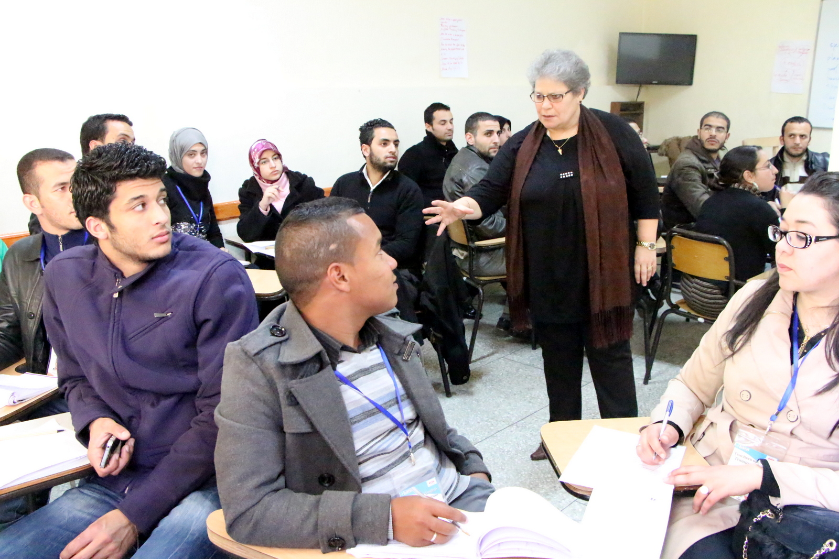
Communicate Disciplinary Procedures
Perform refresher training on procedures when:
  Changes in workplace or procedures occur
  The disciplinary system is not used
  appropriately
Consider informing employees
when a safety or health infraction
occurs and discipline is enforced
Image retrieved from Bing Images
Notes:
Best Practice: Hold meetings or send out safety flashes to review S&H infractions; include infractions from all levels of employees. Safety flashes are important to review the unsafe/unhealthful condition or act, discuss why the condition or act occurred, and to review the actions that led up to the infraction. These are good opportunities to review lessons learned and to discuss what could have been done differently to avoid unsafe/unhealthful conditions or acts. Use the instances as learning opportunities. Omit all sensitive and confidential information (e.g., employee name) from the discussion; only include the details of the incident.
The image shows a group of employees briefed on a S&H infraction experienced at the worksite. Image retrieved from Bing Images (free to share and use license) at: http://2.bp.blogspot.com/-eQ1HoyRfets/UVAo0hCovQI/AAAAAAAAPqQ/D3bxzAsrr9c/s1600/teacher+training1.JPG

Slide 12

Hold Personnel Accountable
Consider adding accountability into job
descriptions and performance appraisals
Recognize good behavior – reinforce
desired behavioral changes
Ensure managers and supervisors
address/correct employee S&H
infractions
Identify and address employee infractions in a timely manner
Hold leaders and managers just as accountable as employees for S&H rules
Notes:
Example information to include in job descriptions include:
Follow and be knowledgeable of all S&H rules and procedures
Report any unsafe conditions or work practices
Example information to include in performance appraisals include:
Follows all S&H rules and procedures
Completes all required safety-related training
Participates in safety-related activities (e.g., safety committees, working groups, inspection, program development)
It is suggested to identify and address all S&H infractions in a timely manner (ideally within 48 hours) so the employees do not forget what they did wrong. Check your Service/Agency guidance for additional information.
Image retrieved from Bing Images (Creative Commons).

Slide 13
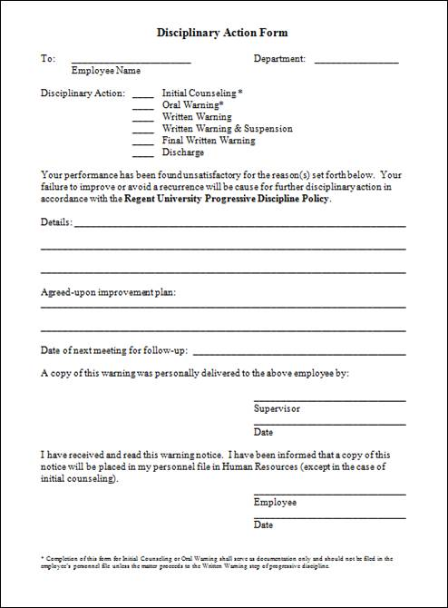
Document Disciplinary Infractions
Infraction description
Causal factor(s)
Disciplinary action(s) taken
Corrective action(s) implemented,
if applicable
Employee’s job position
Manager/supervisor name
How long the employee has worked here
Image retrieved from Regent University
Notes:
The image shows an example disciplinary form used to document S&H infractions. Image retrieved from Regent University at: www.regent.edu/admin/hr/docs/Disciplinary Action Form.doc

Slide 14
Trend Disciplinary Infractions
Gather all documented S&H infractions
Review the information to see if there are any common occurrences
Identify ways to improve the S&H
program, including communication
or training
Consider drafting S&H goals and
objectives based on the results
of trending
Image created by DoD SMCX
Notes:
Trending disciplinary information may help identify holes or problems within the S&H program and/or disciplinary system. Annually, you should review the past year’s disciplinary actions to identify any trends.
Image created by DoD SMCX.

Slide 15

Review and Update Procedures
Consider reviewing the written disciplinary process and procedures:
  Annually
  When changes in process(es) and
  procedures occur
  When the system is not followed
  When management and employees
  are not disciplined equally
Image retrieved from Bing Images
Notes:
Annual reviews help to ensure the disciplinary process is effective and enforced equitably. Changes in processes and procedures must be updated in the written program, and changes in the way your S&H programs operate may dictate a change to what is considered a S&H rule, or a violation of rules.
Image retrieved from Bing Images (Creative Commons).

Slide 16
Conclusion
In this presentation, you learned to:
  Summarize the background and importance of disciplinary systems
  List disciplinary system-related documentation
  Describe the knowledge leadership/management, key personnel, and the workforce should have regarding the disciplinary system
  Identify disciplinary system actions to implement and sustain OSHA VPP

