Slide 1
Emergency Procedures
OSHA VPP
June 2022
Notes:
This presentation outlines emergency procedure requirements for the purposes of Occupational Safety and Health Administration (OSHA) Voluntary Protection Programs (VPP) recognition. It provides information on the background and importance of emergency procedures, required documentation, and the various levels of employee knowledge. It concludes with an action checklist and supplemental details to help with OSHA VPP implementation and sustainment efforts.

Slide 2
Objectives
In this presentation, you will learn to:
Summarize the background and importance of emergency procedures
List emergency procedure-related documentation
Describe the knowledge leadership/management, key personnel, and the workforce should have regarding emergency procedures
Identify emergency procedure actions to implement and sustain OSHA VPP
Notes:
This presentation is beneficial to safety professionals, OSHA VPP representatives, designated emergency managers, and others with emergency management responsibilities.

Slide 3
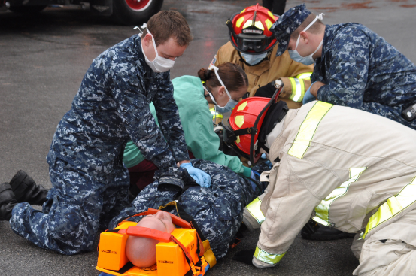
Background
Included in the HP&C criteria for VPP
Addresses planning and responding to workplace emergencies and evacuations for unforeseen situations with the potential to:
Threaten employees, visitors, or the public
Disrupt or shut down operations
Cause physical or environmental damage
Image retrieved from Bing Images
Notes:
HP&C = Hazard Prevention and Control
Emergencies may be natural or manmade. Examples include: floods, hurricanes, tornadoes, fires, toxic gas releases, chemical spills, radiological accidents, infectious diseases, explosions, civil disturbances, workplace violence, confined space incidents, and fall rescues.
Few people can think clearly and logically in a crisis; therefore, it is crucial to be prepared for emergencies. It is also important to conduct self-inspections and identify safety hazards that can make the emergency response process more complex.
For more information on employee alarm systems, review OSHA 29 CFR 1910.165 at: https://www.osha.gov/laws-regs/regulations/standardnumber/1910/1910.165
The image shows emergency responders simulating an emergency scenario to exercise response procedures. Image retrieved from Bing Images (free to share and use license) at: https://upload.wikimedia.org/wikipedia/commons/1/1d/US_Navy_101117-N-3158M-098_Medical_emergency_responders_assist_a_simulated_casualty_at_Naval_Station_Rota_during_exercise_Neptune_Response_2011.jpg

Slide 4
Importance
Prepares the workforce for various types of emergencies
Tests the effectiveness of emergency procedures and protocols
Evaluates the organization’s communication systems
Saves time, property, and lives during an emergency
Ensures there are sufficient resources for emergencies
Image retrieved from Bing Images
Notes:
Emergency procedures ensure the workforce understands how to respond during different types of emergencies. It is essential to evaluate the effectiveness of all aspects of the procedures before an actual emergency occurs. In addition, preparing for emergencies compels emergency managers to verify there are enough resources for all to be safe during emergencies.
Image retrieved from Bing Images (free to share and use license): http://drrosman.com/wp-content/uploads/2011/07/emergency.jpg
The image shows an emergency sign in the front of a hospital.

Slide 5
Documentation
Local emergency action or emergency management plan
Evidence of periodic reviews
Fire prevention plan
Emergency procedures for different types of emergencies
Posted evacuation maps
Emergency drill critique forms/fire drill report forms
Emergency preparedness training records
Image retrieved from Microsoft Clip Art
Notes:
Documentation supporting this sub-element includes your emergency action plan or fire prevention plan. Other documents, such as emergency drill critiques and annual programmatic reviews, show how your organization responds in emergency situations.
OSHA Emergency Action Plan requirements: https://www.osha.gov/pls/oshaweb/owadisp.show_document?p_id=9726&p_table=STANDARDS
OSHA Fire Prevention Plan requirements: https://www.osha.gov/pls/oshaweb/owadisp.show_document?p_table=STANDARDS&p_id=12887
The image represents maintaining as much documentation as necessary to show the establishment and effectiveness of your emergency program. Image retrieved from Microsoft Clip Art.

Slide 6
Leadership/Management Knowledge
Leaders and managers should be knowledgeable about:
Who oversees emergency management
Who serves as the Incident Commander
Last emergency drill conducted
Weaknesses or challenges to improve emergency preparedness
Specific role/responsibilities in emergency drills
Image retrieved from Bing Images
Notes:
Leadership and managers should know the individual or individuals who oversee emergency management, when the organization conducted the last emergency drill/exercise, the findings identified during emergency drill critiques, and what their roles and responsibilities as leaders are during emergencies, especially if they serve as the Incident Commander.
The Incident Commander is the person responsible for all aspects of an emergency response, including: developing incident objectives, managing all incident operations, applying resources, as well as maintaining responsibility for all persons involved.
Image retrieved from Bing Images (free to share and use license) at: http://farm9.staticflickr.com/8143/7367161978_624a00541d_z.jpg
The image shows a member of the military shaking hands with a public safety representative.

Slide 7
Key Personnel Knowledge
The emergency manager should know:
Development and execution of emergency plan and procedures
Annual programmatic review
Frequency and type of drills
Follow-up actions after a drill
Documentation of drills and drill critique process
Accountability and employee participation
Evaluation of changes in the workplace
Plans for individuals who need special assistance
Image retrieved from Bing Images
Notes:
This individual is expected to know just about everything involving the development, implementation, execution, and evaluation of the written emergency plans and procedures. In addition, they are generally the most knowledgeable about supporting documentation and the resources available to execute the program.
Examples of plans for individuals who may need special assistance:
Vibrating alarm notifications and sight guides for low vision or blind employees
Flashing lights for deaf or hearing-impaired personnel
Rescue or stair chairs and a buddy system for physically challenged and mobility-restricted employees
The image shows emergency staff meeting to discuss outreach activities with Federal Emergency Management Agency (FEMA) representatives. Image retrieved from Bing Images (free to share and use license) at: https://upload.wikimedia.org/wikipedia/commons/6/61/FEMA_-_42200_-_FEMA_Community_Outreach_with_DeKalb_Emergency_Management.jpg

Slide 8
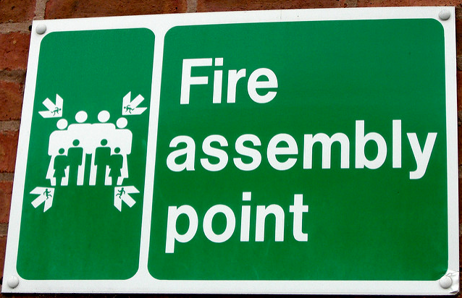
Workforce Knowledge
Employees should know:
Location of the emergency action plan, written emergency procedures, and posted evacuation maps
Emergency reporting and points of contact
Primary and secondary exit routes
Assembly area or rally point
Shelter-in-place locations
Image retrieved from Bing Images
Notes:
Employees should be knowledgeable of the emergency procedures specific to their local work area. Employees must understand what to do and where to go during an emergency. Ask employees how to respond to different emergency types and where to go when evacuating their work area.
The image shows an evacuation assembly point sign where employees rally to and are accounted for during a fire. Image retrieved from Bing Images (free to share and use license) at: http://farm3.staticflickr.com/2027/2155083948_c1569c8757_z.jpg

Slide 9
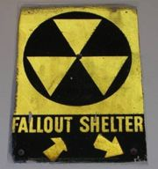
Workforce Knowledge
Employees should know:
Last emergency drill conducted
Actions they need to improve from the last drill
Specific responsibilities in emergency procedures
Emergency response activities, if involved
Involvement in critical operations, if applicable, to evacuation
Taking accountability of others
Additional safety or security precautions
Image retrieved from Bing Images
Notes:
Examples of critical operations include:
Shutting down equipment or machines
Monitoring supplies or other essential services which cannot be shut down for every emergency
Shutting down processes requiring multiple stages or steps for shutdown
Operating fire extinguishers
Shutting down gas or electrical systems and other special equipment that can be damaged if left operating
Sweeping the area to ensure evacuation of all personnel
Assisting personnel requiring special assistance
The image shows a fallout shelter sign, which may be used for shelter-in-place scenarios. Image retrieved from Bing Images (free to share and use license) at: https://upload.wikimedia.org/wikipedia/commons/thumb/e/e6/Fallout_shelter.jpg/180px-Fallout_shelter.jpg

Slide 10
Action Checklist
Conduct a workplace hazard assessment
Create evacuation maps
Develop an emergency action plan
Designate a responsible person
Train employees
Hold emergency drills
Critique emergency drills
Review the plan to ensure it is effective
Notes:
Follow this action checklist to implement, meet, and sustain VPP criteria for emergency management. Each of these action checklist items will be covered in more detail.
Keep in mind, your site may be required to develop a written fire prevention plan to supplement your emergency preparedness and response procedures.

Slide 11
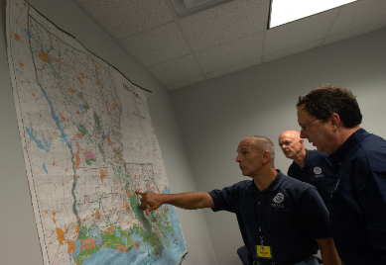
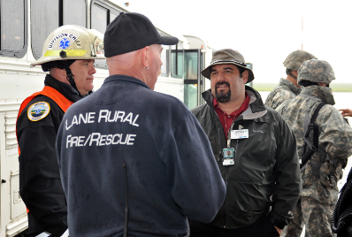
Workplace Hazard Assessment
Involve employees
Conduct an HVA
Review facility layouts (both outdoor and indoor)
Evaluate the structural features of buildings
Images retrieved from Bing Images
Notes:
HVA = hazard and vulnerability assessment
The commitment and support of all employees is critical to the success of the emergency action plan. Employees are more familiar with their work areas and processes than those who are not working in the areas. Involving them in the initial workplace evaluation helps everyone better understand the setup of the facility. Their involvement provides their perspectives and opinions on emergency preparedness and response.
Document your HVA or other similar assessment and use the assessment to draft procedures for likely emergencies.
The left image shows a FEMA emergency management team evaluating the local area to assess hazard potential. Image retrieved from Bing Images (free to share and use license) at: https://upload.wikimedia.org/wikipedia/commons/4/45/Michael_Brown_views_map_at_Office_of_Emergency_Management_briefing.jpg
The right image shows local emergency representatives meeting to assess emergency hazard potential. Image retrieved from Bing Images (free to share and use license) at: https://upload.wikimedia.org/wikipedia/commons/8/85/Joe_Rizzi%2C_center_right%2C_the_emergency_manager_for_the_City_of_Eugene%2C_and_Lane_County_Search_and_Rescue_Fire_Chief_Dale_Borland%2C_center_left%2C_review_information_for_a_mass_casualty_response_scenario_during_120503-A-NY487-875.jpg

Slide 12
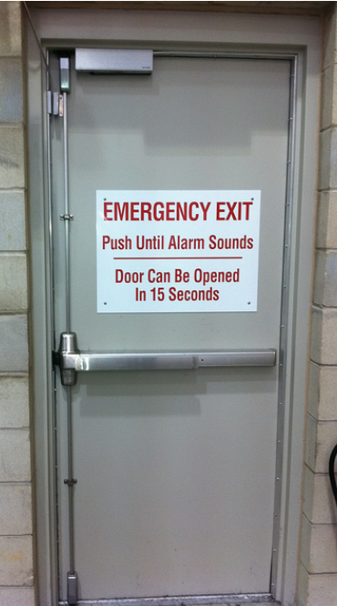
Workplace Hazard Assessment
Determine the emergency systems in place
Alarms, flashing lights, emergency lighting
Ensure exit signs are in line of sight
Identify potential exit routes
Identify hazardous work areas, or those unfit
to serve as an exit
Image retrieved from Bing Images
Notes:
"Exit" signs with an arrow indicating directions must be clearly visible and placed in every location where the direction of travel to reach the nearest exit is not immediately apparent.
OSHA Fact Sheet on Emergency Exit Routes: https://www.osha.gov/OshDoc/data_General_Facts/emergency-exit-routes-factsheet.pdf
The image shows an emergency exit door with clear, easy access for evacuation. Image retrieved from Bing Images (free to share and use license) at: https://c2.staticflickr.com/8/7290/10275292064_7d7d70cd07_z.jpg

Slide 13
Emergency Evacuation Maps
Review the elements of a good evacuation plan:
No emergency exits in restrooms, through rooms with hazardous materials, or into narrow passages
No use of elevators to reach an emergency exit
Designate primary and secondary exit routes
Mark the location of the assembly area(s)
Indicate exits with wheelchair access
Indicate the employee’s current location (You Are Here)
Orient maps to the direction faced while viewing
Notes:
Follow these guidelines when developing comprehensive and clear evacuation plans and maps. It is common for maps to only depict one exit route, lack an indicator to let readers know where they are on the map, or be oriented in the wrong direction. This is an example of a map with poor orientation: the exit is to your right because the map is facing north; however, the exit is to your left because you are facing south as you read it on the wall.
Whenever possible, show the assembly area location or at least note the location of the assembly area, on the evacuation map.
Update map postings as workplace changes occur.
OSHA Evacuation Plans and Procedures eTool: https://www.osha.gov/SLTC/etools/evacuation/floorplan_demo.html

Slide 14
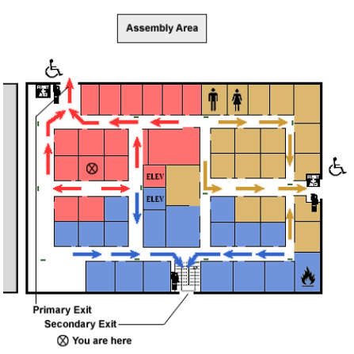
Emergency Evacuation Maps – Example
Image retrieved from OSHA
Notes:
Good evacuation plan elements:
Ensure primary and secondary exits are arranged to minimize the possibility that a fire or other emergency condition blocks multiple exits.
Do not designate emergency exit routes for building evacuation through restrooms (or windows) even if a restroom has a door employees could use as an exit
Lead employees away from rooms with hazardous materials so the employees do not pass the area during an emergency.
Do not designate exit routes through narrow passages; passageways between two buildings may not provide enough open space for safe evacuation during an emergency.
Designate assembly areas outside the building for employees to gather during an emergency.
Clearly illustrate the location of this assembly area, if shown on the map.
Show the locations of stairways and elevators on the floor plan of a multiple-story building and indicate the stairs, not the elevators, are the appropriate means of exit in case of emergency.
Where applicable, designate exits with wheelchair access on the floorplan.
Show the employee's current location in the building; consider a star or a “You Are Here” designation.
The image shows an evacuation plan. In addition to the “You Are Here” designation, a good evacuation map designates primary and secondary exits and is oriented to the direction the reader is facing. Image retrieved from OSHA at: https://www.osha.gov/SLTC/etools/evacuation/floorplan_demo.html

Slide 15
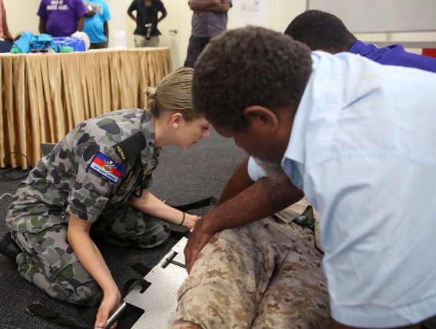
Emergency Action Plan – Components
Means of reporting fires and other emergencies
Names or job titles of persons who can be contacted about the emergency procedures
Evacuation procedures
Procedures for first aid and medical care
Image retrieved from Bing Images
Notes:
The slide lists the minimum information, according to OSHA regulation and VPP expectations, to include in an emergency action plan.
Example means of reporting fires and other emergencies include:
Dialing 911 or internal emergency reporting number
Activating manual emergency pull stations or other alarm systems
The image shows trained personnel providing medical care. Image retrieved from Bing Images (free to share and use license) at: https://live.staticflickr.com/342/19839254316_9f1d4563cd_b.jpg

Slide 16
Emergency Action Plan – Components
Procedures for additional responsibilities
Incident Commander
Persons who stay behind to operate critical plant operations
Persons who temporarily stay behind to shut down critical plant operations
Employees who assist with or perform medical duties
Those who take accountability or have other responsibilities
Image retrieved from Bing Images
Notes:
The slide lists the minimum information, according to OSHA regulation and VPP expectations, to include in an emergency action plan.
The image shows an Incident Commander ensuring total accountability during an evacuation. Image retrieved from Bing Images (free to share and use license) at: http://farm3.staticflickr.com/2175/2503402996_0dcbc24ef7_z.jpg

Slide 17
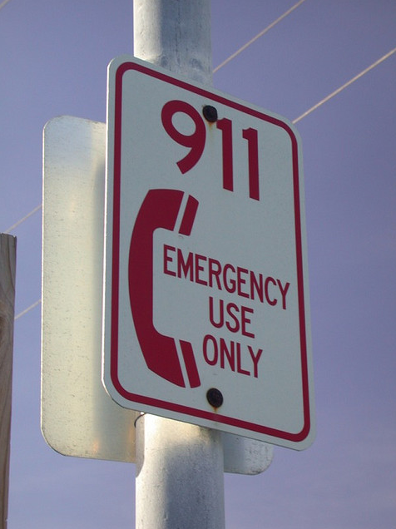
Emergency Action Plan – Components
Accountability for employees
Annual evacuation drills
Employee emergency procedure training requirements and frequency
Emergency telephone numbers
Emergency meeting places
PPE, where needed
Image retrieved from Bing Images
Notes:
OSHA Emergency Action Plan requirements: https://www.osha.gov/pls/oshaweb/owadisp.show_document?p_id=9726&p_table=STANDARDS
The slide lists the minimum information, according to OSHA regulation and VPP expectations, to include in an emergency action plan. OSHA recommends including some optional topics in emergency procedures too, including:
A description of the alarm system used to notify employees (including disabled employees) to evacuate and/or take other actions; the alarms used for different actions should be distinctive and might include horn blasts, sirens, or even public address systems
The site of an alternative communications center to be used in the event of a fire or explosion
A secure on or offsite location to store originals or duplicate copies of accounting records, legal documents, your employees’ emergency contact lists, and other essential records.
The image shows an emergency telephone number posting. Image retrieved from Bing Images (free to share and use license) at: https://upload.wikimedia.org/wikipedia/commons/4/42/911sign.jpg

Slide 18
Emergency Action Plan – Development
Involve employees in the planning process
Create a draft emergency action plan
Gain input from key personnel and management
Finalize the emergency action plan
Keep a copy of the plan readily accessible to employees
Image retrieved from Bing Images
Notes:
Consider assigning emergency monitors in each work area for evacuation safety and accountability. Ensure emergency monitors have the proper training and are familiar with the emergency action plan.
Emergency action plans must include: general issues, evacuation policies and procedures, how to report emergencies, how to alert employees, employee training requirements, and an explanation of drills. The plan must tell all personnel know what to do before, during, and after emergencies. This knowledge is especially important for personnel with additional responsibilities, such as performing critical tasks before evacuating the facility.
The emergency action plan should define assembly areas and who is responsible for:
Bringing attendance sheets/employee rosters
Conducting the last sweep of the work area
Conducting a roll call in the assembly area
You may communicate your plan orally (OSHA 29 CFR 1910.28(b)) if you have 10 or fewer employees. Also, consider having your legal department review your completed plan.
OSHA’s Emergency Action Plan Checklist: https://www.osha.gov/SLTC/etools/evacuation/checklists/eap.html
Create Your Own Emergency Action Plan: https://www.osha.gov/etools/evacuation-plans-procedures/expert-systems
Image retrieved from Bing Images (free to share and use license) at: http://www.qac.org/images/CivicAlerts/10/Emergency-Management-Plan.jpg

Slide 19
Authority of Responsible Person(s)
Assign incident command positions for each/all emergency situations outlined in the plan
Ensure employees are aware of who is in charge during emergencies
Select a responsible individual to lead and coordinate the emergency action plan
Designate a party responsible for coordinating and critiquing emergency drills
Develop a committee or working group for plan review and revision
Notes:
Employees must know the Incident Commander and emergency coordinators and understand these people have the authority to make decisions during emergencies.
The Incident Commander is responsible for assessing the situation to determine whether an emergency exists, activating emergency procedures, overseeing emergency procedures, ensuring there are enough resources (such as personal protective equipment), notifying and coordinating with outside emergency services, and directing shutdown of utilities or plant operations, if necessary.

Slide 20
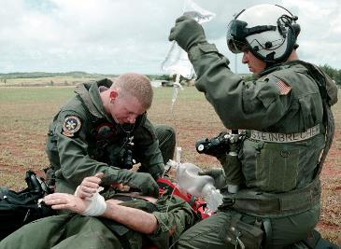
Employee Training – Topics
Types of emergencies and procedures for each
Who is in charge during emergencies
Emergency roles and responsibilities
Potential fire hazards
Unique on-site hazards
Alarms and emergency notification systems
Image retrieved from Bing Images
Notes:
Special on-site hazards may affect the ability to evacuate. Special hazards include, but are not limited to, flammable materials, toxic chemicals, radioactive sources, and water-reactive substances. Review these special hazards during your HVA.
The top image shows US Naval Hospital Corpsman Training. The bottom image shows emergency responders exercising rescue procedures. Images retrieved from Bing Images (free to share and use license) at: https://upload.wikimedia.org/wikipedia/commons/2/2d/US_Navy_010531-N-3889M-004_Navy_Corpsman_Field_Training_Exercise.jpg and https://www.flickr.com/photos/45802067@N03/27272594640

Slide 21
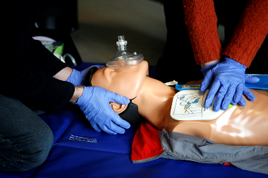
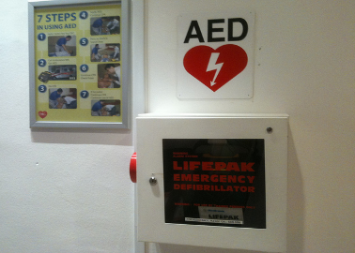
Employee Training – Topics
Location of evacuation and shelter plans
Location and use of emergency equipment
Procedures
Reporting emergencies
Critical operations
Accountability (means for locating missing individuals)
Image retrieved from Bing Images
Notes:
Train your employees in first-aid procedures, including protection against bloodborne pathogens, respiratory protection (including use of an escape-only respirator), and methods for preventing unauthorized access to the site, as applicable to your organization.
Review any specific policies in place for the use of emergency equipment. For example, some worksites have a policy to evacuate the facility in the event of a fire while others have designated, trained fire extinguisher users that are permitted to extinguish fires.
The top image shows training occurring during a CPR class. The bottom image shows an automated external defibrillator available for employees to use. Images retrieved from Bing Images (free to share and use license) at: https://upload.wikimedia.org/wikipedia/commons/8/82/CPR_training-05.jpg and http://farm2.staticflickr.com/1306/4709074970_71ced1d051_z.jpg

Slide 22
Employee Training – Frequency
Include emergency training in new employee orientation
Review the plan with each employee when:
The initial plan is developed
They are initially assigned to the job
Their responsibilities under the plan change
The plan itself changes
Provide make-up training to those absent for drills
Consider retraining employees annually
Notes:
Review your emergency action plan with your employees and verify everyone receives the proper training. Hold practice drills as often as necessary to keep employees prepared. VPP requires all employees to have the opportunity to participate in an annual evacuation drill. This requirements means a drill must occur in their work area at some point throughout the year.
Conducting an evacuation drill in each work area at least once per year serves as an annual training for your employees. When employees are absent for a drill in their area, you should provide a make-up training consisting of a review of the emergency procedures, a review of the drill critique, and a physical walkthrough of their egress route and assembly area. To help with this effort, it is sometimes easier to conduct annual retraining for all employees.
It is good practice to include outside resources, such as fire and police departments, when possible.

Slide 23
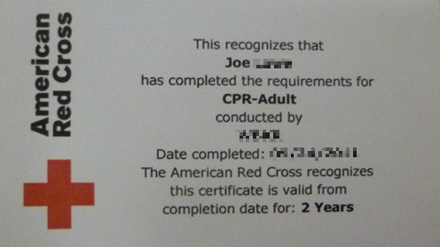
Employee Training – Responsibilities
Ensure employees with additional emergency responsibilities receive training on:
CPR
AED use
PPE
Critical operations
First aid and medical procedures
Fire extinguisher operation
Image retrieved from Bing Images
Notes:
CPR = cardiopulmonary resuscitation
AED = automated external defibrillators
PPE = personal protective equipment
Train employees with additional responsibilities so they can effectively perform their duties. Examples of personnel requiring training includes emergency monitors for each area or those who must stay behind during an emergency to perform special duties or assignments before evacuating.
Document all training. Document the name of the employee, the name of the trainer, the date of the training, the subject (or a short description) of the training, proof of competency (an evaluation of knowledge or demonstration of ability), and the date of the evaluation.
The image shows a wallet card given to persons who complete CPR training. Image retrieved from the Bing Images (free to share and use license) at: http://wac.450f.edgecastcdn.net/80450F/1490womi.com/files/2011/06/P1040382.jpg

Slide 24
Emergency Drills
Determine when the drill will take place
Contact emergency officials participating in the drill
Consider setting up obstacles to evaluate the effectiveness of the procedures
Image retrieved from Bing Images
Notes:
Emergency drills evaluate the execution and effectiveness of existing emergency procedures. Setting up obstacles is a great way to determine the effectiveness of an emergency drill. Some obstacles include blocking an exit door or taking an employee away before executing accountability procedures.
Notify local government agencies when you are conducting a drill, too - you don’t want to alarm the local community when you exercise your plan. When local government agencies know a drill is occurring, they know how to respond, and can inform others a drill is taking place if they receive calls or concerns (e.g., from seeing ambulances or fire trucks).
The image shows an emergency coordinator, taking the lead and authority to account for personnel during an emergency drill. Image retrieved from Bing Images (free to share and use license) at: http://theplymouthbrethren.org.uk/wp-content/uploads/2015/05/Team-Leader-huddle.jpg

Slide 25
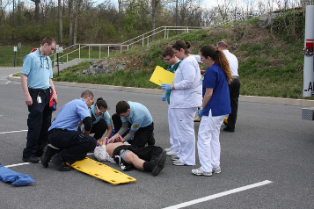
Emergency Drills
Critique the drill for effectiveness
Cover all work shifts
Ensure 100% of employees have the opportunity to participate in an annual evacuation drill
Conduct make-up training for employees who are absent for the annual drill
Image retrieved from Bing Images
Notes:
You do not need to hold a new when an employee is absent from a scheduled drill. Train employees who are not present during the annual evacuation drill. This training should include what type of drill occurred, a summary of the procedures, exit routes, and rally point, the outcome of the drill, and a physical walk of the primary and secondary exit routes to the rally point. Document this make-up training. Evaluating the effectiveness of this training with a knowledge test or demonstration of employee ability.
The top image shows employees and responsible personnel participating in an emergency drill. The image on the bottom shows employees evacuating the work area during an emergency drill. Images retrieved from Bing Images (free to share and use license) at: https://farm9.staticflickr.com/8254/8705544014_fc9329a3a8_z.jpg and https://upload.wikimedia.org/wikipedia/commons/thumb/8/8a/Fire_drill.jpg/300px-Fire_drill.jpg

Slide 26
Evacuation Drill Critiques
Determine who critiques the drill and how
Conduct the drill and document the critique
Submit any drill critique findings to management
Identify a method to track findings until closure
Implement follow-up actions to correct findings
Assess the effectiveness of follow-up actions during the next drill
Image retrieved from Bing Images
Notes:
Various personnel can critique a drill, including the safety office, fire department, emergency manager, or even employee participants, which is a great way to create more employee involvement.
Consider these critique factors when assessing an evacuation drill:
Was the alarm audible?
Did emergency lighting and emergency strobe lights work?
Did staff respond promptly to the alarm (document time taken)?
Were all exits and correct exits used?
Did everyone know where to go and what to do?
Were all occupants accounted for?
Did assembly points of contact know whom to contact?
How long did the emergency responders take to answer and arrive on-site?
Did those who have impairment in mobility, hearing, or seeing evacuate?
In medical sites, did those who have patients follow the proper procedures to evacuate safely for themselves and their patients?
The person leading the critique should ask management and employees to evaluate the effectiveness of the drill. Identify the strengths and weaknesses of your plan and work to improve it. Share results with management and the employees to help them understand where the worksite needs to improve.
The image shows designated exercise evaluators reviewing the effectiveness of an emergency drill. Image retrieved from Bing Images (free to share and use license) at: https://www.missionmanager.com/wp-content/uploads/2015/01/SARPYsm-300x218.jpg

Slide 27
Review, Coordination, and Updates
Develop an emergency plan committee
Review written plans and facility changes
Establish temporary plans and interim life safety measures
Review/update the workplace hazard assessment periodically
Conduct periodic testing and inspections of emergency equipment
Retrain the workforce whenever changes are made
Notes:
Establish an emergency monitor or committee to review written plans, drill results, or other areas of your emergency procedures program. Employees can help draft written plans and procedures and assist in evaluating potential changes to existing plans. Local fire departments and employees involved in hazardous materials operations can provide valuable input to your committee, too.
Always consider changes and challenges to emergency procedures when temporary work, such as construction, will occur for an extended period. Establish temporary plans and safety measures when existing written emergency plans or procedures will not work sufficiently. Review the workplace hazard assessment when these changes occur – you may find new emergency exposures/hazards.
Operations and personnel change frequently. Review the contents of your plan regularly and update it whenever an employee's emergency actions or responsibilities change, or when there is a change in the layout or design of the facility, new equipment, hazardous materials, or processes are introduced that affect evacuation routes, or new types of hazards are introduced that require special actions. Contact information is the most common outdated item in plans – place this information on a separate page in the front of the plan so you can easily update it. Ensure there are procedures if there are visitors present in the areas.

Slide 28
Conclusion
In this presentation, you learned to:
Summarize the background and importance of emergency procedures
List emergency procedure-related documentation
Describe the knowledge leadership/management, key personnel, and the workforce should have regarding emergency procedures
Identify the actions needed to implement and sustain emergency procedures to align with OSHA VPP expectations

