Slide 1
Hazard Prevention & Control
OSHA VPP
March 2020
Notes:
This presentation outlines hazard prevention and control (HPC) requirements for the purposes of Occupational Safety and Health Administration (OSHA) Voluntary Protection Programs (VPP) recognition.
The presentation provides information on the background and importance of HPC, required documentation, and the various levels of employee knowledge. It concludes with an action checklist and supplemental details to help with OSHA VPP implementation and sustainment efforts.

Slide 2
Objectives
In this presentation, you will learn to:
Summarize the background and importance of HPC
List HPC-related documentation
Describe the knowledge leadership/management, key personnel, and the workforce should have regarding HPC
Identify HPC actions to implement and sustain OSHA VPP
Notes:
This presentation is beneficial to safety and health (S&H) professionals, VPP representatives, and others with HPC responsibilities, such as engineers, industrial hygienists, maintenance personnel, emergency managers, and supervisors.

Slide 3
Background & Importance
Included in the HPC criteria for VPP
Outlined in DoDI 6055.01
Applies the hierarchy of controls to hazard control selection
Documents implemented hazard controls
Establishes written hazard control programs
Conducts follow-up studies on hazard controls after implementation
Notes:
DoDI = Department of Defense Instruction
HPC is one of the four main elements of OSHA VPP, but within the element itself, is a HPC sub-element focusing on the selection and application of hazard controls. This sub-element focuses on applying the hierarchy of controls to ensure you consider the most effective controls first. When you identify uncontrolled hazards, use temporary controls until you determine permanent solutions. The sub-element also focuses on documenting controls for use in procedures, inspections, and training, as well as conducting follow-up to ensure each control is effective.
A key component of the HPC sub-element ensures regulatory compliance with written hazard control programs. Written hazard control programs depend on the hazards present at your site and can include, but are not limited to: control of hazardous energy, bloodborne pathogens, process safety management (PSM), respiratory protection, permit-required confined space entry, and hearing conservation.
DoDI 6055.01 requires use of the hierarchy of controls to select hazard controls. To learn more about Department of Defense (DoD) risk management and hazard control information, visit the DoDI at: http://www.dtic.mil/whs/directives/corres/pdf/605501p.pdf.

Slide 4
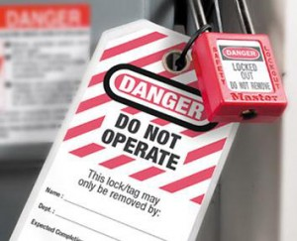
Documentation
Hazard control programs
S&H instructions and SOPs
Documents showing hazard control selection
Documents addressing the use/analysis of hazard controls
Hazard control follow-up evaluations
Image retrieved from Bing Images
Notes:
SOP = standard operating procedure
Make sure you provide examples of completed forms and documents to your assessment team. Do not show them blank forms! They want to see the completed documents to thoroughly assess the processes within your safety management system (SMS).
The documents listed on the slide are not all-inclusive, but do cover the common documentation in support of the prevention and control of identified hazards. Provide examples of how your organization addresses uncontrolled hazards and assesses the effectiveness of current hazard controls.
Show documents displaying how you select your hazard controls. Examples of documents supporting the use and analysis of hazard controls can include: hazard analyses (e.g. job hazard analysis, job safety analysis, fault tree analysis, failure modes and effects analysis), S&H inspection checklists, and S&H training records.
Evaluate any hazard control you implement to make sure it’s an effective control. Document these evaluations to show the controls you select are appropriate for the job performed. This can be as simple as adding a column to your hazard tracking log to show the date a follow-up evaluation was performed.
Image retrieved from Bing Images (free to share and use license) at: http://www.safetymoment.net/wp-content/uploads/2014/03/loto-300x243.jpg.
The image shows a lock and tag as a part of a site’s lockout/tagout program. This program is one of several hazard controls programs required by OSHA and reviewed in HPC.

Slide 5
Leadership/Management Knowledge
Leaders and managers should be knowledgeable about:
Methods to eliminate/control employee exposure to hazards
Processes for abating hazards and selecting hazard controls
Status of uncontrolled hazards/serious deficiencies
Image retrieved from Microsoft Clip Art
Notes:
Leaders and managers must be aware of the methods to eliminate/control employee exposure to hazards and ensure that selected controls protect employees from exposure to identified hazards.
Leaders and managers must be aware of the status of identified hazards and interim control measures in place until closure. They should have a thorough understanding of how the hazard abatement process works, as well as the process for determining the most effective and feasible hazard controls. Hazards assigned higher risk (risk assessment codes (RACs) 1, 2, or 3) uncontrolled for longer than 30 days should be priority items well-known by top leadership.
Image retrieved from Microsoft Clip Art.

Slide 6
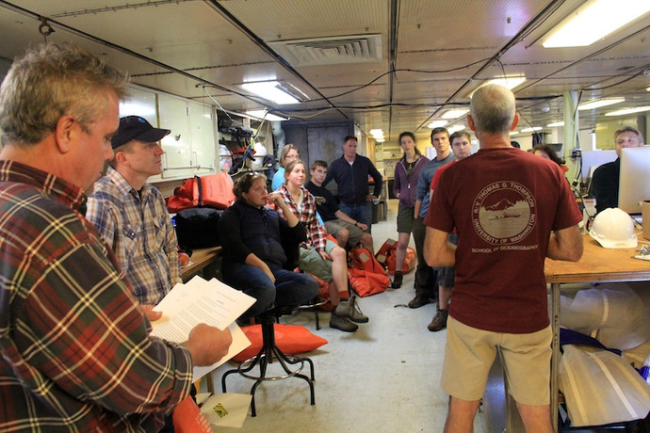
Key Personnel Knowledge
Key personnel should be knowledgeable about:
Processes for selecting hazard controls
Implementation and use of interim control measures
Examples of worksite hazard controls
Follow-up studies on implemented hazard controls
Documented evidence of hazard controls
Image retrieved from Bing Images
Notes:
Key personnel may include S&H staff, industrial hygienists, hazard control program managers, S&H training managers, and supervisors. This list is not all-inclusive, and there may be others within your organization that have HPC responsibilities.
Key personnel must also understand your organization’s process to select hazard controls. They should use the hierarchy of control and determine which control(s) works best for your organization (e.g., hazard, risk level, technical and economic feasibility), including temporary control measures. Provide examples of hazard controls used throughout your organization.
View the hierarchy of control at: https://www.osha.gov/dte/grant_materials/fy10/sh-20839-10/hierarchy_of_controls.pdf.
Key personnel should conduct follow-up studies on implemented controls. Once you implement a control, you need to make sure it’s effective and functioning as you intended.
Organizations generally document hazard controls in hazard analyses, work procedures, and self-inspection checklists. Key personnel must be aware of how you incorporate hazard controls into these documents.
Image retrieved from Bing Images (free to share and use license) at: http://www.interactiveoceans.washington.edu/files/img_3173_med.jpg.
This image represents a meeting where key personnel may be discussing S&H hazards and control methods.

Slide 7
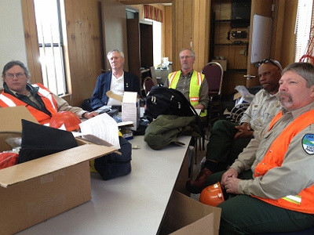
Workforce Knowledge
Employees should be knowledgeable about:
S&H hazards of assigned jobs
Controls used to protect against S&H hazards
Types of PPE worn
S&H training attended
Image retrieved from Microsoft Clip Art
Notes:
PPE = personal protective equipment
Employees should understand how to protect themselves against hazards present in their work areas. This includes not only the use of their PPE, but also the use of engineering and administrative controls.
Image retrieved from Microsoft Clip Art.

Slide 8
Action Checklist
Understand the hierarchy of hazard controls
Identify control options
Select hazard controls
Develop/update a hazard control plan and programs
Document/revise selected control measures
Train employees
Implement selected controls
Evaluate the effectiveness of implemented controls
Review written hazard control plans and training
Notes:
Follow this action checklist to implement and sustain VPP expectations for HPC. Each of these action checklist items will be covered in more detail.

Slide 9
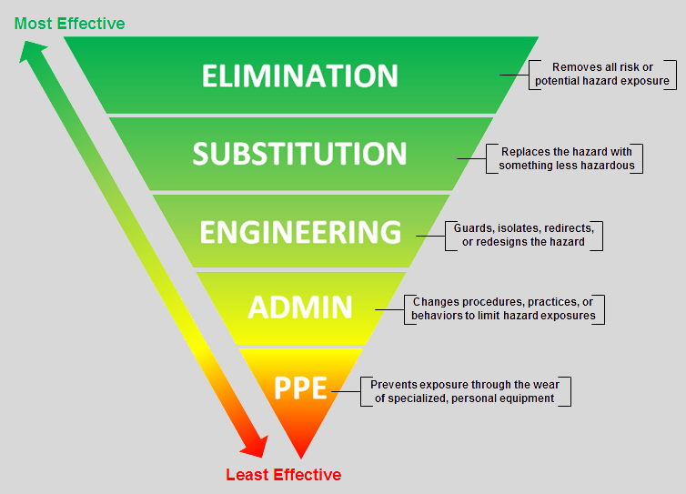
Hierarchy of Hazard Controls
Image created by the DoD SMCX
Notes:
Worksites use the hierarchy of controls structure to eliminate or minimize exposure to hazards. This is the most effective method to reduce exposure to identified hazards and is required by DoD and Service/Agency regulations.
Examples of different levels of hazard controls include:
Elimination/substitution: Most effective form of control, especially if done during pre-planning processes (e.g., moving a process from heights to ground level to eliminate a fall hazard, substituting a solvent-based chemical with a water-based chemical).
Engineering: Modifications, changes in design or equipment, and isolation (e.g., local exhaust ventilation, enclosed paint booths, lead-lined walls in radiation areas, machine guards).
Administrative: Change the way work is completed (e.g., hazard control programs, job rotation, S&H training, housekeeping practices, SOPs).
PPE: Used or worn by employees to reduce exposure (e.g., earplugs, protective gloves, hard hats).
Image created by the SMCX. The image shows a hierarchy of controls, with elimination being the most effective control, and PPE being the least effective to control hazards.

Slide 10
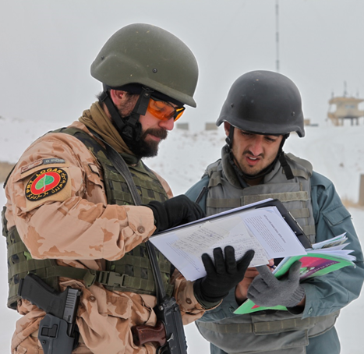
Control Options
Evaluate identified S&H hazards
Review S&H regulations and guidance
Investigate control measures used in other workplaces
Gain employee input and suggestions for hazard controls
Consult with available resources
Image retrieved from Bing Images
Notes:
Understand the S&H hazard (the associated risk level, or RAC, and location) you are trying to control. Evaluating the hazard may help generate ideas for potential hazard controls. Review S&H regulations and guidance to check for specific requirements you must follow to control the identified hazard (e.g., written programs). Consider looking at workplaces that have already controlled the same hazard – see what control(s) they use and decide if it will work at your organization. Collect, organize, and review information with employees to determine the controls that may work best to address the hazard. Your available resources (e.g., S&H staff, industrial hygienists) are very valuable during this phase.
Image retrieved from Microsoft Clip Art. The image shows an employee reviewing S&H guidance with a supervisor to check for any hazard control requirements.

Slide 11
Control Selection
Select controls using the hierarchy of controls
Consider the technical and economic feasibility
Avoid controls which may present new hazards
Review and discuss selected controls with employees
Use a combination of control measures, as needed
Eliminate or control all serious hazards first
Use interim controls while you implement long-term solutions
Notes:
Always consider the technical and economic feasibility of the controls you select. Visit OSHA for clarification on this consideration at: https://www.osha.gov/pls/oshaweb/owadisp.show_document?p_table=FEDERAL_REGISTER&p_id=21773
Run any hazard control ideas by employees to see how they feel about them before procurement. Selecting proper hazard controls is often a groupthink process. It is best to gather a diverse group of people to help brainstorm control ideas and assess how effective each control may be.
Always consider multiple layers, or levels, of control when one hazard does not fully control the hazard. For example, radiation hazard areas are frequently enclosed in a room with a door, offering a level of protection to keep the radiation inside; however, additional controls, like having lead-lined walls and having employees wear lead vests, help further control exposure to the radiation.
In any case, you want to eliminate or control all serious hazards first, and then move to identifying controls for your other hazards. When a control takes time to implement, use interim controls to temporarily protect employees against hazards.

Slide 12
Hazard Control Plan
List and prioritize the hazards needing control
Assign responsibility for installing/implementing controls
Establish a target completion date for each control
Track progress toward completion
Verify the effective of controls once implemented
Image retrieved from Microsoft Clip Art
Notes:
Hazard control plan: Describes how to implement and track selected hazard controls.
Prepare a hazard control plan to lay out your approach to implementing the selected hazard controls – you may do this in conjunction with a written project plan or preparing an abatement plan.
Then, assign responsibility to all involved in installing or implementing the selected hazard controls. Sometimes this takes the effort of maintenance personnel, supervisors, and contractors.
While it may not be set in stone, establish a target completion date; this helps to move the implementation process along.
Think about how you will track progress toward completing your established timelines. In addition, think about how to verify the effectiveness of controls after implementation; this may involve subject matter experts (SMEs) from your organization (e.g., S&H staff, industrial hygienists, engineers). In any case, monitor the progress of implementing controls and check them (at least annually) to verify controls are still effective. Document all your thoughts in a written hazard control plan (maintain it like a project plan) to show how the hazard controls were implemented at your organization.
Image retrieved from Microsoft Clip Art.

Slide 13
Hazard Control Programs
Review identified hazards and S&H regulations
Determine which written programs are required
Develop applicable hazard control programs
Customize programs to fit workplace tasks/S&H hazards
Incorporate implemented hazard controls into each program
Have SMEs and others review completed programs
Communicate program contents to the workforce
Notes:
Hazard control program: Otherwise, known as a S&H program; outlines the procedures and methods used to control specific hazardous exposures (e.g., falls, infectious materials, hazardous energy).
Oftentimes, organizations do not just have one hazard control program that lists all the hazard controls used at your worksite. Instead, you will most likely have several written programs and procedures outlining safe work procedures targeting a specific hazard, with the hazard controls outlined within each different program.
Review S&H regulations (e.g., DoD, Service/Agency, OSHA) to determine which hazard control programs you need at your organization. Do not just create a program because a regulation says a program is required. Only create a program if the program applies to your our organization (and the S&H hazards at your organization)!
Find examples of hazard control programs at: https://www.osha.gov/dcsp/compliance_assistance/sampleprograms.html
Depending on who writes the S&H program (generally S&H staff or an industrial hygienist), you may need subject matter experts to review the content, make sure it aligns with S&H regulations, and includes the information that aligns with your organizational expectations and requirements – they might already have a written hazard control program you need too! Look into your organization’s processes to see what types of approval are required to finalize and implement this program.
Once you finish writing a program, communicate the contents to the workforce so they can understand their roles and expectations.

Slide 14
Hazard Control Documentation
Think about where to document control measures:
Safe work procedures
Operating instructions
Hazard analyses
S&H rules
S&H inspection checklists
New employee orientation
S&H training
Image retrieved from Microsoft Clip Art
Notes:
In addition to documenting hazard controls in your plans and programs, update any other safety documents to show required hazard controls. The list on the slide is not all-inclusive; it is just a few examples of where you might document your hazard controls.
Incorporating hazard control information into you safety documents provides constant reminders to supervisors and employees of the required hazard controls. In addition, including control-related items on an inspection checklist helps to ensure controls remain in place and effective.
Anytime you incorporate a hazard control into a safety document, think about the level of detail you want to include (e.g., Do they need directions on how to use the hazard control? Is there a specific type of gloves employees need to wear?), and the clarity and conciseness of your documented information for the targeted audience.
Image retrieved from Microsoft Clip Art.

Slide 15
Employee Training
Employees | Training
Maintenance staff | Types of hazard controls installed/implemented Hazard control requirements and evaluation methods Preventative maintenance requirements for hazard controls
Managers | Required hazard controls Types of hazard controls installed/implemented
Supervisors & Employees | Required hazard controls How to use hazard controls Hazard control limitations How to maintain hazard controls Hazard control evaluation methods and requirements Process for reporting damaged or ineffective hazard controls
Notes:
Different levels of employees require varying levels of knowledge for the hazard controls you select and implement at your organization. The types of training listed in the table are recommendations; consider each employee’s job and their assigned responsibilities to identify what they need to know about the hazard controls you use in your workplace.
When you select/implement any new hazard control (even an interim control), do not just assume employees will understand how to use it and your maintenance staff will know how to maintain it. Train your employees on what they need to know to use your hazard controls to safely perform their jobs; consider creating a training matrix to identify and determine employee training needs.

Slide 16
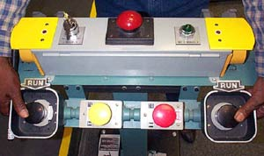
Control Implementation
Implement controls outlined in the hazard control plan, programs, and safety documents
Use interim measures until implementation of a more permanent control
Implement easy and inexpensive controls immediately
Communicate hazard control information to the workforce
Image retrieved from OSHA
Notes:
Once you select and document your hazard controls, you need to implement them according to your hazard control plan (and associated programs and documentation).
While a permanent control may not be immediately feasible, use interim controls, as needed, until you put a more permanent hazard control in place.
Even though you are supposed to prioritize the implementation of your hazard controls by addressing the most serious S&H hazards first, immediately implement easy and inexpensive controls (e.g., housekeeping practices, removing tripping hazards). These are easy to accomplish and reduce risk.
When you implement any hazard control in your workplace, it is your responsibility to communicate the new hazard control to your workforce.
Image retrieved from OSHA at: https://www.osha.gov/SLTC/etools/machineguarding/presses/twohandtrips.html.
The image shows an employee using a hazard control measure (two-handed controls).

Slide 17
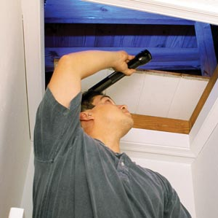
Effectiveness of Controls
Track progress and verify implementation
Involve employees in hazard control evaluations
Conduct regular inspections
Confirm controls operate as designed
Determine the effectiveness of controls
Image retrieved from Microsoft Clip Art
Notes:
Monitor hazard controls once you implement them to determine they are, and remain, effective. Inspect and evaluate controls once they are installed. You may also need to:
Observe employees using the control measure(s)
Ask employees for opinions about the control(s)
Conduct exposure monitoring
Perform another risk assessment
Assess the immediate area for new hazards
Image retrieved from Microsoft Clip Art. The image shows an employee conducting a regular inspection.

Slide 18
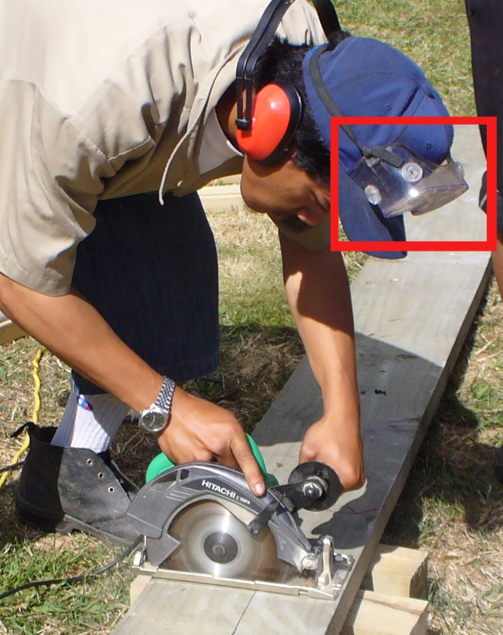
Effectiveness of Controls
See if controls need modified/replaced
Confirm employees use/follow required hazard controls
Conduct routine preventive maintenance, as needed
Document completed hazard control evaluations
Image retrieved from Bing Images
Notes:
Whenever you complete a hazard control evaluation, document the outcomes. This will show your organization took the initiative to make sure the hazard control is appropriate to address the identified S&H hazard and is working as intended.
Image retrieved from Bing Images (free to share and use license) at: http://compliance.safetysmart.com/wp-content/uploads/2012/10/WorkerGoggles.jpg.
The image shows an employee not wearing PPE during a hazardous task. Conduct follow-up to ensure controls put in place are used, and used correctly.

Slide 19
Reviews & Updates
Review hazard control programs annually to make sure they are up-to-date
Review S&H documents for missing or dated hazard controls
Document programmatic reviews and any changes made
Image courtesy of Concurrent Technologies Corporation
Notes:
Review any programs and safety documents you put into place – many organizations do this annually, as required by DoD Instruction 6055.01.
Over the span of 12 months, technology can change significantly. Review current controls to determine if newer or more technologically advanced controls exist. Also, in those cases where you may have selected a less effective hazard control, review each case to determine if the budget now allows for flexibility. In the past 12 months, some of those “too expensive” controls may have also reduced in price.
Image courtesy of Concurrent Technologies Corporation. The images shows the original creation date of the written fall protection program and the latest review/revision date.

Slide 20
Conclusion
In this presentation, you learned to:
Summarize the background and importance of HPC
List HPC-related documentation
Describe the knowledge leadership/management, key personnel, and the workforce should have regarding HPC
Identify HPC actions to implement and sustain OSHA VPP

