Slide 1
Occupational Health Care Program OSHA VPP
January 2021
Notes:
This presentation outlines Occupational Health Care Program (OHCP) requirements for the purposes of Occupational Safety and Health Administration (OSHA) Voluntary Protection Programs (VPP) approval.
The presentation provides information on the background and importance of an OHCP, required documentation, and the various levels of employee knowledge. It concludes with an action checklist and supplemental details to help with OSHA VPP implementation and sustainment efforts.

Slide 2
Objectives
In this presentation, you will learn to:
Summarize the background and importance of an OHCP
List OHCP-related documentation
Describe the knowledge leadership/management, key personnel, and the workforce should have regarding the OHCP
Identify OHCP actions to implement and sustain OSHA VPP
Notes:
This presentation is beneficial to safety professionals, OSHA VPP representatives, industrial hygiene (IH) professionals, medical professionals, health care claims representatives, recordkeepers, and others with responsibilities under the OHCP.

Slide 3
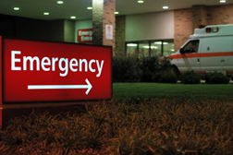
Background & Importance
Included in the HP&C criteria for VPP
Ensures OH professionals assess employee health
Makes sure necessary health services are available for personnel
Includes training for OH care professionals and employees
Requires readily available emergency services
Images retrieved from Bing Images
Notes:
HP&C = hazard prevention & control
OH = occupational health
OH care focuses on employee health status for prevention and treatment of illnesses and injuries. It also includes health-related services (e.g., pre-placement examinations, audiograms, lung function tests).
The top image shows an OH physician. Top image retrieved from Bing Images (free to use and share license) at:
http://3.bp.blogspot.com/_SE3sqIfwYw0/ShWkxEgb8lI/AAAAAAAAAAM/kLDQM4sEgGg/s320/physicianatdesk.jpg
Bottom image shows an emergency entrance to a medical facility. Image retrieved from Bing Images (free to use and share license) at: https://www.lawyersandsettlements.com/images/articles2/ER-sign-article-2.jpg

Slide 4
Documentation
OHCP procedures
OHCP assessments
Program training records
IH reports
Personal sampling or surveys
Employee health and surveillance records
Committee, council, and working group meeting minutes
Board licenses and certifications for physicians, OH nurses, audiologists, and other OH staff
Image retrieved from Bing Images
Notes:
Make sure you provide completed examples of forms and documents to your assessment team. Don’t just show them blank forms! They want to see the documents you filled out to thoroughly assess the processes within your SMS. These documents help verify the OHCP requirements for the OSHA VPP approval process.
Written procedures are essential to manage, track, and complete exam and training requirements. Examples of procedures include: scheduling exams, tracking missed exams, returning employees to work, assessing OHCP program and procedures.
It is a best practice to include OH professionals on safety committees, councils, or in working groups, especially those involving discussions to return employees to work.
Examples of program training records include: first aid, cardiopulmonary resuscitation (CPR), automated external defibrillators (AEDs), physician care, and emergency medical care. This can also include training provided by OH care professionals to employees based on employee exposures (e.g., lead, hearing conservation, respiratory protection).
OSHA assessment team members have a medical access order to review work-related medical records. This includes medical records protected by the Health Insurance Portability and Accountability Act (HIPAA) and Privacy Act. They review IH reports and personal sampling records to ensure you identify and evaluate health hazards, and that appropriate occupational health care actions are met for employee exposures to potential health hazards.
Image retrieved from Bing Images (Creative Commons).

Slide 5
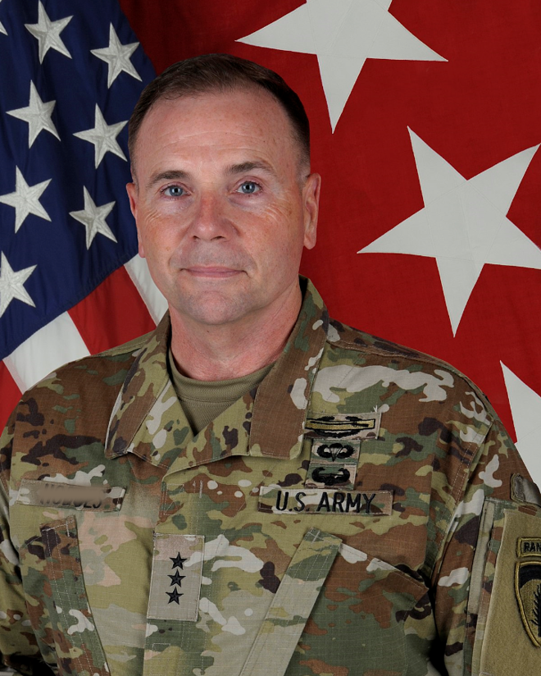
Leadership/Management Knowledge
Leaders and managers should be knowledgeable of:
OH professional services
Employee medical surveillance process(es)
Certification exam process(es)
Procedures for reporting work-related injuries
Medical treatment procedures for injured employees
First aid and CPR/AED programs, if applicable
Procedures for returning an injured employee to work
Image retrieved from Bing Images
Notes:
CPR = cardiopulmonary resuscitation AED = automated external defibrillator
Leaders and managers need to know about site-specific medical surveillance programs, including the process for identifying, scheduling, and tracking employee testing and certifications.
They should also know how to address employees requiring medical assistance, to include following local procedures to complete a medical referral form, providing the injured employee appropriate forms, notifying the chain of command, and initiating the mishap investigation. Supervisors should know who the point of contact is for workers’ compensation assistance.
Leaders and managers assist in the return of an injured employee to work. If the employee cannot return to full duty, then the employee may work in another capacity (e.g., light duty) as approved by the physician. Their supervisor must be aware of any restrictions to assign work tasks. Leadership may work with OH care professionals to develop a return-to-work program to ease employees back to work.
Image retrieved from Bing Images (free to share and use license) at: https://upload.wikimedia.org/wikipedia/commons/thumb/7/79/Frederick_B._Hodges_OCP.jpg/1200px-Frederick_B._Hodges_OCP.jpg

Slide 6
Key Personnel Knowledge
OH and IH personnel should know:
Roles and responsibilities of IH, safety, and OH staff
Staff qualifications, licensure, or certifications
Types of health/medical surveillance and certification programs in place
How medical surveillance data is communicated to employees and management
Health hazard recognition
OHCP audit and evaluation procedures
Health hazard-related training provided to employees, if needed
Image retrieved from Bing Images
Notes:
OH personnel may include: occupational medicine physicians, nurses, physicians assistants, nurse practitioners, paramedics, audiologists, medical technicians, and administrative staff.
IH personnel may include: industrial hygienists, technicians, and administrative staff.
More information on OSHA clinicians is available at: https://www.osha.gov/dts/oom/clinicians
Oftentimes, you need a multi-disciplinary approach to solve workplace issues (e.g., indoor air quality complaints, ergonomic hazards). This approach helps identify additional personnel for medical surveillance programs, ensures medical record updates, and distributes medical surveillance information to employees and management.
Periodic audits and evaluations of existing programs and procedures need to take place. Key personnel should be able to discuss these processes and explain how the assessments are executed, what is done with the results, and how to compare the process with acceptable standards of practice and OSHA requirements.
Image retrieved from Bing Images (Creative Commons).

Slide 7
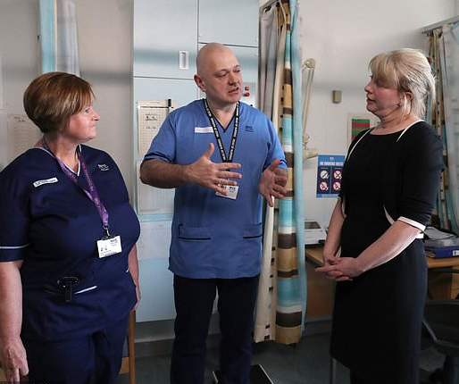
Key Personnel Knowledge
OH personnel additionally should know:
Procedures to provide timely health care services
Roles in employee return to work, work restrictions, or work removal
Roles in emergency care and first aid programs, as applicable
What makes an injury or illness OSHA recordable
Image retrieved from Bing Images
Notes:
Roles and responsibilities and the availability of first aid and emergency care services differs by location. Trained OH personnel are familiar with medical facility requirements and the procedures at your organization.
Additionally, OH personnel conduct pre-placement, periodic medical surveillance, and certification examinations based on IH recommendations or human resource requirements. They should understand their roles in these processes. If applicable, they should understand their responsibilities related to notifying others (varies per location) when a work-related injury or illness occurs for OSHA recordkeeping purposes.
For additional information, visit:
Medical and first aid: https://www.osha.gov/SLTC/medicalfirstaid/
Medical screening and surveillance: https://www.osha.gov/SLTC/medicalsurveillance/
OSHA recordable incidents: https://www.osha.gov/recordkeeping/
The image represents a group of OH personnel discussing safety and health. Image retrieved from Bing Images (free to share and use license) at: https://i.dailymail.co.uk/1/2018/03/13/10/wire-2489422-1520938466-621_634x443.jpg

Slide 8
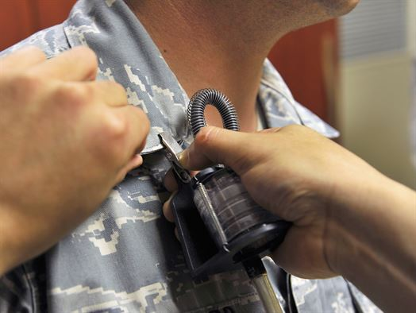
Workforce Knowledge
Employees should know:
Health hazards in their work area
Local emergency procedures
Locations of first aid kits and AEDs
Why they are included in health surveillance programs
Results of IH surveys conducted in their work area and the location of results
Signs and symptoms of work-related illness
Procedures for reporting injuries or illnesses and seeking medical attention
Image courtesy of Kadena AFB
Notes:
AFB = Air Force Base
Employees should know about the health hazards in their work areas and how to protect themselves against these health hazards, including any surveillance programs they are enrolled in. Employees should know about equipment in their workplace, like AEDs and first aid kits, as well as the organization’s policy on using this equipment to support the OHCP.
Employees must also be familiar with the local procedures to follow in the event of a work-related injury or illness requiring medical attention, including how to report and injury/illness and where to seek medical attention.
Employees must also know the signs and symptoms of any work-related illnesses they could encounter due to exposure to a particular hazard. Not only should employees be able to identify these signs and symptoms in themselves, but also in determining whether their coworkers are experiencing a work-related illness.
Familiarity with IH surveys and the results help employees further understand health hazards and how to prevent work-related illnesses.
The image shows an air sampling pump on a worker. Image retrieved from Kadena AFB at: http://www.kadena.af.mil/News/Article-Display/Article/770021/bio-conducts-air-sampling-survey-during-afqc

Slide 9
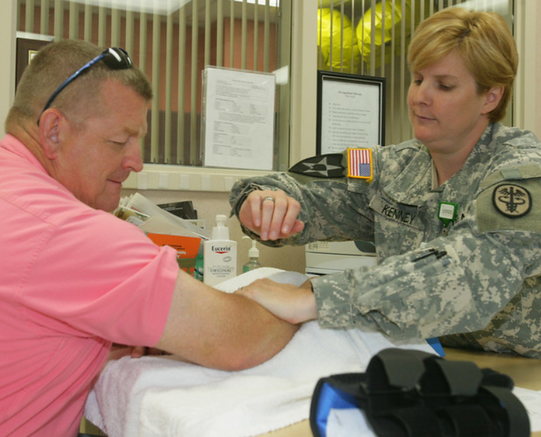
Action Checklist
Develop an OHCP
Develop OH care-related procedures
Establish a multi-disciplinary team approach
Train employees
Conduct medical surveillance and surveys
Conduct an OHCP assessment
Image retrieved from Bing Images
Notes:
Follow this action checklist to implement and sustain VPP expectations for the OHCP. Keep in mind, any SMS is about continuous improvement. Once you complete the items on this list, make sure you are continually reviewing and improving your OHCP! Each of these action checklist items will be covered in more detail on the following slides.
Image retrieved from Bing Images (Creative Commons).

Slide 10
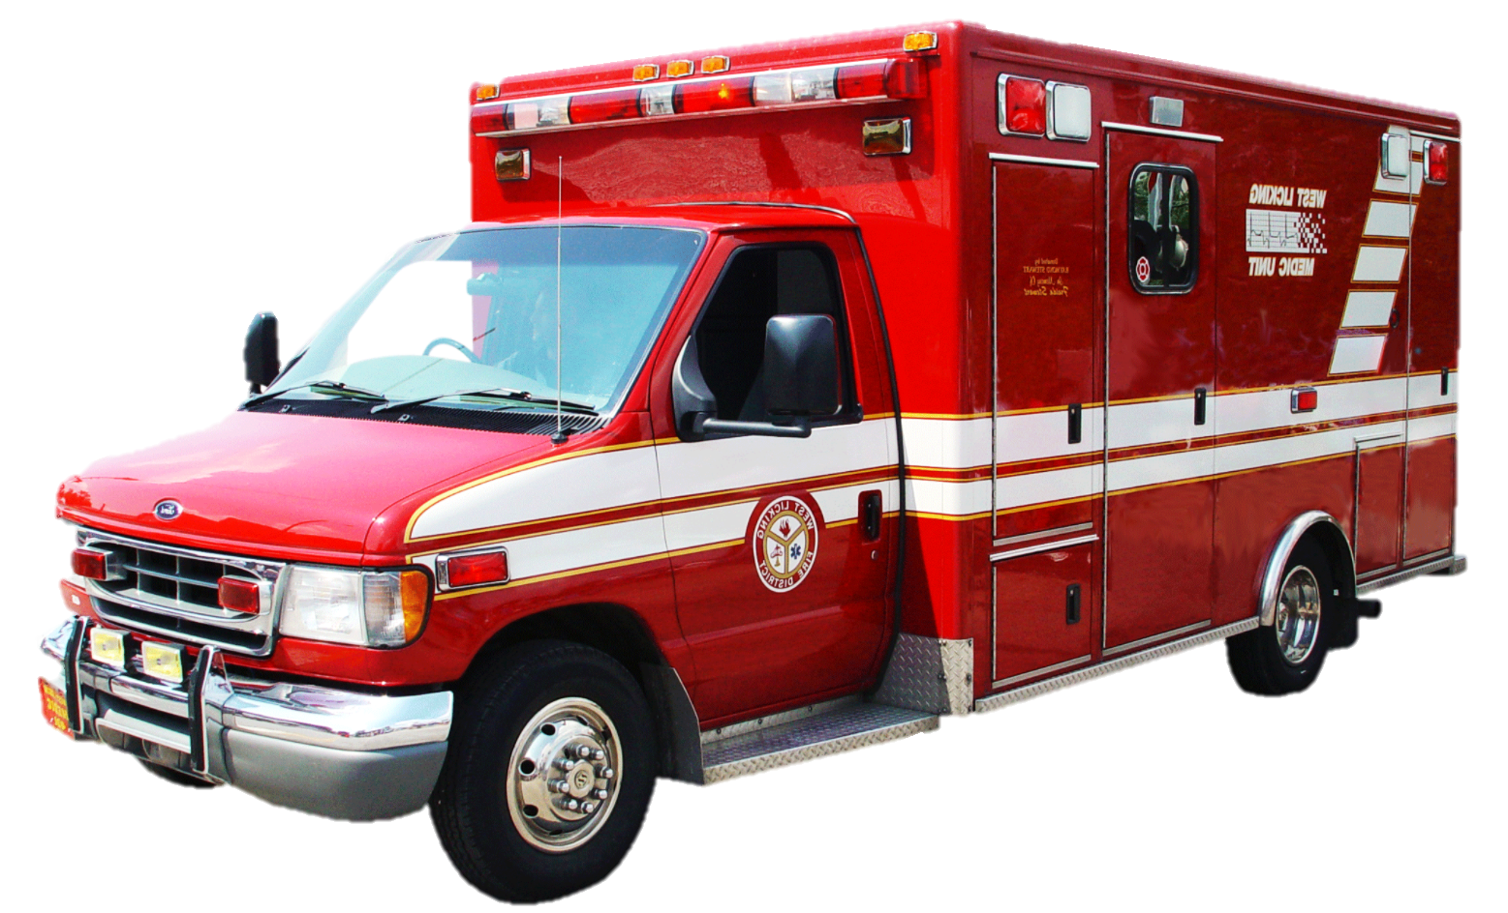
OHCP
Use licensed health care professionals to assess employee health status
Include provisions and arrangements for needed health services
Discuss employee training for first aid, CPR, and AEDs
Ensure emergency medical care is within a reasonable time and distance
Explain emergency procedures and services to employees on all shifts
Image retrieved from Bing Images
Notes:
The slide shows several components to include in your OHCP, as provided in the OSHA Cooperative and State Programs (CSP) 03-01-005 at:
https://www.osha.gov/enforcement/directives/csp-03-01-005 Train personnel you expect to provide first aid or CPR. All personnel, on all shifts, must understand the emergency procedures for their workplace.
Developing the OHCP requires coordination between several organizations:
Medical facility (e.g., medical services, training, hazard recognition/evaluations)
Human resources (e.g., pre-placement and certification exam requirements, link point for workers’ compensation)
Safety (e.g., medical surveillance scheduling, safety inspections, mishap investigation, trend analysis)
Fire department (e.g., emergency response, AED program management)
IH (e.g., baseline/periodic surveys, sampling, health hazard evaluations)
An OSHA letter of interpretation provides clarification on a reasonable time and distance for emergency medical care (https://www.osha.gov/laws-regs/standardinterpretations/2007-03-23), stating:
Where serious accidents are possible (e.g., falls, suffocation, electrocution, amputation), emergency care is available within no more than 3-4 minutes from the workplace.
Emergency care can be an employee trained in first aid, but if no employees are trained, then emergency medical services must respond in 3-4 minutes.
In workplaces (e.g., offices) where the possibility of serious work-related injuries is less likely, a longer response time of up to 15 minutes may be reasonable.
Image retrieved from Bing Images (Creative Commons).

Slide 11
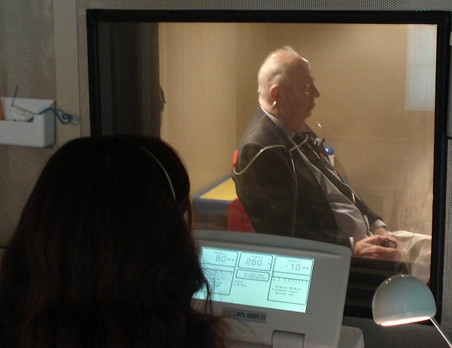
OH Care Procedures
Develop and implement procedures for OH care tasks:
Evaluate fitness for duty
Schedule and track medical surveillance exams
Care for injured or ill workers
Manage occupational injury and illness cases
Communicate health surveillance/IH monitoring results
Facilitate the return of injured/ill employees to work
Image retrieved from Bing Images
Notes:
When developing OH care procedures, think about the prevention of injuries and illnesses, early identification hazards, and potential injuries. Identify all workplace safety and health hazards.
The medical facility generally establishes local procedures to comply with OSHA standards, Joint Commission regulations, and military Service requirements. Many facilities write and maintain procedures in a binder for ready access.
The image shows a technician conducting an audiogram on an employee. Image retrieved from Bing Images (free to share and use license) at: http://farm4.staticflickr.com/3115/3093671106_d3d2da65fe_z.jpg

Slide 12
Multi-Disciplinary Team Approach
Establish a core team of safety, IH, and OH professionals
Involve the team in OHCP assessments, as applicable
Conduct periodic, routine surveys and inspections as a team
Establish procedures for handling OH hazards
Add IH/OH findings to a hazard log for visibility and tracking
Review procedures at least annually
Maintain close communication
Image retrieved from Bing Images
Notes:
Establish a core team to work together in developing and assessing OH care procedures and workplace health hazards. Identify and review hazards together, as well as emergent issues.
Your core team may consist of: safety specialists, industrial hygienists, occupational medicine physicians, OH nurses, and other professionals (e.g., audiologists, physician assistants, nurse practitioners, ergonomists). Involve the core team in the program assessment, as applicable.
Develop procedures for how to deal with issues common at facilities and installations (e.g., indoor air quality complaints, disruptive noise conditions). Established procedures saves time and gets the right parties involved from the start. Update your procedures if there is a change. Ensure the core team members review it annually.
Ensure there is a clear line of communication between the core team members. Hold regular discussion on injuries and mishaps to ensure the OSHA recordkeeper is up-to-date on all occurrences and maintaining the recordkeeping logs.
Image retrieved from Bing Images (Creative Commons).

Slide 13
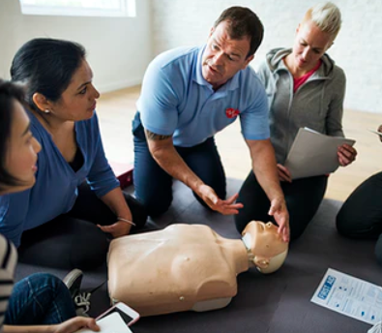
Employee Training
Provide training to ensure employees:
Are aware of the OHCP
Understand local emergency and OH care procedures
Perform first aid, administer CPR, or use an AED, if applicable
Know how to report workplace injury or illness and seek medical attention
Recognize workplace health hazards and the signs and symptoms of exposure
Enroll and participate in medical surveillance programs
Image retrieved from Bing Images
Notes:
Train your employees. Consider incorporating OHCP information into new hire orientation (usually conducted by the Safety Office) and work area-specific training. Also, ensure any documentation related to training (e.g., programs, policies, procedures, forms), are located or stored in a location employees are familiar with. Employee should be able to access all documentation supporting the information they are trained on.
The signs and symptoms of exposure to workplace health hazards cannot only include exposure to hazardous chemicals and toxic substances, but exposure to environmental and seasonal conditions. For example, if employees work in hot environments or outdoors in the summer, you want to make sure they know the signs and symptoms of heat stress or stroke.
Maintain training records and be sure to track any certifications individuals receive from trainers.
Employees who need to be enrolled into medical surveillance programs require training and testing by OH staff and recurring (annual in most cases) medical visits.
Image retrieved from Bing Images (Creative Commons).

Slide 14
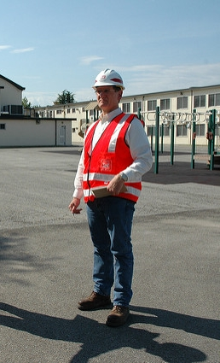
Medical Surveillance & Surveys
Surveys and workplace exposure assessments drive medical surveillance:
Support early recognition and treatment
Limit severity of harm
Identify trigger requirements of toxic and hazardous substance regulations
Use a team approach of supervisors, employees, safety, IH, and OH professionals to conduct surveillance and surveys
Image retrieved from Bing Images
Notes:
Review baseline IH survey reports and baseline hazard assessments. Identify all hazards are included in these document. Review employee enrollment in medical surveillance programs. Update the documents periodically, based on hazards and any changes to processes or tasks.
Involve safety, OH, and IH staff involvement in new assessments or routine surveys. Keep the team engaged and aware of the potential hazards in the field, especially for higher hazard areas.
Involve supervisor and employees. Their participation ensures information regarding hazards, exposure frequency/duration, and the controls in place is accurate – they know their jobs best.
The image shows safety staff conducting a worksite assessment. Image retrieved from Bing Images (free to use and share license) at: http://farm3.staticflickr.com/2651/3909070399_fe42e785b9_z.jpg

Slide 15
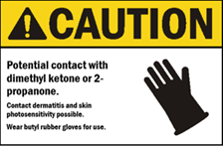
Medical Surveillance & Surveys
Document and track all completed medical surveillance and health hazard surveys
Establish schedules for follow-up surveys and surveillance
Report the results of surveys and surveillance to appropriate personnel
Image retrieved from Bing Images
Notes:
Safety inspections and IH surveys help to identify health hazards with potential to cause harm to employees. Recommend medical surveillance for individuals conducting work in these specific work areas, depending upon the hazard exposure.
Establish procedures, based on requirements of the Privacy Act, to report exposure sampling or monitoring results (e.g., personal air sampling, noise dosimetry) to employees.
The image shows a sign stating double hearing protection is required in the area, as determined based on the results of health hazard survey, specifically, noise sampling. Image retrieved from Bing Images (Creative Commons).

Slide 16
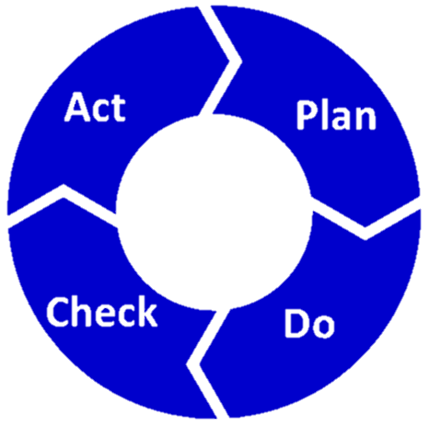
OHCP Assessments
Review OH and IH staffing levels
Determine the effectiveness of required OH care services
Verify health services equipment and calibration
Review capabilities to provide timely emergency services
Image retrieved from Bing Images
Notes:
Conduct an annual evaluation of the OHCP. Consider completing this OHCP evaluation in conjunction with the installation annual self-evaluation.
Review OH staffing levels, credentials, and licensing to ensure all staff qualifications are up to date. Also, ensure no new licensing or credentialing is needed. Credentialing offices are usually responsible for maintaining health care personnel credentials and licensing.
Verify all employees receive all required health services or surveillance.
Emergency services capability depends largely on location. Compared to a freestanding clinic, medical services are straightforward at nearby hospitals. Depending on your available emergencies services, evaluate any health-related programs in place (e.g., first aid, equipment, supply replenishment, AED inspections, personnel training).
The image shows a variation of the Plan-Do-Check-Act feedback loop cycle. Image retrieved from Bing Images (free to share and use license) at: https://upload.wikimedia.org/wikipedia/commons/0/0b/PDCA-Loop.png

Slide 17
OHCP Assessments
Verify all procedures are current, accurate, and effective
Review internal and external audit findings
Compare metrics with previous assessments
Distribute and trend customer feedback surveys
Review findings and plan for improvements
Image retrieved from Bing Images
Notes:
Review all procedures annually to determine effectiveness and accuracy, ensuring no changes need to be made. A best practice is to date procedures after review, even if changes have not been made. These dates help to display your procedures are up to date.
Compare metrics and findings against previous assessments. Review hazard tracking logs to determine if there are any other issues relative to OH procedures.
Consider providing customer/employee feedback surveys. These identify issues related to the appointment process, patient wait times, and staff courtesy.
In the end, review all the findings from your OHCP assessment and develop plans of action to improve. You should continue reviewing your OHCP each year to identify weaknesses for improvement, or even look for ways to become even better in areas where you already excel!
The image shows a customer survey. These are valuable for gathering feedback and improving your program! Image retrieved from Bing Images (free to share and use license) at: http://1.bp.blogspot.com/-7d6ALGhUQ3s/U2Xs7vrxpyI/AAAAAAAAEo8/IhN9sHXpLkc/s1600/customer+survey.jpg

Slide 18
Conclusion
In this presentation, you learned to:
Summarize the background and importance of an OHCP
List OHCP-related documentation
Describe the knowledge leadership/management, key personnel, and the workforce should have regarding the OHCP
Identify OHCP actions to implement and sustain OSHA VPP

