Slide 1
Personal Protective Equipment
OSHA VPP
March 2020
Notes:
This presentation outlines personal protective equipment (PPE) requirements for the purposes of Occupational Safety and Health Administration (OSHA) Voluntary Protection Programs (VPP) recognition.
The presentation provides information on the background and importance of PPE, reviews suggested documentation, and the various levels of knowledge required. It concludes with an action checklist to help with OSHA VPP implementation and sustainment efforts.

Slide 2
Objectives
In this presentation, you will learn to:
Summarize the background and importance of PPE
List PPE-related documentation
Describe the knowledge leadership/management, key personnel, and the workforce should have regarding PPE
Identify PPE-related actions to implement and sustain OSHA VPP
Notes:
This presentation is beneficial to safety and health (S&H) professionals, VPP representatives, as well as others responsible for the selection, issuance, use, inspection, and maintenance of PPE.

Slide 3
Background & Importance
Included in the HPC criteria for VPP
Includes garments or equipment designed to protect against workplace injuries and illnesses
Used as the last defense against hazards
Image retrieved from Washington State University
Notes:
HPC = Hazard Prevention and Control
PPE protects against contact with chemical, radiological, physical, electrical, mechanical, or other workplace hazards.
There are many different types of PPE, each with vastly different purposes. Appropriately designed, constructed, fitted, maintained, and used PPE makes the difference between serious injuries and working safely. It protects you from a hazard - it is that simple!
Examples of PPE include: gloves, face shields, goggles, safety shoes, ear plugs, respirators, hard hats, coveralls, and fall protection harnesses.
PPE is not, and should not be, the preferred hazard control choice to protect employees from hazards. PPE is the last resort for hazard control or interim control. Use PPE when elimination, substitution, engineering, and administrative controls are not feasible or effective to reduce risk to an acceptable level.
View OSHA requirements under Part 1910, Subpart I - PPE, 29 CFR 1910.132 – 1910.138 at: https://www.osha.gov/pls/oshaweb/owastand.display_standard_group?p_toc_level=1&p_part_number=1910
OSHA PPE requirements focus on selection, maintenance, use, and care of PPE.
Image retrieved from Washington State University at: https://ehs.wsu.edu/ohs/images/ppe.jpg

Slide 4
Documentation
PPE program, if applicable
Hazard control programs
PPE hazard assessments
Hazard analyses
PPE training records
Pre-purchase reviews and approvals
PPE inspection and maintenance records
Follow-up evaluations
Image retrieved from Microsoft Clip Art
Notes:
Make sure you provide completed forms and documents to your assessment team. Don’t just show them blank forms! They want to see the documents you filled out to thoroughly assess the processes within your safety management system (SMS).
OSHA does not require a written PPE program; however, establishing a written plan helps you effectively execute and evaluate your PPE requirements. If you do establish a written program, review it annually, just as any other safety program.
You may incorporate PPE into your other hazard control programs too (e.g., respiratory protection, hearing conservation, and fall protection).
PPE hazard assessments ensure you review equipment or processes to identify the required and recommended PPE to perform the job safely. Once you complete your PPE hazard assessment, you can select and purchase your PPE, then incorporate PPE requirements into your hazard analyses documents (e.g., job hazard analysis, job safety analysis). Pre-purchase reviews and approvals show you evaluated and approved the PPE prior to purchase and use.
PPE training records show employees understand how to don, doff, maintain, and store their PPE. PPE inspection and maintenance records validate when employees and assigned personnel inspect PPE and when they conduct maintenance to ensure it is working properly.
Follow-up evaluations are important because they confirm you took the steps to see if selected PPE is effective in protecting your employees against the hazards, and not creating any new hazards in the process.
Image retrieved from Microsoft Clip Art.

Slide 5
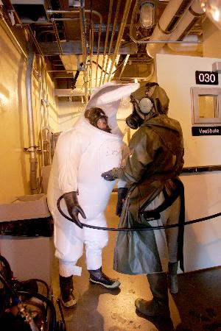
Leadership/Management Knowledge
Leaders and managers should know about:
Personnel in charge of PPE-related processes
Location of documented PPE requirements
PPE procurement and approval processes
Budgetary/resource allocations for PPE
Outcome of PPE inspections and follow-up evaluations
Image retrieved from Yahoo Images
Notes:
It is unlikely leaders and managers will go out in the work area to conduct hazard assessments, train the troops, and inspect PPE; however, they must know who to contact, where to locate PPE requirements, and basic information regarding PPE procurement and approval processes.
An important item leaders and managers should understand is the outcome of PPE inspections and follow-up evaluations. If inspections or follow-up evaluations are continually deficient, they may be able to allocate additional resources toward any PPE gaps in your SMS.
Image retrieved from Yahoo Images (free to share and use license) at: http://farm2.staticflickr.com/1439/878616686_163924bb52.jpg

Slide 6
Key Personnel Knowledge
Key personnel should be knowledgeable about:
PPE regulations and work area requirements
Methods to conduct PPE hazard assessments
Process to select and recommend PPE
PPE training requirements and completion of training
Steps for PPE approval and procurement
PPE inspection and maintenance procedures
Results of PPE follow-up evaluations
Notes:
Key personnel may include: S&H professionals, industrial hygienists, hazard control program managers, S&H training managers, supervisors, maintenance personnel, employees responsible for conducting inspections. This list is not all-inclusive; there may be others within your organization that have PPE responsibilities. Those with PPE responsibilities must understand PPE regulations.
Key personnel should understand the process for completing PPE hazard assessments and what to do with the assessment results. They should also be familiar with specific details such as selecting and recommending PPE, obtaining approvals, and how to purchase it. Key personnel must also understand PPE inspection and maintenance requirements and monitor the completion of inspections.
PPE training is essential in making sure your employees understand how to use, maintain, and store the items they are required to use. OSHA outlines PPE training requirements, so make sure any provided training aligns with these expectations.
Key personnel must also understand the process to conduct follow-up evaluations to determine if implemented PPE is effective. They must also know what to do with the results of these evaluations to continually improve your SMS.

Slide 7
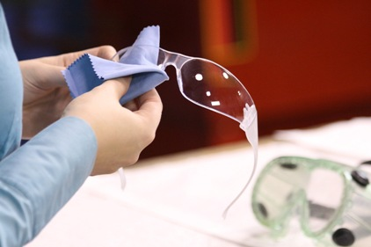
Workforce Knowledge
Employees should know:
When PPE is necessary
Types of PPE worn for specific jobs
PPE limitations
Provided PPE training
PPE inspection responsibilities
Procedures to don, doff, adjust, and wear PPE
Steps to care, maintain, store, and dispose of PPE
Steps for requesting PPE/reporting unsafe PPE
Image retrieved from Yahoo Images
Notes:
Employees must understand when PPE is required and the types they are required to wear to protect themselves against hazards.
PPE limitations are a common gap in employee knowledge. Employees need to understand their PPE does not protect against all hazards, and the limits as to when it is effective. For example, gloves have a breakthrough time. Therefore, if you wear gloves while you are handling a chemical, you may have to discard them after every 30 minutes, or the chemical will deteriorate the glove. Employees must understand these limitations to properly use PPE and to protect themselves.
Employees must be aware of inspection requirements for their PPE. For example, a fall protection harness may need to be visually inspected by an employee prior to wearing it for a shift. Employees must understand the PPE inspections they are responsible for and what to do with the inspection results.
They must also know how to properly wear the PPE provided to them. If they wear it incorrectly, it won’t effectively protect them against hazards. Wearing PPE properly is only one component to protecting employees. In addition, knowing the proper care, maintenance, storage, and disposal of PPE is a requirement. PPE can easily become damaged or ineffective over time if it’s not cared for. There needs to be a process in place for employees to report damaged and ineffective PPE.
Image retrieved from Yahoo Images (free to share and use license) at: http://www.ishn.com/ext/resources/Vendor_News/Vendor-News-2/Cleaning-glasses_422.jpg?1362083133

Slide 8
Action Checklist
Review PPE regulations, processes, and procedures
Consider developing a written PPE program
Complete PPE hazard assessments
Select PPE
Certify PPE hazard assessments
Communicate hazard assessment results
Conduct PPE training
Implement the use of PPE
Evaluate the effectiveness of PPE
Review/update PPE processes and procedures
Notes:
Follow this action checklist to implement and sustain VPP expectations for PPE. Each of these action checklist items will be covered in more detail on the following slides.

Slide 9
PPE Regulations Review
Become familiar with applicable PPE regulations
Check Service or Agency regulations and instructions
Review OSHA PPE regulations
Look at local PPE processes and procedures
Image retrieved from Bing Images
Notes:
Review the OSHA General Industry Requirements under Part 1910, Subpart I - PPE, 29 CFR 1910.132 – 1910.138 at: https://www.osha.gov/pls/oshaweb/owastand.display_standard_group?p_toc_level=1&p_part_number=1910
Review and following existing Service and Agency guidance on PPE requirements (e.g., Army Regulation 385-10, Naval Operations Instruction 5100.23G, and Air Force Instruction 91-203).
See if you have any local processes or procedures in place. Examples may include: PPE selection, approval and procurement, inspections, and follow-up evaluations.
Image retrieved from Bing Images (free to share and use license) at: https://www.atsb.gov.au/media/4174726/Review.jpg

Slide 10
Written PPE Program
Consider developing a written PPE program documenting:
Responsibilities
PPE hazard assessment requirements
PPE training requirements
Selection, procurement, and availability of PPE
Processes for maintaining, using, and disposing PPE
Provisions for conducting periodic evaluations and program reviews
Image retrieved from Bing Images
Notes:
OSHA does not require a written PPE program; however, if you decide to develop a PPE program, ensure it adheres to the local Service/Agency guidance and regulations.
For examples of written PPE programs, visit EMC Insurance or Pennsylvania State University at: https://www.emcins.com/ICEFiles/docs/lossControl/PPE.docx and https://guru.psu.edu/policies/sy06.html
Image retrieved from Bing Images (free to share and use license): http://ocw.nur.ac.rw/NR/rdonlyres/Writing-and-Humanistic-Studies/21W-745Spring-2005/ACD5E24E-DF40-4DEC-9473-ACAC109131B2/0/chp_adv_essay2.jpg

Slide 11
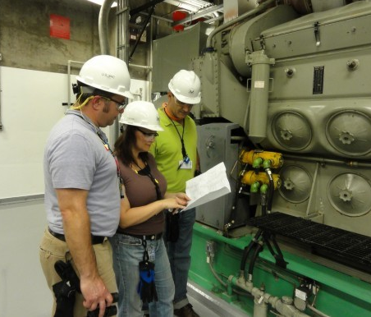
PPE Hazard Assessment
Conduct a hazard assessment
Involve supervisors and employees
Review each work activity
Identify S&H hazards
Determine if PPE can be used as a hazard control
Document the results
Image retrieved from Yahoo Images
Notes:
OSHA 29 CFR 1910.132(d)(1) requires a PPE hazard assessment: https://www.osha.gov/pls/oshaweb/owadisp.show_document?p_table=standards&p_id=9777
PPE hazard assessments are just like any other hazard assessment you conduct. Involve affected employees, supervisors, and key personnel (e.g., safety staff, industrial hygienists) that are familiar with the work activity you’re evaluating. As you review each work activity, identify all the S&H hazards associated with the activity. Assess the hazards to determine if PPE is a feasible hazard control to protect employees against the identified hazards. Remember to use the hierarchy of controls to determine if more permanent options can be used before implementing PPE. If PPE is a reasonable hazard control, then initiate your PPE selection process to identify the types of PPE necessary to protect your employees.
Document the results of the hazard assessment. Capture the work activity evaluated, date of the assessment, person(s) completing the assessment, and person(s) verifying the completion of the assessment.
Image retrieved from Yahoo Images (free to share and use license) at: http://assets.inhabitat.com/wp-content/blogs.dir/1/files/2012/12/Nuclear-inspection-team-537x402.jpg
The image shows a team conducting a PPE hazard assessment of a process. Be sure to also mark down all PPE currently in use for evaluation.

Slide 12
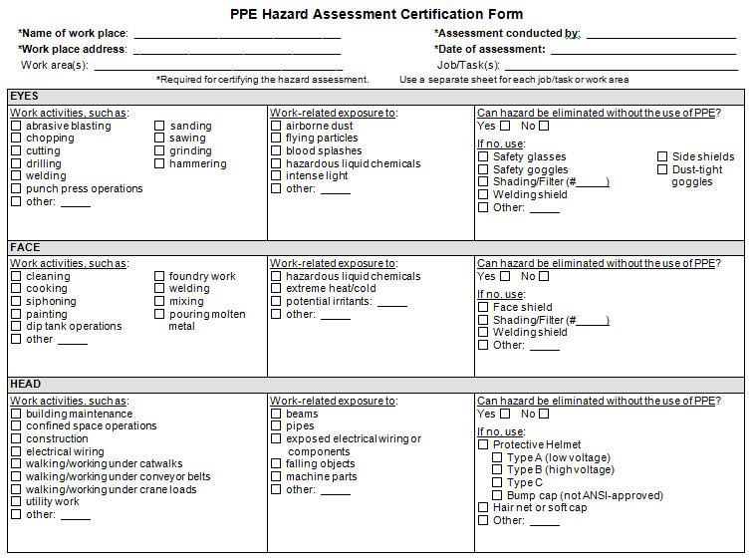
Example – PPE Hazard Assessment
Image retrieved from Washington Labor & Industries
Notes:
View OSHA’s non-mandatory Appendix B of 29 CFR Subpart I for example PPE hazard assessments and PPE selection procedures: https://www.osha.gov/pls/oshaweb/owadisp.show_document?p_table=STANDARDS&p_id=10120
View Oregon OSHA’s guide on PPE hazard assessments at: http://osha.oregon.gov/OSHAPubs/2738.pdf
Image retrieved from Washington State Labor & Industries at: http://www.lni.wa.gov/safety/topics/atoz/ppe/PPEGuide/HazAssessForPPE.doc
The image shows a PPE hazard assessment template.

Slide 13
PPE Selection
Review results of the PPE hazard assessments
Review PPE regulations and certification standards
Involve supervisors/employees
Discuss potential PPE options
Match PPE to S&H hazards
Consider physical comfort, fit, and ability to perform work
Evaluate cost considerations
Image retrieved from Yahoo Images
Notes:
Use the results from the PPE hazard assessment to select PPE for the work activity you evaluated. You may need to revise your completed PPE hazard assessment if your selection process doesn’t align with the PPE you included on the assessment.
Involve employees as much as possible in the PPE selection process. They can provide input on whether the PPE may cause discomfort, or if the PPE will make it more difficult to perform their job. Select the PPE in accordance with completed PPE hazard assessments and job tasks performed.
Consider the comfort and fit of PPE when selecting PPE. If the PPE comes in various sizes, purchase different sizes to fit all the employees using it. It can be hazardous if the PPE does not fit well. You can conduct a fit test to ensure the respirator fits the employee properly.
Reach out to PPE vendors; some vendors will send sample items for your employees to test. Always consider the different sizes you may need before making a major purchase.
Make sure PPE is compatible with other types of PPE if your employees are required to wear more than one form of protection. For example, your employee may have difficultly wearing both a welding shield and safety glasses: therefore, you must ensure using both PPE components do not result in additional hazards.
Image retrieved from Yahoo Images (free to share and use license): https://upload.wikimedia.org/wikipedia/commons/thumb/e/ef/US_Navy_061129-N-5416W-005_Hospital_Corpsman_Seaman_Jered_Cotshwar_sort%5Ersquo%2Cs_blood_samples_during_a_ship%27s_blood_drive_aboard_the_Nimitz-class_aircraft_carrier_USS_Theodore_Roosevelt_%28CVN_71%29.jpg/220px-thumbnail.jpg

Slide 14
Certification & Communication of Results
Certify the PPE hazard assessment
Inform affected employees of:
Hazard assessment results
Selected PPE
Location of completed hazard assessments
Image retrieved from Microsoft Clip Art
Notes:
NOTE: You are required to have a document certifying the completion of your hazard assessments. Make sure a competent person (e.g., safety staff, knowledgeable supervisor) reviews the completed assessments and certifies (sign-off on) the information. It is a good practice to complete this before communicating the results to your employees.
Communicate the results of the assessment to all affected employees – this helps them understand why and what types of PPE are required to safely perform their jobs. Tell them about any new S&H hazards and the PPE selected. It is also a good idea to inform them of why you selected the specific PPE identified and where they can find a copy of the assessment.
Best Practice: Implement a signature process where employees sign-off on their review of the certified PPE hazard assessment when you communicate the results to them. Alternatively, include the certified hazard assessment as a part of your PPE training program.
Image retrieved from Microsoft Clip Art.

Slide 15
PPE Training
Train employees on PPE
Address each specific type of PPE to be worn
Customize training based on types of PPE required
Communicate maintenance and inspection expectations
Document the completion of training
Include OSHA 29 CFR 1910.132, General PPE Requirements
When PPE is necessary
What PPE is necessary
How to properly don, doff, adjust, and wear PPE
PPE limitations
Proper care, maintenance, useful life, and disposal
Notes:
Visit OSHA 29 CFR 1910.132 PPE training requirements at: https://www.osha.gov/pls/oshaweb/owadisp.show_document?p_table=standards&p_id=9777 There is additional regulatory guidance for specific types of PPE (e.g., eye protection, respirators) within the OSHA regulations.
Train each affected employee on the PPE requirements at your organization. In addition, train key personnel who support your PPE program (e.g., supervisors, procurement staff, industrial hygienists).
Inform employees why their PPE is required so they can understand the importance of the training.
Communicate expected maintenance and inspection requirements for their PPE too, such as:
Inspect PPE before and after each use
Take care of PPE at all times
Clean PPE after use
Repair or replace damaged or broken PPE
Store PPE in clean, dry area away from the sun and contaminants
Document any training you provide. Include the name of the employee (roster), date of training, who provided the training (need to be qualified), and the type of training provided.

Slide 16
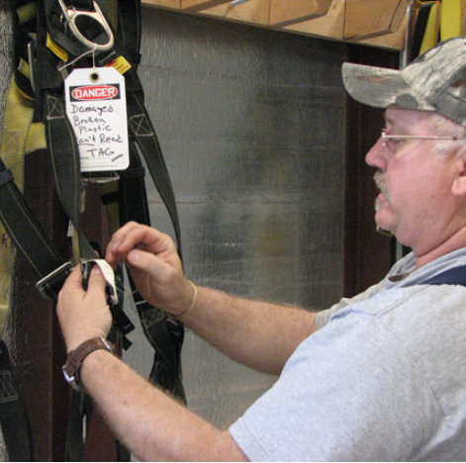
PPE Implementation
Individually fit PPE and institute medical evaluations, as needed
Conduct spot-checks to make sure employees are:
Wearing PPE properly
Performing pre-use PPE inspections
Cleaning, maintaining, and storing PPE as intended
Tagging defective/damaged PPE
Image retrieved from Yahoo Images
Notes:
Implement PPE use after you select and purchase your PPE. Sometimes organizations do this at the same time as PPE training. Sometimes fit tests or medical evaluations/surveillances are required (e.g., respirators) to make sure employees not only wear PPE properly, but that it fits well, and the employee wearing the PPE is healthy enough to use it.
You can appoint personnel to walk through your work areas and survey users to see if they are wearing PPE correctly. This walkthrough may even include a brief interview with employees to determine if they understand what to do if they find damaged or ineffective PPE.
Depending on how you set up pre-use PPE inspections at your worksite, you may be able to review documented logs to determine if employees are completing pre-use inspections, ask them about pre-use inspection procedures, or look for employees using defective or damaged equipment (if you see/find this, they most likely aren’t looking for damage prior to using it).
Image retrieved from Yahoo Images (free to share and use license) at: https://www.peoacwa.army.mil/wp-content/uploads/safety_gear_566.jpg
The image shows an employee tagging a damaged fall protection harness out of service.

Slide 17
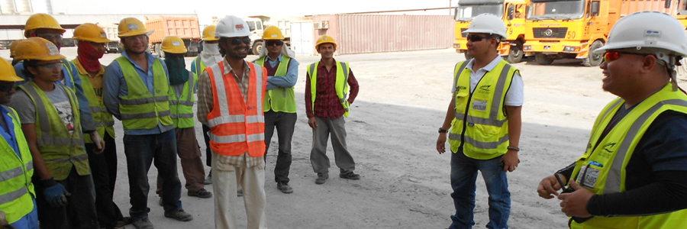
PPE Implementation
See if scheduled maintenance is performed
Encourage supervisors to:
Lead by example
Enforce the use of PPE
Image retrieved from Yahoo Images
Notes:
You can also go one step further in your PPE implementation to see if scheduled maintenance is occurring as planned. Sometimes maintenance personnel get backed up on their maintenance activities; therefore, ensure they have a plan in place to monitor any PPE you need maintained.
Supervisors play a critical role in PPE implementation. Encourage them to lead by example – employees will follow by example if your supervisors wear PPE when they are required to do. Communicate the policy for wearing PPE, when it is required, and have supervisors utilize your disciplinary procedures to address non-conformance to your requirements.
Consider adding PPE components to your inspection checklists or hazard analyses to assist with reviewing the use of PPE at your organization.
Image retrieved from Yahoo Images (free to share and use license) at: http://www.lhsfna.org/LHSFNA/assets/File/Safety%20orientation%20toolbox%20talk.jpg
The image represents a supervisor leading a meeting to discuss PPE requirements and use.

Slide 18
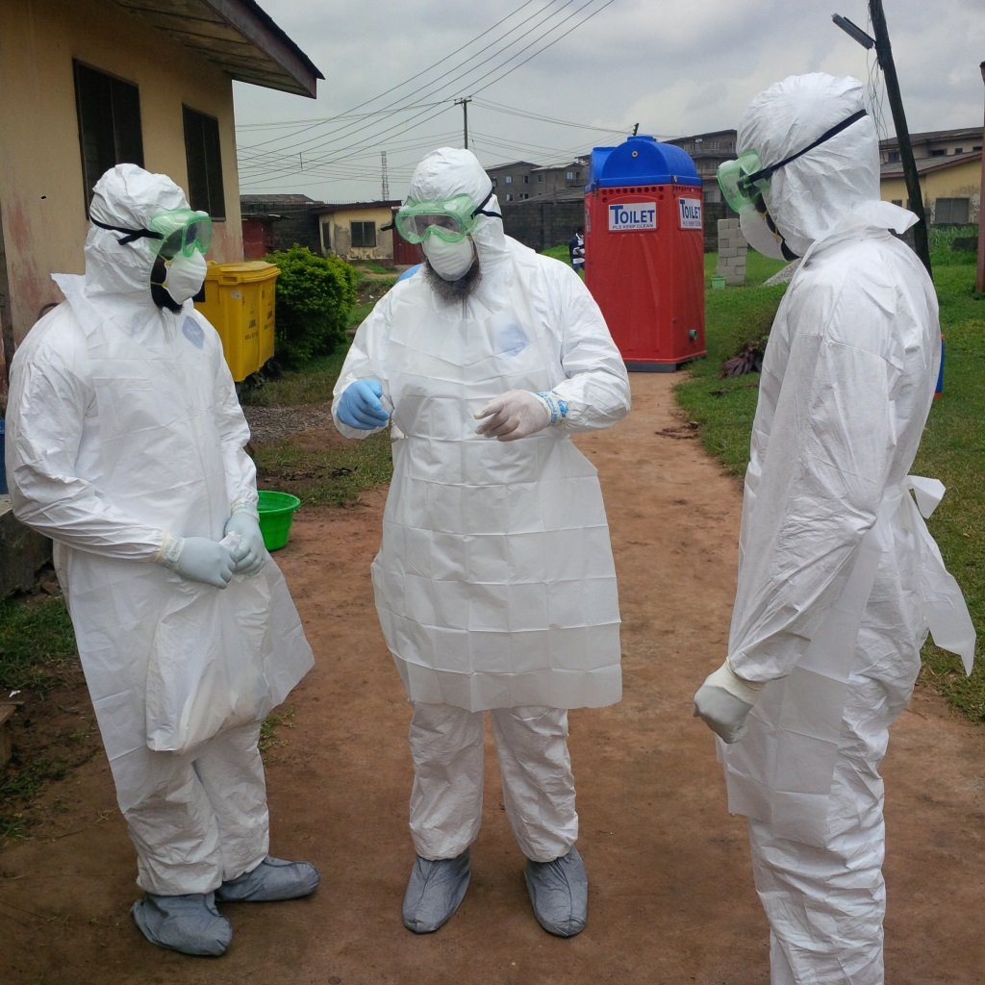
PPE Evaluations
Determine if the PPE is working as intended
See if hazard exposure is eliminated or reduced
Check for any new hazards
Document evaluation results
Consider selecting different hazard controls, if necessary
Image retrieved from Microsoft Clip Art
Notes:
Once you select and implement PPE, the only way to determine its level of effectiveness is to perform follow-up evaluations. These evaluations give insight as to how the PPE is functioning, if employees are using it, and if you need to fine-tune it to reach its maximum protection level. Most importantly, you want to see if the PPE reduced employee exposure!
Use a combination of interviews and observations to evaluate your implemented PPE. Ask investigative questions to determine if employees are using the PPE properly, if PPE is working as intended, if you identify new hazards, if previous hazards are controlled, and how employees feel about PPE. You may also need to conduct follow-up exposure sampling, or analyze injury logs and reported hazards, to help you assess the work activity.
Document any evaluations you complete. This shows you took the extra steps to see if the PPE is effective and functioning as intended. It also helps you show if you decided to keep a certain type of PPE, or replace it.
In some situations, you may find the implemented PPE does not sufficiently protect your employees against harm. In this case, you may need to start the selection process over again, or select a different hazard control. In any case, make sure you evaluate any implemented PPE you put into place.
Image retrieved from Microsoft Clip Art.

Slide 19
Review & Updates
Stay cognizant of regulatory changes
Reassess work activities, as necessary
Revise/update PPE program and hazard assessments to reflect PPE changes
Retrain employees, as needed
Evaluate potential hazard control upgrades to eliminate PPE use
Image retrieved from Microsoft Clip Art
Notes:
S&H regulations change. It is important for you to stay aware of any regulatory changes that affect your organization.
Reassess work activities as needed. Identify and evaluate new equipment and processes, review accident records, and reevaluate the suitability of previously selected PPE. It is a good idea to align this need into your management of change procedures, which initiate a review of work activities when your workplace/process changes.
Look at your written PPE program and certified hazard assessments to determine if your documentation needs revised whenever PPE changes occur in the workplace. These documents tell your employees what PPE to wear.
Retrain your employees when you experience: changes in the workplace or required PPE, an update of your PPE program or PPE training material, and when it is evident employees did not understand the PPE training provided to them. Sometimes PPE manufacturers and vendors offer PPE training too – consider reaching out to them to see if they can assist you with your training needs.
Continually think about alternative hazard control options (e.g., engineering, administrative) to help you address identified S&H hazards. Use PPE as a last resort!
Image retrieved from Microsoft Clip Art.
Best Practice: The image shows a site taking pictures of employees demonstrating and labeling proper PPE use. Hang these pictures in work areas as a reminder of PPE requirements. The SMCX has observed this successful practice at several sites!

Slide 20
Conclusion
In this presentation, you learned to:
Summarize the background and importance of PPE
List PPE-related documentation
Describe the knowledge leadership/management, key personnel, and the workforce should have regarding PPE
Identify PPE-related actions to implement and sustain OSHA VPP

