Slide 1
Preventive and Predictive Maintenance
OSHA VPP
June 2021
Notes:
This presentation outlines preventive/predictive maintenance (PM) requirements for the purposes of the Occupational Safety and Health Administration (OSHA) Voluntary Protection Programs (VPP) approval.
The presentation provides information on the background and importance of PM, required documentation, and the various levels of employee knowledge. It concludes with an action checklist and supplemental details to help with OSHA VPP implementation and sustainment efforts.

Slide 2
Objectives
In this presentation, you will learn to:
Summarize the background and importance of PM
List PM-related documentation
Describe the knowledge leadership/management, key personnel, and the workforce should have regarding PM
Identify PM actions to implement and sustain OSHA VPP
Notes:
This presentation is beneficial to safety and health (S&H) professionals, VPP representatives, designated PM managers and staff, facility/building managers and staff, fire department personnel, and others with PM responsibilities, especially for safety-critical items.

Slide 3
Background & Importance
Included in the HP&C criteria for VPP
Establishes a written PM system to maintain workplace equipment and facilities
Uses manufacturer recommendations to identify potentially hazardous failures
Includes maintenance for hazard controls and safety-critical features
Inspects, maintains, and repairs equipment/facilities before hazardous failures occur
Notes:
HP&C = Hazard Prevention and Control
A written PM system helps you maintain and monitor your workplace equipment. An effective PM system includes maintenance of hazard controls and safety-critical features (e.g., machine guards, exhaust ventilation, emergency stops, interlocks, fire suppression systems, alarm systems). Effective PM systems also use manufacturer recommendations to help identify maintenance needs and scheduling. Finally, they include provisions to conduct separate hazard analysis when specific guidance is not available.
Predictive maintenance: Work performed on a scheduled or unscheduled basis, or continuously during machine operation (e.g., monitoring noise, vibration, heat, or emissions, testing oil, watching low battery indicators, visually inspecting wear and tear) in attempt to minimize failure.
Mishaps can occur when equipment fails during use. Unmaintained safety features or functions may fail to protect employees at critical times, which is why it is important to have a PM system in place to support your safety management system (SMS).

Slide 4
Documentation
Written PM program
Equipment/facilities PM inventory list
PM tracking and scheduling system
OEM maintenance recommendations
PM inspection reports
Example work orders
Maintenance and repair records
Image retrieved from Bing Images
Notes:
OEM = original equipment manufacturer
An OSHA VPP assessment of your PM system typically includes a review of the documentation listed on this slide. This is not an all-inclusive list of documentation.
Make sure you provide examples of completed forms and documents to your assessment team. Do not show them blank forms! They want to see the documents filled out to assess the execution of your PM process.
A written PM program helps you track your workplace equipment to prevent equipment failures and hazards. You should have an inventory list identifying all the equipment and facilities items in your organization needing maintained. Typically, there are so many pieces of equipment to maintain, a tracking and scheduling system is used. These systems are beneficial because they generally alert maintenance personnel when PM is scheduled and what they need to look at.
One way to identify PM needs is to review OEM recommendations and guidance. The OEM generally identifies these items in the instruction manuals and other documents they send with the equipment. Otherwise, if no OEM guidance is available, maintenance personnel must conduct analysis to determine potential PM needs and their own capabilities to provide support.
Other documents you can show to support your PM program include PM inspection reports, example work orders, and maintenance or repair records. These documents show how you track the completion of PM and the actions you take when you can’t fully complete PM actions at that moment.
The image shows a USAF airman using a technical manual for maintenance and repair tasks. Image retrieved from Bing Images (Creative Commons).

Slide 5
Leadership/Management Knowledge
Leaders and management should be knowledgeable about:
Personnel in charge of PM processes
Process for submitting work orders
Status of PM activities/completion
Image retrieved from Bing Images
Notes:
Leaders and managers must understand PM at a high level.
First, they must know whom to contact if they have questions regarding the PM system.
Secondly, they must understand how to submit a work order for equipment or facility issues needing addressed. This is important for submitting their own work orders, or communicating the process to someone who needs to know how to do it themselves.
Finally, they must be aware of the overall effectiveness of the system and the status of improvement actions. They can determine this information through regular meetings and updates from the maintenance department.
Image retrieved from Bing Images (Creative Commons).

Slide 6
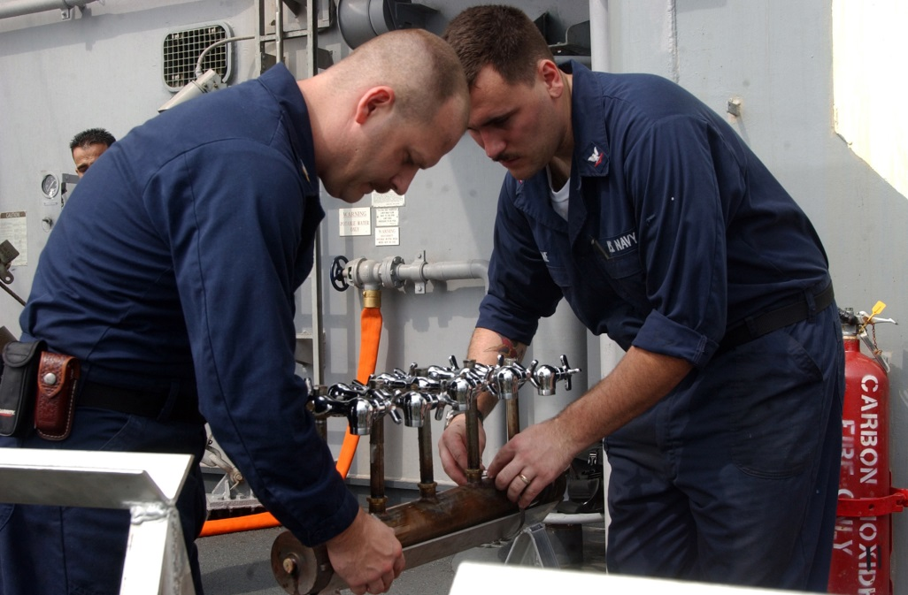
Key Personnel Knowledge
Maintenance staff should have knowledge about:
Responsibilities within the PM Program
Items captured in the program (including safety critical)
Location of OEM guidance
System used to track and schedule PM
Priority for S&H-related maintenance items
Evaluations of new equipment and facilities for PM
Image retrieved from Bing Images
Notes:
Maintenance staff may include anyone overseeing the completion of maintenance activities, and any others with PM roles or responsibilities.
Maintenance staff should know the PM system inside and out. Not only do they need to be familiar with the program, but also they should understand the steps to schedule, prioritize, and track PM and repairs.
Be able to provide examples of items included in the PM system. Examples include equipment and machinery, facilities components, on-site vehicles, sprinkler systems, detection and alarm equipment, fire protection and emergency equipment (e.g., eyewash stations, exit lights, exit signs, AEDs).
Describe the priority system in place. It is important to prioritize items with a higher safety failure, or the potential to create an unsafe work environment, before others. Provide examples to show how you use this prioritization system at your organization.
Image retrieved from Bing Images (Creative Commons).

Slide 7
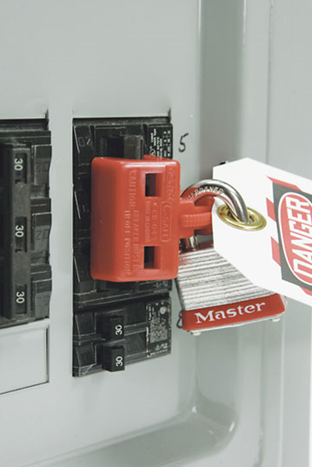
Key Personnel Knowledge
Maintenance staff should also know:
Process for identifying PM requirements
Ratio of scheduled vs. unscheduled maintenance work
Completion rate for scheduled maintenance work
Hazard control program guidance and procedures
Applicable S&H training received
PM trends identified
Image retrieved from Microsoft Clip Art
Notes:
Talk about how new equipment and machinery purchases are reviewed during purchase, or when they enter your workplace; same with new or modified facilities. Maybe you have a form in place to support the items you look at. How are PM requirements determined on new items?
Also, discuss the process for tracking scheduled repairs and PM. Keep data to show if the PM program is on target for scheduled vs. unscheduled maintenance work. If the PM program is behind schedule, be ready to clarify why this is happening.
Maintenance personnel commonly encounter S&H hazards while performing PM, too (e.g., hazardous energy, confined spaces). Be sure maintenance staff can describe the hazards they’re exposed to, procedures related to hazard control programs (such as lockout/tagout), and the types of S&H training they receive so they can safely perform PM.
Finally, be ready to discuss PM-related trends at your organization. You may identify common failures that occur, common maintenance needs, completion or successes rates, or the timeliness to complete scheduled maintenance activities.
Image retrieved from Bing Images (Creative Commons).

Slide 8
Workforce Knowledge
Employees should be knowledgeable about:
PM status of equipment in use
Signs of equipment or facility malfunction and failure
Actions to take in the event of equipment malfunction and failure
Significance of locks and/or tags on equipment
Process for submitting a work order
Image created by the DoD SMCX
Notes:
Employees should know if the PM status is up-to-date for the equipment and facilities they use. Employees should be able to tell you how they verify these PMs are completed. This can be in the form of a sticker, as shown on the slide, a PM log, or accessing a PM database through their supervisor.
When training employees on how to use equipment, this training must include common signs of malfunction and failure. Examples of impending equipment failure can include noise, vibration, overheating, indicators or lights, and visible defects. Additionally, employees should know the actions to take when impending equipment malfunctions or failure occur. Examples of taken actions may include: shutting down the equipment, applying “do not operate” tags, reporting to a supervisor, requesting inspection/maintenance, and warning coworkers.
Employees should also be aware of equipment that may be locked/tagged out during maintenance; they should never attempt to operate locked/tagged out equipment. ‘Do not operate’ locks and tags and LOTO locks and tags are not the same – do not use them interchangeably!
Finally, ensure employees understand the process to submit a work order when they need equipment or facility repairs.
Image created by DoD SMCX. The image shows a PM label enabling equipment users to self-verify the PM status for a piece of equipment.

Slide 9
Action Checklist
Review PM requirements
Consider establishing an SOP
Select a tracking and scheduling system
Conduct a PM survey
Assess PM needs
Document PM instructions
Train PM staff, supervisors, and employees
Perform and document PM inspections and maintenance
Review and improve the PM system
Image retrieved from Bing Images
Notes:
SOP = standard operating procedure
Follow this action checklist to implement and sustain VPP expectations for PM.
Image retrieved from Bing Images (free to share and use license) at: http://libertyparkatandrews.com/wp-content/uploads/2016/09/Maintenance.jpg

Slide 10
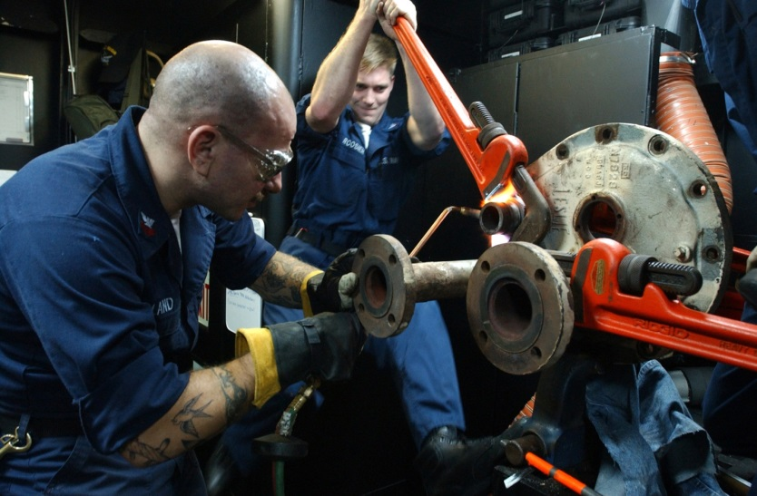
PM Guidance
Service/Agency PM instructions and regulations
Service/Agency and local hazard control programs
OEM manuals and recommendations
OSHA VPP PM requirements
Image retrieved from Bing Images
Notes:
Each Service and Agency establishes PM requirements. Check your Service- or Agency-related instructions and regulations before you work on your PM system. Some Service and Agency guidance directs you to utilize a specific system for tracking and scheduling your PM items. Additionally, your local instructions for your organization may expand on specific PM requirements for your site.
On top of guidance to conduct PM activities, there is also going to be important guidance on performing PM work safely. Much of this guidance is outlined in hazard control programs such as hazardous energy control (lockout/tagout), confined space entry, electrical safety, machine guarding, and fall protection, to name a few.
Outside of regulatory compliance and Service/Agency requirements, it’s also important to refer to OEM manuals for guidance and recommendations on how to conduct PM activities for each piece of equipment.
Finally, OSHA VPP looks for some specifics from PM to ensure an effective process within your safety management system. Review the OSHA VPP criteria for PM to ensure your process covers all of those minimums. Find out additional information regarding VPP requirements at: https://www.osha.gov/pls/oshaweb/owadisp.show_document?p_table=DIRECTIVES&p_id=3851
Image retrieved from Bing Images (Creative Commons).

Slide 11
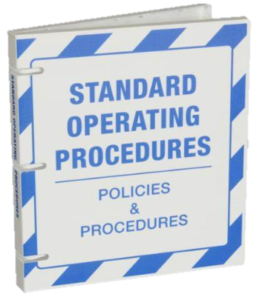
Standard Operating Procedure Development
Follow these tips to write your SOPs:
Choose a consistent format
Consider the audience when writing
Outline specific PM requirements and expectations
Ensure writing is concise and easy to read
Break up large chunks of text
Include a document control notation
Test and review the SOP before approval and implementation
Image retrieved from Bing Images
Notes:
Follow these tips to make sure your SOPs are thorough.
Image retrieved from Bing Images (free to share and use license) at: https://i.pinimg.com/736x/51/18/8e/51188e0fb88afbb1e61b7e1927382aa9.jpg

Slide 12
Example – Standard Operating Procedure
October 7, 2020
Image courtesy of Concurrent Technologies Corporation (CTC)
Notes:
Consider constructing a written SOP for your PM requirements and expectations. You can make your SOP as simple as you’d like, but it can help you identify PM requirements for the machines, equipment, and other safety devices within your organization.
Image courtesy of Concurrent Technologies Corporation. The image shows a SOP for PM on a large friction stir welding machine.

Slide 13
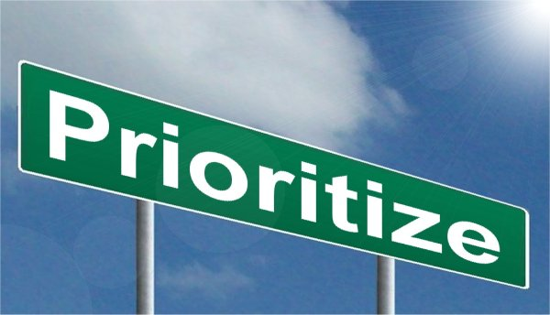
PM Tracking & Scheduling System
Choose a tracking and scheduling system(s)
Know how to enter and schedule items for maintenance or repair
Learn how to prioritize entries
Understand how to check the status of entered items
Image retrieved from Bing Images
Notes:
Look at the options you have for a PM tracking and scheduling system. Any system is acceptable; you can even use a spreadsheet if you don’t have access to an online database. Examples of PM systems include MAXIMO, DEMILS, or MX1.
Choose a system with capabilities best fitting your needs. Make sure the method you choose to track and schedule your PM items is effective.
Image retrieved from Bing Images (Creative Commons).

Slide 14
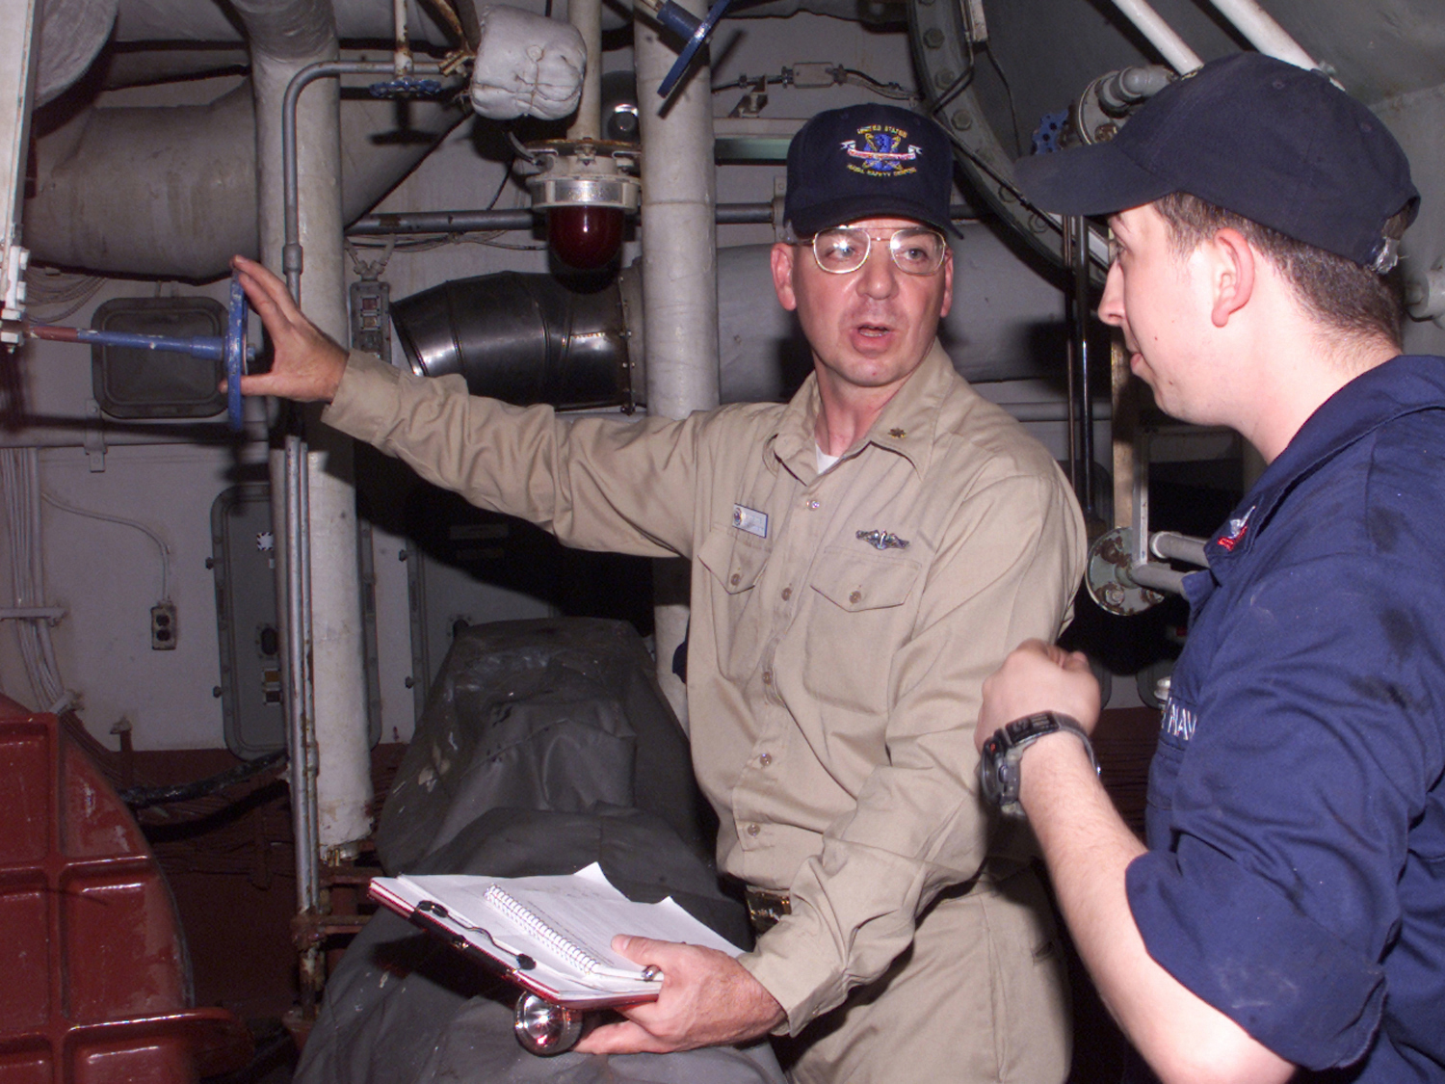
PM Survey
Review previous baseline hazard analyses
Survey the workplace for:
Equipment
Machines
Facility systems
Other materials and items needing continual inspection or maintenance
Develop an inventory list
Image retrieved from Bing Images
Notes:
Use your PM system to capture any safety-critical item requiring frequent maintenance. It is important for you to capture these items in your PM system because they may fail when they don’t function correctly, potentially leading to a mishap.
Examples of items to include in your PM system include:
Warning alarms
Eyewash stations and emergency showers
Machine guards
Interlocks
Vehicles and forklifts
Emergency lights
Fire extinguishers
Exhaust ventilation
Sprinkler systems
Detection alarms
Generators
As you create your inventory list of items requiring PM, look at previously conducted baseline hazard analyses to make sure you comprehensively surveyed each work area.
Image retrieved from Bing Images (Creative Commons).

Slide 15
PM Needs Assessment
Gather available supporting PM documents
Review PM requirements
Identify items missing PM specifications
Reach out to the manufacturer
Take a group approach to identifying PM requirements
Make PM-related SOPs for these items
Image retrieved from Bing Images
Notes:
Once you identified everything requiring maintenance (from a safety perspective) at your workplace, you now need to determine the specific PM requirements you need to implement. Accomplish this by reviewing supporting PM documents (e.g., manufacturer guides). Reach out to the manufacturer if you misplaced the instruction booklet.
If you don’t have supporting PM documents, and can’t reach out to the manufacturer for assistance, consider creating a PM-related SOP to identify the PM you need to perform. Gather a group of informed personnel together. This may include maintenance staff, machine operators, safety staff, and others to make sure you identify all PM items (and a reasonable frequency).
Image retrieved from Bing Images (Creative Commons).

Slide 16
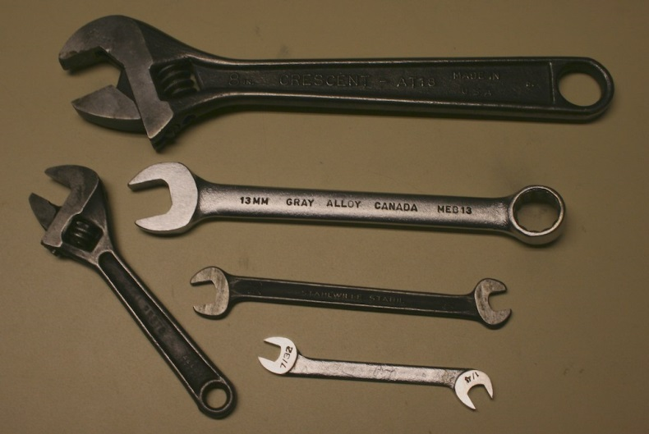
PM Needs Assessment
Look at the pre-use analysis system for new equipment, machines, and materials
Determine who is notified when a purchase request is issued
Determine how PM requirements are reviewed prior to purchase or implementation
Think about how to capture these requirements in the PM system
Image retrieved from Bing Images
Notes:
Review your pre-use analysis system. This is one of the easiest ways to capture new materials, equipment, and machines as they enter your workplace. It is a great opportunity to review these items and determine their PM requirements before your employees install/use them.
Image retrieved from Bing Images (Creative Commons).

Slide 17
PM Documentation
Document PM requirements in the tracking & scheduling system:
Machine, equipment, or safety item description
Location of item (and serial number)
PM procedures
Responsible person(s)
Due dates
Completion dates
Report numbers
Key inspection findings
Work order numbers
Image retrieved from Bing Images
Notes:
When you identify all the safety-critical items in your workplace, and the PM they require, you need to integrate this information into your PM tracking and scheduling system. The list on the slide is not an all-inclusive list of items you may capture, but it’s a good starting point!
Think about how to enter items requiring continual PM (maybe every 6 months, 12 months, etc.) and how to notify the assigned person(s) of a scheduled PM item. Many systems can automatically issue daily or weekly notifications for you.
Image retrieved from Bing Images (free to share and use license) at: http://www.tribenautix.com/wp-content/uploads/2014/09/Tracking-GSP-Engagement-.jpg

Slide 18
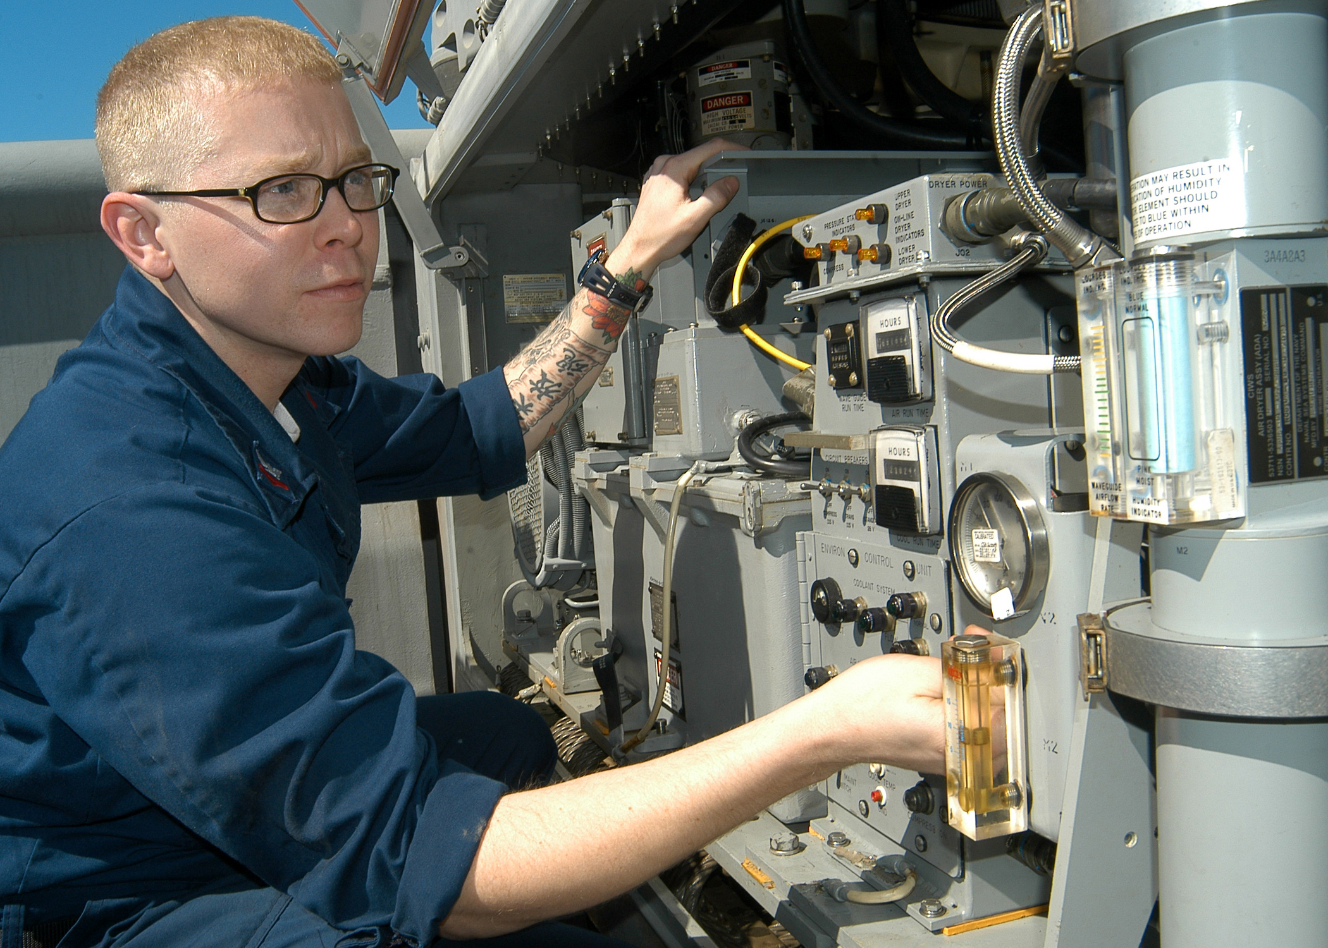
PM Training
MAINTENANCE PERSONNEL
Location of OEM or other PM guidance
PM tracking and scheduling system
Steps to review and address a work order
Hazard control programs and procedures
Image retrieved from Bing Images
Notes:
Think about what your employees need to know for the PM system! Your maintenance personnel need to understand your overall PM system and their responsibilities. Also, train them in the control of hazardous energy and the proper use of locks and tags so they can safely do their jobs.
Image retrieved from Bing Images (Creative Commons).

Slide 19
PM Training
Process to get new materials, equipment, and machines approved
Steps to submit a work order
General awareness of maintenance activities
SUPERVISORS
EMPLOYEES
Image retrieved from Bing Images
Notes:
Supervisors, and maybe others, need to be aware of the pre-use analysis process. They should utilize this system for new materials, equipment, and machines, letting them notify you of these purchase requests so you can look at PM requirements before it enters your workplace.
All employees should understand how to submit a work order, even if it is as simple as reporting it to their supervisor, and then the supervisor formally submits a work order request. This helps everyone be involved in the PM system and report items needing maintenance or repair.
Image retrieved from Bing Images (Creative Commons).

Slide 20
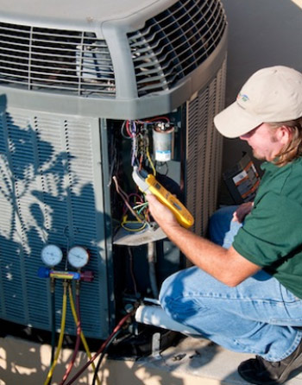
PM Inspections and Maintenance
Follow OEM and/or local technical guidance
Generate formal work orders for repairs
Coach equipment users in proper operation, user maintenance, equipment cleanliness
Document completed inspections and maintenance
Plan for efficiency!
Image retrieved from Bing Images
Notes:
Think ahead – maximize efficiency!
Schedule PM within the same building/work area altogether
Review PM guidance before you start work
See if you have all the required tools beforehand (e.g., stroboscope, infrared thermometer, vibration pen, industrial stethoscope, flashlight, inspection mirror, calibrated torque wrench, specialized protective equipment)
Think about any guards or other obstacles you may need to remove to gain access to the item needing maintained
Make sure you have the forms needed to document the inspection or maintenance activity
Know the steps to take equipment out of service, as needed, when a repair needs to be made
Promptly submit a formal work order for any items requiring repair, or further maintenance. As you conduct your PM inspections and maintenance, you can educate equipment users on the operation, maintenance, and cleanliness of the item you are maintaining. Document all actions you take, and make sure to enter all the information into the correct tracking and scheduling system.
Find additional information on effective PM inspections and maintenance at: http://www.idcon.com/resource-library/articles/preventive-maintenance/461-checking-best-practices-for-preventive-maintenance.html
Image retrieved from Bing Images (Creative Commons).

Slide 21
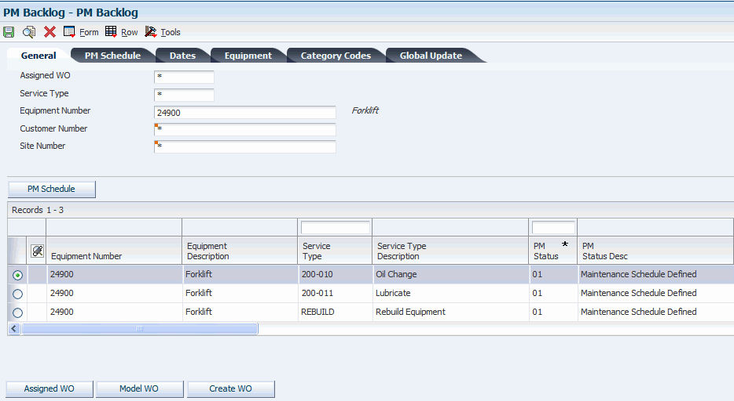
Review and Improvement
Stay updated on scheduled versus unscheduled maintenance work
Provide periodic PM program reviews to leadership
Ensure scheduled LOTO training is up-to-date
Evaluate the effectiveness of the PM system
Trend data, as available
Missed scheduled maintenance
Equipment failures
Completion rates
Image retrieved from JE Edwards
Notes:
When your PM system is up and running, you need to continually review and improve the system. Understand the ratio for your scheduled and unscheduled maintenance work. If scheduled maintenance continually falls behind, investigate! Determine the cause and, if needed, see how you can get the resources you need allocated to support the PM system.
Keep your leaders informed. They are the ones who can help you continually improve the PM system. Provide them with periodic status updates regarding the system. Typically, a maintenance manager leads these meetings because they have the most knowledge and information.
In order for your PM system to function effectively, your maintenance staff needs to know how to perform their work safely. Review completed versus scheduled LOTO training (and any other safety trainings they may need). Make sure you train everyone as needed.
On an annual basis, look at the overall PM system to make sure it is effective. If you identify any gaps in your system, think about how to address them and implement actions to make the system better.
The image shows a PM backlog for scheduled PM items. Image retrieved from JD Edwards at: https://docs.oracle.com/cd/E16582_01/doc.91/e15090/wrk_w_preventive_main_sche.htm#EOACA00718

Slide 22
Conclusion
In this presentation, you learned to:
Summarize the background and importance of PM
List PM-related documentation
Describe the knowledge leadership/management, key personnel, and the workforce should have regarding PM
Identify PM actions to implement and sustain OSHA VPP
Notes:
Moving the needle from reactive maintenance to best maintenance practices takes time, a complete cultural shift, and talented maintenance technicians. With today’s skilled labor shortage, you may find difficultly in locating and retaining skilled technicians, making the need for an effective PM program even more important.

