Slide 1
Process Safety Management
February 2021
Notes:
This presentation outlines process safety management (PSM) requirements for the purposes of Occupational Safety and Health Administration (OSHA) Voluntary Protection Programs (VPP) recognition.
The presentation provides information on the background and importance of PSM, required documentation, and the various levels of employee knowledge. It concludes with an action checklist and supplemental details to help with OSHA VPP implementation and sustainment efforts.

Slide 2
Objectives
During this presentation, you will learn to:
Summarize the background and importance of PSM
List PSM-related documentation
Describe the knowledge leadership/management, key personnel, and the workforce should have regarding PSM
Identify PSM actions to implement and sustain OSHA VPP
Notes:
This presentation is beneficial to safety professionals, VPP representatives, maintenance personnel, and others with PSM responsibilities, to include supervisors in PSM areas.

Slide 3
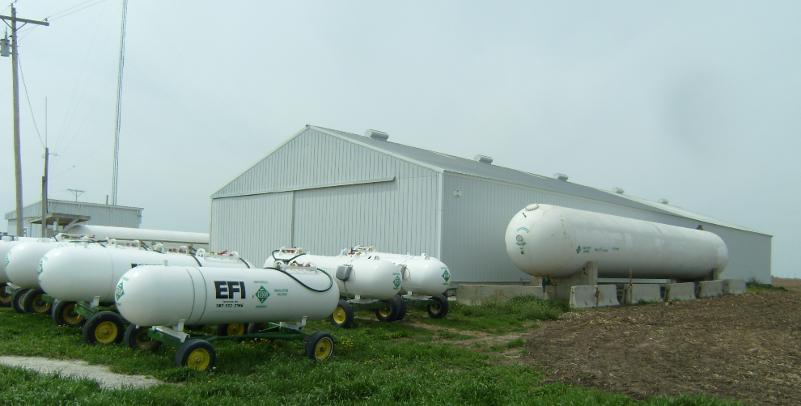
Background & Importance
Included in the HPC element of VPP
Addresses the use of HHCs in processes
Necessary in order to comply with 29 CFR 1910.119
Provides workplace and community safety
Prevents or minimizes the unexpected release of HHCs
Image retrieved from Yahoo Images
Notes:
HPC = Hazard Prevention and Control
HHC = highly hazardous chemical
Process: An activity involving a highly hazardous chemical, including: use, storage, manufacturing, handling, or the on-site movement of such chemicals, or combination of these activities.
PSM: Steps taken to prevent the release of any substance defined as a “HHC” by OSHA.
HHC: A substance possessing toxic, reactive, flammable, or explosive properties and specified by paragraph (a)(1) of 29 CFR 1910.119.
View 29 CFR 1910.119, Process safety management of highly hazardous chemicals at: https://www.osha.gov/pls/oshaweb/owadisp.show_document?p_table=STANDARDS&p_id=9760
The image shows on-site storage of fertilizer with high amount of anhydrous ammonia, a HHC. Image retrieved from Yahoo Images (free to share and use license) at: https://upload.wikimedia.org/wikipedia/commons/a/aa/Anhydrous_ammonia_fertilizer.jpg

Slide 4
Documentation
Process safety information
Process hazard analyses
PSM procedures
Employee participation plans
Emergency action plans
Pre-startup safety reviews
Equipment inspections and test results
Quality assurance evaluations
Image retrieved from Microsoft Clip Art
Notes:
PSI = process safety information
PHA = process hazard analysis
Make sure you provide completed examples of forms and documents to your assessment team. Don’t just show them blank forms! They want to see the documents you filled out to thoroughly assess the processes within your safety management system (SMS).
Examples of PSI include: chemical toxicity, permissible exposure limits (PELs), physical data, reactivity data, corrosive data, thermal and chemical stability data for mixing, and block flow diagrams.
PHA: Organized and systematic effort to identify and analyze the significance of potential hazards associated with the processing or handling of HHCs.
Written PSM procedures include: operating, maintenance, safety, and emergency procedures.
Employee participation plan: A written plan of action regarding the implementation of employee involvement required by the PSM standard.
Update emergency plans and procedures for all scenarios (e.g., tornado, fire, spills).
Image retrieved from Microsoft Clip Art.

Slide 5
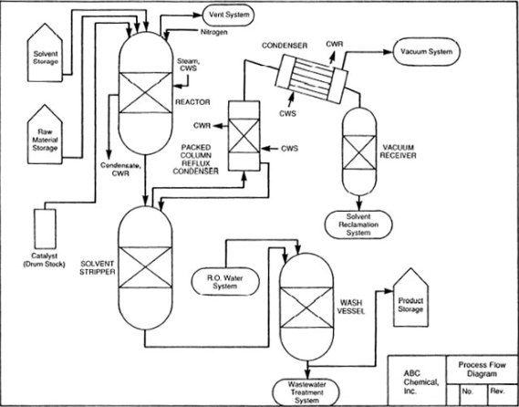
Documentation
Diagrams showing process flow, block flow, and piping and instrumentation
PSM compliance audits
MOC procedures
Incident investigations involving PSM and HHCs
Corrective action forms
Image retrieved from OSHA
Notes:
MOC = management of change
Make sure you provide completed examples of forms and documents to your assessment team. Don’t just show them blank forms! They want to see the documents you filled out to thoroughly assess the processes within your SMS.
OSHA considers process diagrams as PSI; however, it is a good idea to have these on-hand when assessors, engineers, or process operators have detailed questions related to your PSM program and procedures.
MOC procedures are developed to provide guidance to follow whenever you need to make a change in the process (i.e. install new equipment or change the flow of the process due to maintenance).
The image shows an example of a process flow diagram; common types of diagrams used to help understand the process better also include block flow and piping and instrumentation. Image retrieved from OSHA at: https://www.osha.gov/Publications/osha3133.html

Slide 6
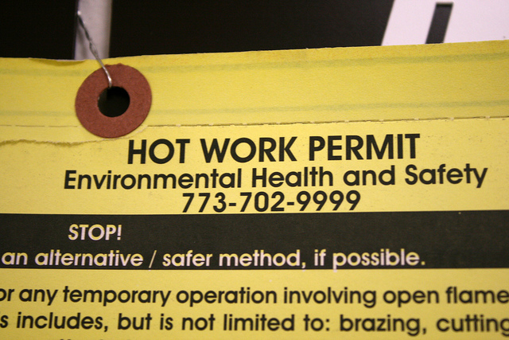
Documentation
PSM maintenance schedule
Contract employee injury and illness log
Hot work permits
Initial and refresher PSM training
OSHA VPP application supplements
Image retrieved from Bing Images
Notes:
Make sure you provide completed examples of forms and documents to your assessment team. Don’t just show them blank forms! They want to see the documents you filled out to thoroughly assess the processes within your SMS.
Welding, torch, or spark producing operations require hot work permits.
View the PSM Application, Supplement A at: https://www.osha.gov/dcsp/vpp/psmfinal2014.html
For more details on PSM Supplements B and C of the OSHA application, visit: https://www.osha.gov/dcsp/vpp/application_sitebased.html
The image shows a hot work permit, which is sometimes necessary for PSM processes. Image retrieved from Bing Images (free to share and use license) at: http://farm5.staticflickr.com/4098/4782291296_4b8d89b309_z.jpg

Slide 7
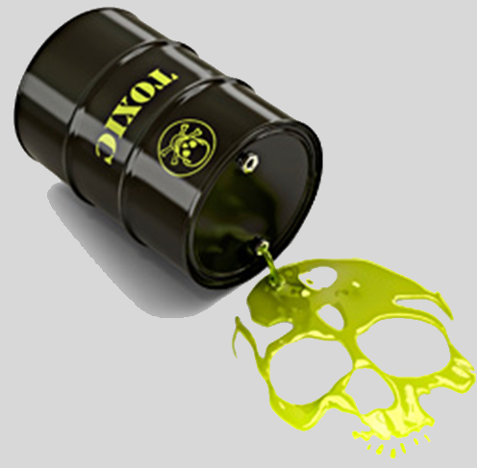
Leadership/Management Knowledge
Leaders and managers should know about
HHC(s) used at the worksite and associated hazards
Written PSM procedures
Emergency response procedures
Employee and leadership responsibilities in the event of a HHC release
Anticipated or new process changes
Training requirements
Image retrieved from Microsoft Clip Art
Notes:
Leaders and managers should be aware of HHC used on-site and the hazards associated with a release. They should also be knowledgeable on PSM-related procedures and their responsibilities in the event of a HHC release.
Image retrieved from Microsoft Clip Art.

Slide 8
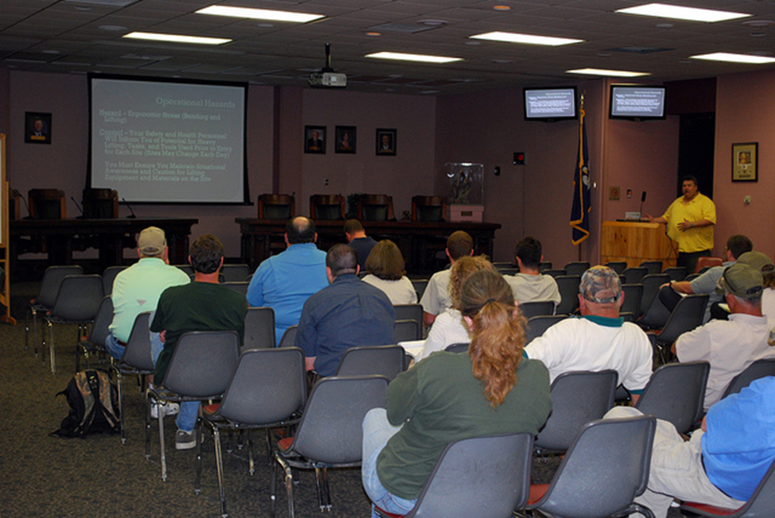
Key Personnel Knowledge
Key personnel should be knowledgeable about:
HHC(s) used on-site and associated hazards
PSM inspection, testing, and audit results
MOC procedures
Maintenance schedules
PSM-related documents
PSM training requirements
Review and revision process
OSHA VPP application requirements
Image retrieved from Bing Images
Notes:
Examples of key personnel include: PSM engineers, system operators, maintenance personnel, S&H staff, and industrial hygienists.
The image shows key personnel providing PSM-related training to affected worksite employees. Image retrieved from Bing Images (free to use and share license) at: https://c1.staticflickr.com/5/4035/4579940996_cc71920108_z.jpg

Slide 9
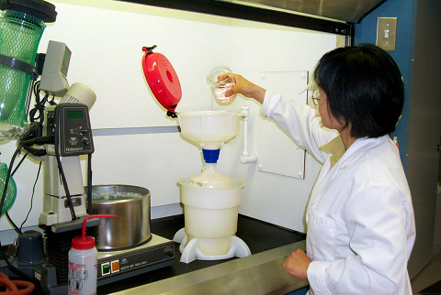
Workforce Knowledge
Employees should know about:
HHC(s) used on site and associated hazards
Signs and symptoms of HHC exposures
Access control points & entrance procedures
Location of PSM documentation
Written PSM procedures
Response procedures for released HHCs
Employee participation in PSM
PSM training received
Image retrieved from Yahoo Images
Notes:
Not only should employees understand the hazard associated with HHCs used in PSM processes, but they should also be aware of the signs and symptoms of exposure to the HHCs.
Employees should have a good understanding of any procedures, including emergency response, related to PSM processes and operations. Ensure employees know the location of any other PSM-related documents.
PSM requires the implementation and documentation of an employee participation plan. Ensure employees participate in the implementation and operation of PSM processes and can reference their participation plan(s).
The image shows an employee using OSHA-compliant waste management system in a laboratory setting. Image retrieved from Bing Images (free to share and use license) at: https://upload.wikimedia.org/wikipedia/commons/d/d6/ECO_Funnel%2C_OSHA_and_EPA_Compliant_Waste_Management_System_in_Laboratory_Use.jpg.

Slide 10
Action Checklist
Assess the chemicals used at the worksite
Create an employee participation plan
Conduct PHAs
Develop written PSM procedures
Train employees
Employ contractor oversight
Hold pre-startup safety reviews
Investigate PSM-related incidents
Review, audit, and update PSM procedures
Complete OSHA VPP supplements
Image retrieved from Microsoft Clip Art
Notes:
Follow this action checklist to implement and sustain VPP expectations for PSM.
Image retrieved from Microsoft Clip Art.

Slide 11
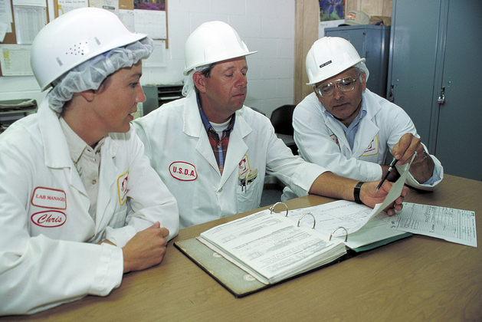
Worksite Assessment
Involve managers, supervisors, and employees
Conduct a walkthrough to look at worksite processes
List processes using, storing, manufacturing, handling, or moving large quantities of chemicals
Review chemical-related documentation
Image retrieved from Bing Images
Notes:
Conduct a site walkthrough and look at the chemicals used in worksite processes. Create a list of all the worksite processes that use chemicals – retrieve input from managers, supervisors, and employees. Ask about alternative chemical names, as well. Know that chemicals may not only be stored in chemical cabinets, but also in underground or aboveground tanks, vats, and barrels.
Chemical-related documentation generally includes safety data sheets (SDSs). SDSs tell you more about the composition and safety information related to each product. For each chemical, look at the ingredient list or composition/information on ingredients section in each SDS. Sometimes chemicals/products have hazardous ingredients that are clear in the product name itself. For example, the product Clorox Bleach is composed of the ingredients sodium hypochlorite and sodium hydroxide. You never know what a chemical’s ingredients are, so use the SDS to your advantage when conducting a worksite assessment.
The image shows an assessment team reviewing process documentation. Image retrieved from Bing Images (free to share and use license) at: http://farm9.staticflickr.com/8307/7880870312_ed079689b1_z.jpg

Slide 12
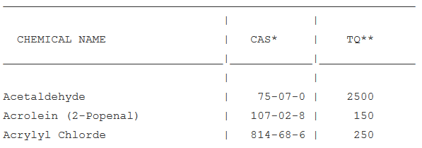
Worksite Assessment
Determine if any chemicals/ingredients are included on OSHA’s PSM HHC list
If so, determine the quantity of your HHC(s)
Compare your HHC quantity against OSHA’s listed TQs
Comply with OSHA’s PSM standard if your quantities meet or exceed a listed TQ
Image retrieved from OSHA
Notes:
CAS = Chemical Abstract Service
TQ = threshold quantity
The SDS lists CAS numbers for each ingredient, helping you compare the chemicals you use at your worksite against those listed on the OSHA PSM HHC list. Compare your chemical list against the OSHA PSM HHC list. OSHA’s PSM HHC list includes a chemical names, related CAS numbers, and TQs. If you have a chemical/ingredient listed in OSHA’s PSM HHC list, look at all your processes to see the volume you have on-site and use within your processes. You can see if your total quantity meets or exceeds the TQ identified in OSHA’s list. If so, then your organization falls under the PSM standard and must implement a PSM program.
Document the findings of the worksite assessment. Documenting these results proves you have evaluated your site. Use 29 CFR 1910.119 and the list of HHCs to determine if chemicals used at your site require PSM.
View the HHCs and their threshold quantities at: https://www.osha.gov/pls/oshaweb/owadisp.show_document?p_table=STANDARDS&p_id=9761
Know you may also have to comply with the Environmental Protection Agency’s Risk Management Program too. View 40 CFR Part 68 at: http://www.ecfr.gov/cgi-bin/text-idx?tpl=/ecfrbrowse/Title40/40cfr68_main_02.tpl
Best Practice: If you do not have HHCs or do not cross the PSM threshold quantity, consider drafting a report or memorandum for record stating you have evaluated the site to determine it does not fall under OSHA PSM requirements. Do not forget to include the date of the evaluation. Consider updating this report occasionally to show you continually assess your worksite.

Slide 13
Employee Participation Plan
Develop a written employee participation plan:
Collect and compile PSI
Complete and review PHAs
Develop PSM procedures
Conduct pre-startup safety reviews
Execute MOC procedures
Assist with incident investigations
Image retrieved from Microsoft Clip Art
Notes:
OSHA’s PSM standard requires a written participation plan, explaining how you will provide opportunities for employees to be involved in your PSM program.
The slide shows several ways in which you can involve employees in your PSM program. This is not an all-inclusive list of involvement activities. Measure the effectiveness of involvement each year to determine if employees are actually participating according to your plan.
For guidance on information to include in your employee participation plan, visit: http://www.gcapcoolcast.com/wp-content/uploads/2012/10/Example-Guidelines.pdf
Image retrieved from Microsoft Clip Art.

Slide 14
Process Hazard Analysis
Create a diverse PHA team
Select the hazard analysis methodology to use
Prioritize processes for PHA by their level of risk
Gather PSI
Image retrieved from Bing Images
Notes:
The intent of a PHA is to analyze causes and consequences related to the release of HHCs. You need to analyze the equipment, instrumentation, human actions, and other factors which may affect the process. It also attempts to determine failure points, methods of operations, and other factors leading to incidents.
A PHA team is essential in conducting a PHA. A PHA team should consist of an engineer, the process operator, and other managers, supervisors, and employees knowledgeable of the process, OSHA PSM requirements, and hazard analysis method used to complete the PHA.
Examples of hazard analysis methodologies include: what-if analysis, hazard and operability study, failure mode and effect analysis, and fault-tree analysis.
When determining which PHAs to complete first, consider: extent of the process hazards, number of potentially affected personnel, age of the process, and process operating history. Always perform PHAs of those processes assessed to be higher risk, first.
For additional PSI information and guidance, view OSHA publication 3132 at: https://www.osha.gov/Publications/osha3132.pdf
The image shows possible members of a PHA team. Image retrieved from Bing Images (free to share and use license) at: http://farm4.staticflickr.com/3804/8758083284_2498b953fb_z.jpg

Slide 15
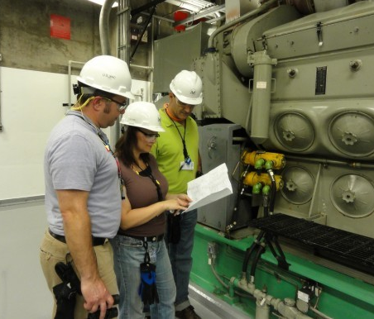
Process Hazard Analysis
Review initial worksite assessment results
Identify and evaluate process hazards
Document the outcome
Communicate hazards to affected personnel
Correct identified hazards
Image retrieved from Yahoo Images
Notes:
When performing a PHA, document: process hazards, previous process-related incidents and near-misses, hazard controls currently in-place, risk of hazard control failure and consequences, facility siting, and potential human factors. Conduct a PHA on all processes covered by the OSHA PSM standard.
Once the PHA is complete, communicate any identified hazards to affected personnel and initiate your corrective action process to abate any hazards. Document any corrective action steps taken, even if they were rejected or failed, to show the effort you put forth to mitigate the hazard.
The image shows a group of employees conducting a PHA. Image retrieved from Yahoo Images (free to share and use license) at: http://assets.inhabitat.com/wp-content/blogs.dir/1/files/2012/12/Nuclear-inspection-team-537x402.jpg

Slide 16
Written PSM Procedures
Safety
PSM Procedures
MOC
Operating
Emergency
Maintenance
Notes:
Write your PSM procedures based on the completed PHA. OSHA’s PSM standard requires five types of procedures: operating, safety, emergency, maintenance, and MOC.
You can incorporate the written procedures into one document for simplicity. Know that safety considerations may be built into other procedures.
When developing procedures for your PSM processes, ALWAYS include managers, supervisors, and employees in procedure development and review. In addition, keep copies of all procedures in readily available locations for employee use and reference.

Slide 17
Safety Procedures
Review identified hazards and risks
Review and/or write S&H procedures
Incorporate S&H controls and safe work practices into each procedure
Exercise established safety procedures for accuracy, revise as needed
Image retrieved from Bing Images
Notes:
S&H = safety and health
Review hazards and risks by looking at previous risk assessments and hazard evaluations. Look at completed S&H documents (e.g., SDSs for HHCs, self-inspection checklists, trends, hazard analyses, technical guides) to identify information to include in your written safety procedures. Do not forget to include hazard control use and required personal protective equipment.
Safe work practices must also be developed, some in accordance with other OSHA regulations. Safe work practices can include: confined space entry; control of hazardous energy (lockout/tagout); opening process equipment or piping; and control over entrance into a facility by maintenance, contractor, laboratory, or other support personnel.
Once you finalize your written safety procedures, conduct a dry-run of the procedures to test their accuracy and ensure hazard controls work effectively.
The image shows an example of a safe work practice (lockout/tagout) performed on an electrical shutoff switch. Image retrieved from Bing Images (free to use and share license) at: http://machinerysafety101.com/wp-content/uploads/2010/11/iStock_000000451877XSmall.jpg

Slide 18
Operating Procedures
Review the process, HHCs, technology, equipment, operating manuals, and control measures
Write operating procedures consistent with PSI
Revise operating procedures when changes occur
Certify the accuracy of procedures annually
Operating procedures
Steps for each operating phase
Operating limits
S&H considerations
Safety systems and their functions
Notes:
Steps for each operating phase include: initial startup; normal operations; temporary operations; emergency shutdown, including the conditions under which emergency shutdown is required, and the assignment of shutdown responsibility to qualified operators; emergency operations; normal shutdown; and, startup following a turnaround or after an emergency shutdown.
Operating limits include: the consequences of deviating from an operating limit, as well as the steps required to correct or avoid a deviation from an operating limit.
S&H considerations include: properties of, and hazards presented by process chemicals; precautions necessary to prevent exposure (including engineering controls, administrative controls, and personal protective equipment); control measures to be taken if physical contact or airborne exposure occurs; quality control for raw materials and control of hazardous chemical inventory levels; and, any special or unique hazards.
Seek suggestions regarding potential hazards, worst-case scenarios, process operations, and proper emergency responses from employees and others involved in the development process. Consider assigning monitors in each work area to oversee safety and PSM implementation. Ensure monitors have the proper training and are familiar with the process operations included in the PSM procedures. Include provisions for contractors in the written operating procedures.
When a change is made, it is expected that operating procedures are immediately revised to reflect the change(s). Then, annually, certify the accuracy and currency of all operating procedures. Document this certification.
For guidance on creating operating procedures, visit: http://www.rmpcorp.com/wp-content/uploads/2014/02/GCPS_2013_TipsforEffecitveOperatingProcedures.pdf

Slide 19
Maintenance Procedures
Involve maintenance personnel
Review equipment maintenance documents and operating manuals
Review and/or write maintenance procedures
Exercise established maintenance procedures for accuracy, revise as needed
Image retrieved from Bing Images
Notes:
Refer to your written preventive/predictive maintenance program to review testing and inspection requirements. Refer to the original equipment manufacturer information or technical guides for more information on specific pieces of equipment. You can also look at engineering designs, plans, drawing, and manufacturer specifications to identify fail-safe points.
Develop procedures for pressure vessels and storage tanks, piping systems, relief systems, vent systems and devices, emergency shutdown systems, controls, and pumps – basically any system in a PSM process. Always include maintenance personnel in the development and review of procedures.
Assure all spare parts and materials used for maintenance activities are suitable and acceptable for their uses. Consider including a process for assuring the appropriate use and accountability of spare parts and maintenance materials.
The image shows employees reviewing maintenance procedures. Image retrieved from Bing Images (free to use and share license) at: https://upload.wikimedia.org/wikipedia/commons/thumb/4/49/131210-N-CE241-025_Cesar_Gomez_explains_damage_control_generator_maintenance_procedures.jpg/511px-131210-N-CE241-025_Cesar_Gomez_explains_damage_control_generator_maintenance_procedures.jpg

Slide 20
Emergency Procedures
Review your current emergency action plan
Add a PSM emergency supplement to the plan
Exercise PSM emergencies
Critique the execution of emergency procedures
PSM emergency supplement
Steps for each operating phase
Steps for handling both catastrophic and small HHC releases
Emergency response
Alarm systems
Training requirements
Notes:
Your emergency action plan should already include other required components under 29 CFR 1910.38, Emergency Action Plans.
Revise your current plan to incorporate emergency situations involving PSM processes and HHCs. Do not only include large or catastrophic releases of HHC, but small releases, as well.
OSHA outlines emergency action plan requirements. View OSHA 29 CFR 1910.38(a) for additional information: https://www.osha.gov/pls/oshaweb/owadisp.show_document?p_table=STANDARDS&p_id=9726

Slide 21
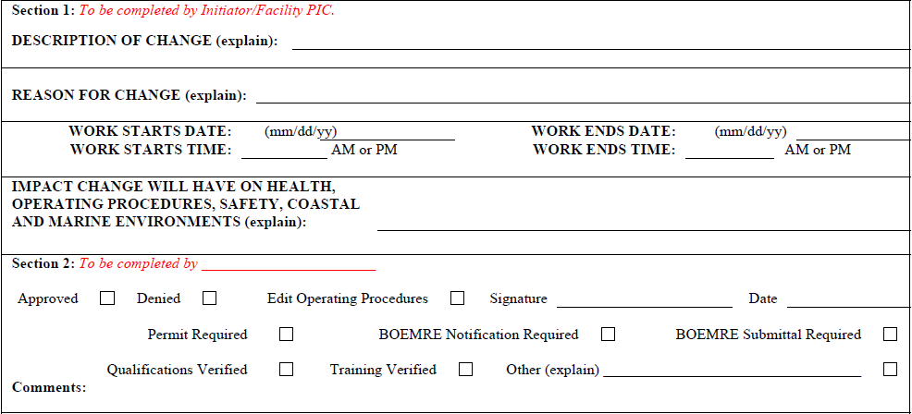
Management of Change Procedures
Build a sequence of MOC approval authority
Establish a SME team
Create a form for documenting changes
Image retrieved from Petsec Energy
Notes:
SME = subject matter expert
You do not need to execute your MOC procedures for replacements in-kind.
Replacement in-kind: An item (e.g., equipment, chemical, procedure) meeting the design specification of the item it is replacing. The replacement can be an identical replacement (e.g., same equipment make and model) or any other alternative item specifically provided for in the design specification. An alternative, though, cannot in any way adversely affect the use of the item, associated items, or hazards.
Your SME team should include: engineers, S&H staff, PSM SMEs, emergency response staff, process operators, and maintenance personnel. Utilize these personnel for developing and executing MOC procedures.
The image shows a snapshot of a MOC form to help document workplace changes related to PSM activities. Image retrieved from Petsec Energy at: http://www.petsec.com.au/wp-content/uploads/2014/12/04.0-MOC.pdf

Slide 22
Management of Change Procedures
Write procedures to manage process changes
Execute MOC procedure and address:
Technical basis for the change
S&H impacts of the change
Modifications to existing procedures
Timeframe for implementing the change
Responsible person(s) to approve process changes
Image retrieved from Bing Images
Notes:
Write procedures to manage chemicals to: process chemicals, technology, equipment, procedures, and facilities affected by PSM processes.
MOC procedures must address: the technical basis for the proposed change; impact of change on S&H; modifications to operating procedures; necessary time period for the change; and, authorization requirements for the proposed change.
Once you develop a MOC procedure, ensure all personnel involved with the process are aware of the steps to initiate a change. Communicate changes and provide training to all employees, maintenance personnel, and contract employees operating a process prior to starting the process up again. Immediately revise PSM procedures when changes occur.
View an example of a MOC procedure at: http://www.petsec.com.au/wp-content/uploads/2014/12/04.0-MOC.pdf
Image retrieved from Bing Images (free to share and use license) at: http://3.bp.blogspot.com/_7E-V2lucIao/TO7JKYZl6BI/AAAAAAAAAUQ/ywAWcfC4WUg/s1600/change-management1.jpg

Slide 23
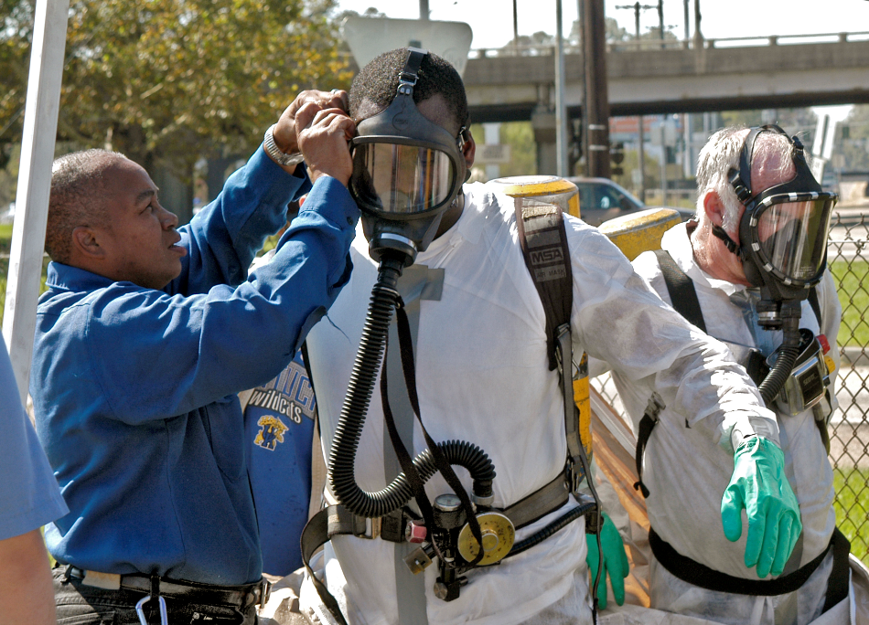
PSM Training
Deliver initial training
Include employees assigned to a PSM process
Include those affected by PSM operating procedures
Do not forget about maintenance personnel and emergency responders
Cover the process overview, PSM procedures, S&H hazards, emergency operations, and safe work practices
Image retrieved from Yahoo Images
Notes:
Deliver initial training to all employees before working on a PSM process. If you discover a process already falls under PSM, develop your PSM program and procedures and train employees as soon as possible. In your initial training, include: an overview of the PSM process(es), written PSM procedures (i.e., safety, operating, MOC, emergency, maintenance), specific S&H hazards, emergency operations (including shutdown), and safe work practices.
Don’t forget to train your maintenance personnel, emergency responders, and any other employee affected by the PSM process (including all involved in maintaining the on-going integrity of process equipment).
You may need to use a combination of classroom and hands-on training to help your employees understand their roles, responsibilities, and other components of the training.
The image shows employees receiving hands-on preparation during PSM training. Image retrieved from Yahoo Images (free to use and share license) at: https://upload.wikimedia.org/wikipedia/commons/0/0b/FEMA_-_16933_-_Photograph_by_Win_Henderson_taken_on_10-09-2005_in_Louisiana.jpg

Slide 24
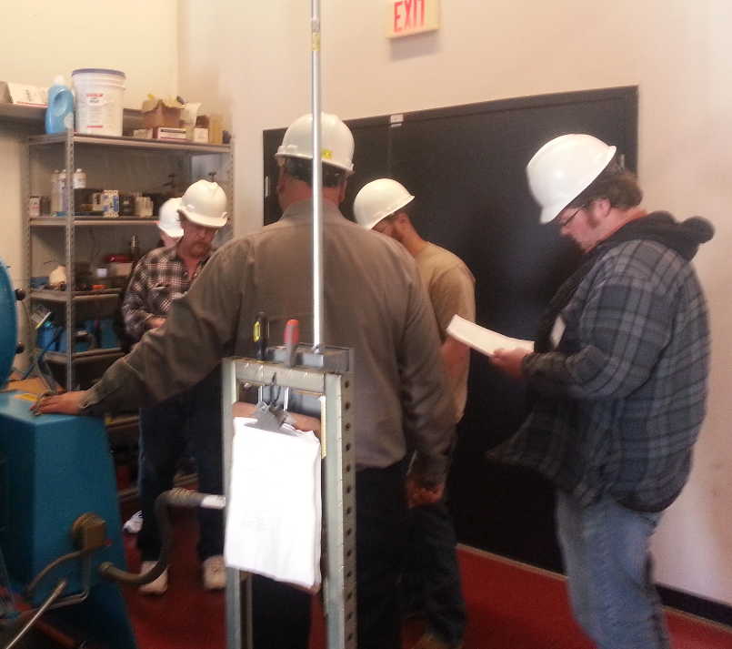
PSM Training
Deliver refresher training every 3 years
Retrain all affected personnel:
After process changes
Prior to the startup of a process after a change
Document the completion of all PSM training
Evaluate the effectiveness of provided training
Image retrieved from Bing Images
Notes:
As a part of your MOC procedures, train all affected personnel as soon as a process change is made, and prior to the startup of the process after the change. Process changes may include: revisions to PSM plans and procedures, technology, equipment, or facilities, as mentioned in your MOC procedure.
Training records must include: employee name, date of training, the means used to verify the employee understood the training.
Evaluate the effectiveness of provided training through: written tests, quizzes, fill in the blank question/answer sheets, and supervisor observations.
The image shows a group of maintenance personnel receiving training on a boiler, a part of a PSM process. Image retrieved from Bing Images (free to use and share license) at: http://www.boilerlicense.com/wp-content/gallery/home/20150408_131022.jpg

Slide 25
Contractor Oversight
Establish a process to evaluate contractor S&H performance
Ensure contractors have received proper training from their employer
Evaluate on-site contractor performance
Maintain a separate contractor injury and illness log
Inform contract employees of:
Potential hazards
Emergency action plan
Hazard controls
Safe work practices
Notes:
PSM requirements only apply to contractor employees performing maintenance or repair, turnaround, major renovation, or specialty work on or adjacent to a PSM covered process. They do not apply to your general service contractors which do not influence process safety (e.g., janitorial work, food and drink services, laundry, delivery or other supply services).
Communicate your hazard reporting process to all contractors. Evaluate contractor performance by conducting periodic walkthroughs to look for hazards and compliance with your established procedures.
As with most effective contractor oversight programs, maintain a contractor injury and illness log. Keep a separate log than your log recording your on-site employee injuries and illnesses.
Also know that contractors must also meet responsibilities listed in 29 CFR 1910.119(h)(3). Contractors are responsible for providing their own training on safe work practices and PSM awareness in order to safely complete their jobs. This can be dependent upon the contractor language, though, further specifying if this training is provided by the contractor or by your organization.
To review contractor responsibilities, visit the PSM standard at: https://www.osha.gov/pls/oshaweb/owadisp.show_document?p_table=STANDARDS&p_id=9760

Slide 26
Pre-Startup Safety Reviews
Initiate a safety review and confirm:
Design specifications of construction and equipment
Accuracy and effectiveness of PSM procedures
Completeness of PHAs (for new facilities)
Execution of MOC requirements (for modified facilities)
Status of identified recommendations
Completed and documented employee training
Review PSM procedures with employees
Image retrieved from Bing Images
Notes:
The purpose of a pre-startup safety review is to communicate PSI to employees for new or modified facilities and processes where HHCs are used.
Initiate safety reviews for: a new HHC to be used in a process, new facilities, and when there are significant process modifications resulting in a change to PSI.
Prior to beginning the process again after a significant change, review the PSM process, the process changes, new or changed PSI, and all PSM procedures with employees.
Significant change: Modifications to the PSM equipment, processes, procedures, technology, or procedures that cause an adjustment in the existing PSI.
The image shows a manager reviewing PSM procedures with employees to ensure they are correct. Image retrieved from Bing Images (Creative Commons).

Slide 27
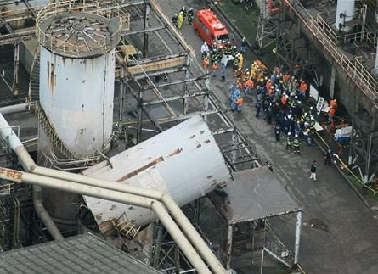
PSM Incident Investigations
Follow established incident investigation procedures
Investigate incidents that did, or could have resulted in, catastrophic release of HHCs
Initiate the investigation within 48 hours
Document the details of the investigation
Share investigation results
Maintain investigation reports for at least 5 years
Image retrieved from Bing Images
Notes:
Follow Service- or Agency-specific guidelines to investigate PSM-related incidents. Consider drafting a supplement to list the circumstances or occurrences requiring formal PSM incident investigation. Make sure the 48 hour initiation timeframe is met to comply with the PSM standard.
Establish an investigation team composed of at least one person knowledgeable of the PSM process, and one contractor if it occurred in a contractor work area.
Document the following information at a minimum: date of the incident, date investigation began, description of the incident, factors contributing to the incident, and recommendations resulting from the investigation.
The image shows an investigation team conducting an incident investigation for a released HHC. Image retrieved from Bing Images (free to use and share license) at: http://1.bp.blogspot.com/-yLjUeFB-dJo/TtryAYk968I/AAAAAAAAABU/Pr3xTlq8ba8/w1200-h630-p-k-nu/1322800650_7zuM6M.jpg

Slide 28
Reviews, Audits, and Updates
Consider developing a PSM committee
Conduct continual testing and inspections of process-related equipment
Retrain the workforce when changes are made
Review/update all PHAs | Every 5 years
Audit the compliance of PSM processes | Every 3 years
Review written PSM procedures | Every 3 years
Notes:
The OSHA PSM standard has several periodic review requirements. Refer to your Service/Agency or local guidance regarding PSM, as your requirements locally may be more stringent than OSHA’s. PSM is considered to be a safe work practice, or hazard control program, and the DoD requires all hazard controls programs and hazard analyses be reviewed annually, as per DoDI 6055.01. Review all other guidance to determine the best review period at your organization. Consider developing a committee to handle PSM process and document reviews.
OSHA requires a re-evaluation of PHAs at least every five years. Make sure the hazard analysis is consistent with the current process and PSI. Review all plans and procedures every three years for accuracy and effectiveness. Also, conduct a compliance audit every three years. You must also retain your previous two compliance audits. During these audits, make sure you have effective processes and procedures in place and followed by employees.
View a checklist from Georgia Tech Research Institute to help you conduct your compliance audits: http://oshainfo.gatech.edu/psm-compliance/psm-checklist.pdf
Exercise your hazard tracking system to document all identified findings and associated resolutions for each. Document all resolutions for the life of the process – OSHA may be interested in this information.
When you made all the changes, train all employees on these changes prior to process startup.

Slide 29
OSHA VPP PSM Supplements
Supplement A | Supplement B | Supplement C
PSM Application | PSM Annual Questionnaire | PSM On-Site Evaluation Questionnaire
Print out this supplement Answer the questions in narrative format Write “Not Applicable” for questions outside the scope of you PSM operations – explain why! Submit the completed supplement with your OSHA VPP application | Review the questions included in this supplement (these change year to year) Answer the questions in narrative form, evaluating both best practices and areas of opportunity If you are a Star site, submit the completed supplement with your annual VPP self-evaluation | Review the questions you answered for supplement A Think about other questions an OSHA assessment team may ask about your PSM Prepare to answer these questions, and others regarding PSM, during on-site OSHA VPP evaluations and recertifications
Notes:
OSHA VPP has supplements A, B, and C for organizations pursing VPP falling under OSHA’s PSM standard.
When applying to become a recognized OSHA VPP site, submit Supplement A with your application. Supplement A is a series of detailed PSM questions about your PSM program. OSHA reviews these questions to obtain a basic understanding of your PSM program, processes, and procedures.
PSM Supplement B is a series of questions compiled annually by OSHA using selected questions from OSHA's Dynamic Inspection Priority Lists. These questions change from year to year. OSHA provides these questions for you to submit with your annual self-evaluation each year. If you are not a Star site, you can just keep a copy of your completed supplement with your annual self-evaluation – this helps with your continuous improvement efforts.
PSM Supplement C is a third, and final series of questions selected by the VPP on-site team members from OSHA's dormant PSM Inspection Priority Lists. These questions are selected just prior to the on-site evaluation and presented to you during the assessment. Each application site covered by the PSM standard receives a different set of questions.
View the PSM Application, Supplement A at: https://www.osha.gov/dcsp/vpp/psmfinal2014.html
For more details on PSM Supplements B and C of the OSHA application, visit: https://www.osha.gov/dcsp/vpp/application_sitebased.html

Slide 30
Conclusion
In this presentation, you learned to:
Summarize the background and importance of PSM
List PSM-related documentation
Describe the knowledge leadership/management, key personnel, and the workforce should have regarding PSM
Identify PSM actions to implement and sustain OSHA VPP
Notes:
This presentation summarizes the basic requirements to meet OSHA’s 29 CFR 1910.119, Process safety management requirements. The presentation is not an all-encompassing summary of every regulatory requirement within 29 CFR 1910.119.
Please refer to the regulation when establishing a PSM program to ensure all regulatory requirements are met.

