Slide 1
Recordkeeping
OSHA VPP
July 2022
Notes:
This presentation outlines recordkeeping requirements for the purposes of Occupational Safety and Health Administration (OSHA) Voluntary Protection Programs (VPP) approval.
The presentation provides information on the background and importance of recordkeeping, required documentation, and the various levels of employee knowledge. It concludes with an action checklist and supplemental details to help with OSHA VPP implementation and sustainment efforts.

Slide 2
Objectives
In this presentation, you will learn to:
  Summarize the background and importance of occupational injury and illness recordkeeping
  List recordkeeping-related documentation
  Describe the knowledge leadership/management, key personnel, and the workforce should have regarding occupational injury and illness recordkeeping
  Identify recordkeeping actions to implement and sustain OSHA VPP
Notes:
This presentation is beneficial to safety and health (S&H) professionals, VPP representatives, designated recordkeepers, and others with responsibilities for reporting information related to occupational injuries and illnesses, such as supervisors, claims representatives, and occupational health care personnel.

Slide 3

Background & Importance
Included in the HPC criteria for VPP
Ensures recordkeeping forms are maintained and accurate
Confirms recordkeepers are knowledgeable of OSHA requirements
Reviews injury and illness incidence rates for on-site contractors
Image retrieved from Microsoft Clip Art
Notes:
HPC = Hazard Prevention & Control
Injury and illness incidence rates: Numerical rates representing recordable injuries and illnesses at a worksite; important when OSHA assesses a worksite’s qualification for VPP.
OSHA Recordkeeper: Person responsible for keeping injury and illness records, making sure they are properly kept.
OSHA 29 CFR 1904 discusses recordkeeping requirements, which require employers to maintain accurate occupational injury and illness records and report work-related fatalities, injuries, and illnesses to OSHA.
View 1904 recordkeeping regulations at: https://www.osha.gov/laws-regs/regulations/standardnumber/1904
Image retrieved from Microsoft Clip Art.

Slide 4

Background & Importance
Checks for evidence of unreported recordable injuries and illnesses
Trends occupational injury and illness data
Serves as a management tool for administering S&H programs
VPP requires injury and illness rates below your industry average
Image retrieved from Microsoft Clip Art
Notes:
OSHA recordkeeping is important in any safety and occupational health management system (SOHMS). It helps you evaluate the safety of your workplace, understand your hazards, and implement worker protections to reduce and eliminate hazards. Ultimately, you can prevent future workplace injuries and illnesses.
Image retrieved from Microsoft Clip Art.

Slide 5
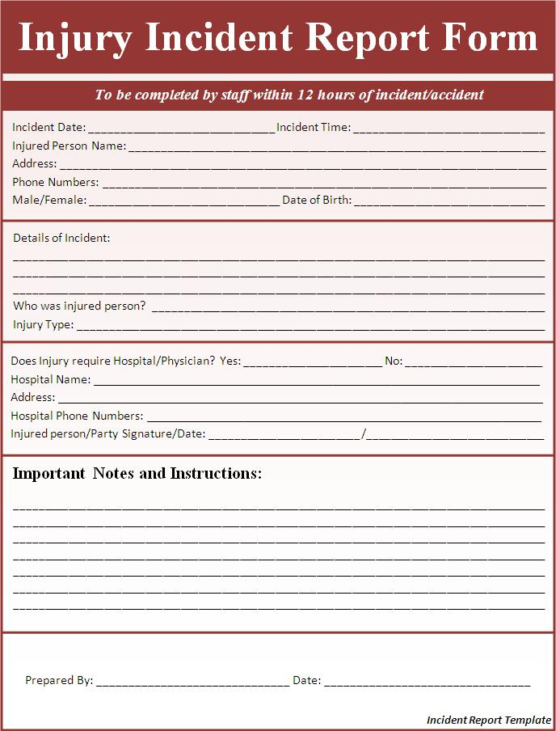
Documentation
OSHA Forms 300, 300A, and 301
Injury and illness incidence rates
Recordkeeper training records
S&H incentive programs and
discrimination policies
Mishap and near-miss
investigation reports
Image retrieved from Microsoft Clip Art
Notes:
An OSHA VPP assessment of your recordkeeping system includes a review of the documentation listed on this slide. This is not an all-inclusive list.
Provide your OSHA Forms 300 and 300A for the past 5 years. Show this information to an assessment team if they completed Health Insurance Portability and Accountability Act (HIPAA) training and have permission to see your confidential employee records. See 29 CFR 1904.33(a) for more information at: https://www.osha.gov/laws-regs/regulations/standardnumber/1904/1904.33 If they haven’t completed HIPAA training, remove personal information (e.g., employee names, social security numbers) from these documents.
Injury and illness incidence rates include the total case incidence rate (TCIR) and days away, restricted, or job transferred (DART) rate.
Verify your designated recordkeeper has the knowledge, experience, or education of OSHA recordkeeping regulations. If you have training records for them, show these!
Incentive programs play a role in recordkeeping. Occasionally, these programs unintentionally incentivize underreporting of injuries and illnesses by awarding low incidence rates. OSHA provides further clarification on incentive programs and their impact on injury and illness reporting at: https://www.osha.gov/laws-regs/standardinterpretations/2018-10-11. It is important you substantiate your incentive program with discrimination policies, as applicable, that help show intolerance for injury and illness report discrimination.
Reports and investigations of first-aid cases, near-misses, and accidents may also be reviewed. These show whether your occupational injuries and illnesses were appropriately recorded and your incidence rates are accurate.
Image retrieved from Microsoft Clip Art.

Slide 6

Documentation
Safety or mishap review committee meeting minutes
First-aid reports
Hazard tracking log
Sharps injury log
Medical surveillance reports
Image retrieved from Microsoft Clip Art
Notes:
Safety or mishap review committee meeting minutes discussing mishaps and follow-up actions show how your team tries to prevent the next mishap from happening.
Prepare first-aid reports to show tracking of minor injuries, if available. Review of these records shows injuries or illnesses are appropriately classified as either first aid or OSHA recordable.
Provide hazard abatement logs to show how you capture the results of mishap investigations and track those hazards to closure or correction.
Determine if your organization requires a sharps injury log. You may be able to use your OSHA Form 300 in place of this document if it includes all the required information outlined in the regulation. View OSHA 29 CFR 1904.8 for additional information regarding sharps recordkeeping at: https://www.osha.gov/laws-regs/regulations/standardnumber/1904/1904.8
If you have medical surveillance reports, have them on hand! These may include audiometric testing records and respirator fit tests. These documents have additional explanations and details about cases included on the OSHA Form 300, and shows how you fulfilled other S&H requirements. This information helps determine if a case should be included on your OSHA Form 300.
Image retrieved from Microsoft Clip Art.

Slide 7

Leadership/Management Knowledge
Leaders and managers should be knowledgeable of:
  Who is responsible for OSHA recordkeeping
  Serious injuries or illnesses that occurred
  Process to notify OSHA recordkeepers of injuries or illnesses
  Causes of recordable injuries and illnesses
  Injury and illness trends
Image retrieved from Microsoft Clip Art
Notes:
Leaders and managers should be able to identify who is responsible for recording occupational injuries and illnesses. They should be familiar with the reporting process and methods to communicate the mishap information to the designated recordkeeper. Leaders may also need to know how to report an injury or illness to OSHA, as needed.
It is important for leaders to know and understand the causes of recordable injuries and illnesses and any workplace trends, especially for serious injuries and illnesses. Knowing this information allows them to create or revise S&H goals and objectives and find solutions for problem areas.
Image retrieved from Microsoft Clip Art.

Slide 8
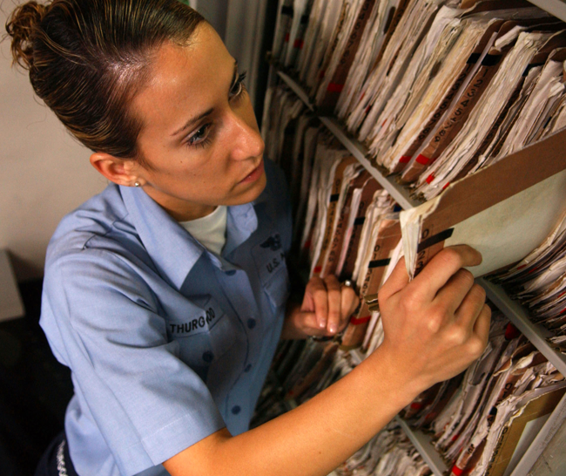
Key Personnel Knowledge
Recordkeeper(s) should be knowledgeable about:
  OSHA recordkeeping regulations
  Recordkeeping system(s) and forms
  Process used to document and retrieve recordable mishap information
  Steps to handle, record, and monitor contractor injuries and illnesses
  Process for adhering to employee work restrictions
  Safeguarding the confidentiality of medical records
Image retrieved from Microsoft Clip Art
Notes:
Recordkeepers are responsible for maintaining your injury and illness records. OSHA interviews recordkeepers to ensure records are properly kept and the recordkeeper understands recordkeeping requirements and interpretations.
Recordkeepers need to explain the recordkeeping process – from receiving notification of a mishap, to documenting it, and using the information to improve the SMS. Recordkeepers need to know the details of the recordkeeping system, especially if it is centralized or computerized.
Recordkeepers must understand what makes a case recordable and how to count the days away, or days of job restrictions and transfers, to maintain accurate records. View general recording criteria at: https://www.osha.gov/laws-regs/regulations/standardnumber/1904/1904.7
Recordkeepers must also understand what to do if you experience a contractor mishap, determine a case is not work-related, or if someone requests medical records.
Image retrieved from Microsoft Clip Art.

Slide 9

Workforce Knowledge
Employees should be knowledgeable about:
  Location of the OSHA Form 300A
  Recent injuries/illnesses occurring in their work area
  Process to report a mishap
  Steps to request medical records
Image retrieved from Microsoft Clip Art
Notes:
Ensure employees know the location of the OSHA Form 300A. The OSHA Form 300A recaps the work-related injuries or illnesses for the last calendar year.
It is important for employees to understand the mishap reporting process so key personnel can gather and maintain accurate information. An employee should keep their supervisor in the loop on the status of job restrictions and days away from work. Supervisors can pass this information along to the recordkeeper to maintain accurate records.
While employees have the right to observe S&H information pertaining to them (e.g., industrial hygiene results, baseline hazard analyses), they also have the right to request their own medical records. These records may include medical examination results or medical surveillance outcomes. Ensure they know the steps to request this information, if they wish to review it.
Image retrieved from Microsoft Clip Art.

Slide 10
Action Checklist
Establish a recordkeeping system
Train the recordkeeper
Determine the work-relatedness and recordability of injuries and illnesses
Stay cognizant of contractor injuries and illnesses
Complete OSHA Form 301
Record case information on the OSHA Form 300
Summarize annual injuries and illnesses on OSHA Form 300A
Calculate injury and illness incidence rates
Compare incidence rates against the industry average
Notes:
Follow this action checklist to implement recordkeeping and sustain VPP expectations. Each of these action checklist items is covered in more detail.

Slide 11
Recordkeeping System
1
2
3
4
Communicate the mishap reporting process
Identify the tools used to capture reported mishaps
Determine how to document recordable injuries and illnesses
Designate an OSHA recordkeeper to determine work-relatedness and record accordingly
Image created by the DoD SMCX
Notes:
First, communicate the responsibilities and expectations for reporting mishaps. You cannot record a mishap if your workforce doesn’t report them. Make sure everyone understands their roles and responsibilities, including occupational health care personnel, safety staff, supervisors, and the designated OSHA recordkeeper.
Next, identify the tool(s) to capture mishap data. The most common tools include electronic databases or self-made spreadsheets and forms.
You may have a separate process to distinguish work-related cases from non-work-related cases. While many organizations opt to use OSHA Forms 300, 300A, and 301, you may have other equivalent tools/forms to document these mishaps.
It is up to you to determine how to maintain your records. It does not matter which method or tool is used. It only matters the records are accurate, complete, and presented upon request.
Finally, identify an OSHA recordkeeper to maintain the recordkeeper system.
Image created by the DoD SMCX.

Slide 12
Recordkeeper Training
Make sure the recordkeeper is knowledgeable of:
  OSHA 29 CFR 1904 recordkeeping regulations
  Definition of OSHA recordable injury or illness
  Process to determine the work-relatedness of a case
  General recording criteria
  Steps to record a work-related case
  Maintaining forms
  Steps to calculate injury and illness incidence rates
Notes:
You may not need to formally train your OSHA recordkeeper, but it is important they understand recordkeeping regulations. At a minimum, they should understand all the concepts included on this slide.
Many times, a designated OSHA recordkeeper is a S&H professional with years of experience. In this case, see if they have enough experience and knowledge to maintain accurate OSHA records.
Other times, organizations select an untrained person to serve as an OSHA recordkeeper. In this case, the designated OSHA recordkeeper isn’t knowledgeable of recordkeeping regulations, doesn’t know about available resources, and may or may not maintain accurate records.
If you think additional training is required, consider finding an online course, or sending the recordkeeper to OSHA 10-hour training for general industry to learn more about recordkeeping requirements.

Slide 13
OSHA Recordable Determination
Record the injury or illness
Update the previously recorded injury or illness
START
NO
YES
Did the employee experience an injury or illness?
Is the injury or illness work-related?
Is the injury or illness a new case?
Does the injury or illness meet recordkeeping criteria?
YES
YES
YES
NO
NO
NO
NO
Do not record the injury or illness
Image created by the DoD SMCX
Notes:
Work-related: Any injury or illness resulting from exposure in the work environment caused or contributed to the condition or significantly aggravated a preexisting condition.
Part of any SMS is gathering the details behind any injury and illness to see if you can classify it as “work-related” and determine if you should record it on the OSHA Form 300.
Case classification and determination for recording purposes should be part of your OSHA recordkeeper’s training (or experience). Be knowledgeable of OSHA recordkeeping regulations to help you determine if OSHA classifies the case as work-related: https://www.osha.gov/laws-regs/regulations/standardnumber/1904/1904.5
Keep in mind there is an established time limit to record each case. Supporting case-related information may not be readily available within this timeframe, so it is up to you to use your best judgment when recording a case – you can always go back and revise the entry later.
Image created by the DoD SMCX. The image shows a flowchart to determine if an injury or illness is work-related and recordable.

Slide 14
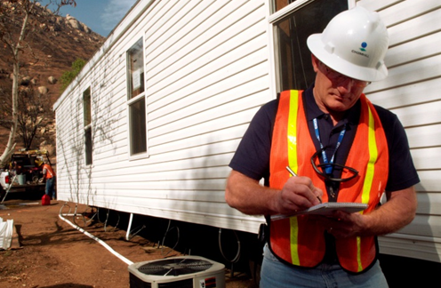
Contractor Injuries & Illnesses
NESTED CONTRACTORS
APPLICABLE CONTRACTORS
Treat nested contractors just like organizational employees
Include recordable injuries and illnesses on your OSHA Form 300
Gather contractor hours worked
Collect annual injury and illness case numbers and incidence rates
Assist in making an RRP/APP when incidence rates exceed their industry average
Image retrieved from Microsoft Clip Art
Notes:
RRP/ARP = rate reduction plan/accident prevention plan
Nested contractor: Contractors intermingled with your workforce and under direct supervision of your management team.
Applicable contractor: Contractors whose employees work 1,000 hours or more in any calendar quarter.
The type of contractors you have at your organization matters in OSHA recordkeeping.
Nested contractors are just like your employees – they come to work, report to someone at your organization, and receive their orders and guidance from your managers on a day-to-day basis. You treat these contractors just like any other employee. If they get injured, initiate an investigation. If you deem the case is recordable, place it on your OSHA Form 300.
Applicable contractors are a different story. If they experience an occupational injury or illness, you do not record their incident on your OSHA Form 300; instead, their organization records it. At the end of the calendar year though, you will collect their injury and illness data from them. You can review the data they provide, include it in your annual VPP self-evaluation, and work with the contractor to devise a plan to drive down incidence rates if they are high. This process helps ensure a safe work environment for both the applicable contractors and your employees.
Image retrieved from Microsoft Clip Art.

Slide 15

OSHA Form 301
Complete within 7 calendar days of recordable injury/illness notification
Document personal information for the injured/ill employee
Identify physician/health care professional information
Detail the incident and the resulting injury or illness
Image retrieved from Microsoft Clip Art
Notes:
Employee information includes: full name, address, date of birth, hired date, and gender.
Physician or other health care professional information includes: name, where the treatment was provided, if treated in an emergency room, and if hospitalized overnight. This information is important because the physician or other health care professional can determine if the case involves days away from work, job restrictions, or duty transfers.
Case information includes: case number, date of injury, time employee began work, time of event, actions prior to injury or illness, description of what happened, what the injury or illness was, the object or substance that harmed employee, and if it was a fatality, the date of occurrence.
NOTE: You can use an equivalent form to document this information. However, your form must include the same information, be readable and understandable, and completed using the same instructions as the OSHA form it replaces.
For additional details on completing OSHA Form 301, visit: https://www.osha.gov/recordkeeping/forms
Image retrieved from Microsoft Clip Art.

Slide 16
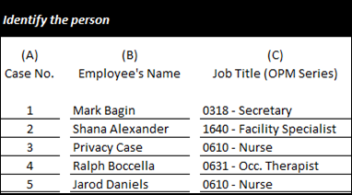
OSHA Form 300
Identify the person
Describe the case
Classify the case
Document:
  Days away from work
  Job transfers
  Job restrictions
Identify the type of injury or illness
Image created by the DoD SMCX
Notes:
Use the OSHA Form 300 to classify work-related injuries and illnesses. Note the extent and severity of each case. Record the details about each injury or illness. OSHA requires you to maintain these logs for 5 years. For VPP purposes, OSHA reviews your past 3 calendar years.
Column A: Include a case number. This may be the same number used on accident investigation forms or assigned to the employee injury/illness report form.
Column B: Include the name of the employee, unless the employee has: an injury or illness to an intimate body part or reproductive system; injury or illness resulting from a sexual assault; mental illness; case of human immunodeficiency virus (HIV) infection; hepatitis or tuberculosis; needlestick injury or cut from a sharp object contaminated with blood or infectious material; or if the employee requests for the name to be removed.
Column C: Add the series number of the federal employee (required by 1960.73) and a short job title.
Column D: Add the date of the incident.
Column E: Include a specific location. Be as specific as possible (e.g., building number, work area).
Column F: Describe the injury/illness, body part affected, and the object or substance that was the cause. Many times, worksites only mention the injury/illness, but not the other specific details.
Columns G–J: Classify the injury or illness as a death, DART, or other recordable case (e.g., prescription issued). Mark only one box for these columns – the most severe outcome of the case. You may need to go back later and update this data point.
Columns K–L: If you have DART, complete the number of DART days and place the number in the appropriate column. Do not count the day of the injury as days away.
Column M: Select injury or chose an illness. Illnesses are broken down between skin disorder, respiratory condition, positioning, hearing loss, or other illnesses such as heatstroke, frostbite, or other extreme temperature illnesses.
For additional details on completing the OSHA Form 300, visit: https://www.osha.gov/recordkeeping/forms
Images created by the DoD SMCX.

Slide 17
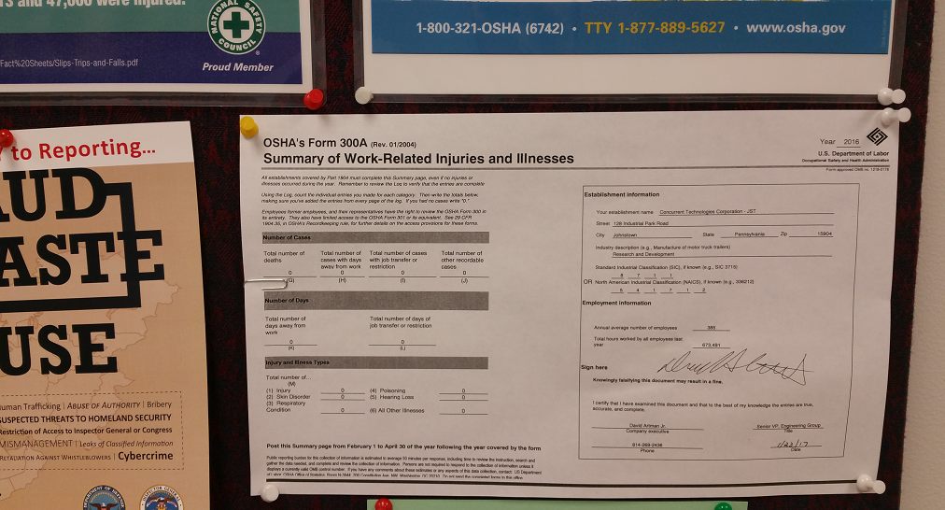
OSHA Form 300A
Transfer information from the OSHA Form 300 to the OSHA Form 300A at the end of the calendar year
Fill in the establishment information
Have the form signed by the highest executive in the organization
Post the signed form between
February 1 and April 30
Image courtesy of Concurrent Technologies Corporation (CTC)
Notes:
The OSHA Form 300A recaps the work-related injuries or illnesses documented on the OSHA Form 300.
Refer to OSHA Form 300, Columns G–M. Review the totals at the bottom of each column. Check the information in each column to ensure the numbers are accurate. It is important to know you may have multiple pages with several totals you must add together.
Copy the total number for each column and move it to the respective column listed on the OSHA Form 300A, even if the number is zero. Double-check the numbers you transfer to the OSHA Form 300A. Consider having someone else review your additions to make sure you transferred them accurately (a common error on OSHA Form 300A).
List your organization’s primary work activity and 6-digit North American Industry Classification System (NAICS) code. Reach out to your Human Resources representative to help you identify the figures you need for employment information.
Have your highest-ranking official review and sign the OSHA Form 300A. Examples of high-ranking officials include Commanders, Directors, and business managers.
Post your signed OSHA Form 300A from February 1 to April 30. It is a good idea to post this form in an area employees frequently congregate or visit, like a break room or safety bulletin board.
For additional details on completing the OSHA Form 300A, visit: https://www.osha.gov/recordkeeping/forms
Image courtesy of Concurrent Technologies Corporation. The image shows a posted OSHA Form 300A.

Slide 18
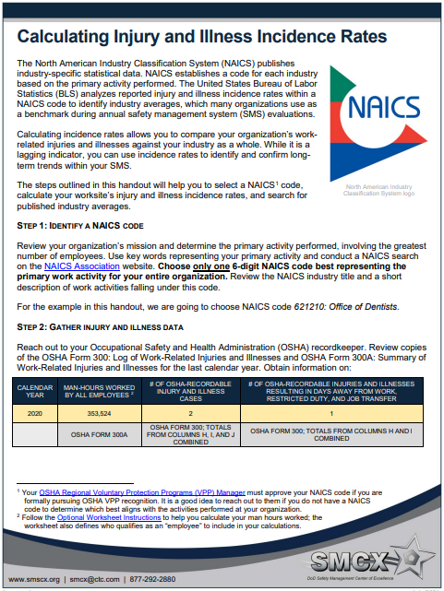
Injury & Illness Incidence Rate Calculations
Identify a NAICS code
Gather injury and illness data
Calculate the TCIR
Calculate the DART rate
Look up published industry incidence rates
View the SMCX guide of calculating incidence rates for detailed steps
Image courtesy of Concurrent Technologies Corporation (CTC)
Notes:
TCIR: The total number of OSHA recordable injuries and illnesses per 100 employees.
DART rate: The number of OSHA recordable injuries and illnesses, resulting in days away, job restrictions, and transfers, per 100 employees.
The NAICS publishes industry-specific statistical data. NAICS codes include 6-digits: The first two digits designate the sector, the third designates the subsector, the fourth designates the industry group, the fifth designates the NAICS industry, and the sixth designates the national industry. You include the NAICS code on your OSHA Form 300A.
Your OSHA VPP regional representative must approve your NAICS code if you are formally pursuing OSHA VPP approval. It is a good idea to reach out to your regional representative if you do not have a NAICS code to determine which best aligns with the activities performed at your organization.
For VPP, you must calculate your rates to see how your organization compares to your industry average. VPP requires the 3-year average of your TCIR and DART rates to be below at least one of the three most recently published years of Bureau of Labor Statistics (BLS) data for your NAICS code.
Refer to the Appendix B in the OSHA Cooperative and State Programs VPP Policies and Procedures Manual for additional guidance on calculating incidence rates:
https://www.osha.gov/sites/default/files/enforcement/directives/CSP_03-01-005.pdf
Review the SMCX Guide, “Calculating Injury and Illness Incidence Rates” or find the guide at: https://smscx.org/Repository/OnePagers/SMCX_OnePager_Calculating_Incidence_Rates_Jul2021.pdf
Image courtesy of the DoD SMCX.

Slide 19
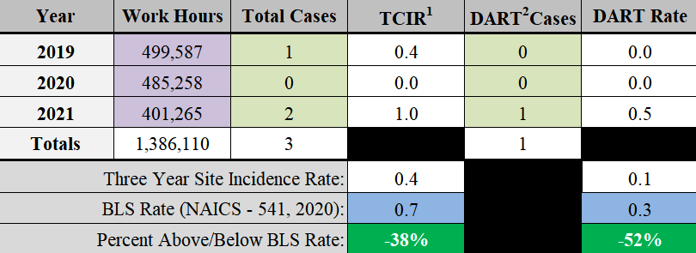
Injury & Illness Incidence Rate Calculations
Compare calculated rates against the published industry averages
Summarize the data
Image created by the DoD SMCX
Notes:
In order to compare your rates against the industry average, you need to know the industry average rates. Follow the steps in the SMCX Guide, “Calculating Injury and Illness Incidence Rates” to find your way through the BLS website and look up your industry average.
It is important to realize the BLS does not always have enough data to publish the full 6-digit NAICS code. Try to match the entire 6-digit NAICS code for your industry. If you can’t match all 6 digits, match 5. If you can’t match 5, match 4, and so on.
Image created by the DoD SMCX.

Slide 20
Conclusion
In this presentation, you learned to:
  Summarize the background and importance of occupational injury and illness recordkeeping
  List recordkeeping-related documentation
  Describe the knowledge leadership/management, key personnel, and the workforce should have regarding occupational injury and illness recordkeeping
  Identify recordkeeping actions to implement and sustain OSHA VPP

