Slide 1
Introduction to OSHA VPP
OSHA VPP
May 2024
Distribution limited to the DoD and U.S. DoD contractors only; May 1, 2024.
Jan 2024
Notes:
This presentation provides an overview of the Occupational Safety and Health Administration (OSHA) Voluntary Protection Programs (VPP). It covers the importance of VPP in the Department of Defense (DoD), details related to OSHA VPP implementation and benefits, and key points for successfully implementing OSHA VPP criteria at your organization.

Slide 2
Objectives
In this presentation, you will learn to:
Describe the OSHA VPP
Differentiate two levels of VPP approval (Star and Merit)
Explain the importance of OSHA VPP within the DoD
Describe the types of personnel contributing to VPP
State and describe the four elements of OSHA VPP
List the benefits of implementing OSHA VPP criteria
Discuss key points to VPP success
Notes:
This presentation is beneficial to organizations thinking about or starting to implement OSHA VPP criteria, safety and health (S&H) professionals, organizational leaders wanting an overview of VPP, and others assigned as VPP implementation leads (e.g., VPP Program Managers).

Slide 3
What is OSHA VPP?
Performance-based SMS criteria, including several MRs
Combined effort between OSHA, management, and labor to continually improve S&H
Collaborative effort among all employees to create a safe and healthful work environment
In 1982, OSHA developed VPP to recognize and promote effective worksite-based SMSs
Image retrieved from OSHA
Notes:
SMS = safety management system
MRs = minimum requirements
On July 2, 1982, OSHA established VPP to formally recognize and promote effective worksite-based SMSs. Congress gives OSHA the authority for VPP through Section (2)(b)(1) of the OSH Act. See more information at: https://www.osha.gov/pls/oshaweb/owadisp.show_document?p_table=OSHACT&p_id=3356.
The VPP implementation process requires you to compare your SMS against the requirements listed in OSHA Instruction: Cooperative State Programs (CSP) 03-01-005, VPP Policies and Procedures Manual, including the MRs. OSHA, management, and labor work together to make sure your SMS is in place and effective. Implementing an SMS helps your organization take the focus off the safety office - everyone has a part in VPP! The collaborative effort helps everyone contribute to creating and sustaining a safe and healthful work environment.
You can find more information about VPP criteria in the CSP 03-01-005, VPP Policies, and Procedures Manual, at: https://www.osha.gov/enforcement/directives/csp-03-01-005.
The image shows a VPP flag OSHA presents when they formally recognize an organization’s SMS. Image retrieved from OSHA at: https://www.osha.gov/dcsp/vpp/newflag.html.

Slide 4
OSHA VPP Approval
Star
Merit
Highest level of approval
All VPP elements/sub-elements in place for one year
Injury and illness rates below the industry average
Recertified every 3–5 years
Working toward Star approval
Some VPP elements/sub-elements not in place
Injury and illness rates above the industry average
Sets a time limit to achieve Star approval within 3 years
Notes:
Merit status: A temporary state of formal OSHA VPP approval.
Your organization cannot apply for OSHA VPP with the expectation to receive and maintain Merit status; the intent of OSHA VPP is to continuously improve your SMS and achieve Star approval. If you achieve Merit status because you have injury and illness incidence rates above the industry average, you must create a rate reduction/accident prevention plan to reduce your rates below your industry average within two years.

Slide 5
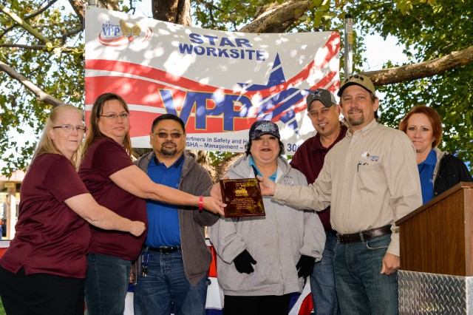
Requirements for OSHA VPP Approval
Annual SMS self-evaluation
DASHO notification
VPP application
Initial OSHA on-site evaluation
Formal OSHA approval
Recertification every 3–5 years
Image courtesy of Hill Air Force Base 309 EMXG
Notes:
DASHO = Designated Agency Safety and Health Official
OSHA VPP has several requirements in place to receive formal approval. First, you need to complete an annual SMS self-evaluation using OSHA’s format. View the format at: https://www.osha.gov/dcsp/vpp/site_based_report.html. You need to complete at least one self-evaluation before you submit a VPP application to OSHA.
Any federal worksite must notify their DASHO of their intent to apply for VPP Star approval before submitting an OSHA VPP application.
Once you apply for VPP Star approval, OSHA schedules an on-site evaluation so they can assess the effectiveness of your SMS. Following this evaluation, they will determine whether they will recommend your site for formal approval. Any MRs rated as a “No” could prevent OSHA from granting your site formal VPP Star approval after an on-site evaluation.
If approved, OSHA expects your worksite to sustain and continually improve your SMS. They will perform another on-site evaluation to reapprove your worksite in a 3–5-year timeframe.
The image shows Hill Air Force Base’s 309th Electronics Maintenance Group (EMXG) celebrating after receiving official VPP Star approval from OSHA. Image courtesy of Hill Air Force Base’s 309th EMXG.

Slide 6
OSHA VPP in the DoD
“Preventable injuries and illnesses cost the DoD an estimated $10 to $21 billion annually” – National Safety Council
“Our goal is zero preventable accidents, and I remain fully committed to achieving the 75% accident reduction target in 2008” – Secretary of Defense, 2007
“All DoD sites to implement an SMS” – DoDI 6055.01, 2014
Image retrieved from DoDI 6055.01
Notes:
DoDI = Department of Defense Instruction
Due to the high costs of injuries and illnesses in the DoD, the Secretary of Defense established a goal to reduce DoD injuries and illnesses in 2007. While this goal has been modified several times, the DoD has not yet accomplished this goal and continues to focus on reducing their injuries and illnesses.
One way to reduce injuries and illnesses is to implement an SMS. DoDI 6055.01 requires all sites under their jurisdiction to implement an SMS. View the DoDI at: https://www.esd.whs.mil/Portals/54/Documents/DD/issuances/dodi/605501p.pdf?ver=2018-11-19-110543-180.
For an overview of the VPP process for federal worksites, visit: https://www.osha.gov/dcsp/vpp/vppflyer.html.
Image retrieved from DoDI 6055.01.

Slide 7
OSHA VPP Star Sites in the DoD
Images created by the DoD SMCX, data as of May 1, 2024
Notes:
Many sites in the DoD choose to receive formal OSHA VPP approval to support the DoDI 6055.01 requirement for implementing an SMS.
The images show the OSHA VPP status for all Services in the DoD.
Keep in mind, not every DoD site chooses to implement OSHA VPP; several Services have their own Service-specific SMS in place or use another recognized SMS model. For additional information on SMS in the DoD, visit: https://smscx.org/.
Images created by the DoD SMCX. Information retrieved from the SMCX e-SMS Tool on May 1, 2024.

Slide 8
OSHA VPP Involvement
Stakeholders
Command Leadership Senior Leaders Union Leaders/Representatives Supervisors Employees Contracting Officer(s) Human Resources Staff Public Affairs Representatives Budget and Resourcing Staff | Safety Professionals Occupational Health Professionals Industrial Hygienists Hazard Control Program Managers Emergency Managers Fire Chief Maintenance Staff OSHA Recordkeeper Training Managers and Instructors
Notes:
Many sites rely on their S&H professionals to execute S&H responsibilities. As you move from a S&H program to an SMS, your S&H professionals can help guide the efforts of your entire team, which includes all levels of employees and managers. In an SMS, while the S&H professionals are the experts, they serve as consultants to help your workforce understand their S&H roles, responsibilities, and expectations so everyone contributes to a safe and healthful work environment.
The table on the slide lists many of the key personnel who hold some level of responsibility for implementing the OSHA VPP criteria. This list is not all-inclusive.

Slide 9
OSHA VPP Elements
Management Leadership & Employee Involvement
Worksite Analysis
Hazard Prevention & Control
Safety & Health Training
Notes:
This slide shows the four main elements of OSHA VPP. The following slides will discuss each in more detail.

Slide 10
Management Leadership & Employee Involvement
Committing to and communicating an effective SMS strategy, with employee involvement
Image retrieved from Bing Images
Notes:
It is important to have both leaders and employees involved in safety and VPP because it demonstrates commitment from all levels.
The image represents a manager and employee coming to a cooperative agreement to better workplace S&H. Image retrieved from Bing Images (Creative Commons).

Slide 11
Management Leadership & Employee Involvement
Sub-Element | Overview
Written SMS | Establishes an overarching written SMS based on the size and complexity of the organization
Management Commitment & Leadership | Describes visible leadership by management and the development of S&H goals and objectives
Planning | Details the planning and integrating of S&H within the organization
Authority & Line Accountability | Establishes S&H authority and responsibilities, as well as the system of accountability for S&H
Contract Employees | Lays out requirements for the oversight and management of S&H for on-site contractors
Employee Involvement | Provides opportunities for employee involvement and encourages employees at all levels to participate in the SMS in at least three meaningful ways
Notes:
Your written SMS is comprised of your S&H compliance programs and written rules, processes, and procedures, to include processes geared towards meeting the requirements of OSHA VPP.
Leaders must show commitment to the SMS and S&H excellence, not only through policy development, providing resources, or drafting goals and objectives, but also by visibly demonstrating their commitment. This can include asking employees around your organization if there are any issues they can resolve, or even participating in S&H activities, when possible.
Provide and direct adequate resources (e.g., time, funding, training, personnel) to those responsible for S&H so they can effectively carry out their responsibilities.
Integrate S&H into all aspects of planning (e.g., planning for new equipment, processes, buildings). Thinking about S&H from the beginning can reduce a lot of rework in the future. When you create a budget, plan for typical and unusual/emergency S&H expenditures, including funding for prompt correction of uncontrolled hazards.
Assign adequate authority to persons responsible for S&H so they are able to carry out their responsibilities. If everyone knows they have the authority to do their jobs, other employees are more likely to listen or help out. Hold persons accountable for meeting their S&H responsibilities. You can do this through a documented performance system and job descriptions.
Contractors need to follow your S&H policy. As a VPP participant, you must have a documented oversight and management system covering applicable contractors. Provide contract employees with S&H protection equal in quality to that provided to employees.
Involve employees in your SMS in at least three meaningful ways (in addition to their employee rights and responsibilities under the OSH Act). Some examples of employee involvement can include: participating in self-inspections, contributing to hazard analyses of routine tasks, involvement in safety committees, and providing S&H suggestions.

Slide 12
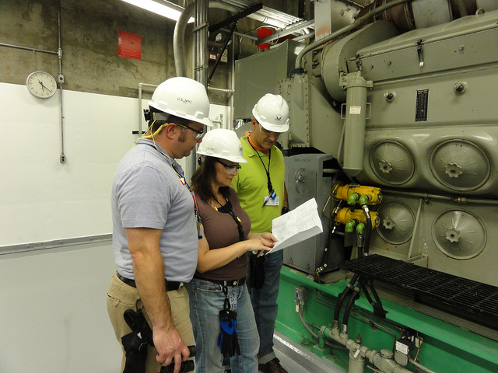
Worksite Analysis
Identifying and assessing S&H hazards
Image retrieved from Bing Images
Notes:
All employees have the right to a safe and healthful workplace, so it is important to be familiar and understand any S&H hazards in their work areas. In addition, train all employees so they are able to identify those S&H hazards.
The image shows several workers conducting an inspection on machinery prior to the start of work. Image retrieved from Bing Images (free to use and share license) at: https://www.flickr.com/photos/nrcgov/7741187290.

Slide 13
Worksite Analysis
Sub-Element | Overview
Baseline Hazard Analysis | Identifies and analyzes the workplace for S&H hazards and their associated controls
Hazard Analysis of Significant Changes | Identifies and analyzes S&H hazards due to changes in the organization and for any non-routine tasks
Hazard Analysis of Routine Activities | Identifies and analyzes S&H hazards for routine tasks, jobs, or processes
Routine Inspections | Establishes a routine inspection system of work areas in order to identify S&H hazards
Hazard Reporting | Lays out the process to report hazards to appropriate management or key personnel
Hazard Tracking | Tracks identified S&H hazards to closure and provides feedback to employees
Accident/Incident Investigation | Sets the incident investigation process, including both mishaps and near-misses
Trend Analysis | Analyzes S&H data to identify and combat workplace S&H trends
Notes:
A baseline hazard analysis identifies and documents all S&H hazards. You do not need to conduct the original baseline again unless there are workplace changes (e.g., processes, equipment, hazard controls), but it’s a good idea to review it at least annually to make sure the hazards haven’t changed. Be sure to analyze routine activities and significant changes too.
Conduct hazard analyses on routine jobs, tasks, and processes with: written procedures, injuries, illnesses, near-misses, as well as those perceived as high hazard tasks, required by regulation, and any other areas you decide is warranted. Examples of significant changes include non-routine tasks, and new or modified processes, materials, equipment, and facilities.
Review your routine inspection process. Determine how often these need done, who performs them, how the results are documented, and what is done with the results. Cover the entire worksite quarterly.
Provide employees who report a hazard with timely and appropriate responses. Let them know the progress of identifying the hazard, or why you choose not to do something they suggested. Use a hazard tracking log to track all hazards to completion.
During mishap and near-miss investigations, review who investigates each incident, determine the process for documenting findings, identify all contributing factors, and communicate pertinent information to employees. Review the details of the incident with employees, tell them what could have been different to prevent the accident, and what they can do moving forward.
Trend S&H data (e.g., injuries and illnesses, inspection findings, near-misses, employee reported hazards, and OSHA Form 300 information) to identify areas of improvement and develop S&H goals and objectives.

Slide 14
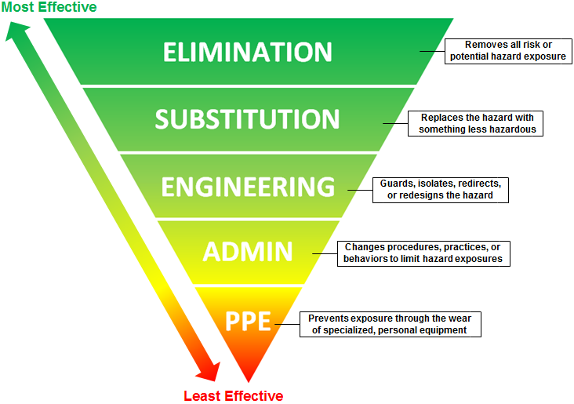
Hazard Prevention & Control
Selecting and assessing controls for identified S&H hazards
Image created by the DoD SMCX
Notes:
PPE = personal protective equipment
Hazard prevention and control makes sure you are addressing all the hazards you identify during worksite analysis. You want to make sure you quickly abate or control these hazards and continually prevent them from harming your workforce.
The image shows the hierarchy of control methods, prioritizing elimination and substitution of a hazard over lesser control methods, such as PPE and administrative control. Image created by the DoD SMCX.

Slide 15
Hazard Prevention & Control
Sub-Element | Overview
Hazard Prevention & Control | Describes the hierarchy of controls to eliminate or control identified S&H hazards
Disciplinary System | Sets the disciplinary system for violations of S&H policies, procedures, and rules
Emergency Preparedness | Establishes written procedures for emergency situations and exercises
Preventative/Predictive Maintenance | Requires preventive and predictive maintenance components to monitor and maintain workplace facilities and equipment
Personal Protective Equipment | Selects PPE when necessary and reinforces OSHA requirements for using and maintaining PPE, to include training requirements
Occupational Health Care Program | Provides preventive and health care services for personnel, to include medical surveillance, pre-employment physicals, and hazard recognition
Recordkeeping | Reinforces recordkeeping requirements for work-related injuries and illnesses; including recordkeeping accuracy and recordkeeper training
Notes:
Implement hazard controls using the hierarchy of controls. Ensure the elected controls protect the employees from exposure to S&H hazards. Implement follow-up studies to evaluate the effectiveness of implemented controls.
Update your emergency procedures when you have changes to egress routes or auditory systems. Involve employees in at least one evacuation drill annually.
Select PPE to address the hazards too. Be familiar with the PPE used and ensure PPE is adequate. Train employees to understand the proper use, maintenance, storage, or disposal of all PPE.
Complete and maintain any injury or illness documents. OSHA 29 CFR 1904 provides recordkeeping requirements. OSHA requires you to maintain records for five (5) years; however, for VPP purposes, the evaluators review three (3) years of data. Ensure the recordkeeper is trained on recordkeeping requirements and regulations.

Slide 16
Safety & Health Training
Training all levels of employees on the SMS and supporting
S&H programs
Image retrieved from Bing Images
Notes:
If you are pursuing OSHA VPP Star approval, you must assess your training process, understand your process for conducting, documenting, tracking, and evaluating the effectiveness of training, and understand VPP training sub-elements.
The image illustrates instruction occurring during an in-classroom training session. Image retrieved from Bing Images (free to share and use license): https://upload.wikimedia.org/wikipedia/commons/7/74/US_Navy_090617-N-9610C-029_Chad_Stober%2C_an_instructor_at_John_C._Stennis_University_%2C_center%2C_teaches_students_Japanese_in_a_training_classroom_aboard_the_Nimitz-class_aircraft_carrier_USS_John_C._Stennis_%28CVN_74%29.jpg.

Slide 17
Safety & Health Training
Sub-Element | Overview
S&H Training | Educates all levels of employees on hazards and associated controls Uses qualified instructors Helps managers, supervisors, and employees understand their S&H roles and responsibilities Develops and implements a new employee orientation Documents training attendance Evaluates training for retention and effectiveness Reviews and updates training criteria
Image retrieved from Bing Images
Notes:
Train managers, supervisors, non-supervisory employees, and contractors on workplace hazards, recognizing hazardous conditions, signs and symptoms of workplace-related illnesses, safe work procedures, and emergency procedures. Update training information when there are any changes to procedures or policies.
Managers and supervisors must understand their S&H responsibilities. Many times, this includes some level of S&H training.
New employee orientation/training must include, at a minimum, worksite hazards, protective measures, emergency evacuation procedures, employee rights and responsibilities under the OSH Act and 29 CFR 1960.10.
Document all training, including: attendance, date, and trainer name.
Training curricula must be up-to-date, specific to your worksite operations, and modified, when needed, to reflect changes and/or new workplace procedures, trends, hazards and controls identified by hazard analysis. Employees must be able to understand all training information.
Employee should always be trained on the hazards they’re exposed to and the methods to controls the hazards.

Slide 18
OSHA VPP Benefits
Increased understanding of S&H requirements and expectations
Fewer injuries and illnesses and associated costs
Improved lines of communication
Improved employee morale and productivity
Removal from OSHA’s targeted inspection list
Image retrieved from Microsoft Clip Art
Notes:
Targeted inspection: A planned OSHA inspection, targeting specific industries due to high injury and illness incidence rates, or severe violators.
OSHA expects you will experience several benefits as you implement OSHA VPP criteria.
First, there is generally an increased understanding of S&H requirements and expectations among your entire workforce. S&H training and communication contribute to this benefit.
Then, as everyone begins to take ownership of S&H, they usually become more aware of their surroundings and identify hazards so you can correct them quicker. This generally leads to fewer injuries and illnesses; thus, better injury and illness incidence rates, less costs associated with medical treatment and workers’ compensation, and reduces missed workdays and job restrictions and transfers.
Next, improved lines of communication make employees feel as if their opinion and contribution matters. Employee involvement and a hazard reporting and feedback system contribute to this benefit.
Finally, as you continually improve your SMS, employees typically have higher morale and productivity because they helped build what is in place.
OSHA removes VPP Star sites from random compliance inspections. Visit OSHA Enforcement for additional information on targeted inspections: https://www.osha.gov/dep/.
Image retrieved from Microsoft Clip Art.

Slide 19
Keys to VPP Success
Look at S&H in a different way:
It is not a program, it is a core value
It is not just meeting requirements—it is eliminating hazards
“We don’t do it until we can do it safely!”
Image retrieved from Microsoft Clip Art
Notes:
Most employees look at VPP as another task or program. It is important you communicate VPP is formal approval of your SMS, comprised of all your organization’s S&H policies, programs, procedures and processes.
Image retrieved from Microsoft Clip Art.

Slide 20
Keys to VPP Success
Gain management commitment to workplace S&H
Establish a framework, rather than a “to do list”
Drive organizational culture change
Commit to continuous improvement
Image retrieved from Microsoft Clip Art
Notes:
Management commitment to VPP demonstrates the importance of VPP and encourages continuous improvement. An SMS is a framework to help you direct and control resources to manage safety. Ensure all levels of employees are on board and take on the S&H program as their own.
Image retrieved from Microsoft Clip Art.

Slide 21
Keys to VPP Success
Involve workers in all S&H programs and SMS
Gain union support
Empower everyone to see, report, act
Promote a positive safety culture
Image retrieved from Microsoft Clip Art
Notes:
Employee involvement encourages employees to take ownership of the S&H program. Union support can be beneficial for motivating employees to become involved in your S&H program and promote the importance to continually improve S&H.
Encourage all employees to recognize hazards or hazardous conditions—they offer a new set of eyes and different perspectives.
The safety culture is important in creating a supportive atmosphere to foster safety as a core value. Encourage high standards of safety performance.
Image retrieved from Microsoft Clip Art.

Slide 22
Conclusion
In this presentation, you learned to:
Describe the OSHA VPP
Differentiate two levels of VPP approval (Star and Merit)
Explain the importance of OSHA VPP within the DoD
Describe the types of personnel contributing to VPP
State and describe the four elements of OSHA VPP
List the benefits of implementing OSHA VPP criteria
Discuss key points to VPP success

