Slide 1
Industrial Hygiene Procedures and Safety Management System Assessments

Slide 2
Purpose of the Webinar
Familiarize Safety Management System (SMS) assessors with common Industrial Hygiene (IH) procedures to focus on during the assessment process
Describe IH data management systems and how sites utilize to meet SMS requirements
Inform on how IH procedures and surveys apply directly to SMS assessment criteria
Review common IH-related shops and hazards to be aware of while conducting SMS assessments
Notes:
Please reference the Back Up Information, attached to the webinar, starting on slide 19, for a more detailed explanation of Safety Management System requirements and IH specific sub elements pertaining to Industrial Hygiene/Health hazards.

Slide 3
Typical IH Procedures
General Worksite Information
Individual Process/Task Information
Chemical Information
Data Evaluation

Slide 4
Data Management System – DOEHRS
Defense Occupational and Environmental Health Readiness System (DOEHRS)
Developed to address unexplainable illnesses suffered by military personnel
Available for use by all branches of the military
A system to record longitudinal exposure records of Department of Defense (DoD) employees, for occupational hazards
Assembles, compares, evaluates, and stores:
IH surveillance data,
Occupational hazard information,
Personnel exposure information,
Workplace IH monitoring/sampling data, and
Hazard control usage data
Notes:
This is just one data management system available for the ease of tracking and recording IH survey data. For our intents and purposes we will base our data collection procedures on the use of DOEHRS.

Slide 5
General Worksite Information
Ensure all necessary data is collected:
Workplace Information
Point of Contact
Shop Description
Shop Prioritization Categorization
Observations and Notes

Slide 6
General Worksite Information
Notes:
Elaborate Workplace Information and Point of Contact.
Shop Description: What does the shop do? What are they responsible for? What processes occur? What hazards exist that a person entering should be aware of?
Prioritization: Check the Selection Criteria (DA PAM 40-503), Determines the frequency of follow-up visits and helps to develop a sampling strategy - High (1) = Annual (e.g. RAC = 1 or 2, OSHA Expanded Standard, exposure levels recently above action levels); Medium (2) = Biannual (e.g. RAC = 3, annual audiograms, routine ventilation surveys); Low (3) Triennial (e.g. RAC = 4 or 5, simple administration duties, no or negligible health risk)
Observations and Notes: Record shop deficiencies, recommended corrective actions, standards not being met. Record all shop contact.

Slide 7
Individual Process/Task Information
Ensure all necessary data is collected:
Workplace Information
Process Information
Process Personnel
Hazards and Hazard Source
Hierarchy of Hazard Controls

Slide 8
Individual Process/Task Information
Notes:
Again, Workplace Information
Process Information: DOEHRS Terminology – Process Category, Common Process, Methods Used
Ex. Industrial – Laboratory Ops. – Analysis, Chemical
Ex. Administrative – Administrative – Paper Shredding
Duration and Frequency
Process Personnel: Name and Last 4 of SSN, or DOB. It is critical to link personnel to process exposures.
Process Description: How is the process completed from start to finish? What chemicals are used? How and when are they introduced? Does any equipment used introduce hazards? What hazards are employees exposed to and what is used to control them?
Hazards and Hazard Sources: Record all hazards found and what causes those hazards.
Hierarchy of Hazard Controls: What engineering, administrative, and PPE controls are in place for employees? Are they used? Are they adequate? Is there a deficiency in control use or hierarchy implementation (observations and notes)?

Slide 9
Chemical Information
Ensure all necessary data is collected:
Workplace Information
Product Information
Ingredient Information
Exposure Routes

Slide 10
Chemical Information
Notes:
Again, Workplace Information
Product Information: Process used in, product name/manufacturer, NSN/LPN, amount used. This information is easily obtainable from shop SDS books, chemical lockers, and flammable storage cabinets. Remember though, that a book may be out of date or missing SDSs, always perform your own chemical inventory, as well.
Ingredient Information: Name of each chemical component, CAS number of each ingredient, and the percentage of each ingredient in the chemical. (Found in SDSs)
Exposure Routes: Using the NIOSH Pocket Guide, an IH can find exposure route information on the ingredients in the chemical. Not all ingredients are located in the pocket guide, but SDS information will also state the exposure routes of the chemicals as a whole.

Slide 11
Data Evaluation
Once the shop visit is completed and all data is collected:
Ensure all necessary data was collected
Review data to ensure accuracy
Summarize the findings
Enter data collected into the IH tracking system
Update existing shop/process information
Create a new shop/process (as needed)

Slide 12
Data Evaluation Conclusion
Determine the need for additional IH surveys or sampling
Based on prioritization and the hazards found present, do you need to conduct:
Noise source surveys
Personal noise dosimetry
Passive or active air sampling
Swipe sampling
Ventilation system surveys?

Slide 13
DOEHRS – SMS Assessment Relevance
Why is an understanding of a Data Management System important to SMS Assessors?
SMS Sub Element – Baseline Hazard Analysis
Baseline Industrial Hygiene
Industrial Hygiene Tracking and Reporting
Baseline Industrial Hygiene
DOEHRS, if fully implemented, helps satisfy these SMS IH Process requirements
Notes:
Why is an understanding of DOEHRS important to SMS Assessors?
SMS Sub Element - Baseline Hazard Analysis - Baseline Industrial Hygiene
Ensure a baseline Industrial Hygiene (IH) study has been completed, including chemical inventory, review of previously reported hazards, trends, and illnesses, to identify and quantify employee exposures to typical health hazards such as noise, chemical exposure, dust, etc....
SMS Sub Element - Baseline Hazard Analysis - Industrial Hygiene Tracking and Reporting
A process to record, track, and report IH data has been developed which includes all information (i.e. sampling time, date, employee, job title, concentrated measures, and calculations) to assist the site in future IH sampling efforts.
Industrial hygiene records and reports are maintained as required.
SMS Sub Element - Baseline Hazard Analysis - Baseline Industrial Hygiene
Does the site have a documented sampling strategy used to identify health hazards and assess employees’ exposure (including duration, route, and frequency of exposure), and the number of exposed employees?
DOEHRS, if fully implemented, helps satisfy these SMS IH Process requirements
*** Reference Back Up slides 29, 30, & 31 for SMS critical information pertaining to Industrial Hygiene and conducting SMS assessments.

Slide 14
DOEHRS – SMS Assessment Relevance
DOEHRS provides a database to associate personnel to:
Similar Exposure Groups (SEGs)
Potential IH/safety hazards and controls
Master Schedule for IH sampling/surveys
Recurring Sampling Alerts and Notifications
Digital sample logs
Notes:
DOEHRS Provides a database to associate data to personnel:
Job processes or tasks (SEGs)
Potential IH/Safety hazards and controls
Engineering – Ventilation
Administrative – Trainings, SOPs, Work/Rest Cycles, etc…
PPEs utilized
Establish a Master Schedule for IH sampling/surveys
Sampling type
Associated SEGs
Associated hazards and controls
Digital Sample log
Sample ID
Sampling Time
Sampling Volume
Source of Contaminants
Analytical Methods
Compare Results to OELs
Calculate Time Weighted Averages

Slide 15
DOEHRS – SMS Assessment Relevance
Ventilation Systems
Associated with specific hazards
Track past/historical IH surveys
Record IH survey results
Determine adequacy to recommended standards
Respiratory Protection Programs
Identify potential Ergonomic Concerns
Chemical Inventory Lists
Notes:
Ventilation Systems Used
Associated with specific hazards
Track past/historical IH surveys
Record IH survey results
Determine adequacy to recommended standards
Respiratory Protection Programs
Identify potential Ergonomic Concerns
Chemical Inventory Lists
Associated potentially hazardous chemicals to specific processes

Slide 16
Common IH Shops and Hazards
Shop | Common Hazards
Vehicle maintenance | Chemicals (oils, greases, lubricants, chemical compounds) Noise (use of pneumatic tools, electric tools, hand tools; cooling fans, ventilation systems, personal radios) Carbon monoxide (forklifts, vehicles operating indoors) Ceramic fibers/asbestos (brake change operations) Silica (blasting booths/rooms) Hydrogen/sulfuric acids (charging and maintaining lead acid batteries, build-up of hydrogen gas)
Electronics repair | Chemicals (isopropyl alcohol, soldering flux – formaldehydes, acetaldehydes, acetone, abietic acids) Metals (solders – lead, tin, silver) Radio frequency (antennas)
Laboratories | Noise (ventilation hoods, equipment – centrifuges, mixers/shakers) Bloodborne pathogens (needlesticks) Steam/hot objects (sterilization units) Chemicals (solvents, acids, bases – adverse chemical reactions, storage concerns, chemical spills)

Slide 17
Presenters
For more information, visit https://vppcx.org/ or contact one of the presenters:
Eric Gray
graye@ctc.com
(904) 486-4003
Brandon Hody
hodyb@ctc.com
(814) 269-6461
John Youngblood
youngblj@ctc.com
(814)248-7727

Slide 18
QUESTIONS

Slide 19
Backup Information

Slide 20
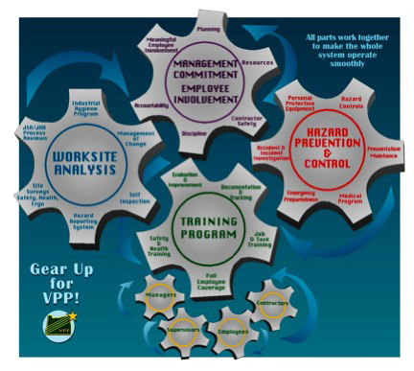
Brief SMS Explanation
VPP = Voluntary Protection Programs
Aligns with policy, regulation, and SOH Strategic Plan
VPP compares the existing site safety & health management system against “best in class” criteria
Four Elements of VPP
Management Leadership & Employee Involvement
Worksite Analysis
Hazard Prevention & Control
Safety & Health Training

Slide 21
Brief SMS Explanation
The Department of Defense (DoD) Safety Management Center of Excellence (SMCX) historically focused on VPP, but are experts in the evaluation of other SMS:
Governing Organization | SMS
Occupational Safety and Health Administration (OSHA) | Voluntary Protection Programs (VPP)
American National Standards Institute (ANSI) | Z-10, Occupational Safety & Health Management Standard
Occupational Health and Safety Assessment Series (OHSAS) | 18000, Health & Safety Management Systems

Slide 22
SMCX SMS Assessment Explained
Four Elements = 81 sub-elements evaluated
Plan-Do-Check-Act Model and the 3-P Process
Paper (document reviews)
People (interviews)
Places (site walkthroughs and observations)
Three Stages of Maturity
Stage 1 = Decide and Develop
Stage 2 = Implement and Execute
Stage 3 = Evaluate and Improve
Each Action Assessed
Red = No Action Taken
Yellow = In Progress
Green = Complete

Slide 23
On–Site Assessments & Team Composition
Team composition will vary based on:
Size/complexity of worksite
The processes and jobs performed
The potential risks and hazards which may be encountered
A DoD team may include:
Team Lead (knowledgeable in VPP/SMS)
Subject matter experts (SMEs):
Safety (0018 or highly qualified USR)
Occupational Health
Public Health
Ergonomics
Fire
Environmental
Industrial Hygiene/Bioenvironmental
Employees
Union Representatives
Change Managers
Definition – Evaluation Team:
An interdisciplinary group of professionals and sometimes other employees who conduct onsite evaluations. The team normally consists of a team leader, a back-up team leader, safety and health specialists, other specialists as appropriate, management and employees.

Slide 24
DOD IH Regulations and Government References
United States Army
The Army Industrial Hygiene Program – Department of Army Pamphlet 40-503
United States Air Force
Departmental AF 48 Series Publications pertaining to Bioenvironmental Engineering
United States Navy/Marine Corps
Navy Bureau of Medicine and Surgery (BUMED) Environmental Quality Programs

Slide 25
SMS Elements Relating to Industrial Hygiene

Slide 26
Management Leadership & Employee Involvement
Management Commitment to Safety & Health Protection – Planning
Does the site have an effective, documented process to ensure safety and health is routinely integrated in all the site's planning processes? | Review written procedures in the site’s safety and health plan: Do they have procedures in place to perform hazard analysis? Does command consult the Safety, IH, Occupational Health, etc. before making critical decisions which may pose a health risk to employees? Are safety/IH training initiatives adequately funded? Is PPE available when needed? The interview process is critical to verify these elements: Do employees know who the Safety/IH staff are and how to contact them? Has the Safety/IH staff been actively involved in the workplace?
Do employees have access to safety professionals, industrial hygienists, occupational health/medical facilities and personnel, and other needed professionals such as engineers? (contractors, in-house staff, etc.)

Slide 27
Management Leadership & Employee Involvement
Management Commitment to Safety & Health Protection – Planning
Are required inspections and IH surveys/sampling being done as required? | Review past inspection results Review past IH surveys Interview employees if they have participated in any IH sampling/surveys in the past
Is assigned training being completed in a timely manner? | Review training completion records During interviews, ask employees about previous trainings: Hazard Communication (HAZCOM) Bloodborne Pathogens Radiation Safety Respiratory Protection Workplace hazard identification and controls PPE use, limitation, and maintenance

Slide 28
Management Leadership & Employee Involvement
Management Commitment to Safety & Health Protection – Planning
Do employees have the required PPE, are they utilizing it, and is it in good condition? | Be observant and notice PPE use during site walk about The location and condition of the PPE can tell us a lot Inquire about the extent of PPE training employees were provided
Are reported hazards being corrected in a timely manner? | Review the hazard control logs to ensure they are up to date Interview employees about reported hazards: Have they ever reported a hazard? Ensure they are receiving required feedback on corrective actions

Slide 29
Management Leadership & Employee Involvement
Employee Involvement – S&HMS Awareness
Are employees knowledgeable about the site's SMS? | Make sure employees know where to locate the site’s written safety program Ask them to describe the safety program Employees aren’t expected to know it verbatim, but should: Know their roles and responsibilities in the sites SMS Understand the site’s safety/IH goals
Can employees freely participate in the SMS without fear of reprisal or discrimination? | Verify through observations and employee interviews Make sure employees know there will be no repercussions for answering truthfully

Slide 30
Management Leadership & Employee Involvement
Employee Involvement – S&HMS Awareness
Do employees have access to results of self inspections, accident/incident investigations, pertinent medical records, IH sampling results, upon request? | Review past IH survey reports and self inspections During employee interviews ask: How were the employees informed of IH survey/ sampling results Did the IH who conducted the survey notify them or results? Do they understand why the IH surveys/ sampling were conducted?
Are employees knowledgeable about their OSHA rights and responsibilities? | Verify through employee interviews Ensure the OSHA rights poster (or DD 2272) are up to date, signed, and posted in common areas

Slide 31
Worksite Analysis
Baseline Hazard Analysis – Baseline Industrial Hygiene
Ensure a baseline Industrial Hygiene (IH) study has been completed, including chemical inventory, review of previously reported hazards, trends, and illnesses, to identify and quantify employee exposures to typical health hazards such as noise, chemical exposure, dust, etc. | Review past IH reports Interview the IH department about the baseline Who performed the baseline? Does the site utilize a database to maintain their IH data? Does the completed IH baseline includes ergonomics? Verify, through interviews, that all results were shared with affected employees Review the sites chemical Inventory list Is it comprehensive and up to date? Where is it located?

Slide 32
Worksite Analysis
Baseline Hazard Analysis – Baseline Industrial Hygiene
Does the site have a documented sampling strategy used to identify health hazards and assess employees’ exposure (including duration, route, and frequency of exposure), and the number of exposed employees? | Do sampling, testing, and analysis follow nationally recognized procedures? Does the site compare sampling results to the minimum exposure limits or follow more restrictive Occupational Exposure Limits? Review past IH reports Interview the IH department about the baseline Who performed the baseline? How were the results compared to consensus standards? OSHA - Permissible Exposure Limits ACGIH – Threshold Limit Values/Short Term Exposure Limits NIOSH – Recommended Exposure Limits Was there any overexposures recorded? Where is the IH data maintained?

Slide 33
Worksite Analysis

Slide 34
Worksite Analysis
Hazard Analysis of Routine Jobs –Tasks-Processes
Is there at least a minimally effective hazard identification and analysis system in place for routine operations and activities, which addresses both safety and health hazards? | Ensure non-supervisory employees are involved in the development and review of hazard analysis programs: Job Hazard Analysis (JHA) Job Safety Analysis (JSA) Composite Risk Management Worksheets Job Safety Training Outlines (JSTOs) Does the site incorporate risk analysis into Standard Operating Procedures or Training Manuals?

Slide 35
Worksite Analysis

Slide 36
Worksite Analysis

Slide 37
Worksite Analysis

Slide 38
Worksite Analysis

Slide 39
Hazard Prevention and Control

Slide 40
Hazard Prevention and Control

Slide 41
Hazard Prevention and Control

Slide 42
Safety and Health Training – Non S&H Employees

Slide 43
Safety and Health Training

Slide 44
Safety and Health Training – S&H staff

Slide 45
SMS Assessments - Summary

Slide 46
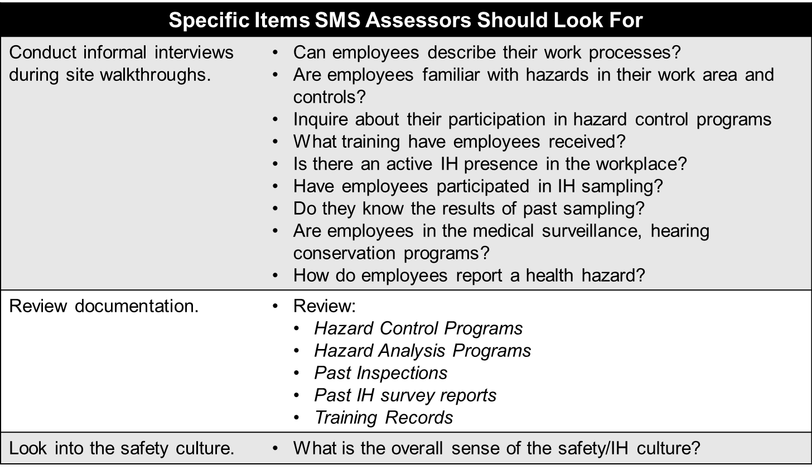
SMS Assessments - Summary

