Slide 1
Authority and Line Accountability
OSHA VPP
November 2020
Notes:
This presentation outlines authority and line accountability requirements for the purposes of Occupational Safety and Health Administration (OSHA) Voluntary Protection Programs (VPP) recognition.
The presentation provides information on the background and importance of authority and line accountability, required documentation, and the various levels of employee knowledge. It concludes with an action checklist and supplemental details to help with OSHA VPP implementation and sustainment efforts.

Slide 2
Objectives
In this presentation, you will learn to:
Summarize the background and importance of authority and line accountability
List authority and line accountability-related documentation
Describe the knowledge leadership/management, key personnel, and the workforce should have regarding authority and line accountability
Identify authority and line accountability actions to implement and sustain OSHA VPP
Notes:
This presentation is beneficial to safety and health (S&H) professionals, VPP representatives, leaders, and various levels of management and supervision.

Slide 3
Background & Importance
Included in the ML&EI criteria for VPP
Addresses top management’s ultimate responsibility for S&H
Identifies S&H responsibilities for all personnel
Assigns authority to responsible personnel
Dedicates adequate resources to fulfill responsibilities
Holds personnel accountable for their assigned responsibilities
Provides access to qualified S&H professionals
Notes:
ML&EI = Management Leadership and Employee Involvement
The authority and line accountability sub-element of VPP ensures just what its name implies, identifying those who have the authority to make S&H decisions and changes in the workplace. This sub-element also defines the S&H responsibilities held by all levels of personnel and checks the systems in place to hold personnel accountable for meeting those responsibilities.

Slide 4
Documentation
Organizational charts
S&H mission, vision, and policy statements
S&H program signatures page
Letters of designation
Job descriptions outlining S&H responsibilities
Performance appraisals considering S&H
S&H budget and resource allocations
Image retrieved from Bing Images
Notes:
Make sure you provide completed examples of forms and documents to your assessment team. Don’t just show them blank forms! They want to see the documents you filled out to thoroughly assess the processes within your safety management system (SMS).
Organizational charts may include the structure of leadership/management, where safety falls within the organization, and the structure of the safety office, if applicable.
An organizational chart reflecting the hierarchy of safety office authority helps to justify access to qualified S&H professionals.
S&H resources may include budget, S&H professionals, dedicated safety representatives, allocated training time, S&H promotions/marketing/initiatives, hazard controls, and personal protective equipment (PPE) availability.
The image shows a hierarchy of authority in an organization. Image retrieved from Bing Images (free to share and use license) at: https://atabsh.files.wordpress.com/2011/09/organizational-structure.jpg

Slide 5
Leadership/Management Knowledge
Leaders and management should know about:
Their S&H roles and responsibilities
Who has S&H responsibilities
Authority given to those assigned S&H responsibilities
How they are held accountable for S&H
How they hold others accountable
Resources dedicated to ensure workplace S&H
Image retrieved from Bing Images
Notes:
Responsibility, without appropriate authority, to implement change often results in uncontrolled hazards or ineffective hazard controls. Issues may arise when top managers delegate authority to persons who lack sufficient power or resources to ensure an effective SMS. Sometimes, you may need letters of designation. For example, you may assign a first line supervisor responsibility for collecting self-safety inspections from all other first line supervisors and checking them for completeness. The other first line supervisors may indicate this first line supervisor has no rank or authority over them to ensure they complete their inspections; having a letter in place to show this authority becomes useful.
A common question for leaders and managers includes whether or not they have provided feedback for S&H performance during appraisals. When management failures occur in S&H, you need to reflect these failures somewhere to hold management personnel accountable. Ultimately, top management must accept responsibility for S&H in the organization, even if they delegate some S&H functions to others.
The image represents leadership discussing their S&H responsibilities. Image retrieved from Bing Images (free to share and use license) at: https://upload.wikimedia.org/wikipedia/commons/8/8c/Flickr_-_The_U.S._Army_-_Basic_combat_training_visit.jpg

Slide 6
Key Personnel Knowledge
Key personnel should be knowledgeable about:
Documentation outlining S&H responsibilities
How responsibilities are incorporated into performance appraisals
S&H budget and how it is determined
Training budget and training time allocations
Special funding for S&H initiatives
Availability of qualified S&H professionals
Notes:
S&H professional resources include: safety professionals, qualified industrial hygienists, and occupational health care professionals.
You do not have to “own” these personnel, meaning they do not have to be a direct part of your organization; “access” can defer to base safety and industrial hygiene offices or outside occupational health care facilities.
Key personnel may include:
Human resources
S&H training managers
Budget office
Industrial hygiene
Occupational health
S&H professionals
Recordkeepers
Union steward

Slide 7
Workforce Knowledge
Employees should be knowledgeable about:
Their S&H roles and responsibilities
Who is ultimately responsible for S&H in the organization
How they are held accountable for their roles and responsibilities
Availability of S&H assistance, training, and resources
S&H-related items in their performance appraisals, if applicable
How to be involved in the SMS
Image retrieved from Bing Images
Notes:
Employees do not need to know what the S&H budget is or how it is determined, but should have the basic understanding of the resources available to them. Employees provide valuable information on identifying and determining types and quantities of needed resources, such as S&H training, personal protective equipment, and S&H subject matter expertise.
A common misconception is the safety professional(s) is ultimately responsible for S&H, rather than top leadership. It is important employees understand the head of the organization is responsible for ensuring their S&H at work.
The image represents a group of employees and their willingness to contribute.
Image retrieved from Bing Images (Creative Commons).

Slide 8
Action Checklist
Establish standards of S&H performance
Convey top leadership’s responsibility for S&H
Identify resources needed to achieve performance standards
Assign authority for responsibilities, if needed
Develop a performance measurement system
Apply measures and consequences for lack of accountability
Evaluate the accountability system
Notes:
Follow this action checklist to implement and sustain VPP expectations for authority and line accountability. Each of these action checklist items will be covered in more detail on the following slides.

Slide 9
Standards of Performance
Document S&H performance expectations through:
S&H mission, vision, and policy
Written S&H plans, programs, and procedures
S&H goals and objectives
Job descriptions
S&H rules
Be specific, descriptive, and clear in communicating performance standards
Image retrieved from Bing Images
Notes:
Document all assigned S&H responsibilities. Make sure these responsibilities are specific and clearly understood.
A job description may include a generic expectation for S&H performance, but you need to define each individual responsibility in some way.
Consider documenting these responsibilities in written programs, procedures, or policies, or other potential documents. For example, your safety self-inspection program may have language stating supervisors are responsible for ensuring the completion of inspections each quarter. When you incorporate these responsibilities into programs, communicate them directly to supervisors at the time they assume their position so they can carry out their expectations.
The image represents the need to document any responsibilities and safety performance standards.
Image retrieved from Bing Images (free to share and use license) at: https://pmtribe.files.wordpress.com/2011/03/responsibilities.gif

Slide 10
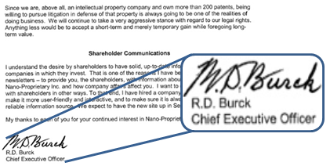
Leadership Responsibility
Top leadership must accept ultimate responsibility for workplace S&H:
Develop a S&H policy stating leadership’s responsibility
Approve and sign a written S&H program
Communicate LEADERSHIP’s S&H program – NOT the safety office’s
Set the example by following the rules
Image retrieved from Bing Images
Notes:
S&H professionals serve as subject matter experts to head the efforts in implementing the leadership’s S&H program, not the other way around. A documentation of your leadership’s commitment to S&H shows they accept ultimate responsibility.
In addition to documenting leadership’s ownership of the S&H program, it is best to communicate this information to the workforce, especially if your workplace has a misconception about it being the safety office’s program.
The image shows the CEO signature on a document. When the highest-ranking official signs a document in your organization, it demonstrates their commitment and highlights their responsibility.
Image retrieved from Bing Images (free to share and use license) at: http://farm1.staticflickr.com/145/353099637_8bbb99028a.jpg

Slide 11
Resources Needed to Achieve Standards
Analyze historical data to determine potential S&H needs
Identify resources needed to mitigate potential workplace hazards
Determine resources needed to maintain compliance or safe work conditions
Evaluate the need for more S&H professionals
Image retrieved from Bing Images
Notes:
If you are going to hold employees accountable to perform to standards, or meet responsibilities, you have the obligation to provide employees the resources needed to achieve them. Requirements and obligations include:
The Federal Program under 29 CFR 1960.7 (Financial Management) requires federal agencies to provide appropriate resources for a S&H program: https://www.osha.gov/laws-regs/regulations/standardnumber/1960/1960.7
The OSHA General Duty clause also details this obligation: https://www.osha.gov/pls/oshaweb/owadisp.show_document?p_table=OSHACT&p_id=3359
The images shows various S&H professionals working together. You may need additional subject matter experts to support your S&H program.
Image retrieved from Bing Images (free to share and use license) at: http://farm8.staticflickr.com/7677/17125926318_bdfe32ae37_z.jpg

Slide 12
Resources Needed to Achieve Standards
Estimate the time needed to fulfill S&H responsibilities
Anticipate emergency situations and expenses
Draft a S&H budget
Review annually for increases or decreases in budget needs
Image retrieved from Bing Images
Notes:
What resources are necessary? It depends on the task, but generally, provides employees:
Safe machinery and materials
Safe facilities and physical environments
S&H training and job-specific education
Standard operating procedures to complete tasks safely
Safe tools and equipment
PPE needs
The image shows PPE need for one type of job tasking. You may need different types of PPE depending on your work environment.
Image retrieved from Bing Images (Creative Commons).

Slide 13
Authority
Some employees cannot carry out responsibilities without authority
Review the best fits, by job title, for S&H responsibilities
Conflicts occur with people of the same position or job title
Create letters of designation, as needed
Have leadership communicate assigned authority
Image retrieved from Bing Images
Notes:
Think of a situation where an organization gives a supervisor a S&H responsibility and, as part of this responsibility, has to tell another supervisor what to do. This situation may create a conflict between the supervisors since they are of the same position and authority within their normal job duties.
The image shows a frustrated supervisor.
Image retrieved from Bing Images (Creative Commons).

Slide 14
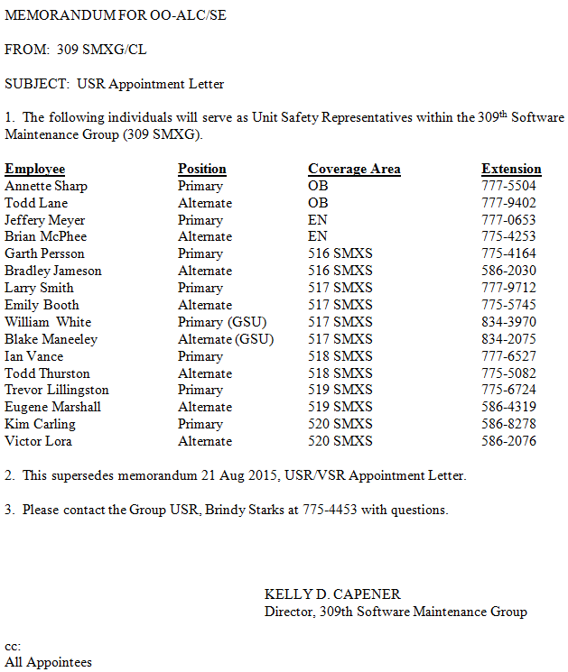
Example – Appointment Letter
Image courtesy of Hill AFB 309th SMXG
Notes:
Letters of designation appoint employees to positions, as needed, and provide their written authorities and limitations. Leadership signs these letters. Leaders and managers communicate this information to ensure all affected employees understand the authorities given to an individual(s).
The image shows an appointment letter for a new Unit Safety Representative at Hill Air Force Base (AFB); this letter is important to give the individual authority to carry out the actions delegated and assigned to them. Notice the letter is signed by the Director of the organization.
Image courtesy of Hill AFB 309th Software Maintenance Group (SMXG).

Slide 15
Performance Measurement System
Review current S&H responsibilities for all positions
Assign priorities to S&H responsibilities
Develop performance indicators for each responsibility
Identify how to collect performance indicator data
Review the current system for S&H criteria
Incorporate prioritized responsibilities into current system for each position
Notes:
OSHA uses workplace inspections and citations to measure your employer's safety performance. For more information on OSHA’s inspection process, please visit: https://www.osha.gov/dte/grant_materials/fy10/sh-20853-10/osha_inspections.pdf
Responsibility: Identify all S&H responsibilities a position holds. List all of those responsibilities individually.
Priority: Prioritize each responsibility in order, determining which responsibilities are most important. Weigh some responsibilities more than others when you evaluate performance.
Measurement: Develop performance indicators for each responsibility quantifying success. A performance indicator is how you measure whether or not an individual met their responsibility.
Method: Identify the way(s) to collect data and come up with the performance indicators. Identify who or how you will collect data to determine if someone has met a responsibility.
Incorporate: Review the current performance measurement system to determine what S&H criteria, if any, are included. Then, incorporate the prioritized responsibilities into the performance review. If there are several S&H responsibilities, ensure more than one performance criterion exists.

Slide 16
Accountability
Compare failures to performance standards and expectations
Expect consequences for failure to perform
Equitably apply consequences across all personnel, including leadership and management
Apply consequence to individual responsibilities, rather than an overall responsibility
No consequences = No accountability
Notes:
To be effective, accountability depends on clearly defined and enforced consequences. There should be consequences when personnel do not meet their S&H responsibilities. These consequences are often documented and sometimes included in performance appraisals.
Consequences for failing to meet S&H responsibilities must:
Be justified
Correspond to the degree of positive or negative results
Be applied consistently to all personnel
Before making derogatory marks in performance appraisals, investigate why the employee(s) did not meet the responsibility(ies). Hold personnel accountable for a responsibility only if they have control of the resources or the ability to fulfill the responsibility. If personnel are being measured and held accountable for meeting responsibilities they have no control over, they may attempt to gain control of those results somehow; these attempts may take the form of inappropriate behaviors. For example, if you measure a supervisor only on accident rates, they may threaten to terminate or retaliate against anyone who completes an OSHA injury report. Not only is the supervisor's behavior counterproductive, but it is illegal. It is a result, though, of an expectation for which they have little control.
To build a high level of trust between management and labor, apply consequences consistently at all levels of the organization. When management fails to meet a responsibility, hold them accountable just as an employee would.

Slide 17
Accountability System Evaluation
Evaluate the accountability system annually:
Are personnel meeting S&H responsibilities?
Are consequences applied when responsibilities are not met?
Are there any new S&H responsibilities not currently measured?
Were any standards difficult to measure?
Do any accountability policies, plans, procedures, or processes need to be modified?
Notes:
Evaluations can be done by safety professionals or a safety committee.
If there are potential weaknesses in your accountability system, take notes on the behaviors and conditions in the workplace possibly pointing to inadequate or missing accountability system policies, plans, processes, and procedures. Incorporate new performance standards, as needed, to correct S&H behaviors or meet other or new responsibilities.

Slide 18
Conclusion
In this presentation, you learned to:
Summarize the background and importance of authority and line accountability
List authority and line accountability-related documentation
Describe the knowledge leadership/management, key personnel, and the workforce should have regarding authority and line accountability
Identify authority and line accountability actions to implement and sustain OSHA VPP

