Slide 1
Contract Employees
OSHA VPP
March 2022
Notes:
This presentation outlines contract employee requirements for the purposes of the Occupational Safety and Health Administration (OSHA) Voluntary Protection Programs (VPP) recognition.
It also provides information on the background and importance of contract employees, required documentation, and the various levels of employee knowledge. The presentation concludes with an action checklist and supplemental details to help with OSHA VPP implementation and sustainment efforts.

Slide 2
Objectives
In this presentation, you will learn to:
Summarize the background and importance of contract employees
List contract employee-related documentation
Describe the knowledge leadership/management, key personnel, and the workforce should have regarding contract employees
Identify contract employee-related actions to implement and sustain OSHA VPP
Notes:
This presentation is beneficial to safety and health (S&H) professionals, VPP representatives, contracting officer representatives (CORs), or other personnel involved in the management of on-site contractors.

Slide 3
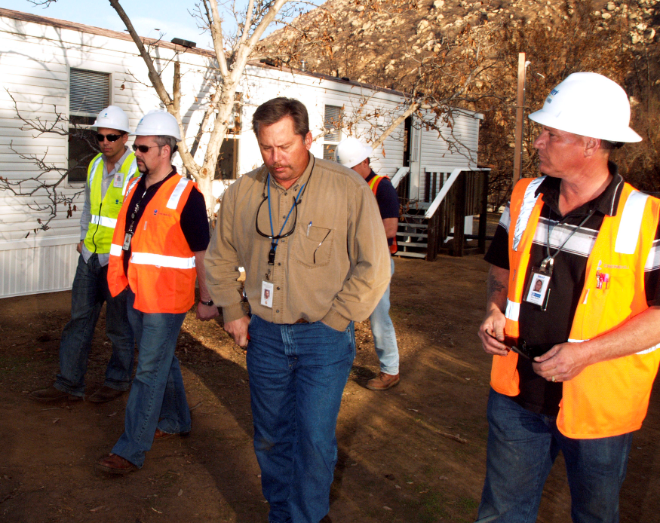
Background & Importance
Included in the ML&EI criteria for VPP
Covers oversight of all on-site contractors
Considers selecting contractors based on their past S&H performance
Image retrieved from Yahoo Images
Notes:
ML&EI = Management Leadership & Employee Involvement
Applicable contractor: A contractor whose employees work for your organization at least 1,000 hours in any calendar quarter within the last 12 months and are not directly supervised by your organization.
Contract employee: Individuals employed by a company providing services, under contract, to your organization, usually at your worksite.
General contractor: A construction site owner or site manager who controls construction operations and is responsible for assuring safe and healthful working conditions at the worksite; these may also be applicable contractors at your organization.
Resident contractor: A company providing ongoing, on-site services to your organization, who occupies delineated work areas within your worksite; these may also be applicable contractors at your organization or contract employees supervised by your organization.
Contract employees or temporary employees supervised by your organization’s management are governed by your safety management system (SMS).
Contractor supervision exists when you supervise the products or services a contractor produces, as well as the methods and processes the contractor uses to accomplish their work. Apply this definition to your resident and general contractors to determine if you can classify them as applicable or contract employees supervised by your organization.
Image retrieved from Yahoo Images (free to share and use license) at: https://upload.wikimedia.org/wikipedia/commons/2/29/FEMA_-_33789_-_A_building_inspector_speaks_with_contractors_and_FEMA_officials_in_California.jpg
The image shows contractors at a worksite. Effective contractor oversight ensures you control hazards created from contractor activities. Notice how many of the contractors have hard hats on, while one does not.

Slide 4
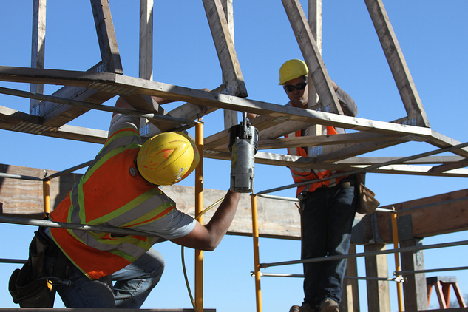
Background & Importance
Establishes a process to correct and control contractor-created S&H hazards
Enforces S&H contract provisions
Reviews contractor I&I data to determine improvement potential
Images retrieved from Yahoo Images
Notes:
I&I = injury and illness
Monitor your contractor I&I rates to ensure contract employees are not sustaining I&Is. OSHA expects Star-quality sites to help contractors who have high I&I rates identify causes and create plans to help reduce their rates.
OSHA does not require contractors to achieve VPP recognition if your organization is pursuing or has obtained VPP recognition; however, you are required to inform contractors that you are pursuing or have obtained VPP recognition. Resident contractors may apply for VPP recognition, but only if your worksite has already achieved VPP Star status. On the other hand, general contractors may pursue VPP recognition while working at your worksite regardless of whether you are a Star site. They must be at your worksite for a minimum of 12 months in order to do so.
Images retrieved from Yahoo Images (free to share and use license) at: https://c1.staticflickr.com/7/6047/6284030630_7c4f62feb7_z.jpg and https://upload.wikimedia.org/wikipedia/commons/6/67/Afghan_contractors_work_to_build_a_new_facility_%284454281292%29.jpg

Slide 5
Documentation
Contractor oversight/management program
Contractor selection criteria
Sample contracts, stating S&H provisions
S&H training records for contractors
Contractor audits, inspections, and reviews
Disciplinary actions for contractor S&H infractions
Contractor I&I rates
Contractor APP/RRP
Notes:
APP = accident prevention plan
RRP = rate reduction plan
An OSHA VPP assessment of your contractor management program typically includes a review of the documents listed on this slide. This is not an all-inclusive list of documentation. Make sure you provide examples of completed forms and documents to your assessment team. Do not show them blank forms! They want to see the documents filled out to assess the execution of your contractor oversight processes.
Your contractor selection process should include requirements to evaluate contractors on their past S&H performance. Provide these requirements and the process you follow.
Provide evidence that you oversee contractors and ensure they follow S&H requirements outlined in their contracts. Show documentation capturing audits or inspections, contractor S&H briefings, and periodic reviews of contractor performance. Provide documentation to support how you exercise your contractor disciplinary process for S&H infractions.
Collect I&I information from applicable contractors (contract employees supervised by your organization are included in your own I&I rates). This includes their total case incident rate (TCIR) and days away, restricted, and transferred (DART) rate. Show this information and any applicable APP/RRPs to help reduce the contractor’s I&I rates.

Slide 6
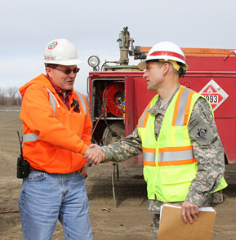
Leadership/Management Knowledge
Leaders and managers should be knowledgeable of:
Selection and screening of potential contractors
Locations of on-site contractors
Who manages on-site contractors
Disciplinary process for contractor S&H violations
Image retrieved from Bing Images
Notes:
Leadership and upper management need to have a general understand the screening and selection process used for your contractors. They should also know the on-site locations of your contractor employees. In addition, they should have a general understanding of disciplinary processes or any action taken against contractors for not meeting contractual S&H requirements.
It is important for leaders and managers to understand who manages on-site contractors. Oftentimes, this is a COR.
Image retrieved from Bing Images (free to use and share license) at: http://farm8.staticflickr.com/7054/6780185212_d7f720bd5f_z.jpg
The image shows a site leader meeting contractors at a worksite.

Slide 7
Key Personnel Knowledge
Key personnel should be knowledgeable about:
Contractor management roles and responsibilities
S&H criteria in contractor selection
Control of S&H hazards created by contractor activities
Disciplinary actions taken against contractors, if applicable
S&H audits and inspection processes and results of contractor work areas
Reporting, investigating, and documenting contractor I&Is
Contract S&H provisions
Notes:
Key personnel may include CORs, S&H professionals, or other personnel involved in managing on-site contractors.
Key personnel should be familiar with the specific S&H criteria used to evaluate a contractor’s past S&H performance and fitness for work. In addition, key personnel should understand the specific S&H provisions contractors must meet. Most importantly, key personnel should periodically visit contractor areas to validate these provisions.
CORs typically understand contract provisions and their role in managing contractor compliance requirements; however, they are not always knowledgeable of S&H regulatory requirements. Planned S&H audits and inspections by S&H professionals help to interpret S&H contract provisions and maintain contractor S&H compliance.

Slide 8
Workforce Knowledge
Employees should be knowledgeable about:
Contractor activities in their work areas
S&H hazards generated by contractor work
Reporting contractor-created hazards and unsafe behaviors
Image retrieved from Bing Images
Notes:
Ensure employees are familiar with contractors working in, or adjacent to, their work areas. Your employees must be aware of additional S&H concerns that contract work creates. If employees observe unsafe conditions caused by contractors, or see contractors committing unsafe acts, employees must know how to report these S&H concerns.
Image retrieved from Bing Images (free to use and share license) at: https://upload.wikimedia.org/wikipedia/commons/8/8a/US_Navy_090310-D-5972N-002_Civilian_employees_work_with_Information_Systems_Technician_2nd_Class_James_Rago_to_troubleshoot_the_video_teleconference_system_of_a_video_information_exchange_system.jpg
The image shows worksite employees and contractors working together. Oftentimes, contract employees supervised by your organization work side-by-side organizational employees performing the same job duties - this makes it difficult to tell who is a contract employee and who is an organizational employee.

Slide 9
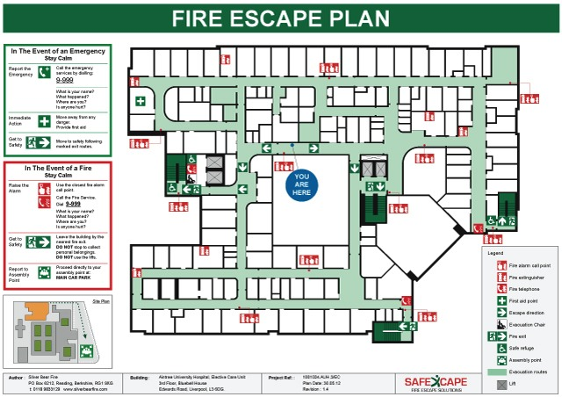
Contractor Knowledge
Contractors should be knowledgeable about:
S&H hazards in their work area
Hazard controls
Site S&H rules and regulations
Local emergency procedures
Steps to report S&H hazards and workplace incidents
S&H goals and objectives
Rights under the OSH Act
Basic VPP elements
Site participation in VPP
Image retrieved from Bing Images
Notes:
OSH = occupational safety and health
The level of knowledge expected from contractors depends on the type of contractors in your workplace. Applicable contractors must be aware that your site participates in VPP and understands your on-site S&H rules. Their employer trains them on the hazards of their work, reporting procedures, and emergency procedures. Know that the VPP assessment team may still ask contractors questions about this information, but this information may differ from your own procedures.
A general rule of thumb for contract employees supervised by your organization and working alongside organizational employees is that they must know the same information that your own employees know. This seamless work relationship creates the need for employees and contractors alike to understand the same S&H rules and expectations equally. Additionally, these contract employees must know basic OSHA VPP fundamentals. They should strive to achieve the same S&H goals as your own employees – therefore, they should know your S&H goals and objectives too.
Image retrieved from Bing Images (free to use and share license) at: http://i.stack.imgur.com/VZCIc.jpg
The image shows an emergency evacuation sign and diagram template. All contract employees should be familiar with your local emergency procedures.

Slide 10
Action Checklist
Create a contractor oversight program
Train designated CORs
Establish a contractor selection process
Review contractor S&H program
Hold pre-contract meetings
Provide contractor S&H training
Perform S&H audits and inspections of contractor work areas
Collect and review contractor S&H data
Assist with APPs/RRPs, as necessary
Develop relationships with contractors
Notes:
Follow this action checklist to implement and sustain VPP expectations for contract employees. Each of these action checklist items will be covered in more detail.

Slide 11
Contractor Oversight Program
Determine contractor S&H screening requirements
Instruct contractors to follow site S&H rules
Describe processes to monitor contractor S&H performance
Discuss hazard identification and correction in contractor work areas
Explain contractor discipline for S&H infractions
Encourage contractors to implement a SMS
Image retrieved from Microsoft Clip Art
Notes:
Write a contractor oversight program to execute the management of your on-site contractors. Shape the information towards holding contractors responsible for S&H requirements, S&H standards, and contract provisions. This slide includes some examples of procedures you want to include in your oversight program; however, this is not an all-inclusive list of contractor oversight procedures.
Think about assigning responsibilities to execute these management processes. In the DoD, CORs often handle these duties, but include any additional support personnel the COR may need.
You may have a single contractor oversight program that covers all contractual requirements and all aspects of contractor management. It is acceptable to have one, all-encompassing program, but include all applicable S&H oversights that apply to your contractors.
Image retrieved from Microsoft Clip Art.

Slide 12
Contractor Oversight Program
Pre-Contract | Post-Award | During Contract | Post-Contract
Review I&I rates and OSHA citation history | Review contractor written S&H program | Monitor adherence to contract S&H provisions | Rate contractor performance
Examine contractor qualifications | Hold pre-contract S&H briefings | Perform S&H audits and inspections | Place great performers on a pre-approved list
Check EMRs | Work with contractors to develop an APP/RRP, if necessary | Take disciplinary actions, as necessary | Review and revise the contractor oversight program, as needed
Consult previous employers of contractor | Encourage SMS implementation | Monitor contractor I&I rates* | Report contractor information on annual VPP self-evaluation*
Notes:
EMR = experience modification rates
The table shows the phases of contract operations. In each phase, there are recommendations for when to conduct each contractor oversight activity; you can incorporate this information into your written contractor oversight program. Note that in OSHA VPP, you only need to collect annual self-evaluation information and I&I rates for applicable contractors. Many of the items in this table are discussed in the following slides.
*VPP only requires I&I rate monitoring and annual self-evaluation information for applicable, on-site contractors

Slide 13
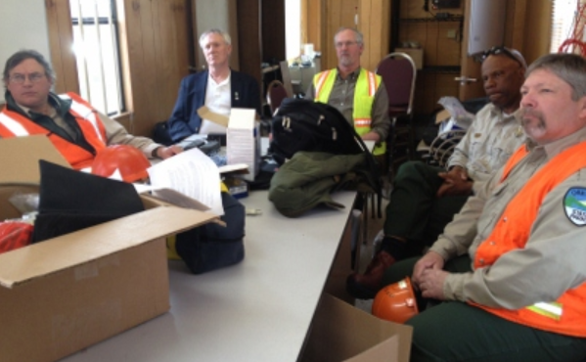
COR Training
Provide additional S&H training to CORs:
S&H oversight of contractors
Hazard identification and evaluation
VPP-specific needs or requirements
Image retrieved from Bing Images
Notes:
Train CORs to monitor how your contractors adhere to contract S&H requirements. Most, if not all CORs, do not have training or education in workplace S&H. Providing additional training to CORs on S&H expectations increases the effectiveness of S&H oversight for your on-site contractors.
A common deficiency in S&H oversight is the ability of CORs to conduct effective S&H inspections of contractor work areas. Train CORs in hazard identification and evaluation to provide better oversight. In addition, have S&H professionals periodically accompany CORs when assessing contractor compliance with S&H regulations and contract provisions.
Communicate any additional responsibilities you want your COR to know, especially those aimed at meeting VPP requirements. For example, you must document applicable contractor I&I incidence rates in your annual self-evaluation. Since the CORs maintain the relationship with the contractor, you may want the COR to request and obtain this information for you.
Image retrieved from Bing Images (free to use and share license) at: https://upload.wikimedia.org/wikipedia/commons/e/e8/B210_Safety_Training_%287256587444%29.jpg
The image represents CORs attending training related to their S&H responsibilities.

Slide 14
Contractor Selection
Consider these factors when selecting contractors:
I&I rates for the last three years
Reports of significant I&Is
EMR for the last three years
OSHA violations in the last three years
Previous employers’ reviews and recommendations
S&H experience, qualifications, and certifications
Image retrieved from Bing Images
Notes:
EMR: A numerical multiplier calculated by insurance companies to represent a company's accident and injury record as compared to the industry average. An EMR of 1.0 means a company has an average safety record. An EMR below 1.0 means the company has a good safety record, while an EMR above 1.0 indicates a poor safety record.
Review contractor S&H performance history during the selection process. The slide includes a list of common items to review when selecting contractors; this list is not all-inclusive. Require potential contractors to demonstrate their S&H program capabilities and experience during contract solicitations, as prescribed by the Federal Acquisition Regulation (FAR), the Defense Federal Acquisition Regulation Supplement (DFARS), and other Agency FAR supplements.
Obtain a list of previous employers the contractor worked for and ask them about the contractor’s S&H performance. In addition, review the S&H experience, qualifications, or certifications of employees or contractor S&H representatives, if applicable. For construction sites, for example, you may require the contractor have an on-site S&H professional to manage and monitor the worksite.
Use OSHA’s establishment search website to find contractor companies and their citation history: https://www.osha.gov/pls/imis/establishment.html
Image retrieved from Bing Images (free to use and share license) at: https://c2.staticflickr.com/8/7460/12239180354_a309cb6442_b.jpg

Slide 15
Contractor S&H Program
Review the contractor’s submitted S&H program:
Applicable hazard control programs
S&H training requirements and records
Hazard reporting, identification, and correction processes
Mishap reporting and investigation policies
Emergency number(s) and procedures
Image retrieved from Microsoft Clip Art
Notes:
Contractors should submit their S&H program to your organization for review once you award a contract. The slide includes a list of potential sections in contractor S&H programs to review for effective S&H protection of all employees; this list is not all-inclusive. The intent of this program is to outline how your contractors comply with S&H requirements and regulations, as well as reduce the impact of contract work activities on the S&H of your employees.
At all DoD sites, contractors are required to comply with your installation and local S&H requirements. Ensure contractors include a statement regarding adherence to these requirements. Requirements may include speed limits, cell phone use while operating vehicles, personal protective equipment (PPE) use, or even complying with specific S&H plans or hazard control programs. For example, you may incorporate contract provisions stating the contractor must follow your confined space entry program, rather than have the contractor exercise their own program. This ensures uniform application of a safety-critical process across your organization.
Do not accept a contractor’s S&H program if it does not meet contract provisions and S&H regulatory requirements. Ensure the contractor addresses any program elements they do not meet, which you can discuss during the pre-contract meeting.
Image retrieved from Microsoft Clip Art.

Slide 16
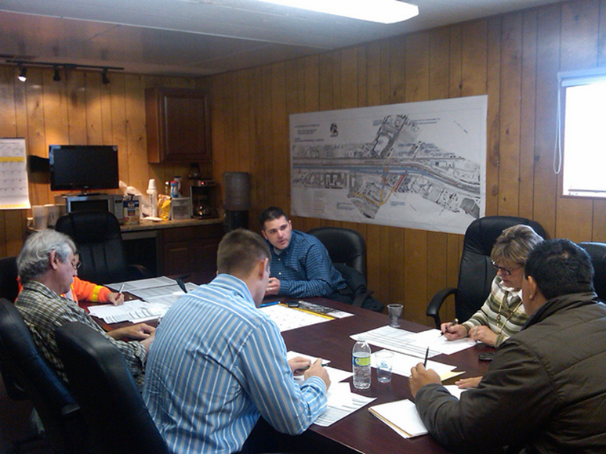
Pre-Contract Meetings
Involve all stakeholders
Review S&H contract provisions and on-site S&H rules
Discuss work changes impacting S&H, if needed
Follow-up on contractor S&H documentation
Conduct a worksite walkthrough
Encourage implementation of a SMS
Image retrieved from Bing Images
Notes:
Hold pre-contract meetings with contractors before contract work begins. Involve all applicable stakeholders in these meetings. These meetings allow you to discuss areas of concern with the contractor and review applicable S&H requirements before the work begins.
Personnel to involve in the pre-contract meeting can include acquisition and contracts personnel, project managers, S&H professionals, and key stakeholders (e.g., fire department, emergency services, and security), depending on the contractual work being performed. Also, consider including project superintendents, supervisors, quality control representatives, subcontractors, and the COR’s quality assurance representatives.
Pre-contract meetings are an opportune time to assess contractor-operated work areas and identify potential S&H hazards. Consider having your own site S&H professionals participate in this walkthrough with the COR to assist in hazard identification and gain knowledge of the potential hazards created by the contractor.
Many times, contractors submit S&H programs, S&H training, or other evidence of S&H compliance post-award. If you have not already reviewed these documents, these meetings allow you to ensure each document is adequate prior to beginning work. This is also the time to ask any questions regarding the documents, or follow-up on any changes you recommended the make contractor beforehand.
Image retrieved from Bing Images (free to use and share license) at: http://farm8.staticflickr.com/7057/6881676937_45a7c9974e_z.jpg
The image shows a pre-contract meeting occurring with contractor management and safety representatives, as well as representatives from the VPP worksite.

Slide 17
Contractor S&H Training
Provide NEO to applicable contractor employees:
Specific S&H hazards of your site
S&H rules and expectations on site
Hazard reporting procedures
Organization’s participation in OSHA VPP
Local emergency procedures and evacuation
Organization S&H goals and objectives
Image retrieved from Bing Images
Notes:
NEO = new employee orientation
There will be instances where you need to provide additional training to contract employees outside of the training they receive from their employer. Specifically, include applicable contractors in your NEO.
Including applicable contractors in your NEO communicates or reinforces S&H requirements specific to your organization. Coordinate with the contractor to ensure you do not duplicate information between the trainings provided by them and by you. Also, review the contract provisions to differentiate S&H trainings outlined as a contractor responsibility or your responsibility.
Image retrieved from Bing Images (free to use and share license) at: https://upload.wikimedia.org/wikipedia/commons/0/02/FL_Technics_Training_-_Inside_the_class.jpg
The image shows training for both organizational employees and contract employees supervised by the host organization. Train contract employees supervised by your organization like your own employees, unless otherwise specified under the contract.

Slide 18
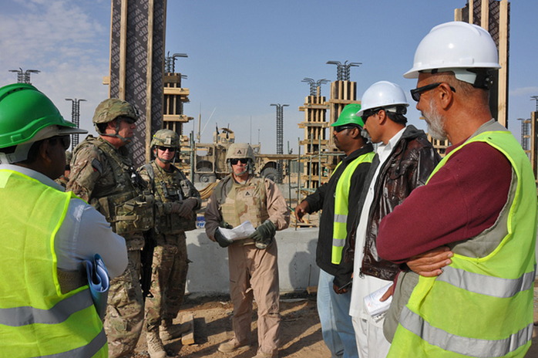
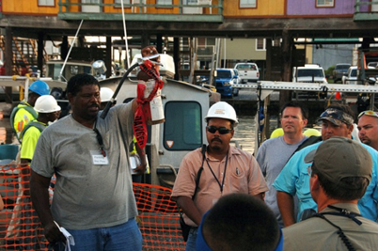
Contractor S&H Training
Integrate contract employees supervised by your organization into your S&H training program
Invite contractors to participate in S&H activities, events, and S&H meetings
Document the completion of training
Images retrieved from Bing Images
Notes:
Train contract employees supervised by you organization the same way you train your own employees. Provide NEO to these contract employees as if you hired new employees to work for you.
Additional topics of interest for contract employees supervised by your organization may include:
S&H hazards and their associated controls
Safe work procedures
How to recognize hazardous conditions
Signs and symptoms of workplace I&I
Mishap reporting procedures
OSHA VPP fundamentals
Invite contractors to participate in S&H activities, events, or meetings. Justify S&H-related meetings, at a minimum, when the content of the meeting potentially affects the S&H of the contract employees.
Top image retrieved from Bing Images (free to use and share license) at: http://farm7.staticflickr.com/6037/6325832341_def56c4542_z.jpg
Bottom image retrieved from Bing Images (free to use and share license) at: http://farm5.staticflickr.com/4076/4744382332_1d264ef96e_z.jpg
The top image shows Service members meeting with contractors to discuss contract work. The bottom image shows a daily safety meeting for contractors; ensure contractors are holding daily meetings and ask to see documentation of what was covered.

Slide 19
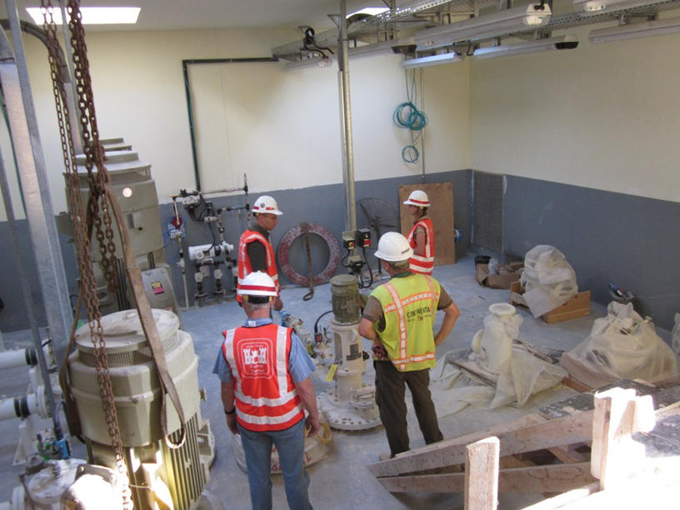
S&H Audits and Inspections
Review contractor S&H inspection findings
Conduct S&H inspections of contractor work areas
Assess contractor compliance with S&H provisions
Assign “Stop Work” authority to CORs, as needed
Review toolbox talks or contractor S&H meeting minutes
Discuss areas of concern and potential solutions
Image retrieved from Bing Images
Notes:
Review the contractor’s S&H inspections to make sure they are completed and to see if deficiencies are corrected. In addition, conduct your own S&H inspections of contractor work areas. The COR typically conducts these inspections or surveillance activities, but you are encouraged to include S&H professionals. You can conduct planned inspections; however, you should consider unplanned inspections and spot checks too. Identify and document hazards found during site walkthroughs and compare these findings to the contractor’s inspections.
Review other documents that may relate to contract S&H provisions, such as S&H meetings or toolbox talks, submitted hazard reports, and mishap investigation results. Hold meetings to discuss deficiencies with the contractor.
CORs should:
Visit the contractor worksite periodically to evaluate the quality of the contractor’s work, adherence to schedule, and compliance with federal, state, and local regulations
Observe contract employees working to ensure they follow applicable S&H rules, including wearing proper PPE
Document identified hazards and non-compliances with contract provisions
Address S&H non-compliances with the appropriate contract official(s)
Exercise disciplinary procedures when contractors commit repeat non-compliance (in accordance with contract provisions), as needed
Image retrieved from Bing Images (free to use and share license) at: https://c1.staticflickr.com/5/4108/5029376112_0bceb54ebe_b.jpg
The image represents CORs, safety staff, and contractor conducting an inspection of a contractor work area.

Slide 20
Contractor S&H Data
Gather contractor S&H data:
OSHA recordable contractor mishaps
Results of mishap investigations
I&I rate information for the calendar year
Incorporate data into:
OSHA VPP application
Annual self-evaluation
Contractor submitted data is for the mishaps experienced while working at your worksite; not at their corporate level
Graphic created by the DoD SMCX
Notes:
For OSHA VPP, you must gather contractor I&I information. You include this information in your annual self-evaluation and OSHA VPP application. This information comprises the total number of applicable contractors, total number of contract employees supervised by your organization and intermingled with your own employees, and the I&I incidence rates for each applicable contractor. Contract employees supervised by your organization should immediately report any on-site I&Is that occur while working at your worksite.
I&I incidence rate information for applicable contractors must include:
North American Industry Classification System (NAICS) code
Total work hours
Total number of injuries
Total number of illnesses
Sum of I&Is
TCIR for I&Is
Total number of injuries involving DART
Total number of illnesses involving DART
Sum of I&I cases involving DART
DART rate
Require applicable contractors to submit their TCIR and DART data for your review. Include I&I information for contract employees supervised by your organization in your I&I data and rates. Review applicable contractor mishap data and investigations if they have I&I rates above their industry average to ensure proper and accurate recordkeeping. You can help the contractor develop APPs/RPPs to combat high I&I rates. Additionally, ask the contractor to submit any plans to lower their rates to you in writing.
Graphic created by the DoD SMCX.
The graph represents an I&I analysis for contractors while working on-site.

Slide 21
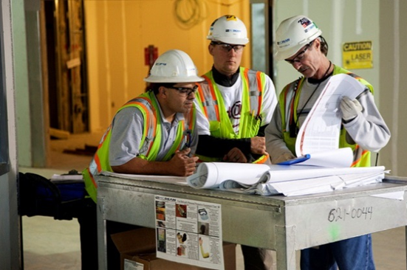
Accident Prevention/Rate Reduction Plans
Help contractors develop a written APP/RRP for high I&I rates:
Brainstorm potential solutions to combat I&I trends
Develop implementation plans
Establish goals and objectives for lowering I&I rates
Assign responsibility for tracking and reporting progress
Image retrieved from Bing Images
Notes:
APP/RRP: A documented plan of action outlining the steps or corrective measures to take in reducing I&I incidence rates and preventing future mishaps.
The overall purpose of an APP/RPP is to reduce an applicable contractor’s I&I rates so their activities pose less risk to your employees. Though not required, OSHA may expect a rate reduction plan when applicable contractor I&I rates exceed the industry average. Offer your assistance and help contractors with high I&I rates develop a plan of action towards I&I reduction.
Review mishap data with the applicable contractor to identify I&I trends, if not already identified by the contractors themselves. For each negative trend, list potential solutions that may combat or eliminate the trend. Once the contractor selects solutions, they should develop abatement plans to tackle the trends and assign responsibility for ensuring progress throughout the abatement process. It may not always be possible to reduce I&I rates to a level below the industry average, so the contractor should establish goals and objectives for an achievable amount of reduction. Have the contractor include this information in a written deliverable to show the efforts being made towards S&H protection.
Image retrieved from Bing Images (free to use and share license) at: https://c1.staticflickr.com/5/4104/5056771149_64db6449f2_z.jpg
The image represents contractors reviewing their I&I rate information.

Slide 22
COR & Contractor Relationships
Encourage contractor participation on VPP/safety teams and committees
Invite contractors to attend safety meetings
Work with contractors to improve their I&I rates
Provide suggestions to improve contractor S&H programs
Field contractor suggestions to improve your S&H programs
Image retrieved from Bing Images
Notes:
Develop sound relationships with your contractors to improve your SMS and add value to your VPP efforts. Invite contractors to S&H meetings and other S&H activities. Include contractors, when possible, as part of your VPP team or safety committee.
Consider including contractors in safety days or safety celebrations, if possible. Developing good relationships with contractors builds trust between management, labor, and employees. Work cooperatively with your CORs and contractors to encourage good performance -- NOT by telling them how to do the job!
Image retrieved from Bing Images (free to use and share license) at: http://4.bp.blogspot.com/_Ty0HUPmsLIA/S8ifWptj_TI/AAAAAAAAAnI/BDL8gkcaSK4/s1600/index.2.jpg

Slide 23
Conclusion
In this presentation, you learned to:
Summarize the background and importance of contract employees
List contract employee-related documentation
Describe the knowledge leadership/management, key personnel, and the workforce should have regarding contract employees
Identify contract employee-related actions to implement and sustain OSHA VPP

