Slide 1
Employee Involvement
OSHA VPP
October 2020
DISTRIBUTION STATEMENT D: Distribution authorized to the DoD and U.S. DoD contractors only; October 1, 2020. Other requests shall be referred to: Director, Operational Safety, OUSD(P&R), 4000 Defense Pentagon, 2E580, Washington, DC 20301.
WARNING: This document contains technical data whose export is restricted by the Arms Export Control Act (Title 22, U.S.C., sec. 2751, et seq.) or the Export Administration Act of 1979, as amended, Title 50, U.S.C., App. 2401 et seq. Violation of these export laws are subject to severe criminal penalties. Disseminate in accordance with the provisions of DoD Directive 5230.25.
Notes:
This presentation outlines employee involvement requirements for the purposes of Occupational Safety & Health Administration (OSHA) Voluntary Protection Programs (VPP) recognition.
The presentation provides information on the background and importance of employee involvement, required documentation, and the various levels of employee knowledge. It concludes with an action checklist and supplemental details to help with OSHA VPP implementation and sustainment efforts.

Slide 2
Objectives
In this presentation, you will learn to:
Summarize the background and importance of employee involvement
List employee involvement-related documentation
Describe the knowledge leadership/management, key personnel, and the workforce should have regarding employee involvement
Identify employee involvement actions to implement and sustain OSHA VPP
Notes:
This presentation is beneficial to safety and health (S&H) professionals, VPP representatives, leaders, different levels of management, and safety committee members.

Slide 3
Background
Included in the ML&EI criteria for OSHA VPP
Encourages active and meaningful involvement of employees at all levels
Emphasizes a team approach to S&H
Is critical to a strong S&H culture
Image retrieved from Bing Images
Notes:
ML&EI = Management Leadership & Employee Involvement
It is important for employees at all levels to have input to the elements of a safety and occupational health management system (SOHMS).
Process improvements, the design of safety precautions, and changes to work procedures are more effective and readily accepted with employee involvement.
The employees doing the work truly understand the hazards of the work. Seek input on hazard controls from the employee doing the work – they are more likely to use what they help create.
The image shows how employee involvement opportunities foster better relationships between employees and leadership – it brings them all together.
Image retrieved from Bing Images (free to share and use license) at: https://farm4.staticflickr.com/3635/3390622840_b89898fc4e_z.jpg

Slide 4
Importance
Improves communications and relationships between management and employees
Improves hazard recognition and control to prevent mishaps
Yields better ideas through diversity and collaboration
Creates opportunities for management to recognize and appreciate workers
Advances the overall S&H culture in the workplace
Improves employee knowledge and understanding
Image retrieved from Bing Images
Notes:
Involving employees in S&H activities results in a better, safer workplace with fewer hazards and injuries.
When management recognizes and shows appreciation to employees for their contributions to safety, their collective ability to make things better is unleashed.
Image retrieved from Bing Images (free to share and use license) at: http://www.stepbystep.com/wp-content/uploads/2013/01/How-to-Retain-Great-Employees.jpg

Slide 5
Documentation
S&H committee, working group, or special team documents
Hazard analyses completed with employee input
S&H self-inspection records
S&H training content documents generated with employee input
S&H process improvement suggestions
Articles, posters, slogans, and other awareness materials created with employee input
Notes:
Make sure you provide completed examples of forms and documents to your assessment team. Don’t just show them blank forms! They want to see the documents you filled out to thoroughly assess the processes within your SOHMS.
Ensure your documents capture employee engagement at all levels, such as safety training content given by or developed with input from departmental employees, or employee safety suggestions.
Examples of safety committee, working group, or special team documents include: a charter, meeting minutes, or slides presented during a meeting.
Examples of hazard analyses include: job hazard analyses, baseline hazard assessments, and job safety training guides.
Many organizations believe complying with safety rules and reporting hazards is meaningful employee involvement for OSHA VPP. On the contrary, working safely is a condition of employment. Reporting hazards without the fear of reprisal is an employee right, and not a form of meaningful involvement either.

Slide 6
Documentation
Employee involvement documentation should include:
A description of the activity
The date the activity occurred
The names of the employees who participated
Types of employee involvement activities
Number of participating employees
Image retrieved from Bing Images
Notes:
Always document the names of employees participating in involvement activities. This provides proof the activities not only occurred, but actually involved employees.
Examples of data collection and reporting designs include: tracking the hazard analyses generated by employees, the percent of inspections completed by employees in each work area, and adopting employee safety suggestions.
Collecting data on employee involvement activities provides management with information to assess the effectiveness of selected employee involvement strategies. For example, suppose you want to increase employee involvement through the development and updating of hazard analyses. Management needs to know:
How many hazard analyses have been developed
How many employees were involved
Which organizations are and are not meeting command expectations for employee involvement
The image shows a supervisor officially documenting an activity. Image retrieved from Bing Images (free to share and use license) at: https://c1.staticflickr.com/9/8009/7158859680_c696b868b0_z.jpg

Slide 7
Leadership/Management Knowledge
Leaders and managers should know about:
The importance of involving employees in S&H
Meaningful employee involvement opportunities
Strategies employed encouraging employee involvement
Methods for assessing the effectiveness of employee involvement strategies
Image retrieved from Bing Images
Notes:
When involving employees is not successful, it is usually due to a lack of emphasis by leaders. Leaders and managers must understand and embrace the importance of employee involvement. They must also know about available involvement opportunities and to measure or monitor involvement in their respective areas of responsibility.
If leaders do not show enough interest in employee involvement, most employees are not going to show interest in involvement either.
The image shows leaders visibly involved in employee involvement activities. Image retrieved from Bing Images (free to share and use license) at:
http://cf2.foodista.com/sites/default/files/styles/featured/public/field/image/2011_05_4644732791_4383747f9e_z.jpg

Slide 8
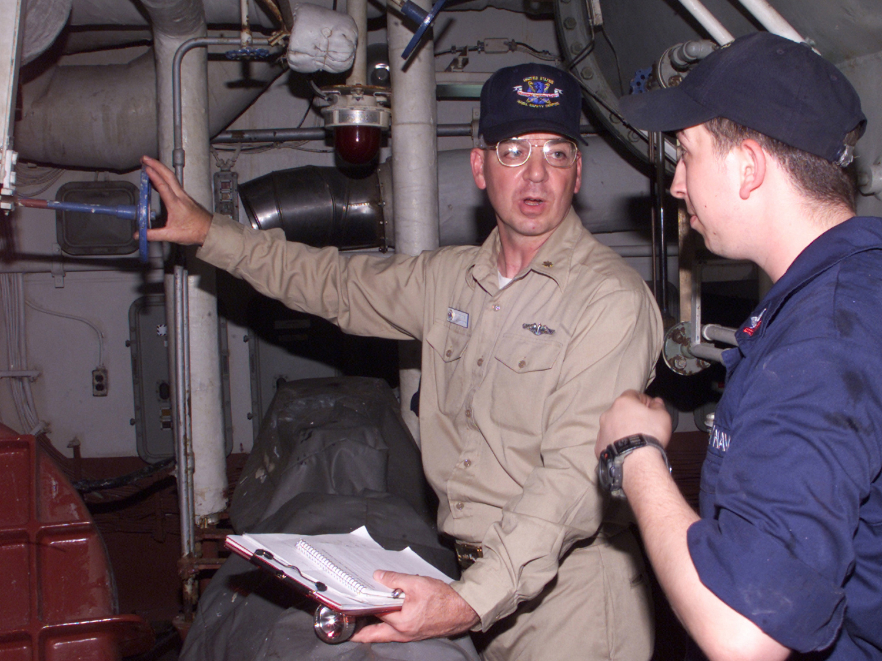
Key Personnel Knowledge
Key personnel should know:
Strategies employed to encourage employee involvement
How employees are involved in S&H
Documented efforts to record employee involvement activities
How the effectiveness of employee involvement is measured
Image retrieved from Bing Images
Notes:
Key personnel encompasses a range of individuals. Any person responsible for a process where employees are involved should have some understanding of how involving employees works. Employees are typically involved in activities such as safety self-inspections, job hazard analyses, safety suggestion programs, mishap reenactments, safety promotional or awareness events and information, and safety committees, to name a few activities. Responsible persons for these activities range from supervisors, safety staff, leadership, to other designated employees.
The image shows a supervisor completing a safety self-inspection with an employee. Document each employee’s name on the inspection form to show involvement in the activity. Image retrieved from Bing Images (free to share and use license) at: https://upload.wikimedia.org/wikipedia/commons/d/d5/US_Navy_020724-N-9802B-001_A_safety_Inspection_is_conducted_in_the_main_spaces_aboard_USS_Essex_%28LHD_2%29.jpg

Slide 9
Workforce Knowledge
Employees should know:
The importance of being involved in S&H
How their supervisors and leaders demonstrate involvement in S&H
Management expectations and support for employee involvement
Employee involvement opportunities in the workplace
How to meaningfully describe and discuss their involvement
Image retrieved from Bing Images
Notes:
Employees who understand the importance of safety take ownership for their roles and make safety a part of their job.
Employees must recognize their involvement in S&H. Employees will be asked questions about the involvement in the SOHMS during interviews with on-site OSHA assessment teams. Typically, OSHA expects employees to describe three meaningful ways in which they are involved.
The image shows an employee participating in a safety day fair. Image retrieved from Bing Images (free to share and use license) at: https://farm8.staticflickr.com/7356/14108940593_cf64be58fe_z.jpg

Slide 10
Action Checklist
Identify employee involvement opportunities
Select and implement approved initiatives
Communicate and market available opportunities
Show leadership and management support for each initiative
Monitor the effectiveness of employee involvement
Notes:
Follow this action checklist to implement and sustain VPP expectations for employee involvement. Each of these action checklist items will be covered in more detail.

Slide 11
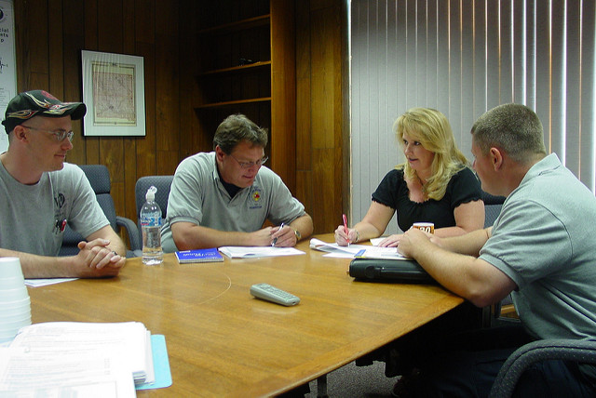
Identify Involvement Opportunities
Use employee teams to generate ideas
Discuss and evaluate each idea
Prioritize the desirability of each idea
Present prioritized recommendations to management for review and approval
Create an implementation initiative for each approved recommendation
Image retrieved from Bing Images
Notes:
Consider establishing an implementation team or committee to develop and evaluate employee involvement ideas. Solicit ideas from the entire workforce and consider union involvement during this initial phase. It is best to involve the employees in this process. Consider all ideas received, regardless of the source, during the brainstorming process. It is important to understand opportunities that work at one organization might not work at another.
Discuss and evaluate each idea. Think about the feasibility, the potentially involved employees, the potential for positive impact on S&H, and the alignment with S&H goals and objectives or identified trends. The top choices reflect a good balance of feasibility and positive impact.
Present your top choices to leadership for approval. Incorporate any revisions required by management. For each approved initiative, create an initiative implementation plan, outlining how you will go about incorporating employee involvement for each specific idea.
Employees do not meet meaningful involvement requirements by reporting hazards (since it is an employee right), participating in incentive programs, or simply working in a safe manner.
The image shows a group of employees meeting with management to discuss opportunities for involvement. Image retrieved from Bing Images (free to share and use license) at: http://farm4.staticflickr.com/3300/3635127709_b7044a50c9_z.jpg

Slide 12
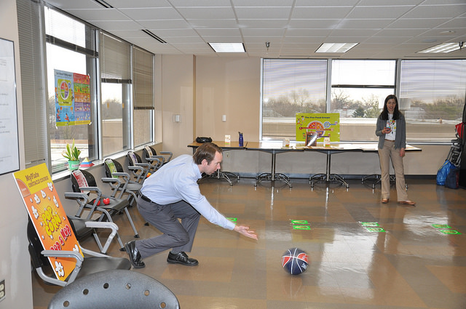
Employee Involvement Opportunities
Participating in S&H audits
Assisting with mishap and near-miss investigations
Conducting S&H self-inspections
Participating in S&H suggestion programs
Being involved in S&H planning
Providing or presenting S&H training
Performing or reviewing hazard analyses
Participating on S&H committees and teams
Images retrieved from Bing Images
Notes:
Other employee involvement opportunities include:
Acting as safety observers
Training and mentoring coworkers
Conducting monthly emergency equipment inspections
Creating emergency “drill” scenarios and debriefings
Updating emergency telephone numbers and signs
Conducting preventative maintenance inventories
Creating safety posters
Updating safety posters or bulletin boards
Reviewing safety programs and policies
Developing area or equipment-specific inspection checklists
Presenting information on a safety topics to a work group
Providing S&H suggestions
Participating in the selection of personal protective equipment
Creating safety videos
Participating in Safety Day activities (e.g., personal health fairs, testing fire extinguishing skills, games aimed at increasing safety knowledge)
Evaluate each idea. For each idea, consider:
Would people see it as meaningful?
How many people would be involved?
Does it have the potential to make a real impact?
Does it promote employee awareness/enthusiasm concerning safety?
Does it help to implement a needed program element?
How hard would it be to implement?
Are there intensive time demands?
Are additional materials/facilities needed?
What is the likelihood of employee resistance?
How will we collect metrics, maintain records, communicate progress/results?
The bottom image represents an employee and a supervisors reviewing a hazard analysis in the workplace. Image retrieved from Bing Images (free to share and use license) at: https://www.itfe.edu.au/wp-content/uploads/2017/04/News_health-and-safety_768x576-768x410.jpg
The top image shows employees participating in a safety and wellness fair. Image retrieved from Bing Images (free to share and use license) at: https://farm8.staticflickr.com/7283/16675838428_b7a185a30e_z.jpg

Slide 13
Employee Involvement – Committees/Teams
Consider these tips for committees and teams:
Elect key positions and define roles and responsibilities
Develop a charter and meeting agendas
Document and distribute meeting minutes
Provide means to report recommendations/actions to leadership
Publicize positive results of activities
Rotate the committee/team members periodically
Notes:
Committee charter: A document defining the function and purpose of the committee. It may include meeting frequency, the number of members needed for a quorum, the number of members in the committee, and a term of service to allow new members to join. Management members must not pull rank at these meetings – the charter should state this factor.
Develop charters for any sub-committees or employee teams. Also, rotate your committee and team members to give more employees the opportunity to participate. Hand-select teams if you need certain skill sets to solve the issues at hand.
Key positions in a committee typically include: a chair, vice chair, and secretary. Each member needs a clearly defined purpose, usually written in a mission statement. Members should be aware of their responsibilities. Example safety committee roles or functions include: evaluating safety suggestions, participating in self-inspections, creating a safety/VPP awareness campaign, and assisting in personal protective equipment selection. Committees must be comprised of equal members of management and non-management. Management and non-management members should alternate through the chair position.

Slide 14
Employee Involvement – Self-Inspections
Consider these tips for safety self-inspections:
Train responsible employees
Utilize employees to augment assessments in the worksite
Rotate different employees through inspections
Involve management in inspections as visible leadership
Discourage checklist blindness
Develop a review process for inspection results
Notes:
Train those responsible for conducting inspections on hazard identification and the inspection process.
Bring new eyes into the inspection process. Sometimes it pays to bring in employees from another work area to get a new set of eyes on the area receiving the inspection. When we look at our own area repeatedly, we can miss findings due to familiarity.
Establish a rotational schedule so different employees participate. Consider including management in safety self-inspections occasionally, too. Doing so provides a form of visible leadership and management involvement.
Management and the safety office should review self-inspection results. Obvious hazards and repeat findings indicate a need for management intervention in the work area.
Encourage employees to question anything they suspect may be hazardous, improper, obsolete, or out of place to discourage checklist blindness. Checklist blindness occurs when inspectors simply follow the checklist without questioning items not included on it.

Slide 15
Employee Involvement – Investigations
Consider these tips for mishap investigations:
Work under the guidance of trained investigators
Train employees on responsibilities
Employee team members may:
Help gather facts
Provide information based on their personal knowledge and skills
Participate in discussions of causal and contributing factors
Provide suggestions on the implementation of corrective actions
Image retrieved from Microsoft Creative Commons
Notes:
If you conduct review boards for mishaps, employees can help brainstorm methods to prevent reoccurrence of the mishap under investigation.
The image shows an employee assisting in a mishap investigation by documenting a description of the scene. Image retrieved from Microsoft Creative Commons.

Slide 16
Employee Involvement – Hazard Analysis
Consider these tips for hazard analysis:
Train employees on how to conduct and develop a hazard analysis
Document hazard analyses, including who performed them
Obtain approval of hazard analyses quality from the safety office
Review hazard analyses at least annually and revise as needed
Image retrieved from Bing Images
Notes:
Include all signatures or names of the employees involved in the development or review of the hazard analysis on hazard analysis documentation.
The optimal team to conduct a hazard analysis would typically be a combination of an engineer, supervisor, employee(s), and a safety professional. Typically, the safety professional can serve as a quality review and approval of the document developed by the team. If the hazard analysis does not include engineering-related hazards, such as loads and structures, engineers do not need to participate. Involve employees in these reviews.
The image illustrates a team conducting a hazard analysis. Image retrieved from Bing Images (free to share and use license) at:
http://i0.wp.com/machinerysafety101.com/wp-content/uploads/2014/06/iStock_000004224281XSmall.jpg?resize=300%2C198

Slide 17
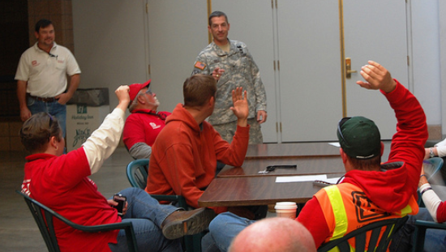
Employee Involvement – Training
Consider these tips for safety training:
Have employees provide training, when reasonable
Have employees speak on safety topics during meetings
Document meetings including presenter name(s) and topic(s) covered
Image retrieved from Bing Images
Notes:
Attending S&H training does not count as meaningful employee involvement for OSHA VPP; it is a condition of employment when required for the job.
Instead, employees can provide training to their peers or to new employees, such as training on job hazard analyses or how to safely perform tasks. In addition, employees can present at Safety Stand Downs or other safety meetings. When these meetings occur, document who participated, who presented, and the topic(s) discussed.
The image shows an employee presenting on a topic during a safety meeting held in the morning before work. Image retrieved from Bing Images (free to share and use license) at: http://farm7.staticflickr.com/6159/6150316351_1b3010f37f_z.jpg

Slide 18
Implement Approved Initiatives
Assign a responsible person or team to each approved initiative
Define desired outcome(s)
Generate an implementation plan
Provide progress reports to management and adjust plans, as needed
Update written programs, processes, and training to include involvement
In your plan:
Identify major steps
Identify target completion dates for each step
Assign responsibility for each major step
Notes:
An implementation plan includes the steps to complete the initiative, timeframes for completion, and assigned responsibilities.
Choose the responsible person(s) with care and consider union representation when you assign personnel to each opportunity. Select managers with the experience to lead effectively. Choose team members who care and bring job knowledge to the process. Make sure you have a diverse team, representing different areas of your workplace. Choose team members open to others’ points of view.
Inform management of initiative progress. Include a briefing schedule in the implementation plan to determine who communicates the results to management; depending on the initiative timeline, this communication can occur monthly, quarterly, or at management’s discretion. Have management approve the implementation plan along with any adjustments, if needed.
Once employee involvement efforts are underway, consider revising written programs or policies related to activities where employee involvement will occur. For example, consider writing language into your safety self-inspection program recommending, or even requiring if you so choose, employee involvement in completing self-inspections. In addition, consider including all potential ways for employees to be involved in new employee orientation training.

Slide 19
Communicate & Market Opportunities
Develop a communication and marketing team
Create a communication plan describing the vision and mission
Involve leaders in all plans and activities
Have leaders encourage employee involvement
Image retrieved from Bing Images
Notes:
Management at all levels must encourage employees to be involved in S&H. The communications team is vital to engaging employees in OSHA VPP implementation and sustainment efforts.
Image retrieved from Bing Images (free to share and use license) at: http://2.bp.blogspot.com/-Kg6MTRwXtrs/SkNwqFn7hzI/AAAAAAAAAMk/zBUh2fOp3BU/s1600/EE+10.gif

Slide 20
Communicate & Market Opportunities
Engage the Public Affairs Office to assist with marketing activities
Develop marketing materials
Seek out volunteers to help spread the word
Communicate methods or ways to be involved to all employees
Image retrieved from Bing Images
Notes:
Engage the Public Affairs Office in your marketing process to ensure effective communication.
Include employee involvement activities in new employee orientation, where you provide an overview of OSHA VPP, discuss employee involvement opportunities, and cover their OSHA rights.
The communications team brainstorms how to market employee involvement.
Some examples of potentially effective initiatives are:
Poster campaigns to reinforce the contents of the new employee information
Videos produced by the marketing team with leadership emphasizing the importance of employee involvement
Porcelain Press (small messages the team wants to communicate placed in restrooms)
Safety Day booths
All hands meetings/commercials
Emails
Safety contests
Image retrieved from Bing Images (free to share and use license) at: http://www.thebluediamondgallery.com/pictures/marketing.jpg

Slide 21
Show Leadership & Management Support
Participate in employee involvement strategy development, as needed
Participate as a member on the safety committee
Review and approve recommended involvement initiatives
Image retrieved from Bing Images
Notes:
Employees will jump at the opportunity to get involved in the SOHMS when they know their involvement is one of management’s highest priorities.
Image retrieved from Bing Images (free to share and use license) at: https://thebitterbusiness.files.wordpress.com/2015/01/business-strategy.jpg

Slide 22
Show Leadership & Management Support
Plan for resources to implement involvement initiatives
Periodically review progress and the results of approved initiatives
Support/revise/redirect initiatives as appropriate
Hold personnel accountable for S&H responsibilities and initiatives
Recognize employees for S&H contributions
Image retrieved from Microsoft Creative Commons
Notes:
More employees get involved when leadership recognizes participants for excellent involvement.
Image retrieved from Microsoft Creative Commons.

Slide 23
Monitor Effectiveness
Identify performance indicators to measure involvement levels
Hold leadership reviews to report performance indicators
Generate recommendations based on results
Review the process to increase effectiveness of employee involvement initiatives
Identify future improvements in hazard control and mishap prevention
Celebrate employee involvement successes
Image retrieved from Bing Images
Notes:
Performance indicators: Numerical metrics used to evaluate the effectiveness of processes or actions.
Leaders need to know the progress made in each employee involvement initiative. Developing performance indicators help leaders understand how the initiatives are working, if at all.
Align performance indicators with goals and objectives. If a goal is 30% of employees participating in safety self-inspections the first year, you should identify the different employees who participated throughout the year and divide it by the total number of employees.
Items to discuss during leadership reviews include, but are not limited to:
Progress made versus time elapsed
Meeting of strategy/initiative target dates
Accountability for responsible parties
Items to discuss after implementation include, but are not limited to:
Number of employees involved vs. number expected to be involved
Number of products generated vs. expected to be generated
Percentage of quality reviews completed for products generated
Items to discuss when reviewing involvement results include, but are not limited to:
Impacts on S&H problems or trends
New hazards identified and controlled
Employee suggestions or recommendations implemented
When you celebrate and promote the achievement of great employee involvement, it causes more employees to want to be a part of the process.
The image shows a workplace celebration after employee involvement records were set. Image retrieved from Bing Images (free to share and use license) at: http://farm9.staticflickr.com/8145/6980349068_ca4683877e_z.jpg

Slide 24
Conclusion
In this presentation, you learned to:
Summarize the background and importance of employee involvement
List employee involvement-related documentation
Describe the knowledge leadership/management, key personnel, and the workforce should have regarding employee involvement
Identify employee involvement actions to implement and sustain OSHA VPP

