Slide 1
Management Leadership & Commitment
OSHA VPP
June 2021
Notes:
This presentation outlines management commitment and leadership requirements for the purposes of the Occupational Safety and Health Administration (OSHA) Voluntary Protection Programs (VPP) recognition.
The presentation provides information on the background and importance of management commitment and leadership, required documentation, and the various levels of employee knowledge. It concludes with an action checklist and supplemental details to help with OSHA VPP implementation and sustainment efforts.

Slide 2
Objectives
In this presentation, you will learn to:
Summarize the background and importance of management commitment and leadership
List management commitment and leadership-related documentation
Describe the knowledge leadership/management, key personnel, and the workforce should have regarding management commitment and leadership
Identify management commitment and leadership actions to implement and sustain OSHA VPP
Notes:
This presentation is beneficial to safety and health (S&H) professionals, VPP representatives, leaders, and various levels of management.

Slide 3
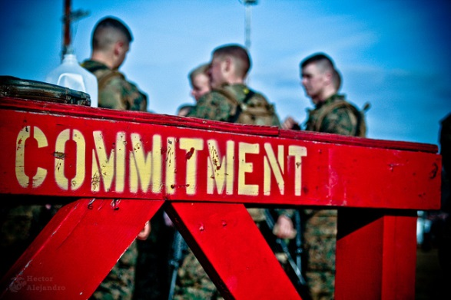
Background & Importance
Included in the ML&EI criteria for VPP
Addresses visible S&H leadership, goals & objectives, and performance
Sets the tone for the safety culture
Establishes authority and responsibility
Motivates and inspires the workforce
Promotes accountability for leaders and employees
Image retrieved from Bing Images
Notes:
ML&EI = Management Leadership and Employee Involvement
There are two aspects to this VPP sub-element – management commitment and management leadership.
Management commitment shows your management team’s dedication to employee S&H. Leaders set the direction and help their workforce accomplish goals, such as implementing and sustaining a safety management system (SMS) or addressing specific hazard control concerns that were identify through trend analysis. Committed managers encourage employees to meet S&H obligations and expectations. It is an essential element that shapes your safety culture and sets expectations for the entire workforce.
Management leadership provides the resources for organizing and controlling activities within your organization.
Your employees do not have authority to instruct others to complete S&H tasks without management or leadership’s written approval.
Accountability is crucial in an SMS. Commitment from your Leaders and management teams shows employees that Leaders care about their S&H, that S&H is important to the organization, and that Leaders expect employees to act positively regarding these important topics. In this case, it is all levels of your workforce effectively executing established processes and processes exactly as it says in your documentation, while creating a safe and healthful workplace. Both management and employees need to be held accountable in order for your SMS to be successful.
Image retrieved from Bing Images (Creative Commons).

Slide 4
Documentation
S&H policy
Leadership VPP commitment letter
Union VPP commitment letter, if applicable
SSP
Leadership involvement strategy, if applicable
S&H goals and objectives
Open door policy
Image retrieved from Microsoft Clip Art
Notes:
SSP = strategic safety plan
Make sure you provide completed examples of forms and documents to your assessment team. Don’t just show them blank forms! They want to see the documents you filled out to thoroughly assess the processes within your SMS.
The S&H policy defines top management’s expectation of your S&H program/SMS.
The leadership commitment letter shows leadership’s obligation to creating a safe and healthful workplace. It also encourages your site’s participation in OSHA VPP implementation.
Your union(s) needs to support your intent to implement OSHA VPP criteria. Have them develop a written letter stating their support. Sometimes, unions consider VPP implementation tasks as additional work outside the normal scope of work.
S&H goals are oftentimes part of a SSP. Your organization’s goals need to support the safety objectives set forth in your SSP. Ensure your S&H goals are attainable and measurable. Consider establishing S&H goals and objectives geared to increase management commitment and leadership.
An open door policy shows your managers and leaders welcome all concerns and questions, including those related to S&H.
Image retrieved from Microsoft Clip Art.

Slide 5
Documentation
Approved S&H budgets, including resource allocations
Leadership walkthrough reports
Leadership and management performance appraisals
Employee and leader disciplinary cases
Employee and leader recognition or awards
Commander/Director calls
Perception survey results
Image retrieved from Microsoft Clip Art
Notes:
S&H budgets direct the resources and funding needed to effectively execute and support your S&H program.
Leadership walkthroughs give your leaders an opportunity to identify hazards and ask employees about S&H. Document the completion of these walkthroughs to show your leader is actively engaged in your program.
Performance appraisals hold your managers and leaders accountable for carrying out assigned roles and responsibilities. Integrate S&H components into appraisals to hold leaders and managers accountable for S&H.
Disciplinary cases show how you discipline both employees and managers for not adhering to S&H polices and expectations. Conversely, recognition or awards shows examples of positive S&H recognition. This could be for a group of employees, an individual, or a level of leadership.
Documented Commander/Director calls (all hands meetings, safety stand downs) show your leader discusses S&H and encourages involvement.
Perception survey results may tell you more about how the employees feel about your current leadership. It may also give you ideas on how to increase or modify management leadership and commitment at your organization.
Image retrieved from Microsoft Clip Art.

Slide 6
Leadership & Management Knowledge
Leaders and management should know about:
S&H goals, objectives, and SSP
Ways they visibly demonstrate commitment to S&H
Their S&H responsibilities
Persons with S&H responsibilities
Components of performance appraisals and accountability process
S&H planning processes, including budgets and resource allocations
Outcomes of the annual VPP self-evaluation
Notes:
Leaders are responsible for approving, if not writing, your S&H goals, objectives, and SSP. They need to know these goals and which information to communicate to the workforce, such as how to accomplish the goals.
Examples of visually demonstrating commitment include: writing and communicating S&H commitment statements, wearing required personal protective equipment (PPE), and following established S&H rules.
Examples of visible leadership include: participating in safety walkthroughs, holding S&H-focused group meetings, and being involved in SMS implementation.
Leaders and managers should be familiar with any S&H policies, procedures, or commitment letters in place. They should know the location of these documents and be able to provide a basic overview of the content.
Leadership should be familiar those assigned S&H responsibilities within your organization. They should also know the process for granting authority to those individuals. For example, an area safety representative may need to follow up on a corrective action. The area safety representative needs to have the authority to take action on this corrective action. Leaders and managers assign this authority through written documentation.
Leaders and managers need to understand how S&H is included in their employees’ performance appraisals. They also need to be aware of the accountability/discipline process and their role in the process.
They also need to understand the budget and resource allocation processes to ensure employees have what they need to get their jobs done safely, including planning for unforeseen expenditures.
Outcomes of the annual VPP self-evaluation are important for leaders to know the areas they are best at, where they need to improve their SMS, and new goal and objective opportunities.

Slide 7
Key Personnel Knowledge
Key personnel should be knowledgeable about:
Examples of management commitment for S&H
Examples of visible leadership for S&H
Disciplinary actions taken for S&H infractions
Location of management commitment documents
S&H goals, objectives, and SSP
S&H roles and responsibilities
Processes to approve budgets and allocate resources
Notes:
Key personnel may include: S&H staff, industrial hygienists, occupational health personnel, human resources representatives, and other VPP and S&H subject matter experts.
Key personnel should be familiar with how leaders and managers demonstrate their commitment for S&H. For example, key personnel should be able to tell a VPP assessor if their leaders or managers participate in workplace inspections or Commander’s Calls.
Key personnel may develop or review S&H goals and objectives depending on their roles and responsibilities. At a minimum, they should understand the process your organization uses to develop and revise S&H goals and objectives.
Key personnel also need to be familiar with their roles and responsibilities in the S&H program, the main points of contact for S&H program elements, VPP elements, and any processes associated with VPP implementation and sustainment.

Slide 8
Workforce Knowledge
Employees should be knowledgeable about:
Existence and location of management commitment documents
Examples of how leaders and managers visibly demonstrate S&H support
S&H goals and objectives
How they participate in achieving S&H goals and objectives
Roles and responsibilities in the S&H program
Availability of S&H resources
Notes:
Examples of documents showing management commitment may include: safety policy letter or SSP. It is important for employees to be familiar with the S&H policies and procedures and their roles and responsibilities in the S&H program.
Employees should be able to describe ways or examples their leadership is visible and supports the SMS. Some examples include: attending or presenting meetings, visiting work areas, awarding or recognizing employees for positive S&H efforts and achievements, and distributing S&H-oriented messages to the workforce.
Employees do not need to know the exact budget, but should be familiar with how to obtain the resources they need, including PPE or ergonomic equipment (e.g., chairs, keyboards).

Slide 9
Action Checklist
Establish, document, and communicate S&H goals and objectives
Draft, publish, and communicate a S&H commitment letter
Consider drafting a leadership involvement strategy
Promote visible management leadership, with respect to the SMS
Focus on continually improving the strategy
Notes:
Follow this action checklist to implement and sustain VPP expectations for management commitment and leadership. Each of these action checklist items will be covered in more detail on the following slides.

Slide 10
Establish S&H Goals and Objectives
Review identified trends, SMS problem areas, and leadership initiatives
Establish SMART S&H goals based on this review
Brainstorm on how to achieve these goals
Develop SMART S&H objectives for each goal
Assign responsible person(s)/group(s) to each objective
Communicate S&H goals and objectives to all employees
Notes:
SMART = specific, measurable, attainable, realistic, and time-oriented
Review identified trends, areas of improvement, and leadership initiatives to identify where you need to focus your goals. Using this information, develop SMART goals and objectives related to your needed S&H improvements. Then, determine how you will achieve each established goals. Consider assigning your safety committee to think about these steps – these will become your objectives. As with any initiative, identify who is responsible for carrying out each established objective.
Clearly communicate S&H goals and objectives to your employees; help them understand what you are trying to achieve. Consider having your top leader communicate the S&H goals and objectives to the employees, then have your managers reinforce and support the completion of established goals.

Slide 11
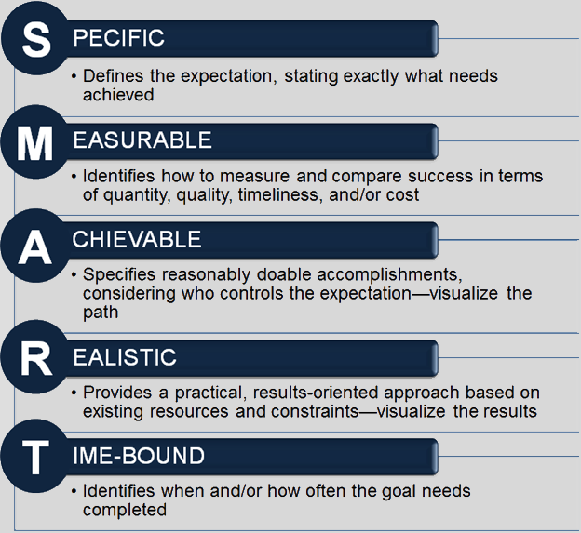
Establish S&H Goals and Objectives
Image created by the DoD SMCX
Notes:
Example of a poor S&H goal: Improve our safety record.
Example of a good S&H goal: Reduce our OSHA recordable injuries by 50 percent over the next five years.
Example of a poor S&H objective: Increase employee safety training.
Example of a good S&H objective: Provide monthly safety training sessions to each group (throughout fiscal year 2020–2021) at which 90% of the employees attend.
Image created by the DoD SMCX.

Slide 12
Implement S&H Goals and Objectives
Tell employees how to contribute to these goals
Evaluate progress periodically
Keep employees involved and notify them on the progress
Measure success at the end of the timeframe
Communicate the successes and failures to leadership
Revise unmet goals
Use trends and SMS problem areas to identify new goals
Notes:
It is essential to communicate the goals and objectives to your employees and tell them what they can do to help achieve these goals – if it isn’t obvious, your organization probably won’t meet your goals. Emphasize these communications by posting them in a location where they can easily review it as needed (e.g., safety bulletin board, internal website).
Periodically evaluate your goals and objectives to monitor your progress and identify obstacles to achieve them. Keep employees updated on the status of any progress made throughout the duration of the goal.
Measure the success of each goal and objective at the completion of your identified timeframe. Use a combination of key personnel, managers, and employees to evaluate existing goals and objectives. If you have any unmet goals or objectives, consider revising them and reestablishing them for your next period of performance.

Slide 13
Draft a S&H Commitment Letter
Develop a S&H commitment letter stating how the organization will:
Maintain compliance with OSHA standards
Continuously improve S&H
Meet VPP requirements
Have the highest ranking senior official sign the commitment letter
Communicate the letter to employees
Make the letter readily available to employees
Image retrieved from Bing Images
Notes:
If you experience a change in management, make sure your new leader develops and signs a new commitment letter. Many times, the safety committee or VPP staff drafts this letter and has the top leader finalize and sign it to show commitment to S&H.
Have your leader(s) communicate your letter to the workforce. Consider promoting this letter during a leadership call to make it more personal to the employees (as opposed to email).
Once you communicate the letter to your employees, post it in a location where they can easily review it as needed (e.g., safety bulletin board, internal website).
Image retrieved from Bing Images (free to share and use license) at: http://2.bp.blogspot.com/-EgOyyKUiiHs/TbIFMTFvkkI/AAAAAAAACtM/Hf3_ELdJpw0/s1600/si.jpg
The image demonstrates someone adding a signature to an S&H policy.

Slide 14
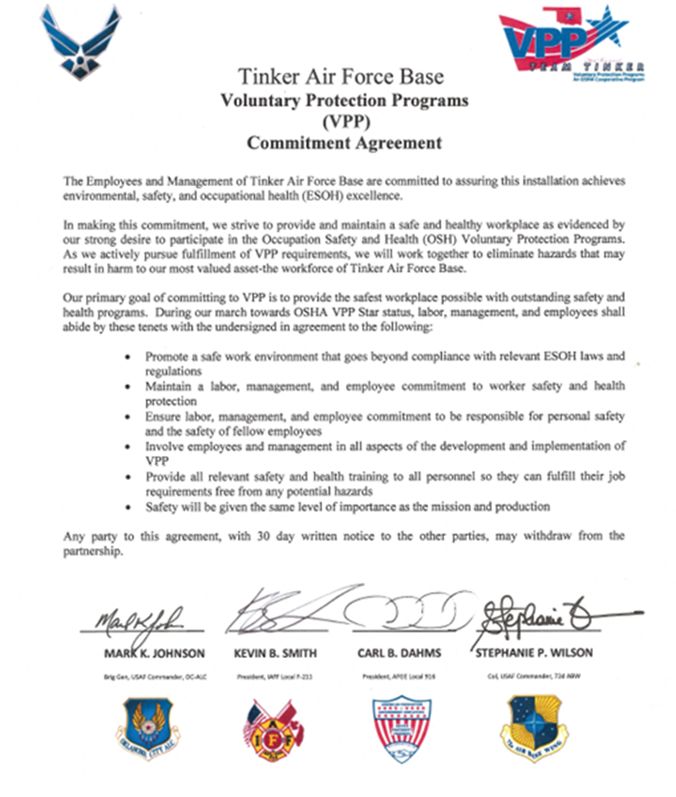
Example – S&H Commitment Letter
Image courtesy of Tinker Air Force Base
Notes:
Depending on your organization, you may have one leader, or several leaders, sign and promote your S&H commitment letter.
Image courtesy of Tinker Air Force Base. The image shows a commitment letter signed by several organizational leaders.

Slide 15
Develop a Leadership Involvement Strategy
Brainstorm activities to involve leaders and managers in the SMS
Choose strategies:
Promoting leader interaction with employees
Emphasizing visible leadership
Propose the top ideas to top management
Consider putting the approved strategies into a written plan
Gain approval to move the plan into action
Image retrieved from Bing Images
Notes:
A leadership involvement strategy spells out what you expect leaders at all levels to do in order to provide visible and effective S&H leadership.
Be inclusive in brainstorming ideas for the leadership involvement strategy. Effective leadership activities for top leaders, middle managers, and supervisors are not always the same. Involve top leaders, managers, and supervisors and ask what they think employees would like to see. Seek ideas from employees, committees, and unions and ask how they would like to see leaders and managers express their commitment for S&H. It is critical for you to build a strategy to make a noticeable difference and not waste your leaders’ valuable time.
Use a committee to rank all of the ideas you gather. Consider whether it is practical to implement the activity and its efficacy to influence workers. Make sure you narrow your ideas down to the ones you know your organization can execute effectively. Make sure your selected activities support the OSHA VPP sub-element, Management Commitment and Visible Top Management Leadership, and the overall purpose of your involvement strategy.
Run the proposed strategies by top management to see if they agree these are good strategies to employ throughout your organization. Once they agree, or you revise initial ideas, put your strategies into a written plan. While a written plan is not required for OSHA VPP purposes, it is a good idea to identify ways to improve this sub-element, document it, and execute your plan throughout your organization.
Identify due dates for each activity/frequency of completing each activity, responsible person(s), and metrics for measuring performance. Decide how to document these strategies, seek approval from top management, and move forward with implementing your plan.
Image retrieved from Bing Images (free to share and use license) at: http://www.socialbrite.org/wp-content/uploads/2012/02/Strategy_bigstock-525x348.jpg

Slide 16
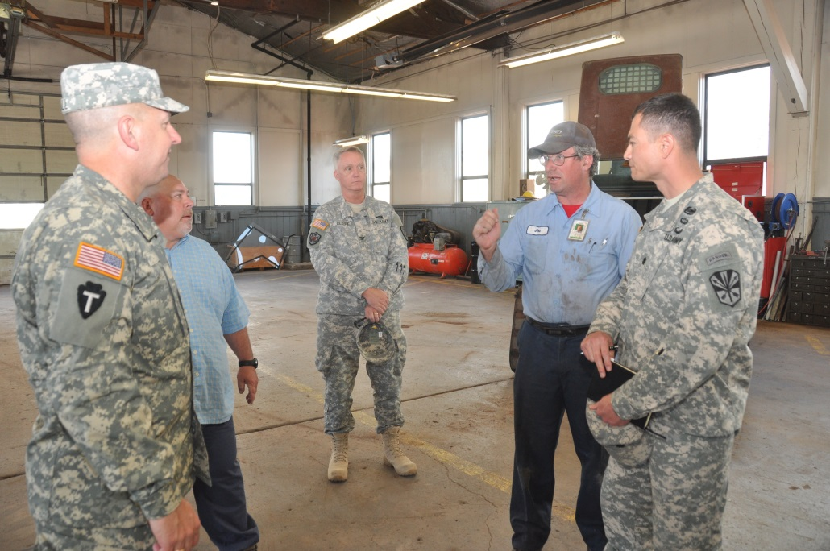
Implement a Leadership Involvement Strategy
Communicate the plan to leaders and managers
Educate them on their expectations
Monitor the execution of the established strategies
Document completed involvement activities
Image retrieved from Bing Images
Notes:
Remember this discussion is about visible leadership and management commitment. Do not delegate leadership and management actions required by the strategy to lower level personnel.
Hold the assigned level of personnel accountable for executing their assigned strategies. At first, focus on timely completion of required actions, moving to the quality of actions performed. Document all completed involvement activities, as determined in your plan, so you have documentation to show how you support this sub-element to an assessment team.
Image retrieved from Bing Images (free to share and use license) at: https://upload.wikimedia.org/wikipedia/commons/a/ac/Arizona_Guard_leader_visits_northern_facility_employees%2C_communicates_future_plans_140325-Z-TA763-021.jpg

Slide 17
Implement a Leadership Involvement Strategy
Provide strategy updates to leadership
Compile leadership performance metrics
Discuss leadership performance at leadership review meetings
Track leadership activities against the strategic plan
Image retrieved from Bing Images
Notes:
Determine who is responsible for providing strategy updates to leadership. During leadership review meetings, you can discuss strategy involvement obstacles, gathered metrics, and the way forward. Consider having the leaders who performed the activity brief their experience and/or findings to the group. It is also an opportunity where top management can express their concerns or feelings for specific involvement activities.
Best Practice: Consider assigning your VPP representatives to monitor leadership performance and strategy. When asked, they can attend leadership review meetings, or set up personal meetings, to discuss current performance against planned performance and identifying actions to address lack of performance, as needed.
Image retrieved from Bing Images (free to share and use license) at: https://www.501c3.org/wp-content/uploads/2014/12/board.jpg

Slide 18
Promote Visible Management Leadership for S&H
Ways leaders and managers show their commitment for S&H and the SMS include:
Establishing clear lines of communication | Holding personnel accountable for actions
Following S&H rules | Providing and directing resources to/for S&H
Documenting employee access to top management | Assigning authority to those with S&H responsibilities
Providing employees with equal, high-quality S&H protection | Maintaining a written SMS
Identifying responsible persons to carry out S&H expectations and requirements | Planning for unusual/emergency S&H expenditures
Integrating S&H into planning processes | Ensuring timely response to employee reports of hazardous conditions
Notes:
The components listed on the slide are not an all-inclusive list of ways your leaders and managers can demonstrate visible leadership to S&H; however, these are the examples provided in the CSP-03-01-005, VPP Policies and Procedures Manual. Think about ways your leaders can go above and beyond to visibly show they support S&H.
View the CSP at: https://www.osha.gov/enforcement/directives/csp-03-01-005
While you may incorporate some of these ideas into your leadership involvement strategy, you don’t want to lose sight of leaders and managers always demonstrating this commitment, whether a plan is in place or not.

Slide 19
Focus on Continuous Improvement
Address problems during regular performance reviews
Consider periodic surveys to gauge employee perceptions of leadership
Complete an annual self-evaluation of the SMS
Review and revise leadership involvement strategies and SSP
Image retrieved from Bing Images
Notes:
Assess your leadership involvement strategy as a stand-alone evaluation, or as part of your annual VPP self-evaluation.
In your annual self-evaluation, consider addressing:
Gaps in your leadership involvement strategy
Worksite conditions
Employee perception survey results
Breakdowns in communication among leaders and managers.
Resources for safety perception surveys include:
Air Force Combined Mishap Reduction System: https://www.afcmrs.org/
Army Readiness Assessment Program (ARAP): https://arap.safety.army.mil/
Ground Climate Assessment Survey System: https://www.semperfisurveys.org/
Enterprise Safety Applications Management System (ESAMS) “Personnel Safety Survey” and “Safety Climate Survey”: access to the perception surveys requires an ESAMS account.
Image retrieved from Bing Images (Creative Commons).

Slide 20
Conclusion
In this presentation, you learned to:
Summarize the background and importance of management commitment and leadership
List management commitment and leadership-related documentation
Describe the knowledge leadership/management, key personnel, and the workforce should have regarding management commitment and leadership
Identify management commitment and leadership actions to implement and sustain OSHA VPP

