Slide 1
Planning
OSHA VPP
October 2022
DISTRIBUTION STATEMENT D: Distribution authorized to the DoD and U.S. DoD contractors only; October 1, 2022. Other requests shall be referred to: Director, Operational Safety, OUSD(P&R), 4000 Defense Pentagon, 2E580, Washington, DC 20301.
WARNING: This document contains technical data whose export is restricted by the Arms Export Control Act (Title 22, U.S.C., sec. 2751, et seq.) or the Export Administration Act of 1979, as amended, Title 50, U.S.C., App. 2401 et seq. Violation of these export laws are subject to severe criminal penalties. Disseminate in accordance with the provisions of DoD Directive 5230.25.
Notes:
This presentation outlines planning requirements for the purposes of Occupational Safety and Health Administration (OSHA) Voluntary Protection Programs (VPP) implementation.
The presentation provides information on the background and importance of planning, budgeting, required documentation, and the various levels of employee knowledge. It concludes with an action checklist and supplemental details to help with OSHA VPP implementation and sustainment efforts.

Slide 2
Objectives
In this presentation, you will learn to:
Summarize the background and importance of planning
List planning-related documentation
Describe the knowledge leadership/management, key personnel, and the workforce should have regarding planning
Identify planning actions to implement and sustain OSHA VPP
Notes:
This presentation is beneficial to safety and occupational health (SOH) professionals, VPP representatives, as well as others with safety and health (S&H) planning responsibilities, to include those involved in budget development, facility changes, and the purchase of new chemicals, machinery, and equipment.

Slide 3
Background
Included in the ML&EI criteria for VPP
Covers planning for typical and unusual S&H expenditures:
Budget and resource allocations
Prompt correction of uncontrolled hazards
S&H training allocations
New or changing processes, chemicals, equipment, or facilities
Integrates S&H into the overall management planning process
Image retrieved from Bing Images
Notes:
ML&EI = Management Leadership and Employee Involvement
Planning in the early stages of any project, activity, or process change ensures you identify potential hazards and subsequent hazard controls before the work begins and employee exposures occur. Planning helps identify the budget, time, and other resources in advance to prepare for these risks.
Example resources include: personnel, job skills, materials, time, and equipment.
Reviewing S&H concerns late in the planning cycle may lead to unanticipated S&H obstacles, limiting options to move forward with the initial plan, and increased costs.
Your goal is to prevent mishaps in the planning process. A good risk assessment identifies anticipated risks, while your action plan implements the controls to reduce overall operational risk.
Image retrieved from Bing Images (Creative Commons).

Slide 4
Importance
Ensures organizational planning covers S&H
Develops a proactive strategy to S&H planning and expenditures
Helps determine S&H needs and potential resources
Assists in identifying S&H goals
Establishes processes to identify hazards before they enter the workplace
Helps select hazard control measures
Prepares for emergency expenditures
Image retrieved from Bing Images
Notes:
Use the planning process to establish S&H goals and objectives.
Ensure your goals are specific, measurable, attainable, realistic, and time-oriented (SMART). For information on SMART goals and objectives, visit this webpage: https://smscx.org/Repository/OnePagers/SMCX_OnePager_SMART_Goals_Objectives_Jul21.pdf
Develop a plan to prioritize process improvements. Layout your resources, including personnel, job skills, materials, and equipment. Set timelines and milestones.
Image retrieved from Bing Images (Creative Commons).

Slide 5
Documentation
Strategic safety plans
S&H perception survey results
Committee/working group charters
Meeting minutes
S&H budget
Procurement approval records
Image retrieved from Bing Images
Notes:
Make sure you provide completed examples of forms and documents to your assessment team. Don’t just show them blank forms! They want to see the documents you filled out to thoroughly assess the processes within your safety and occupational health management system (SOHMS).
Personnel involved in site planning may find an organizational chart and list of tenet organizations, volunteers, and imbedded contractors useful in planning processes. These documents are useful if someone is unfamiliar with your worksite. Compensation reports detailing the costs of legacy injury cases may identify trends and additional budgeting requirements towards combatting those trends.
Safety personnel generally develop a strategic plan and S&H goals. Goals need to have objectives detailing the actions needed to obtain the goals.
Perception surveys are not an OSHA VPP requirement; however, they identify where to adjust the safety culture. Use the results of these surveys to evaluate the current budgeting and resources to determine if additional funds, personnel, or other items are needed in a particular area.
A safety budget includes, but is not limited to, expenditures for the overall budget, new equipment and processes, personal protective equipment (PPE), safety training, controlling identified hazards, and awards and promotions. It is also important to have documentation outlining exactly how the budget was determined.
Image retrieved from Bing Images (free to share and use license) at: https://2012books.lardbucket.org/books/individual-finance/section_10/cfaf26f1b70ba7701bd3a040d0a9cf6f.jpg.

Slide 6
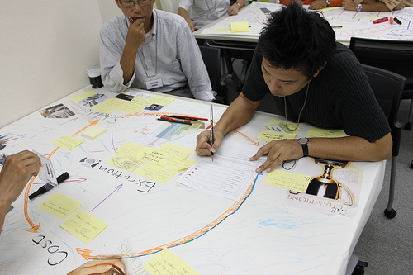
Documentation
S&H staffing requests
Facility modification documents
Hazard assessment forms and reports
Plans for construction project phases
SOH staffing requests
Image retrieved from Bing Images
Notes:
Facility modification documentation may include maps, blueprints, and specification packages.
Hazard assessment documentation may include pre-planning forms with anticipated risks and other hazard assessments (e.g., job hazard analyses, process hazard analyses) for evaluating the work environment and processes at the beginning of a change.
If you are a construction company, you must consider S&H for each individual phase of your construction projects.
Image retrieved from Bing Images (free to share and use license) at: http://www.techstagram.com/wp-content/uploads/2015/05/Project-Management.jpg.

Slide 7
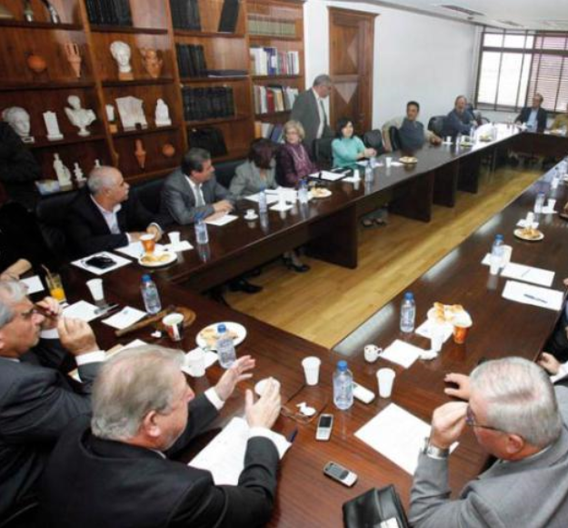
Leadership/Management Knowledge
Leaders and managers should be knowledgeable of:
Processes in place to ensure adequate resources for S&H
S&H budget and its components
Current on-site construction activities
Process for approving procurements
Recent changes to work areas or facilities
Image retrieved from Bing Images
Notes:
Leadership should know about: budget development, procurement approvals, and facility and process modification approvals.
Upper management must provide adequate resources for S&H programming, such as funding, time, and professional staff.
Image retrieved from Bing Images (free to share and use license) at: http://i2.wp.com/cyprus-mail.com/wp-content/uploads/2013/05/PASYDY-top-brass.jpg?fit=730%2C9999.
The image shows a planning meeting between divisional groups.

Slide 8
Key Personnel Knowledge
Key personnel should be knowledgeable about:
Recent S&H-related purchases or expenditures
How the S&H budget is determined
Procurement processes
S&H training allocations and plans
Procedures to evaluate the S&H of construction projects
Strength of S&H staffing
Budget process guidelines
Image retrieved from Bing Images
Notes:
Key personnel can include: management, safety staff, facility managers, assigned budget or resource personnel, training managers, project managers, and human resources. Various key personnel are included in S&H health planning because you incorporate S&H planning into every process!
Key personnel must have a thorough understanding of the processes they own and consider safety and health in the planning phase. Additionally, key personnel must know not only the details of the S&H budget, but also the items evaluated to determine the budget. S&H planning also includes training budgets and allocations.
Image retrieved from Bing Images (Creative Commons).

Slide 9
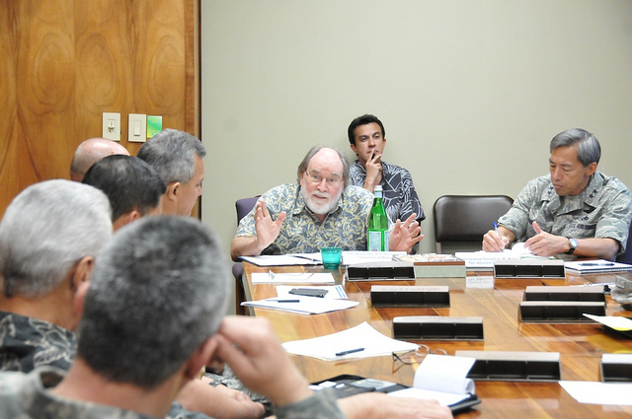
Workforce Knowledge
Employees should be knowledgeable about:
Processes to request new chemicals, equipment, or PPE
Their involvement in the safety decision-making process, if applicable
Current construction activities, process changes, or facility modifications affecting workplace S&H
Processes for assessing risk
S&H-related training they receive
Image retrieved from Bing Images
Notes:
Employees often inform their supervision when they need new chemicals, materials, or equipment – it is important that employees understand the processes for requesting these items.
Employees should understand the various types of training they received and how often training occurs.
Images retrieved from Bing Images (free to share and use license) at: http://farm8.staticflickr.com/7172/6694049353_3cc95e04c8_z.jpg.
The image shows employees engaged in planning processes.

Slide 10
Action Checklist
Incorporate S&H in the management planning processes
Pre-plan for S&H
Create a budget
Establish a procurement approval process
Communicate workplace changes
Employ the use of developed processes
Monitor and measure planning processes
Image retrieved from Bing Images
Notes:
Follow this action checklist to implement and sustain VPP expectations for planning. Each of these action checklist items will be covered in more detail.
Image retrieved from Bing Images (Creative Commons).

Slide 11
Management Planning Processes
Identify resources, both financial and human
Budget for resources and training
Develop and prioritize goals and objectives
Create timelines and assign responsibility
Develop metrics to measure progress
Be flexible and adjust plans, as necessary
Establish open and clear lines of communication
Image retrieved from Bing Images
Notes:
Create S&H goals based on the results of S&H evaluations. Think about how to achieve your overall management goals. Communicate progress and setbacks to team members and employees – keep everyone in the loop so they know how to help.
Don’t place the responsibilities on one individual – instead, use a group approach! Include multiple groups, individuals, and other employees in the planning process, especially key contractor representatives, to be highly successful across your organization.
Image retrieved from Bing Images (free to share and use license) at: http://3.bp.blogspot.com/-UYE6z8QZ-ZY/Ur-VFBA4NgI/AAAAAAAACPY/EUff9b1_Gcg/s1600/Goal-Setting.jpg.
The image shows the SMART requirements for setting meaningful goals and objectives.

Slide 12
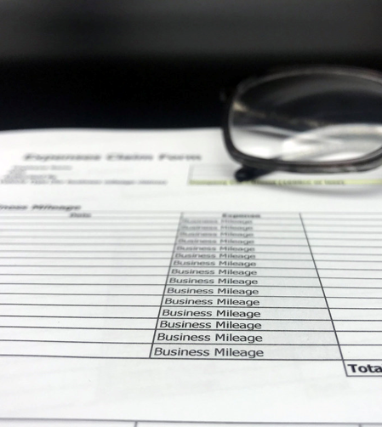
Safety & Health Pre-Planning
Identify local internal and external resources
Develop a list of hazard analyses to conduct
Create or fine-tune processes related to procurement approvals
Make a list of all potential safety expenses
Include S&H personnel in emergency planning, especially to identify possible emergency expenditures
Identify all training requirements
Image retrieved from Bing Images
Notes:
There may be local organizations in your community that can assist with the overall planning for your organization. These organizations include other government agencies, non-profit S&H organizations, and volunteer groups.
Your pre-planning efforts ensure you identify and eliminate or control hazards before they enter the workplace. You do this by developing a list of hazard analyses and conducting them during your efforts.
Consider the Plan-Do-Check-Act cycle for process improvement, especially planning. For more information on the Deming cycle, visit: https://deming.org/explore/p-d-s-a.
Image retrieved from Bing Images (Creative Commons).

Slide 13
Budget Development
Develop a S&H budget each year, considering:
Need for additional S&H professionals
Required S&H training
Hazard controls – safeguards, safety devices, PPE
Safety communications, promotions, and incentives
Review historical budget needs
Consider unapproved requests from previous years
Image retrieved from Bing Images
Notes:
The safety staff is generally responsible for developing the safety budget during the planning process. The safety budget is usually part of an overall organizational budget. You must prioritize important and essential items vs. what is “nice to have”.
Write the budget in detail, outlining categories where budgeting is needed and comparing it to previous allocations and resources. Always provide justification as to why the budget needs to increase, if applicable, or why you need previously unapproved requests approved now.
Image retrieved from Bing Images (free to share and use license) at: http://3.bp.blogspot.com/--o4aX9boBpU/UFoBbmhFXWI/AAAAAAAAWUE/gOgqKKVXAmQ/s1600/budget-clip-art(3).jpg.
The image shows a person developing a budget; assure you have the proper resources to meet the expectations of your S&H plan.

Slide 14
Pre-Use Approval Processes
Check Service or Agency guidance for existing processes and forms
Develop pre-use approval processes
Identify situations in which employees may try to avoid approval processes
Think about how to enforce the processes
Involve key personnel in identifying S&H specifications
Integrate S&H specifications into the procurement process
Determine who needs to sign off on requests
Notes:
Pre-use approval processes have many benefits. First, S&H professionals can identify hazards and develop approaches to control identified hazards before they enter the workplace. The pre-use approval process ensures all new purchases or changes are compliant with S&H regulations (e.g., machine guarding). In addition, analyzing your equipment before use saves time and money; for example, if new machinery arrives and needs additional safety guarding or safety devices before use.
Review existing Service or Agency guidance for the procurement of new chemicals, purchasing of machinery, or changing the way a process is completed prior to developing your own processes. Many Services and Agencies have existing pre-use approval forms.
Create pre-use approval processes (if necessary) for new chemicals, equipment, machinery, facilities, or processes. Each of these may have individual processes. These processes require S&H reviews and approvals PRIOR to purchasing or changes.
Key personnel may include: S&H staff, industrial hygienists, occupational health, environmental specialists, and fire department personnel.
Identify S&H requirements in the purchase of new equipment, materials, or chemicals; standardize these expectations and apply them to every purchase order or specification. S&H professionals should use their knowledge and expertise to develop these criteria. Train management, supervisors, and affected personnel on all pre-approval processes. Enforce all pre-approval processes.

Slide 15
Communication
Develop procedures for communicating pre-use analysis processes and changes in the workplace
Image retrieved from Bing Images
Notes:
Communicate workplace changes to all affected employees. Training may be required depending how the change affects work processes. For example, new chemicals create a change in procedures; therefore, you must train employees on these procedural changes. Make sure to document all training sessions and communications.
Image retrieved from Bing Images (free to share and use license) at: https://voicesofglass.files.wordpress.com/2014/01/changeschallengesahead.gif.

Slide 16
Communication
Develop procedures for communicating pre-use analysis processes and changes in the workplace
Inform all affected personnel of:
Pre-use approval procedures, including items employees bring in from home to use at work
Anticipated or previously-occurring workplace changes
How changes relate to jobs and affect employees
Anything needing to be done differently due to the change
Additional S&H training required
Image retrieved from Bing Images
Notes:
Examples of when to inform affected personnel include:
What changes have occurred (e.g., new chemicals)
How the change affects work (e.g., new hazards)
What needs to be done different (e.g., changes in procedures, new PPE).
It is important to not only communicate pre-use approval procedures with employees, but the process they need to follow when they bring items, like PPE or chemicals, in the workplace.
Image retrieved from Bing Images (Creative Commons).
The image shows a supervisor showing an employee how a new chemical changes their work processes.

Slide 17
Plan Execution
Initiate the documented approval process
Include appropriate S&H staff in reviews and approvals
Document all pre-use approvals and plan changes
Hold personnel accountable when processes are not followed
Image retrieved from Bing Images
Notes:
Plan execution revolves around ensuring employees (e.g., employees, supervisors, stakeholders) use your planning processes. The system of approvals and reviews prior to purchases and changes helps reduce S&H risk potential. Rely on your accountability guidance if employees do not use your processes consistently.
Image retrieved from Bing Images (free to share and use license) at: http://svprojectmanagement.com/wp-content/uploads/2013/01/FAN9000744-300x199.jpg.

Slide 18
Monitor & Measure
Ensure communications are effective
Review the planning process annually
Check work areas for unapproved equipment, chemicals, or changes
Was the budget enough?
Were there any unforeseen emergency events?
Did any supplies, materials, PPE, or other S&H items run out?
Does the budget need increased?
Did you accomplish all training goals?
Notes:
Utilize the most effective means of communication possible. For example, simply sending a mass email of changes to all employees is not as effective as having a safety stand down meeting to discuss changes in person.
Review and monitor the safety planning process. Annually, re-evaluate the plan to determine if the planned budget was enough or if the budget needs increased. Evaluate each budgeted or planned item to determine if the funding or allocations were enough to accomplish them.
Use your inspection process to look for new chemicals, equipment, or process and facility changes. S&H professionals typically look for these items during annual safety inspections, but it is always good to have a second set of eyes looking for these things – especially supervisors inspecting their work areas. Look for these items during workplace inspections because they could have been overlooked initially. All new chemicals, equipment, and process or facility changes need to go through a pre-use analysis process for hazard identification and purposes.
Best Practice: Use the OSHA VPP annual self-evaluation to monitor the effectiveness of your SOHMS.

Slide 19
Conclusion
In this presentation, you learned to:
Summarize the background and importance of planning
List planning-related documentation
Describe the knowledge leadership/management, key personnel, and the workforce should have regarding planning
Identify planning actions to implement and sustain OSHA VPP

