Slide 1
Safety & Health Management System Evaluation OSHA VPP
January 2021
Notes:
This presentation outlines safety and health management system (S&HMS) evaluation requirements for the purposes of the Occupational Safety and Health Administration (OSHA) Voluntary Protection Programs (VPP) recognition.
The presentation provides information on the background and importance of S&HMS evaluations, required documentation, and the various levels of employee knowledge. It concludes with an action checklist and supplemental details to help with OSHA VPP implementation and sustainment efforts.
For the purpose of this presentation, S&HMS is synonymous with safety management system (SMS), annual VPP self-evaluation, and annual self-evaluation.

Slide 2
Objectives
In this presentation, you will learn to:
Summarize the background and importance of SMS evaluations
List SMS evaluation-related documentation
Describe the knowledge leadership/management, key personnel, and the workforce should have regarding SMS evaluations
Identify SMS evaluation-related actions to implement and sustain OSHA VPP
Notes:
This presentation is beneficial to safety professionals and VPP representatives, as well as others with responsibilities or involvement in the annual VPP self-evaluation.

Slide 3
Background
Included in the ML&EI criteria for VPP
Used to evaluate the effectiveness of the SMS
Submitted with the OSHA VPP applications
Submitted annually to OSHA
Once VPP recognition is achieved
Image retrieved from Microsoft Clip Art
Notes:
ML&EI = Management Leadership and Employee Involvement
The purpose of the annual self-evaluation is to critically look at the SMS and identify strengths and weaknesses of the system. Once you identify strengths and weaknesses, you can address the weaknesses and push towards continuous improvement.
Sometimes, organizations mistakenly think safety and health (S&H) inspections qualify as an annual self-evaluation. In fact, a comprehensive S&H inspection does not meet the criteria of this evaluation unless it broadly assesses the four VPP elements.
NOTE: You must submit the most current annual VPP self-evaluation with the OSHA VPP application in order for OSHA to consider your organization for VPP recognition. OSHA references the most currently completed annual VPP self-evaluation during their on-site visit to assess your SMS. VPP recognized worksites are required to submit a completed evaluation annually to their regional OSHA/VPP office; it is due by February 15 each year.
Keep in mind the annual self-evaluation is the tool to drive S&H excellence and continuous process improvement within your SMS.
Image retrieved from Microsoft Clip Art.

Slide 4
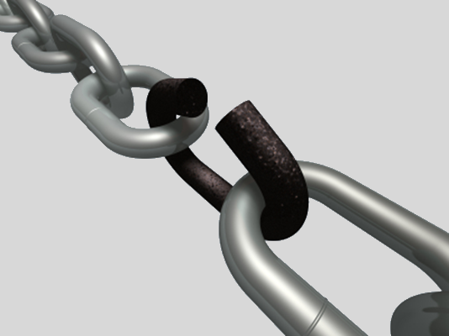
Importance
Provides an opportunity to review and assess the overall SMS
Recognizes strengths and weaknesses of the SMS and S&H program
Identifies goals for improvement
Presents employee involvement opportunities
Image retrieved from Microsoft Clip Art
Notes:
Annual self-evaluation: A critical review performed to assess the effectiveness of all four VPP elements and their sub-elements.
Image retrieved from Microsoft Clip Art.

Slide 5
Importance
Facilitates communications between organizational functions
Helps evaluate SMS implementation effectiveness
Focuses on maintenance, sustainment, and continuous improvement
Image retrieved from Microsoft Clip Art
Notes:
What else does the annual self-evaluation do? It also helps you analyze not only your injury and illness data, but contractor injury and illness data too. The evaluation describes the implementation, maintenance, and continuous improvement efforts you made to change your safety culture and move your S&H program to a SMS.
Image retrieved from Microsoft Clip Art.

Slide 6
Documentation
Annual VPP self-evaluations
How well do you execute your S&H programs and processes?
Image retrieved from Bing Images
Notes:
Make sure you provide completed examples of forms and documents to your assessment team. Don’t just show them blank forms! They want to see the documents you filled out to thoroughly assess the processes within your SMS.
Annual self-evaluations show how well your organization executes S&H programs and processes. You want to be able to provide as many completed annual self-evaluations as you can to show how your SMS has improved over time.
View the annual self-evaluation format at: https://www.osha.gov/vpp/2014-format
Please note certain VPP regions have templates they prefer for the annual self-evaluation. The templates contain the same basic requirements, but the formats are slightly different. Contact your Regional VPP Manager to see if they have a regional template.
Find your Regional VPP Manager’s contact information at: https://www.osha.gov/vpp/vpp-managers-text
Image retrieved from Bing Images (free to share and use license) at: https://upload.wikimedia.org/wikipedia/commons/thumb/c/c4/Coloured%2C_textured_craft_card.jpg/1280px-Coloured%2C_textured_craft_card.jpg

Slide 7
Documentation
The annual self-evaluation should include:
A description of the employees
Worksite and contractor injury and illness rates
Significant S&H changes and events
Success stories and implemented best practices
Written descriptions of how each VPP sub-element is met
Progress made on recommendations/goals from the previous year
Identified SMS strengths and weaknesses
Goals for improvement
Notes:
Each worksite has a different composition of employees. Be specific and describe the types of employees you have at your site (e.g., civilians, military personnel, volunteers, contractors).
Include injury and illness rates for your specific organization and for any applicable contractors working at your worksite.
Applicable contractor: A contractor whose employees worked at least 1,000 hours for a VPP participant in any calendar quarter within the last 12 months and are not directly supervised by the participant.
Significant S&H changes and events may include: leadership changes, facility modifications, the addition of new processes, or changes in resources (e.g., S&H staff).
When writing your self-evaluation, focus on the efforts put forth over the past calendar year. Use previous results (from old annual self-evaluations, if possible) to see how you have improved.
In addition, you’ll complete the Process Safety Management (PSM) Supplemental B Questionnaire, if PSM occurs at your site.

Slide 8
Leadership/Management Knowledge
Leaders and managers should know about:
The purpose of the annual self-evaluation
SMS strengths and weaknesses
Implemented best practices
Significant S&H changes and events
S&H goals and objectives for which they are responsible
Their responsibility for the final review and approval of the annual self-evaluation
Notes:
Leaders drive the SMS. Consider how you communicate SMS evaluation information to your leaders - maybe you have to establish periodic meetings with leadership, maybe you have to email them the results of the annual self-evaluation. Either way, keep leaders in the loop. Let them know of identified strengths and weaknesses. Bring them ideas on how to improve identified gaps. Ensure they understand the timeframe to fix an identified weakness. Leaders should be aware of any completed annual self-evaluations. They should approve and sign off on these to acknowledge their acceptance.

Slide 9
Key Personnel Knowledge
Key personnel should know about:
Who conducts the annual self-evaluation
VPP sub-elements for which they have direct functional responsibility
Purpose and importance of the annual self-evaluation
Identified strengths and weakness from the last annual self-evaluation
Goals for improvement
When to submit the annual self-evaluation to OSHA
Notes:
Key personnel may include: S&H staff, industrial hygienists, occupational health personnel, emergency managers, contracting office personnel, human resources staff, and some managers and supervisors.
Key personnel manage or provide support for many VPP elements. They may be able to provide great insight on the strengths and weakness of your SMS and help generate goals for your organization.

Slide 10
Workforce Knowledge
Employees should be knowledgeable about:
The annual self-evaluation as a part of OSHA VPP Star recognition
Ways to provide input for the annual self-evaluation
Goals for improvement
Goals directly affecting them
Image retrieved from Bing Images
Notes:
Involve employees as much as possible in the development and review of the annual self-evaluation. All levels of employees should know how to contribute information to improve your SMS, even if it doesn’t directly relate to the annual self-evaluation.
Image retrieved from Bing Images (Creative Commons).

Slide 11
Action Checklist
Develop a plan to complete your annual self-evaluation
Collect and review SMS documents
Complete and review the annual self-evaluation
Submit the evaluation to OSHA, if applicable
Focus on continuous improvement
Image retrieved from Microsoft Clip Art
Notes:
Follow this action checklist to implement and sustain VPP expectations for SMS evaluation. Each of these action checklist items will be covered in more detail.
NOTE: Conduct at least one annual self-evaluation prior to submitting your OSHA VPP application. You need to find out how your Regional VPP Manager wants the evaluation submitted – electronically or mailed.
Image retrieved from Microsoft Clip Art.

Slide 12
Pre-Planning
Read through the VPP requirements listed in OSHA’s CSP 03-01-005
Become familiar with OSHA’s annual self-evaluation format
Know when to perform an annual self-evaluation:
As part of the OSHA VPP application process
At least one year prior to submitting an OSHA VPP application
Annually, once OSHA recognizes your worksite as a VPP Star
Notes:
View OSHA’s Cooperative and State Programs (CSP) 03-01-005 at: https://www.osha.gov/sites/default/files/enforcement/directives/CSP_03-01-005.pdf
View the annual self-evaluation format at: https://www.osha.gov/vpp/2014-format
Developing the annual self-evaluation is not an individual effort. Involve employees, key personnel, and program owners to help create a comprehensive evaluation. Using a team approach also facilitates communication and creates employee involvement opportunities.
Perform annual self-evaluations as part of your OSHA VPP application process. Complete an annual self-evaluation at least one year prior to submitting your OSHA VPP application. Working ahead allows you enough time to re-survey your SMS and show OSHA you have the ability to evaluate and improve your SMS.

Slide 13
Pre-Planning
Treat the evaluation like a project
Think about how you want to execute it
Identify:
Responsible persons to address each VPP sub-element
Timelines for completion
Required resources
Image retrieved from Microsoft Clip Art
Notes:
Image retrieved from Microsoft Clip Art.

Slide 14
Pre-Planning
Allow enough time to gather information
Allot time to review the content
Identify one person to perform a final scrub on the information
Image retrieved from Bing Images
Notes:
The annual self-evaluation is due to OSHA by February 15 each year for VPP Star sites.
Consider starting the evaluation process around September to finish it on time. Ensure there is enough time to gather information, write the narrative pieces of the evaluation, and review the information for accuracy.
Image retrieved from Bing Images (free to share and use license) at: http://toolkit.pellinstitute.org/wp-content/uploads/2009/12/Plan3.jpg

Slide 15
Document Review
Review supporting documents to complete the annual self-evaluation:
VPP perception surveys
Hazard analyses
Written hazard control programs
Injury and illness rates
Trend analysis information
S&H training records
Accident investigation results
Open deficiencies in the hazard tracking log
Safety inspection results
Goals and objectives (current and previous year)
Notes:
You should review the documents listed on the slide during an SMS evaluation – these are only some examples, this list is not all-inclusive.
Other information may include: management and employee initiatives, budgets, visible involvement documentation, presented S&H awards, performance evaluations, preventative maintenance records, occupational health documents, injury and illness rates, and contractor oversight inspections.
Be ready to provide a written explanation if there are questionable injury and illness rates for your organization or the applicable contractors. Example reasons to provide a written explanation may include: a significant increase in rates, high contractor rates, or a change in the industry classification code.

Slide 16
Evaluation Completion
Assign a person/group to each VPP sub-element
Communicate roles and responsibilities to each assigned person/group
Focus on the calendar year evaluated
Image retrieved from Microsoft Clip Art
Notes:
Example roles and responsibilities for someone assigned to develop the annual self-evaluation include: hold interviews with management and employees, review related documents, conduct site walk-throughs, and refrain from assuming any information is correct - verify it all!
You may have to provide assigned persons/groups with additional information to carry out their roles and responsibilities, such as basic interview techniques, what questions to ask, how many/who to interview, and what to look at.
Remember, your annual self-evaluation is for a specific calendar year (Jan 1 to Dec 31). Show OSHA what you accomplished over the year related to VPP implementation, sustainment, and continuous improvement.
Image retrieved from Microsoft Clip Art.

Slide 17
Evaluation Completion
Write comprehensive narratives for each sub-element and describe:
Related activities
Initiated and implemented action plans
Examples, where necessary
Current condition and status
Strengths and weaknesses
Status of previous goals, if applicable
Corrective action plans to resolve issues
Goals for improvement
Specific actions, responsible parties, and target completion dates
Notes:
Consider these questions when developing the annual self-evaluation:
Do the employees have a basic knowledge of the self-evaluation and what it contains?
Are documents provided to support employee knowledge and practices?
Does it meet established goals and objectives?
Is it operating effectively?
Have best practices been identified?
Do obstacles hindering the development and implementation of your self-evaluation exist?
Are there improvements to make the process more effective?
Are there any goal modifications and suggestions for the upcoming year?
Hint: The e-SMS Tool and associated portals have the capability to pull together an annual VPP self-evaluation if your organization is a registered site and your “Action Plan” is up-to-date. https://sms.smscx.org/
Narratives for each sub-element must include: how the criteria is addressed (e.g., documents, interviews, trend analysis) and the actions taken to implement, maintain, sustain, and continuously improve the criteria.
Include any identified weaknesses or gaps in the recommendations for improvement portion of the sub-element evaluation. Do not focus solely on strengths. Include best practices or improvements related to the sub-element over the calendar year as well.

Slide 18
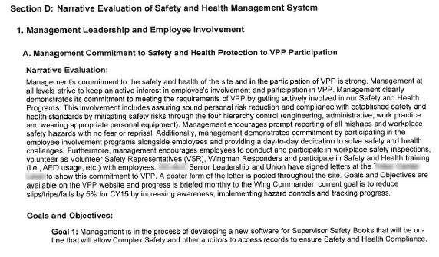
Example – Annual Self-Evaluation
Image courtesy of the DoD SMCX
Notes:
The image shows a snippet from an OSHA VPP Star site annual self-evaluation.

Slide 19
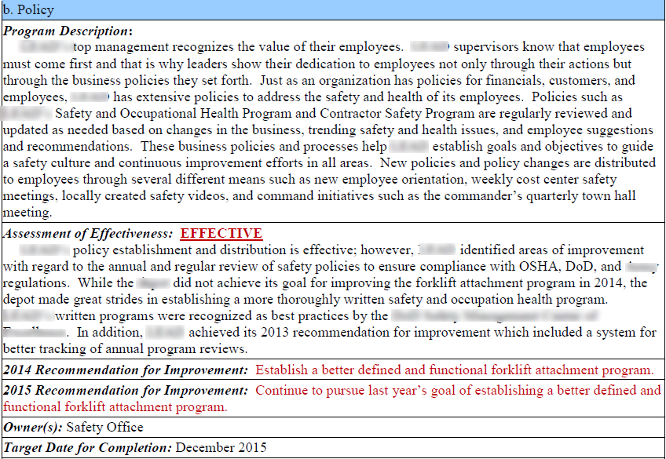
Example – Annual Self-Evaluation
Image courtesy of the DoD SMCX
Notes:
The image shows a snippet from an OSHA VPP Star site annual self-evaluation.

Slide 20
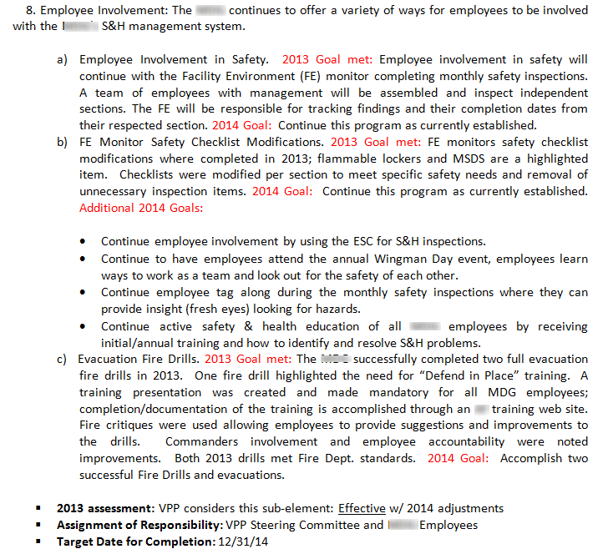
Example – Annual Self-Evaluation
Image courtesy of the DoD SMCX
Notes:
The image shows a snippet from an OSHA VPP Star site annual self-evaluation.

Slide 21
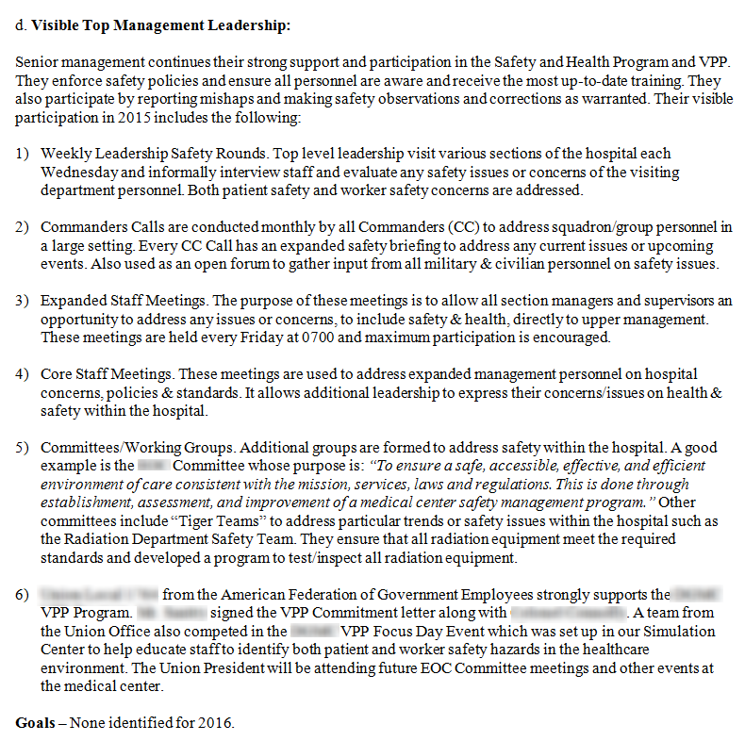
Example – Annual Self-Evaluation
Image courtesy of the DoD SMCX
Notes:
The image shows a snippet from an OSHA VPP Star site annual self-evaluation.

Slide 22
Evaluation Review
Assign one person to collect and review each narrative
Ensure narratives are comprehensive and accurate
Make sure goals are set for continuous improvement
Image retrieved from Microsoft Clip Art
Notes:
Designate one person to “collective” your annual self-evaluation. Return any section(s) without comprehensive information back to the assigned person(s). Make sure any goals you set for continuous improvement are relative to your worksite as well.
Image retrieved from Microsoft Clip Art.

Slide 23
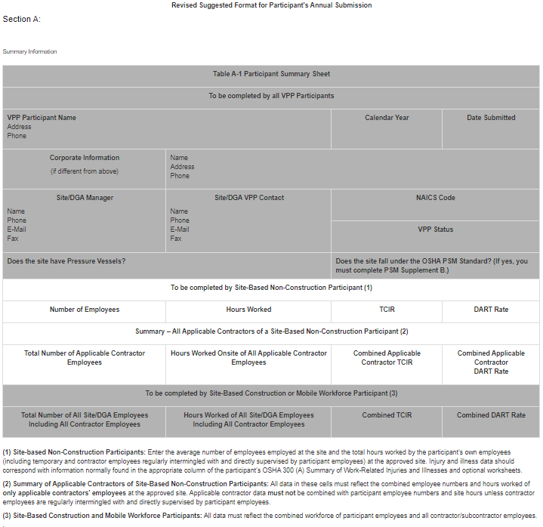
Evaluation Review
Compile the information (using the OSHA format)
Have the management team review the evaluation
Make adjustments to the evaluation, as necessary
Image retrieved from OSHA
Notes:
Ensure management reviews the final version of the evaluation for approval; ensure the information is accurate. Many worksites also have labor representatives review the annual self-evaluation at this point. Keep in mind OSHA verifies the information provided in the annual self-evaluation and the application when they conduct their on-site evaluation.
The image shows a snapshot of the OSHA VPP annual self-evaluation format.
Image retrieved from OSHA at: https://www.osha.gov/vpp/2014-format

Slide 24
Evaluation Review
Finalize the evaluation
Present the evaluation to leadership for approvals and signatures
Image retrieved from Bing Images
Notes:
Ensure management reviews the final version of the evaluation for approval; ensure the information is accurate. Many worksites also have labor representatives review the annual self-evaluation at this point. Keep in mind OSHA verifies the information provided in the annual self-evaluation and the VPP application when they conduct their on-site evaluation.
Image retrieved from Bing Images (free to share and use license) at: http://autopsy.pathology.ufl.edu/files/2012/02/autopsy-paperwork.jpg

Slide 25
Submissions
If you are a VPP Star worksite: | Send the annual self-evaluation to your OSHA Regional Office by February 15
If you are not a VPP Star worksite: | Keep the document on file Submit the annual self-evaluation with your OSHA VPP application when you are ready
Notes:
Contact your OSHA Regional Office prior to the due date to determine how they want you to submit the annual self-evaluation (i.e., electronically or hard copy through the mail).

Slide 26
Continuous Improvement
Use the annual self-evaluation information to:
Revise existing, or create new, S&H goals and objectives
Update, or create, implementation/sustainment action plans
Continually identify ways to improve your SMS
Image retrieved from Microsoft Clip Art
Notes:
Use the annual self-evaluation to continue implementing and sustaining VPP requirements and drive continuous improvement.
Image retrieved from Microsoft Clip Art.

Slide 27
Conclusion
In this presentation, you learned to:
Summarize the background and importance of SMS evaluations
List SMS evaluation-related documentation
Describe the knowledge leadership/management, key personnel, and the workforce should have regarding SMS evaluations
Identify SMS evaluation-related actions to implement and sustain OSHA VPP

