Slide 1
Written Safety Management System
OSHA VPP
January 2021
Notes:
This presentation outlines written safety management system (SMS) requirements for the purposes of the Occupational Safety and Health Administration (OSHA) Voluntary Protection Programs (VPP) approval.
The presentation provides information on the background and importance of a written SMS, required documentation, and the various levels of employee knowledge. It concludes with an action checklist and supplemental details to help with OSHA VPP implementation and sustainment efforts.

Slide 2
Objectives
During this presentation, you will learn to:
Summarize the background and importance of a written SMS
List written SMS-related documentation
Describe the knowledge leadership/management, key personnel, and the workforce should have regarding the written SMS
Identify written SMS-related actions to implement and sustain OSHA VPP
Notes:
This presentation is beneficial to leaders, safety and health (S&H) professionals, and VPP representatives.

Slide 3
Background
Included in the ML&EI criteria for VPP
Serves as the overarching guidance for the SMS
Establishes a planned process for carrying out S&H procedures and SMS expectations
Documents the elements and sub-elements of VPP
Encompasses other S&H programs and processes, like those required by standard
Image retrieved from Bing Images
Notes:
MLEI = Management Leadership and Employee Involvement A written SMS is synonymous with a written S&H program. Many organizations already have a written SMS, which is comprised of the general S&H policies, procedures, processes, and programs they execute in the workplace. A written SMS is important in expanding S&H program documentation towards capturing the overall processes and systems in an organization, to include how those processes and systems incorporate the four elements of VPP (e.g., Management Leadership and Employee Involvement, Worksite Analysis, Hazard Prevention and Control, and Safety and Health Training).
Image retrieved from Bing Images (Creative Commons).

Slide 4
Importance
Provides guidance in the workplace for VPP implementation and sustainment
Minimizes the likelihood and severity of workplace injuries and illnesses
Allows for the anticipation of workplace challenges
Ensures consistency in processes and procedures
Image retrieved from Bing Images
Notes:
Your written SMS gives your employees guidance on your organizational expectations, carrying out policies and procedures, and maintaining and sustaining the best S&H program possible. A comprehensive written SMS helps you guide your workforce in the correct direction. An effective written SMS helps you experience some of the benefits listed on this slide.
View the OSHA VPP Policies and Procedures Manual (CSP 03-01-005) for additional information regarding the written SMS requirement:
https://www.osha.gov/sites/default/files/enforcement/directives/CSP_03-01-005.pdf.
Image retrieved from Bing Images (Creative Commons).

Slide 5
Documentation
Written SMS document
Organizational chart
Safety office organizational chart, if applicable
List of subordinate worksites
Site map
Applicable S&H programs
Image retrieved from Bing Images
Notes:
Make sure you provide completed examples of forms and documents to your assessment team. Don’t just show them blank forms! They want to see the documents you filled out to thoroughly assess the processes within your SMS.
An overarching written SMS documents the VPP elements and sub-elements of your S&H implementation and sustainment efforts. It also provides direction to your workforce by providing procedures for implementing VPP throughout your organization.
An organizational chart must include a breakdown of all organizations and their leaders from the top down and any associated tenant activities. The safety office organizational chart is important because it shows specific contacts when any safety questions arise. It also indicates where the safety office is located in the organization’s hierarchy.
Be sure to have a list of all your organization’s subordinate worksites. It is important to delineate the organizations covered by your safety program. It is also important because you need to monitor the execution of their safety program and gather their safety statistics.
You need a site map to support your written SMS. A site map shows locations of specific buildings and operations. It is important because it is required to complete self-safety inspections at least once a quarter.
Examples of S&H programs include, but are not limited to: permit-required confined space entry, hearing conservation, hazardous energy control, hazard communication, and fall protection.
Image retrieved from Bing Images (Creative Commons).

Slide 6
Leadership/Management Knowledge
Leaders and managers should know about:
S&H hazards throughout the organization
Written S&H programs
Benefits of VPP partnership and approval
Best practices in S&H throughout the organization
Improvements made through incorporating VPP elements/sub-elements
Image retrieved from Bing Images
Notes:
Managers need to make S&H a core value. Managers set the stage for employee involvement. Without demonstrated commitment and enforcement, a S&H policy may be meaningless to employees.
Image retrieved from Bing Images (Creative Commons).

Slide 7
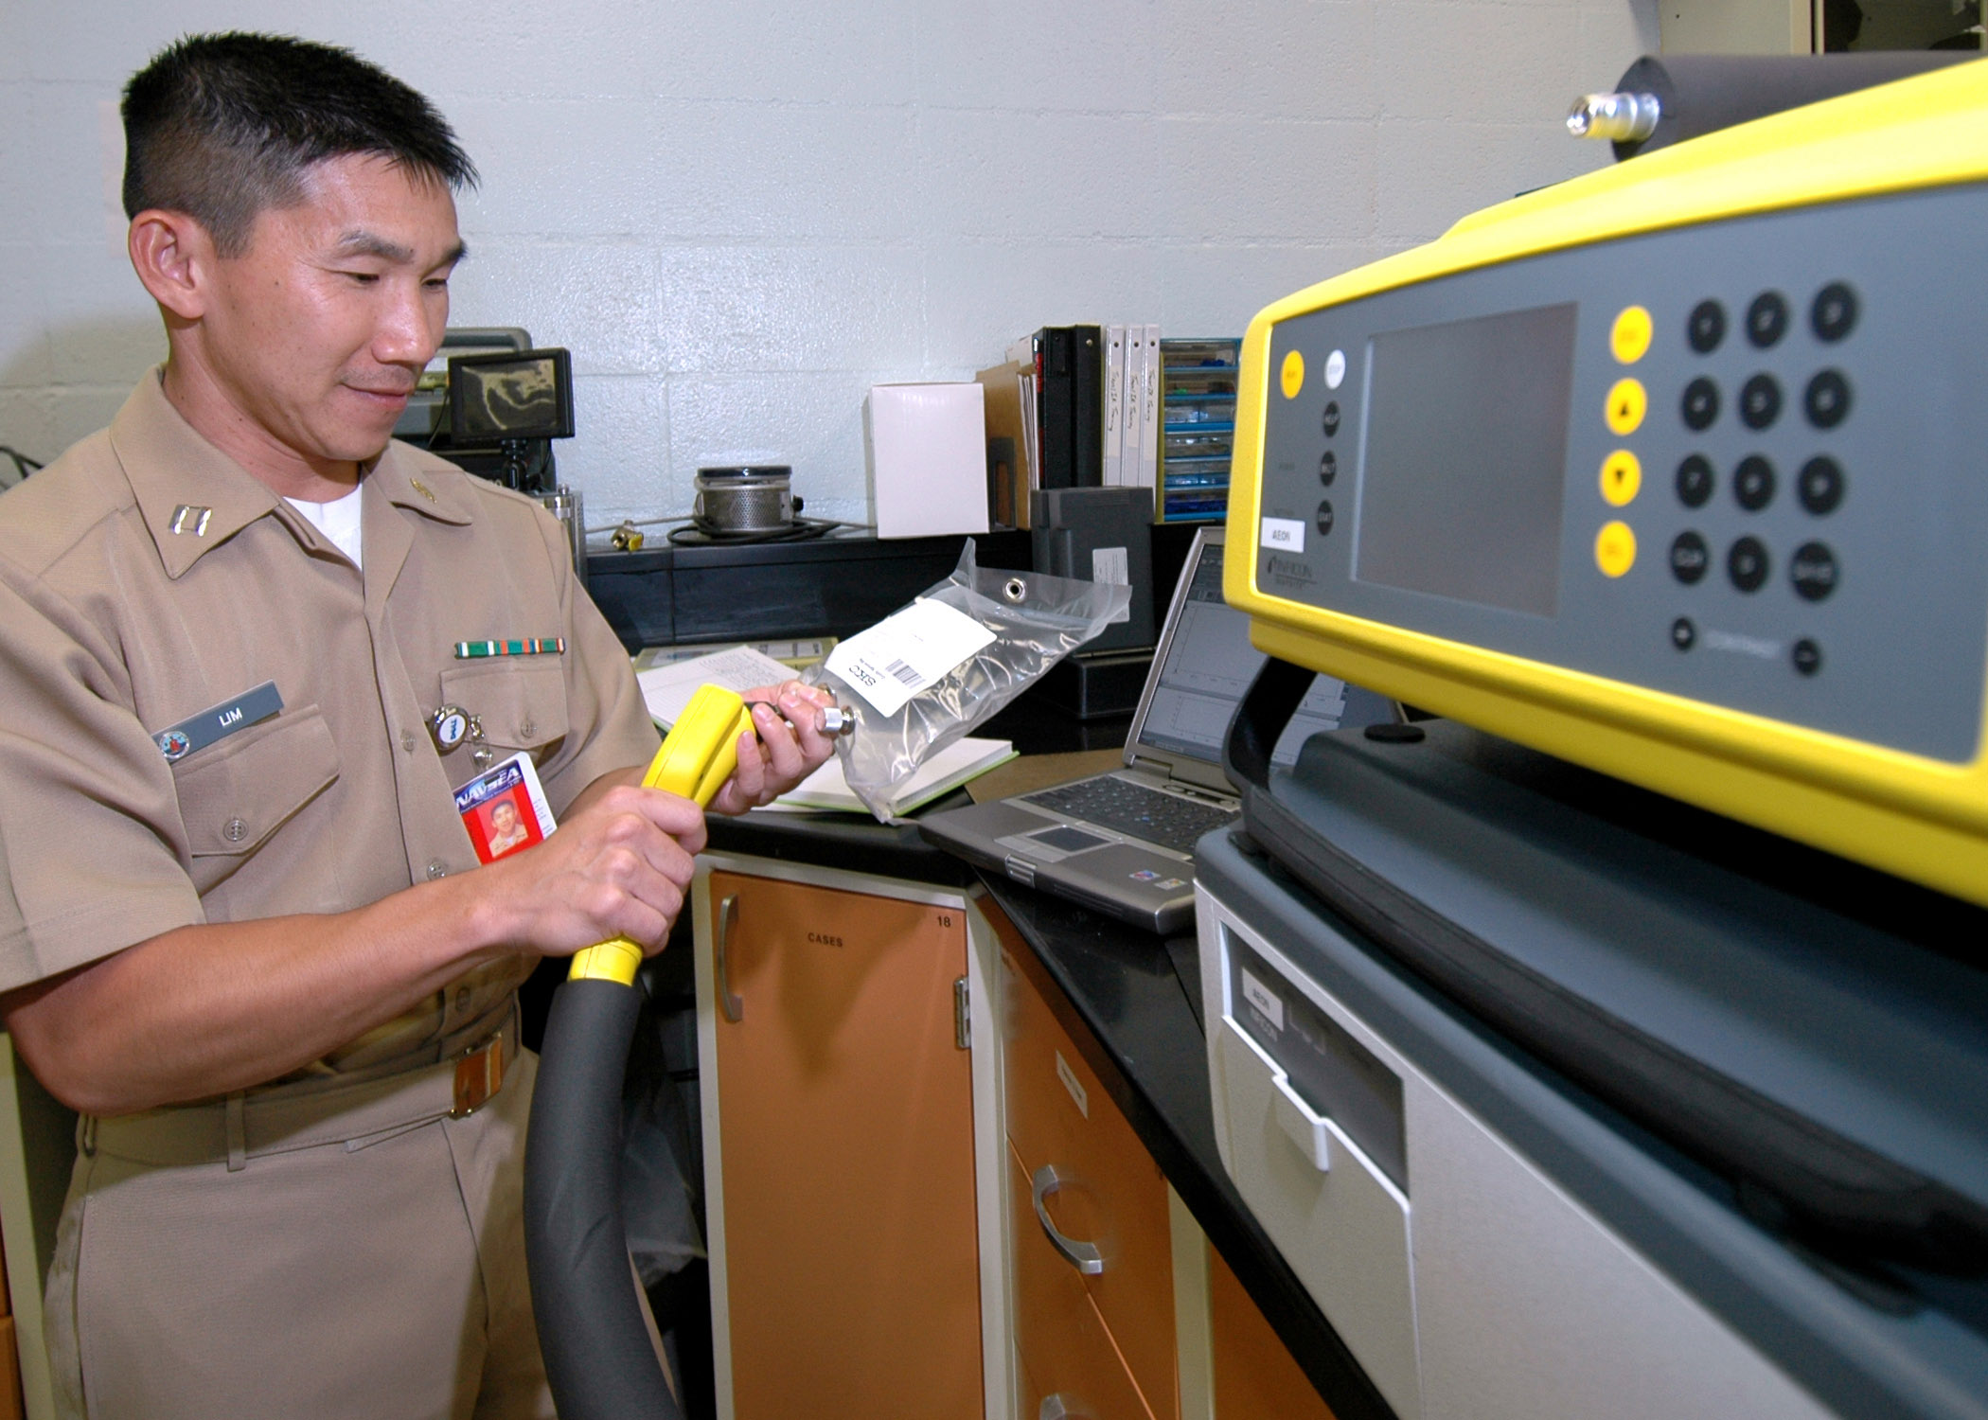
Key Personnel Knowledge
Key personnel staff should be knowledgeable about:
Federal, Service/Agency, state, and local S&H regulations
Points of contact for S&H programs
S&H-related documentation
Responsibilities with the written SMS
All workplace-related S&H hazards
Image retrieved from Bing Images
Notes:
Key personnel can include S&H professionals, occupational health staff, industrial hygienists, recordkeepers, and preventative maintenance personnel.
Key personnel should understand their responsibilities as detailed within the written SMS.
Image retrieved from Bing Images (free to share and use license) at: https://upload.wikimedia.org/wikipedia/commons/a/af/US_Navy_060207-N-3019M-003_Lt._Kyle_Lim,_industrial_hygiene_officer_assigned_to_Navy_Environmental_and_Preventative_Medicine_Unit_Six_(NEPMU-6),_tests_an_air_sample_for_contaminants.jpg

Slide 8
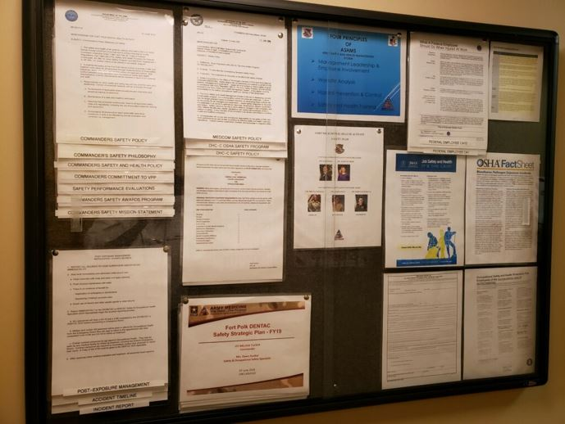
Workforce Knowledge
Employees should be knowledgeable about:
Existence of the written SMS and S&H programs
OSHA VPP elements
Location of S&H documents
Responsibilities within the SMS
Location of/access to S&H resources
Image courtesy of Ft. Polk DENTAC
Notes:
Employees should be familiar with the existence of the overarching written SMS and written S&H programs. They should also know where they can find these documents, should they need to reference them, as well as their responsibilities in any SMS processes or procedures. Additionally, all employees should have a general understanding of the OSHA VPP fundamentals, such as the four elements.
Image courtesy of the Fort Polk Dental Activity (DENTAC).

Slide 9
Action Checklist
Review Service/Agency and VPP requirements
Write an overarching SMS document
Update the written SMS periodically
Image retrieved from OSHA
Notes:
Follow this action checklist to implement and sustain VPP expectations for your written SMS. Each of these action checklist items will be covered in more detail on the following slides.
Image retrieved from OSHA at: https://www.osha.gov/dcsp/vpp/index.html

Slide 10
Review Requirements
Look at DoD instructions
Check Service/Agency regulations
May require written programs not required by OSHA
Review applicable OSHA standards
29 CFR 1960, Federal Employee OSH Programs
Standards for required written S&H programs
Study OSHA VPP criteria
Refer to CSP 03-01-005
Images retrieved from Bing Images
Notes:
OSH = occupational safety and health
An example of DoD instructions providing S&H information include: DoDI 6055.01, DoD Safety and Occupational Health Program.
Examples of Service or Agency regulations and instructions related to the written SMS include:
Air Force: AFI 91-202 (Air Force Mishap Prevention Program)
Army: AR 385-10 (Army Safety Program)
Navy: OPNAV M-5100.23 (Navy Safety and Occupational Health Manual)
Marine Corps: NAVMC Directive 5100.8 (Marines Corps Occupational Safety and Health Program Manual)
Defense Logistics Agency: DLAI 6055.01 (DLA Occupational Safety and Health)
In additional to consolidating DoD and your Service/Agency requirements into your written SMS, you also need to include the written S&H programs required by OSHA. As applicable to your work, this can include program such as hazardous energy control, permit-required confined space entry, hazard communication, or fall protection, for example.
And the main goal of the written SMS, in the end, is to ensure you incorporate the elements and sub-elements of VPP. It’s important to review the VPP criteria to have an understanding of what your Service/Agency requires that you already have, as well as VPP requirements you may not be meeting and need to include.
Images retrieved from Bing Images (Creative Commons).

Slide 11
Write an SMS Document
Incorporate all four VPP elements and their sub-elements into the document
Outline procedures for implementing each element/sub-element
Address any requirements from 29 CFR 1960
Include written S&H programs required by your Service/Agency and OSHA
Gather employee input, as appropriate
Have the highest ranking official sign the written SMS
Notes:
When writing your SMS, consider providing an overview of each VPP element and a list of steps in which employees can help you to implement each element. The goal of your written SMS isn’t just to lay out the elements and sub-elements, but also the procedures as to how you will implement them.
Make sure any information you include does not contradict other documents used at your workplace. Consider using existing guidance to help create this document.
When appropriate, consider the input of employees or their representation in drafting or approving the written SMS. This may be especially important when you draft language regarding employee involvement in the SMS.
Have the top leader in your organization, which is usually the Commander or Director, sign the document; this helps to show leadership commitment.
Visit OSHA’s Recommended Practices for S&H Programs at: https://www.osha.gov/shpguidelines/

Slide 12
Update the Written SMS
Review the written SMS periodically and make changes when:
Written procedures are modified or change
Changes occur to the VPP criteria
Regulatory changes or updates require a change in procedures
DoD, Service/Agency, or Higher HQ guidance or instructions are updated
Self-evaluation of the SMS requires a change in process or procedure
The written SMS document is outdated
Image retrieved from Bing Images
Notes:
There are many reasons why you might need to update your written SMS, as you can see listed on the slide. Your written SMS may need updated as often as annually, depending on the result of your self-evaluation. OSHA VPP requires you critically evaluate your SMS annually, not only for effectiveness, but for continuous improvement. Continuous improvement may mean a change to your current processes or procedures in meeting the VPP elements.
In general, if you have not reviewed and updated your written SMS in quite some time, it is best to review this document every three (3) years, at a minimum. Remember, some specific S&H programs require annual reviews, and may need updated within your written SMS more often.
Image retrieved from Bing Images (Creative Commons).

Slide 13
Conclusion
In this presentation, you learned to:
Summarize the background and importance of a written SMS
List written SMS-related documentation
Describe the knowledge leadership/management, key personnel, and the workforce should have regarding the written SMS program
Identify written SMS-related actions to implement and sustain OSHA VPP

