Slide 1
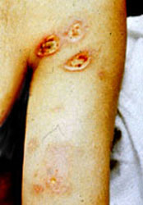
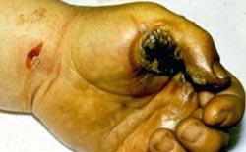
Electrical Hazard Awareness Training for Non-Electrical Workers
Please view slides in “Notes Page.” Go to “View” then choose “Notes Page.”
Notes:
The Electrical Hazard Awareness Training for Non-Electrical Workers was developed in 2014 under the auspices of the DoD Electrical Safety Working Group (ESWG). This course is an introduction to the principles of electrical safety with the intent of providing people with the ability to recognize electrical hazards and provide a basic awareness. It is helpful for both on the job safety and at home safety because over half of the electrical fatalities and shock incidents at work or at home occur to people who are not electrical workers. We hope all DoD personnel will want to view this training course and avoid becoming a statistic.

Slide 2
Electrical Hazard Awareness –Why?
Electrical thermal burns cause injuries to skin surfaces; electrical burns can also cause internal burns to vital organs, arc flash burns, flame burns, contact burns (thermal burns) or a combination thereof.
Electricity is an unseen killer:
It is invisible to the human eye
Doesn't make any sound
Gives off no odor
Notes:
As a source of energy, electricity is used without much thought about the hazards it can cause. Because electricity is a familiar part of our lives, it often is not treated with enough caution. An electrical hazard is any dangerous electrical condition. Electricity is unseen and electrical hazards are easily un-recognized. Electricity provides no warning of its hazards, and hazard awareness is important to prevent electrocution. Electrical thermal burns cause injuries to skin surfaces; electrical burns can also cause internal burns to vital organs, arc flash burns, flame burns, contact burns (thermal burns) or a combination thereof.
Coming in physical contact with an electrical voltage can cause current to flow through the body, resulting in electric shock and electrocution. Serious injury or even death may occur. As a result, an average of one worker is electrocuted on the job every day of every year! Electrocution is the fifth leading cause of work-related deaths. More than half of fatal workplace electrocutions occur during constructing, repairing, cleaning, inspecting, or painting.

Slide 3
Statistics
The National Institute for Occupational Safety and Health (NIOSH) reported that from 1992 through 2002:
Contact with overhead power lines was the most common cause of electrocutions, resulting in 42% of all on-the-job electrical deaths.
The second most common cause of electrocutions was failure to properly de-energize electrical equipment.
The third most common cause was contact with electrical components mistakenly thought to be de-energized due to a mistake in wiring or re-wiring, or misidentified wiring.
Contact with buried, underground power lines caused 1% of the fatalities.
Notes:
For further statistics, see the Electrical Safety International Foundation website: http://www.esfi.org/index.cfm/page/Injury-and-Fatality-Statistics/pid/12015

Slide 4
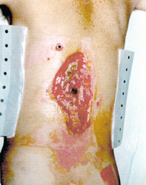
Examples of Electrical Injuries
Entrance Wound Arc Flash
Exit Wound Thermal Contact Burns
Notes:
Electrical current creates an entrance wound and an exit wound: Resistance of the skin transforms electrical energy into heat, which produces burns around the entrance point. Children biting or chewing on an electrical cord can suffer oral burns.
Electric shock injuries can be thought of as “icebergs” where most of the injury is unseen below the surface. Within the body, current can burn internal organs in its path. This type of injury might be difficult to diagnose because only the initial signs of injury are the entry and exit wounds. Damage to internal organs may not be apparent but cause internal tissue damage.
Exit Wound: Current flows through the body from the entrance point, until finally exiting where the body is closest to the ground. Electricity can also cause thermal contact burns. High voltage shocks cause electrical thermal burns.
For the arc flash thermal injury, this man was near a power box when an electrical explosion occurred. Though he did not touch the box, electricity arced through the air and entered his body. The current was drawn to his armpits because perspiration is very conductive.
Refer to OSHA: http://www.osha.gov/SLTC/etools/construction/electrical_incidents/burn_examples.html

Slide 5
NFPA 70E, Standard for Electrical Safety in the Workplace
Training requirement:
Training must be provided to employees who face a risk from electrical hazards.
Training components:
Identify and understand the relationship between electrical hazards and possible injury.
Understand the safety related work practices and procedures as well as any practices deemed necessary for avoiding electrical hazards which can cause personal injury or death.
Notes:
National Fire Protection Association (NFPA) Standard 70E is the gold standard for electrical safety in the workplace.
Training must be provided to employees who face an injury risk from an electrical hazard. Training is done so that one can identify and understand the relationship between electrical hazards and possible injury.
Employees must be trained in safety related work practices and all safety procedures as well as any practices deemed necessary for avoiding electrical hazards which can cause personal injury or death.

Slide 6
Electrical Safety Awareness Training
Basic minimum requirement for “non-energized” and “unqualified” workers
NOT sufficient for anyone working on or near exposed energized electrical conductors
Additional training is required for those employees who work on energized electrical systems.
Notes:
Dangerous electrical conditions are where a potential exists for exposure to energized electrical conductors or circuit parts. Basic training is needed for workers to recognize electrical hazards. This awareness training provides basic understanding of how electrical hazards occur and how to avoid these hazards.
This awareness training is not sufficient for anyone working on or near exposed electrical conductors or circuit parts where energized work is required.
Additional training is required for persons who work on energized equipment. Energized means that electricity is flowing and not rendered to be in a safe condition called an “electrically safe work condition.”

Slide 7
Electrical Safety Training Levels
All workers must receive training on electrical hazards depending on the type of work performed. The three levels of electrical safety training are:
Unqualified worker electrical safety hazard awareness
Qualified Worker specialized training in safe work practices and procedural requirements to provide protection against electrical hazards associated with individual job tasks
Emergency response
Notes:
All workers who may be exposed to electrical hazards must receive training to be able to recognize and avoid hazards associated with energized conductors or circuit parts. This training is for unqualified worker electrical safety awareness.
NFPA 70E and the Occupational Safety and Health Administration (OSHA) require three levels of training: unqualified worker, qualified worker, and specialized training for emergency response personnel.
Qualified worker training is specialized training in safe work practices and procedural requirements to provide protection against electrical hazards associated with individual energized job tasks or work procedures.

Slide 8
Unqualified Workers
Unqualified worker electrical safety hazard awareness
Identify and understand the relationship between electrical hazards and possible serious personal injury
Unqualified workers “shall be trained in and familiar with any electrical safety related practices necessary for their safety”
Notes:
Awareness training is done so that persons can identify and understand the relationship between electrical hazards and possible personal injury. Workers shall be trained in and familiar with any electrical related practices necessary for their safety. Persons who receive awareness training are technically called unqualified workers because these persons cannot work on energized electrical circuits.
Employees or unqualified workers must still be trained to understand work practices and procedure requirements as necessary to provide protection from electrical hazards associated with their job or task assignments. This awareness includes job tasks where working on energized conductors or circuit parts is not a part of a job assignment but training is needed to recognize and avoid electrical hazards.

Slide 9
Qualified Workers
Qualified worker is someone who has specialized training in safe work practices and procedural requirements to provide knowledge necessary to understand the hazards and be able to identify protective measures against electrical hazards associated with individual job tasks
Skills-based training which complement and address specialized knowledge
Notes:
A qualified person as defined by NFPA 70E and OSHA is someone with specialized knowledge in the construction and operation of equipment; or a specific work method; and who are trained to recognize and avoid electrical hazards that may be present with respect to that equipment or work method. Qualified persons must be familiar in the use of special precautions, protective clothing and protective equipment, insulating and shielding materials, and insulated tools and electrical test equipment.

Slide 10
Emergency Response
Emergency Response
Employees exposed to shock hazards and others responsible for taking emergency action
First aid and necessary emergency actions
Notes:
Emergency response training involves training for persons responsible for taking emergency actions in an electrical mishap. These persons must be knowledgeable in first-aid and special precautions to follow for incidents involving electrical hazards.

Slide 11
Circuits and Conductors
Electricity flows like a river in a pathway. These electrical pathways are called circuits.
A circuit must be complete or closed for electricity to flow. If the circuit is not, then it is considered an open circuit.
Any material that conducts electricity (i.e., the human body) will be able to close an open circuit.
The earth, water, concrete, and the human body are all conductors of electricity
Notes:
What are circuits? The path that electricity flows is called a circuit. A circuit must be complete or closed for electricity to flow. If the circuit is not closed, then it is considered an open circuit. Any material that conducts electricity, for example the human body, will be able to close an open circuit.
Electricity is the movement of charged particles called electrons. Electricity occurs when electrons flow between two points. To use electricity, we need to contain and control the flow of electrons. Conductors provide a path for the electrons to flow. Electricity can flow like a river. The force of movement is called voltage and measured in volts. One will receive an electrical shock if a part of the body completes an electrical circuit, for example by touching a live wire and an electrical ground, or touching a live wire and another wire at a different voltage.
Use extra caution when working with electricity when water is present in the environment or on the skin. Pure water is a poor conductor, but small amounts of impurities, such as salt and acidic compounds, both contained in perspiration, make it a ready conductor.

Slide 12
Types of Injuries Related to Contact With Electricity
Electrical shock- contact of a human body with any source of voltage high enough to cause sufficient current to pass through the muscles.
Electrocution- death due to electrical shock from interruption and stopping the heart and damage to brain function.
Injury due to Arc Flash: Burns due to radiant heat, arc flash, and flying melted electrical parts.
Falls- moving back after shock or thrown back by shock or arc.
Notes:
Types of injuries related to contact with electricity: Electrical shock is the contact of the human body with any source of voltage high enough to cause sufficient current to pass through the muscles. Electrocution is death due to electrical shock and trauma which interrupts and stop the heart or damages brain function.
Injury due to arc flash includes severe burns from radiant heat, arc blast, meaning an explosion, and flying melted electrical components. Falls from height can occur from a reflex action of moving back after shock, or thrown back from the effects of a shock or arc.

Slide 13
What is Electricity?
Flow of electrons in a closed path which provide an energy source for powering equipment.
Electricity follows the path of least resistance.
How does electrocution occur?
A person contacts an electric pathway by contacting an energized circuit or conductor
Inadequate grounding
Notes:
In summary, electricity is the flow of electrons in a closed path which provide an energy source for powering equipment.
Electricity follows the path of least resistance.
How does electrocution occur?
Electrocution can occur when persons contact an energized circuit.
Grounding provides a path for electric current to flow safely rather than flowing through persons.

Slide 14
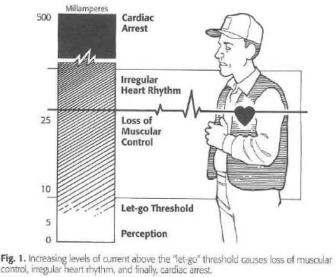
What is Electric Shock?
The body becomes part of the electrical circuit when in contact with an energized conductor; the person will receive a shock and loss of muscular control.
Severe shock can cause the heart and lungs to stop functioning and severe burns may occur where current enters and exits the body.
Notes:
An electrical shock is received when electrical current passes through the body. Whenever two wires are at different voltages, current will pass between them if they are connected, not necessarily physically connected but electrically connected. Your body can connect the wires if you touch both of them at the same time and current will pass through your body. Wet clothing, high humidity, and perspiration increases the chance for an electrocution. Severe shock can cause the heart and lungs to stop functioning and severe burns may occur where current enters and exits the body. It is important to know that when a shock occurs, there is always a chance of electrocution, even in dry conditions.

Slide 15
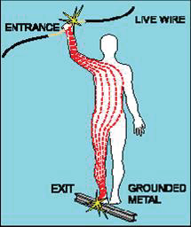
How is an Electric Shock Received?
When two conductors have potential differences (aka different voltages), current will flow if they are connected together.
Electric shock normally occurs when an individual contacts:
Both wires of an energized electric circuit.
One wire of an energized circuit and the ground.
A metallic part that has become energized by contact with an energized conductor. The metal parts of electric tools and machines may become energized if there is a break in the insulation of the tool or machine wiring.
Any conductor that is carrying current.
Notes:
When there is a difference in potential difference, current flows.
How is an electric shock received? Electricity travels in closed circuits, and its normal route is through a conductor. Electric shock occurs when the body becomes a part of the circuit. Body muscle mass can affect the extent of electric shock.
Electric shock normally occurs when an individual contacts:
Both wires of an energized electric circuit.
One wire of an energized circuit and a path to the ground.
A metallic part that has become energized by contact with an energized conductor. The metal parts of electric tools and machines may become energized if there is a break in the insulation of the tool or machine wiring.
Any conductor that is carrying current.

Slide 16
Why All Electric Shocks Should Be Avoided
Shocks can result in long term negative consequences. “While the total number of US occupational electrical injury cases is low, the risk of mortality and morbidity is disproportionately high.”¹
Contact with electric current has a lower number of non fatal workplace injuries when compared with other workplace injuries, but electrical mishaps causing lost time injuries are more likely to lead to a fatality than nearly all other mishaps.
Multiple hazards may create an injury in an electrical failure and yet not be fully recognized or documented.¹
Serious injury/death
Electrocution
Organ damage
Neurological disruption
Cellular effects
Shock
¹ Dr. Mary Capelli-Schelpfeffer, Journal of Disability Medicine, Vol 10. No 1, Jan.- March 2014
Notes:
Electric shocks can result in long term or chronic health effects. While the total number of occupational injury cases is low in comparison to other workplace injuries, the risk that exposure to electric current leading to a workplace fatality or an unrecognized or unreported injury is disproportionately high. In other words, contact with electric current has a lower number of non fatal workplace injuries when compared with other workplace injuries, but electrical mishaps causing lost time injuries are more likely to lead to a fatality than nearly all other mishaps.
Electrocution can cause serious injury, death and damage to vital organs. The multiple hazards from electric current can cause an injury and yet not be fully recognized or documented at the time of the event. For example, during contact with electric current which causes a shock, changes may occur on the cellular level causing adverse effects to cellular function, or disruption to the nervous system leading to chronic psychological or neurological changes which are not immediately detected or recognized.
Source: http://www.ncbi.nlm.nih.gov/pmc/articles/PMC3771718/table/t1-0590935/
And: http://www.electricalinjury.com/publications/MORSE_EMBS_DEI_03.pdf

Slide 17
Electrical Injury Mechanism from Shocks
Unintentional or accidental electrical exposure
Electric Power
Loss of Energy Control
Physical harm to people and damage to essential equipment
Severity depends on:
How much energy flows.
How long the event lasts.
How energy is imparted to the affected person and nearby surroundings.
Energy is transformed and transferred
Adapted from article from Dr. Mary Capelli-Schelpfeffer, Journal of Disability Medicine, Vol 10. No 1, Jan.- March 2014
Notes:
The use of electrical power during work can lead to instantaneous or chronic injuries or fatalities, and damages to essential equipment and facilities. Specifically during an unintentional or accidental exposure to electric current, there is a loss of energy control due to lapses in the engineered systems, the human systems, or both. Variations in the nature and magnitude of the energy forms released during an electrical incident offer an explanation in part for the spectrum of possible human trauma, burns, and complex disabilities observed from an electrical injury.

Slide 18
Multiple Bio-effects of Shocks from Electrical Current
Courtesy of Dr. Mary Capelli-Schellpfeffer
Notes:
Years ago, shocks were considered minor events. The bottom line today is that ALL SHOCKS SHOULD BE AVOIDED as they can cause either an immediate and potentially fatal response or a variety of chronic negative health impacts.
There are many types of harmful energy produced during an electrical event. The energy of 1 megawatt is essentially equivalent to one stick of dynamite. The energy forms are electrical, thermal, non-ionizing radiation-ultraviolet and infrared, chemical, acoustic (sound), and mechanical. There are many possible adverse biological effects from hazardous energy that can be released during a lapse of energy control. Additionally, the energy transfer may be “invisible”.
Shocks occur unintentionally during completion of work tasks. Electricity is not a visual entity. Only the results may be detectable. A trace of energy transfer may occur at the organ tissue, or at the cellular and molecular level. Molecular or cellular energy transfer may cause subtle changes including psychological and neurological effects which may cause long term consequences and chronic symptoms.
“The appearance of these consequences of electrical injury might be substantially delayed with onset of 1 to 5 or more years after the electrical event.” The possible delay in observable effects make it difficult to ascribe symptoms to the remote injury that occurred from electric shock when these symptoms from the electrical shock might not arise until well after the event.
Source: http://www.ncbi.nlm.nih.gov/pmc/articles/PMC3771718/

Slide 19
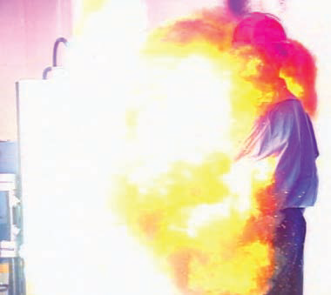
Terms Which Describe Electricity
Voltage - Force
Current – Flow
Conductors
Resistance
Arc Flash
Arc Blast
Ohm’s Law
Notes:
Definitions of key terms are important for understanding electrical safety:
Voltage is the force of electricity flowing through a conductor, analogous to pressure from the flow of water in a pipe.
Current is a measurement of the flow of electrons through a conductive material, analogous to the flow of water in a pipe. For example, operating an electric switch is like turning on a water faucet. Behind the faucet or switch there must be a source of water or electricity with something to transport it, and with a force to make it flow. In the case of water, the source is a reservoir or pumping station; the transportation is through pipes; and the force to make it flow is provided by a pump. For electricity, the source is the power generating station; current travels through electric conductors (wires); and the force to make it flow - voltage, measured in volts, is provided by a generator.
Conductors are substances such as metals that have little resistance to the flow of electric current. Resistance provides an obstacle for current, in other words, resistance is the opposition that a substance offers to the flow of electric current. - Dry skin has a fairly high resistance, but when moist, resistance drops radically, making it a ready conductor. Resistance is measured in ohms.
Arc flash is a sudden, massive release of electrical energy through air resulting in a fireball. An arc flash gives off intense heat that can cause severe burns. Temperatures are as high as 35,000 ˚F. High voltage arcs also produce immense pressure. This pressure, called an arc blast can hit a worker with great force and sends molten metal droplets from melted copper and aluminum electrical components great distances at extremely high velocities. Arc flash is also called an arc fault.
The arc blast is a very dangerous condition associated with an arc flash resulting in a thermal explosion with tremendous force.
Ohm’s Law explains the mathematical relationship between current, voltage and resistance.

Slide 20
Current and its Effect on the Human Body
Current | Reaction
1 milliamp | Perception level of faint tingle
5 milliamps | Slight shock, involuntary actions may lead to injuries
10-50 milliamps | Painful shock, muscular control lost, let-go threshold
50-150 milliamps | Individual cannot let go, severe shock, respiratory arrest
500 and above (0.5 amps) | Severe burns, nerve damage, ventricular fibrillation, cardiac arrest
1 amp = 1,000 milliamps
Notes:
Severe injuries can occur from milliamps of current. One (1) ampere is equal to 1,000 milliamps. Greater than 500 milliamps (0.5 amps) can cause the heart to stop. The severity of injury from electrical shock depends on the amount of electrical current and the length of time the current passes through the body. For example, 1/10 of an ampere (amp) of electricity going through the body for just 2 seconds is enough to cause death. Refer to: http://www.elcosh.org/document/1624/888/d000543/section2.html
The voltage can be very high and not cause a fatality as long as the current is low. For example, a taser can deliver 10.000 volts but they are generally not fatal.
The extent of an electrical injury is determined by several factors: current, voltage strength, resistance to flow, the duration of contact with the source, the pathway of flow, and the type of current – Direct Current (DC) or Alternating Current (AC).

Slide 21
Electricity Mishap Effects
Electrocution causing
Severe burns
Internal organ burns and external skin burns
Abnormal heart beat called fibrillation
Fires
Arc flash
Arc blast
Damaged or destroyed equipment

Slide 22
The Effects of Electric Current on the Human Body Depend on Several Factors
Circuit characteristics (current, resistance, frequency, and voltage)
Resistance of the body
The current’s path through the body determined by contact location and body chemistry
Duration of contact
Environmental conditions that affect the body’s contact resistance
Notes:
Very little current is required to cause an injury or even death. Ten thousandths of an amp might be fatal. The skin’s resistance to electric current changes as a function of the moisture present and changes in ambient temperature, humidity; and human factors such as anxiety and fright. Body tissue contains water and electrolytes which are highly conductive. The voltage determines the amount of current passing through the body based on Ohm’s law which states that current (amperes) equals voltage divided by resistance.

Slide 23
Electrical Injuries
Types
Fatal electrocution
Electric shock
Burns
Falls
Traumatic Effects
Permanent nerve damage, including paralysis
Loss of muscle, skin, or other tissue due to burns and/or necrosis
Loss of a digit or limb
Severe burn scarring and disfigurement
Brain damage
Low voltage does not mean low hazard
Notes:
Electrical injuries consist of four main types: 1) fatal electrocution, 2) electric shock, 3) burns, and 4) falls because of muscle reflex action from an electrical shock. Electrocution can cause permanent nerve damage including paralysis, loss of muscle, skin or other tissue from internal or external burns. A severe shock can cause much more damage to the body than is visible. A person may suffer internal bleeding and destruction of tissues, nerves, and muscles. Sometimes the hidden injuries caused by electrical shock result in a delayed death.
Even if the electrical current is too small to cause injury, the reaction from the shock can cause one to fall resulting in bruises, broken bones, or even death.
Low voltages does not mean low hazard. Low voltages can be extremely dangerous because, all other factors being equal, the degree of injury increases the longer the body is in contact with the circuit.

Slide 24
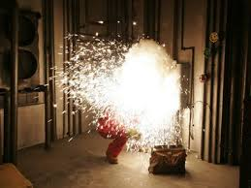
Electricity Can Harm in Many Ways
(5) Arc Flash - External burns,
shrapnel, thermal blast
(1) Electric Shock - Nervous system - brain, heart, breathing
(2) Contact burns
(3) Electric shock muscle effects, reflex action, no-let-go
(4) Internal burns
Photo courtesy Lloyd Gordon, PhD, Dept. of Energy
Notes:
Electricity can harm the human body in different ways: 1) Electricity can harm the heart. Electricity causes fibrillation or abnormal heart action and stops the heart from functioning properly. Electric current also harms the brain and nervous system and can cause one to stop breathing; 2) skin burns are contact burns from hot objects caused by heating from the flow of electricity; 3) electric shock can cause a no-let-go or a violent reflex muscle action. For example, this reflex action can cause one to fall off a ladder; 4) Internal burns are caused by electricity flowing inside the body and can destroy tissue and internal organs, and; 5) arc flash is an electrical short circuit through air which causes extremely high temperatures and an explosion with a fireball.

Slide 25
Since We Work Around Electricity Every Day, We Forget How Dangerous It Can Be
Contact with overhead power lines is the leading cause of on-the-job electrical death
43 percent of all occupational electrical fatalities from 2003 to 2007 in the U.S. were from contact with overhead power lines
However, only two percent of nonfatal electrical accidents occurred from worker contact with overhead power lines
Non-fatal electrical injuries are the 2nd most costly workers comp claim (Electrical Safety Foundation International)
Notes:
Contact with overhead power lines is the leading cause of on-the-job electrocution fatalities. Aluminum ladders or extended booms conduct electricity. When making physical contact with power lines, ladders or booms become energized. Overhead power lines are especially hazardous.
43% of all occupational fatalities from 2003 to 2007 were from contact with overhead power lines. But worker contact with overhead power lines was involved in only two percent of nonfatal electrical accidents. Non-fatal electrical injuries are also the 2nd most costly workers’ compensation claim. These statistics demonstrate that injuries which occur from non-fatal electrical incidents are severe and the likelihood for a fatality is high when power line contact occurs.

Slide 26
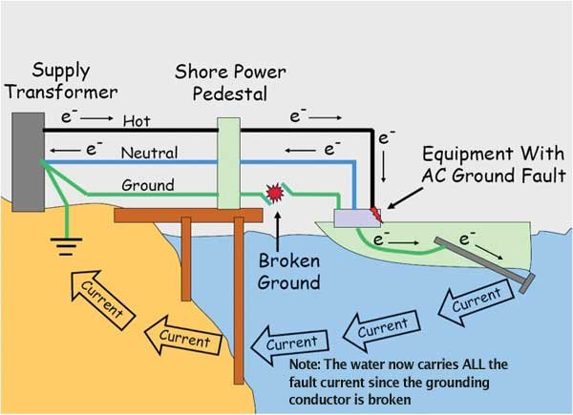
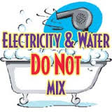
The Most Dangerous Locations To Use Electrical Equipment
Example of Electric Shock Drowning
Water conducts electricity
Notes:
Water can become energized near a dock. Persons swimming in electrified water can die from electrocution, called electric shock drowning.
Other electrocution risks can occur with water and electricity with the following examples:
Never use any electrical appliance near water
Never touch anything electrical with wet hands or bare feet
Never leave an electrical appliance where it can fall into the bath or basin
Never leave an electrical appliance unattended around children
Switch off and unplug all portable electric appliances, such as hairdryers, hair straighteners, shavers, etc after use
Do not use portable heaters in bathroom areas - use a strip heater installed high on the wall or a ceiling unit installed by a registered electrical contractor
Use extreme care when using electrical appliances near sinks, baths or swimming pools
If an electrical appliance has been immersed in water it must be disposed of immediately

Slide 27
Electricity Can Cause Death By:
Fibrillation of the heart without immediate emergency response
Reflex action resulting in falls
Internal burn injury resulting in organ failure
Respiratory arrest leading to suffocation
Severe neurological damage
Severe burn injury to the outside of the body
Force of an arc blast including shrapnel
Notes:
Electricity is fatal because of the way it affects the body through adverse effects on the heart, severe muscular contractions or reflex actions, internal and external burns, the cessation of breathing, severe neurological injury and external burns.

Slide 28
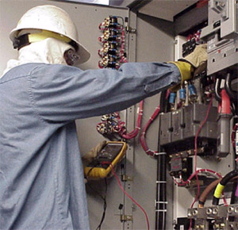
What Primarily Causes Electrocution?
Contact with overhead power lines
Contact with live circuits in panels
Poorly maintained cords and tools
Lightning strikes
Trained electrician servicing an electrical panel
Notes:
Be sure to review all items and point out that many operating engineers have been killed by contact with live overhead lines. This picture depicts a trained electrician with proper electrical PPE servicing an electrical panel.
ONLY a trained electrician can work in a live electrical panel. They should always attempt to get the circuits shut down and locked out.

Slide 29
Injury from Facility Arc Flash - Working Without Qualification and Authorization
Electrical hazards can cause injuries which are debilitating, slow to heal and extremely costly
You can be seriously injured or killed
A person touching an energized conductor is always in danger of possible electrocution

Slide 30
Four Main Types of Electrical Injuries
Shock
Burns
Falls due to contact with electricity
Electrocution (death)
Aftermath from contact with power lines
Notes:
The following text describes the fatality pictured in this slide:
In 2003, a 53-year-old construction worker was electrocuted and died when the forklift he was guiding hit an overhead powerline and became energized. The victim was connected to the forklift by a cable he was holding. The system arced to the grass and caught the grass on fire. The operator initially stayed in the cab until the fire spread to the forklift then jumped clear as instructed in prior training.

Slide 31
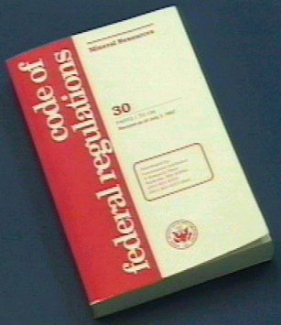
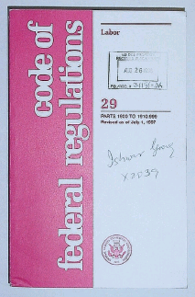
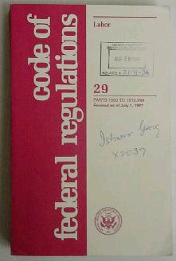
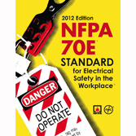
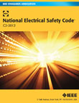
National Electrical Standards
OSHA - Code of Federal Regulations
NEC - Standard for the safe installation of electrical wiring
Technical requirements for persons who design, install and inspect electrical system installations.
NFPA 70E – Published by the National Fire Protection Association, Standard for Electrical Safety in the Workplace®
Latest edition 2012, Electrical safety for persons working
Specifies personal protective equipment, establishing an electrically safe working condition, safe work practices for work involving electrical hazards, training, and general requirements for electrical safety related work practices
National Electrical Safety Code ®
Safety requirements for workers in the generation and distribution of electricity and communication industry (utilities, line workers, cable TV workers)
Notes:
National electric standards In the U.S. the Occupational Safety and Health Administration (OSHA) establishes and enforces regulations associated with electrical safety in the workplace OSHA regulations are published in the Code of Federal Regulations (CFRs).
The National Electric Code sets standard for the safe installation of electrical wiring and provides technical requirements for persons who design, install and inspect electrical system installations. NFPA 70E, published by the National Fire Protection Association, NFPA 70E, Standard for Electrical Safety in the Workplace is the standard for electrical safety requirements. The latest edition is 2012. It specifies personal protective equipment, establishes requirements for electrically safe working conditions, and specifies the requirements for safe work practices for work involving electrical hazards, and training.
National Electrical Safety Code ® is published by the Institute for Electronics and Electrical Engineers (IEEE) and provides safety requirements for workers in the generation and distribution of electricity and communication industry (utilities, line workers and cable TV workers.)

Slide 32
Working With Electricity at Heights and Using Ladders
Falls are caused by accidental contact with electricity
Be aware! Maintain safe working distances with lines
The safest ladder to use around electricity is fiberglass
Unsafe condition
Notes:
Risks of electricity are great while working at elevations because any contact with electricity, no matter how mild, can cause a physical reaction that can result in a fall. The situation is made more difficult because it may not be possible to shut off the electricity and it may be high voltage.
The safest ladders to use around electricity is fiberglass. Fiberglass does not conduct electricity. Metal ladders and wood ladders with metal reinforcement wire can conduct electricity, which can shock or electrocute anyone touching the ladder or touching someone in contact with the ladder.

Slide 33
NFPA 70E-2012 Requirements for an Electrical Safety Program
Document and implement an electrical safety program appropriate for the electrical hazards, voltage, energy level and circuit conditions
Provide an awareness of electrical hazards for all persons who work in an environment with these hazards
Qualified workers
Skills and knowledge related to the construction and operation of electrical equipment or installations, or a specific work method and trained to recognize and avoid the hazards that may be present with respect to that equipment or work method.
“Unqualified” workers
Job briefings
Hazard identification and risk assessment
Training documentation and assessment of understanding
Notes:
NFPA 70E-2012 provides requirements for an Electrical Safety Program. The electrical safety program documents and establishes responsibilities for implementing electrical safety appropriate for the electrical hazards, voltage, energy level and circuit conditions. The electrical safety program provides an awareness of electrical hazards for all persons who work in an environment with these hazards.
Qualified workers have the training, skills and knowledge related to the construction and operation of electrical equipment or installations, or a specific work method to recognize and avoid electric hazards that may be present with respect to that equipment or work method.
“Unqualified” workers are all other persons. Components of the electrical safety program include Job briefings; Hazard identification and risk assessment and Training documentation and method for the assessment of understanding the training.

Slide 34
NFPA 70E
Establishing electrically safe working conditions
Limited, restricted and prohibited approach shock protection boundaries
Arc flash boundary
Qualified persons
One who has skills and knowledge related to the construction and operation of electrical equipment and installations and have received training to recognize the hazards and required control measures
Unqualified persons - all others
Notes:
Electrical approach boundaries establish safe distances to prevent electric shock. NFPA 70E defines Limited, Restricted and Prohibited Approach shock protection boundaries. A separate distance from a high voltage energized source is called the Arc flash boundary.
Qualified persons are persons who work within the shock and arc flash protection boundaries and these persons have skills and knowledge related to the construction and operation of electrical equipment and installations, and have received specialized training to recognize the hazards and required control measures. Unqualified persons are persons not trained to work on energized circuits.

Slide 35
OSHA Electrical Safety Requirements
The Occupational Safety and Health Administration (OSHA) sets federal requirements for electrical safety based on NFPA 70E for electrical safety programs
Training requirements:
Specific requirements called Lockout/Tagout for controlling hazardous electrical energy
Employees shall be trained in and familiar with the safety-related work practices that pertain to their job assignments which are necessary for their safety
Notes:
The Occupational Safety and Health Administration (OSHA) sets federal requirements for electrical safety based on NFPA 70E for electrical safety programs. OSHA requires safety-related work practices to prevent electric shock or other injuries resulting from either direct or indirect electrical contacts, and when work is performed near or on equipment or circuits which are, or may be energized.
OSHA has Lockout/Tagout requirements and specific requirements for controlling hazardous electrical energy. Employees must be trained and familiar with the safety-related work practices that pertain to their job assignments which are necessary for their safety.

Slide 36
OSHA Electrical Safety Requirements (Cont’d.)
Additional OSHA requirements:
Electrical protective equipment
Wiring design and protection
Wiring methods, components, and equipment for general use
Electrical equipment and installations
Hazardous (classified) locations
Use only tested and “approved equipment”
Notes:
OSHA prohibits the use of portable metal ladders if they are utilized where the ladder can contact energized electrical conductors. Portable ladders must be non-conductive if they are utilized where employees or the ladder can accidentally contact energized conductors or circuit parts.
Additional OSHA requirements include electrical protective equipment, wiring design and protection, wiring methods, components, and equipment for general use, electrical equipment and installations, and hazardous (classified) locations such as areas used for the storage a and transfer of flammable liquids; and using only approved equipment.
Approved equipment is tested by a Nationally Recognized Testing Laboratory (NRTL). A NRTL must accept, certify, label, list, or otherwise determine that equipment is safe for it to be considered "approved". Examples of testing laboratories are: Underwriters Laboratory (UL), TUV (Germany), Factory Mutual (FM), and the Canadian Standards Association (CSA).

Slide 37
Electrically Safe Work Condition
Unqualified persons shall not work on energized equipment
A written permit and management authorization is required for energized work
All electrical circuit conductors and circuit parts shall be considered energized until the sources of energy are removed
All energized work must be performed by qualified persons
Testing circuits for current flow is energized work
Notes:
OSHA requires that live parts to which an employee may be exposed shall be de-energized before the employee works on or near them, unless the employer can demonstrate that de-energizing introduces additional or increased hazards, or is infeasible due to equipment design or operational limitations. Live parts that operate at less than 50 volts to ground need not be de-energized if there will be no increased exposure to electrical burns or to explosion due to electric arcs.
Electrically safe work condition is established before working on a circuit by de-energizing it. Electrically safe work condition is established by identifying all power sources; interrupting the load and disconnecting power; visually verifying that a disconnect has opened the circuit; locking out and tagging the circuit; testing for voltage, and grounding all power conductors.
An electrically safe working condition is where electrical conductors and circuit parts have been disconnected and tested to verify conductors or circuit parts have been de-energized. Electrically safe working conditions are established to ensure personnel safety. Unqualified persons shall not work on energized equipment. Unqualified persons can only work on de-energized equipment.
All energized work must be performed by trained, qualified persons. A written permit and management authorization is required for energized work. All electrical circuit conductors and circuit parts shall be considered energized until the sources of energy are removed; circuits tested; and lockout/tagout procedures are fully implemented. All circuit testing is considered energized work.

Slide 38
Shock Protection Boundaries
Limited Approach Boundary
An approach limit from an energized conductor or circuit part within which a shock hazard exists.
Prohibited Approach Boundary
An approach limit at a distance from an exposed energized conductor or circuit part within which work is considered the same as making contact with the electrical conductor.
Restricted Approach Boundary
An approach limit at a distance from an exposed energized conductor or circuit part within which there is an increased risk of shock due to electrical arc-over with inadvertent movement for personnel working in close proximity to the energized conductor.

Slide 39
What are the Hazard Controls?
Engineering controls are a part of the design that prevent the worker from being injured while using equipment containing a hazard.
Administrative controls protect the worker when engineering controls are insufficient, not yet in place, or removed or disabled for testing or maintenance. These controls rely on the actions of the worker (i.e., wearing personal protective equipment (PPE)).
Hierarchy of Controls demonstrates the most effective to least effective method for reducing hazards which can cause personal injury: 1) Physically remove (eliminate) the hazard; 2) Replace (substitute) the hazard with a less dangerous condition; 3) Isolate or separate persons from the hazard through engineering controls and workplace design; 4) Change the way persons work (administrative controls); use special PPE to protect the worker.
Notes:
Two major categories exist for control of electrical hazards: Engineering controls and Administrative controls
The hierarchy of controls is a way to describe the most effective to least effective method for reducing hazards, for example an electrical hazard. Since hazard elimination or hazard substitution is not practical or possible with electricity, engineering methods are important for removing persons from the hazard by distance or location. Personal Protective Clothing is the least effective way to reduce a hazard because PPE relies on the correct protective gear and a trained workforce which knows the limitations of such gear.

Slide 41
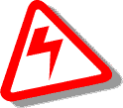
Control of Electrical Hazardous Energy
Engineering Controls
Enclosures
Breakers
Fuses
Grounding
GFCIs
Insulation
Interlocks
Administrative Controls
Training
Work Controls - SOPs, LO/TO
Two person rule
Protective equipment
Warnings
Notes:
Examples of engineering controls are: Enclosures, breakers, fuses, grounding, ground-fault circuit interrupters (GFCIs), insulation and interlocks.
- Examples of administrative controls: Training, work controls such as standard operating procedures (SOPs), lockout/tagout (LO/TO), plug control, two person rule, protective equipment and warning signs.
Have the electricity shut down = Engineering control
Maintain a safe working distance = Administrative control
Wear personal fall arrest system = Personal protective equipment

Slide 42
Nationally Recognized Testing Laboratory (NRTL)
UL
Canadian Standards Association
NRTLs, such as Underwriters Laboratories are third-party organizations recognized by OSHA as having the capability to provide product safety testing and certification services to manufacturers of a wide range of products for use in the American workplace.
The use of NRTL approved equipment is required because these usually have inherently designed systems to prevent injury.
Notes:
OSHA requires that all electrical equipment including power cords and power strips be tested and approved by a third party called a Nationally Recognized Testing Laboratory. Testing and approval ensures the equipment is equipped with design features which protects the user from electrocution.
Nationally Recognized Testing Laboratories are, for example, Underwriters Laboratories, Factory Mutual or the Canadian Standards Association (CSA). These organizations are recognized by OSHA as having the capability to provide product testing and certification to manufacturers of a wide range of products.
OSHA publishes a list of NRTLs. The web link for OSHA NRTL is: http://www.osha.gov/dts/otpca/nrtl/

Slide 43
Ground-Fault Circuit Interrupters (GFCIs)
GFCIs interrupt the flow of electricity when an unintended electrical fault occurs.
Use of GFCIs is the most important factor for reducing electrocutions over the past twenty years.
GFCIs are required for all cord and plug connected equipment supplied by 125 volt, 15-, 20- or 30-amp circuits.
GFCIs are required for all outdoor and indoor locations where damp or wet conditions could occur.
Notes:
A ground-fault is an unintentional electrical path between a power source and a grounded surface. Ground faults most often occur when equipment is damaged or defective. If your body provides a path to the ground for this current, you could be burned, severely shocked or electrocuted.
Ground-fault circuit interrupter, called a GFCI is an electrical device that can either be installed in the electrical system or built into a power cord to protect against severe electrical shocks. The GFCI continually matches the amount of current going to an electrical device against the amount of current returning from the device along the electrical path.
Whenever the amount of current going differs from the amount returning by approximately 5 milliamps, the GFCI interrupts the electric power within as little as 1/40 of a second, protecting you from a dangerous shock. GFCI’s are able to detect the loss of current resulting from leakage through a person who is beginning to be shocked. If this situation occurs, the GFCI switches off the current in the circuit. GFCI’s are different from circuit breakers and fuses because they detect leakage currents rather than overloads.
GFCIs play an important role in preventing electrocutions. The GFCI is designed to protect people from severe or fatal electric shocks but because a GFCI detects ground faults, it can also prevent electrical fires and reduce the severity fires by interrupting the flow of electric current. GFCIs are required for all cord and plug connected equipment supplied by 125 volt, 15-, 20- or 30-amp circuits. GFCIs are also required for all indoor locations where damp or wet conditions could occur.

Slide 44
Electrical Protective Device
Circuit breakers and fuses are over current devices which shut off the electricity flow if an overload or ground-fault in the circuit occurs. Circuit breakers and fuses protect equipment and facilities.
Work done on circuit breakers and fuses should only be done be qualified workers.
The only device whose sole purpose is to protect people is the GFCI.
Notes:
Circuit breakers and fuses are over current devices which shut off the electricity flow if an overload or ground-fault in the circuit occurs. Circuit breakers and fuses protect equipment and facilities. The basic idea of an overcurrent device is to make a weak link in the circuit. Unlike a fuse, a circuit breaker can be re-used by re-closing the contacts. Fuses and circuit breakers are designed to protect equipment and facilities. Work done on circuit breakers and fuses should only be done be qualified workers.
The only electrical protective device whose sole purpose is to protect people is the ground-fault circuit-interrupter.

Slide 45
Inadequate Wiring Hazards
A hazard exists when a wire is too small to carry the current
If a tool draws more current than the cord can handle, a fire can occur without tripping the circuit breaker
Wire Use | Rated Ampacity | Wire Gauge
Low-voltage Lighting and Lamp Cords | 10 Amps | 18 Gauge
Extension Cords | 13 Amps | 16 Gauge
Light Fixtures, Lamps, Lighting Runs | 15 Amps | 14 Gauge
Receptacles, 110-volt Air Conditioners, Sump Pumps, Kitchen Appliances | 20 Amps | 12 Gauge
Electric Clothes Dryers, 220-volt Window Air Conditioners, Built-in Ovens, Electric Water Heaters | 30 Amps | 10 Gauge
Notes:
A hazard exists when a wire is too small to carry the required current. If a tool draws more current than the cord can handle, a fire can occur without tripping the circuit breaker. Wire-gauge size is inversely related to the diameter of the wire. For example, a No. 12 gauge flexible cord has a larger diameter wire than a No. 14 flexible cord.

Slide 46
Grounding Hazards
Conductive parts of an electrical wiring system (tools, ceiling light fixtures, switch plates, conduits, etc.) we touch should be at zero volts relative to ground.
Housing of motors, appliances, fixtures or tools that are improperly grounded may become energized.
If you come into contact with improperly grounded electrical device, you will be shocked.
Notes:
Grounding is a physical connection to the earth, which is at zero volts.
Current flows through a conductor if there is a difference in voltage (electrical force). If metal parts of an electrical wiring system are at zero volts relative to ground, no current will flow if our body completes the circuit between these parts and ground. Motors, appliances, fixtures or tools that are improperly grounded may become energized. If you come into contact with an improperly grounded electrical device, you will be shocked.

Slide 47
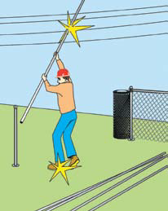
Overhead Power Line Hazards
Death or serious injury occurs if an antenna comes into contact with overhead power lines. The safe distance for the antenna from the power line is two times the height of the antenna.
Accidental contact with overhead power lines kills people and causes many serious injuries every year.
Carpenters, painters, crane operators or anyone touching or contacting an overhead power line risks a serious or fatal electric shock.
Vehicles, plant machinery, or equipment should not be taken within 10 feet of power lines.
Notes:
For overhead power line hazards, find out if the work really has to be carried out under or near overhead lines, and can't be done somewhere else. Make sure materials (such as bales or spoil) are not placed near overhead lines, and temporary structures are erected outside safe clearance distances.
Rules for working near power lines:
Assume they are energized.
Use non-conductive wood or fiberglass ladders.
Keep away all conductive objects at least twice the height of an antenna.
Never fully extend an antenna directly under power lines.
Antennas should never come closer to a power line than two times the antenna height. For additional safety information, refer to TB-43-0129. “Requirements for Use of Antenna and Mast Equipment".

Slide 48
The Ground May Become Energized!
Electricity decreases with the resistance of the ground
As potential drops, fields develop around the electrified machine
If you step across a line of unequal potential, you could be electrocuted
Notes:
This slide shows on way how current can flow through the ground. By the crane contacting the high voltage power line, current moves into the ground’s surface. The voltage decreases away from the crane over the surface of the ground depending on the ground’s resistance. Energy fields can be set up around the grounded object. If a person steps across two different levels of voltage or touches an object at a different voltage level, electricity may pass through the body causing a shock or electrocution.

Slide 49
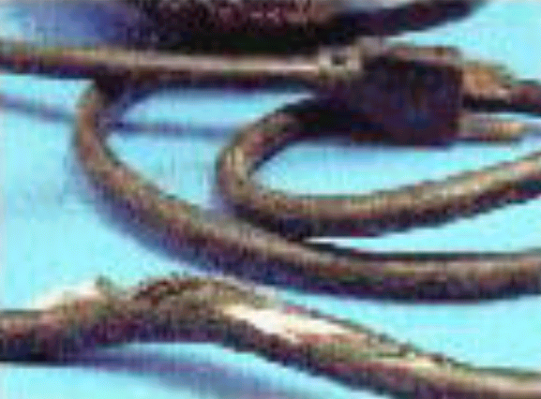
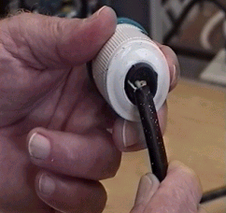
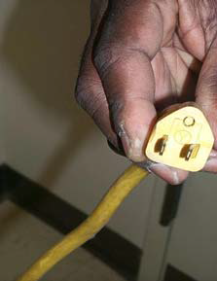
Inspect Extension Cords
Remove damaged or frayed cords from service
Ground prong broken off
Notes:
Power cords can become frayed or damaged from heavy use and age and should be inspected regularly. Frequently, mishandling (such as pulling a plug from a socket by jerking the cord rather than removing the plug carefully by hand) causes damage to a cord, tearing the external protective sheathing or detaching it from the plug head and exposing energized wires.
Less obvious than damaged and frayed cords is the threat posed by missing ground prongs, the rounded third prong on electrical plugs. These ground prongs often break off from mishandling or are removed intentionally to fit a plug into two-prong outlets. Ungrounded plugs – especially on kitchen appliances like refrigerators and dishwashers – can pose a significant electrocution risk.

Slide 50
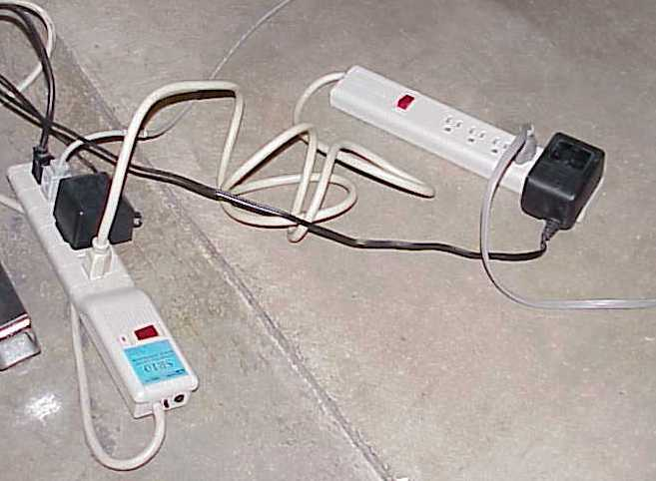
Never daisy chain extension cords (plugging into each other)
Never daisy chain multi-outlet strips
Notes:
Extension cords interconnected, or “daisy chained” can readily provide more outlets and/or reach greater distances. A “mixed daisy chain” consists of interconnecting extension cords and power strips. When multiple power strips are interconnected, the one directly connected to the outlet is often supplying power to more than the approved number. This current overload can result in a fire or can cause a circuit breaker to trip. The risk is magnified when another outlet in the same wall or floor receptacle is also overloaded in a similar fashion. When other outlets on the same circuit are also overloaded, the risk increases. Interconnecting these devices is a violation of Occupational Safety and Health Administration (OSHA) regulations and the National Electrical Code because doing so can cause them to become overloaded, leading to a fire.
Flexible cords can be used in the workplace if heavy or extra heavy duty cords are needed for temporary purposes.
Also, OSHA regulations require that conductors and electrical equipment be used in accordance with the conditions under which they are approved by a recognized testing organization. Most power strips are approved for providing power to a maximum of four or six individual items.

Slide 51
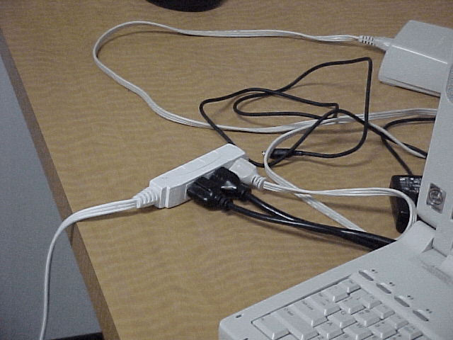
Extension Cords
One extension cord unapproved for its use is used to power multiple devices creating a fire hazard.
Unsafe Use of Extension Cords
Using as permanent wiring.
Using unapproved extension cords.
Overloading power capabilities of the cord during temporary use.
Plugging one extension cord into another and another, etc. called “daisy chaining”
Using one surge protector/power strip to power another
Notes:
Electrical distribution equipment, such as extension cords, was the second leading cause of fire deaths in the U.S. between 1994 and 1998. The most common cause of fires from extension cords is due to improper use and/or overloading, especially when cords have multiple outlets. Most extension cords are only rated for a maximum of ten amps or 1200 watts. Overloading can occur when multiple devices are plugged into one cord or when cords are “daisy chained” (plugging multiple extension cords together).

Slide 52
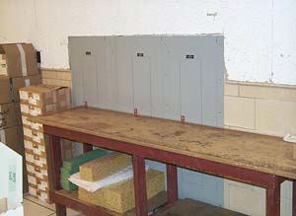
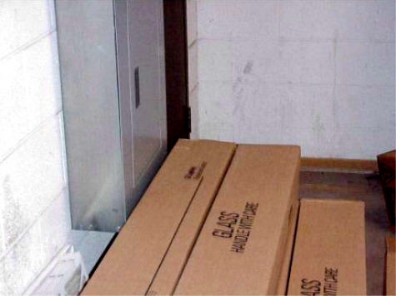
Do not Block Breaker Panels and Other Facility Electrical Equipment Leave at Least 36 Inches Clearance in Front of Electrical Panels
Notes:
Electrical panels should never be blocked. Blocking electrical panels that house circuit breakers is a violation of both Occupational Safety and Health Administration (OSHA) regulations and National Fire Protection Association (NFPA) codes. These regulations require accessibility to the front of electrical panels to have a minimum of three feet of clearance and a minimum width to be the width of the equipment or 2.5 feet, whichever is greater. In case of an electrical emergency, there must be a clear working space in front for quick access to the circuit breakers.

Slide 53
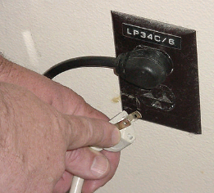
Plugs
Never remove the
ground pin (the third
prong); this could lead
to an electrical shock
Violation shown here
is a power strip with
a missing grounding
prong

Slide 54
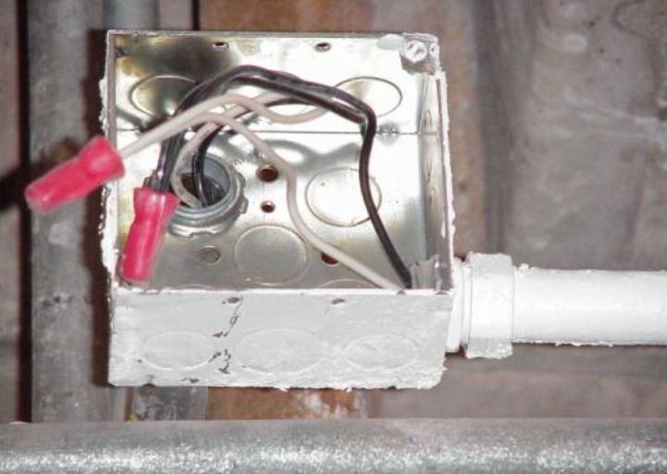
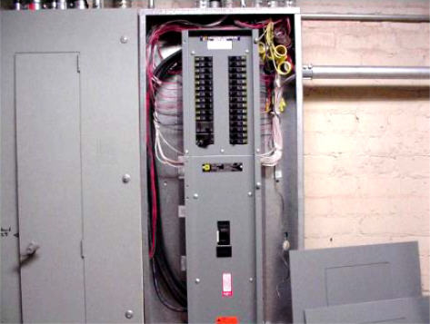
Exposed Conductors
Report exposed conductors or equipment with covers left off
Notes:
Covers left off energized circuits are hazardous. Electrical panels contain circuit breakers designed to trip and stop the flow of current to specific circuits and appliances. Easy access to electrical panels is essential, and panels should never be blocked or inaccessible. All live components must be covered to protect against shock. Electrical panel boxes in commercial buildings should be locked and accessible by trained personnel only. Such hazards present imminent danger and should be immediately reported.

Slide 55
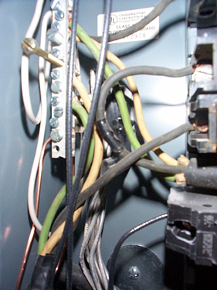
Electrical Parts
Live parts of electric equipment operating at 50 volts or more need guarding against accidental contact
Notes:
Reference 1926.403(i)(2)
Except as required or permitted elsewhere in the subpart, live parts of electric equipment operating at 50 volts or more shall be guarded against accidental contact by cabinets or other forms of enclosures, or by any of the following means:
By location in a room, vault, or similar enclosure that is accessible only to qualified persons.
By partitions or screens so arranged that only qualified persons will have access to the space within reach of the live parts. Any openings in such partitions or screens shall be so sized and located that persons are not likely to come into accidental contact with the live parts or to bring conducting objects into contact with them.
By location on a balcony, gallery, or platform so elevated and arranged as to exclude unqualified persons.
By elevation of 8 feet or more above the floor or other working surface and so installed as to exclude unqualified persons.

Slide 56
Resources - Electrical Safety Websites
Center of Excellence for Electrical Safety - http://www.lanl.gov/safety/electrical/
OSHA - http://www.osha.gov/index.html
OSHA NRTLs - http://www.osha.gov/dts/otpca/nrtl/index.html
NFPA - http://www.nfpa.org/
Notes:
References sources: Department of Energy Center of Excellence for Electrical Safety; OSHA electrical safety compliance assistance; OSHA’s Nationally Recognized Testing Laboratories and NFPA.

Slide 57
Quiz for Electrical Hazard Awareness (Please view this portion of the presentation in “slide show view.” After the question, advance to the next slide, then click on the slide to reveal the answer.) Question 1. The most dangerous place to use electrical equipment is?
Indoors
Outdoors
Near water
Near other electrical equipment

Slide 58
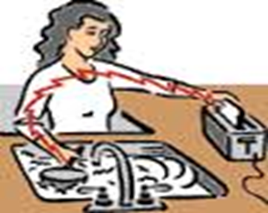
The most dangerous place to use electrical equipment is:
C. Near water

Slide 59
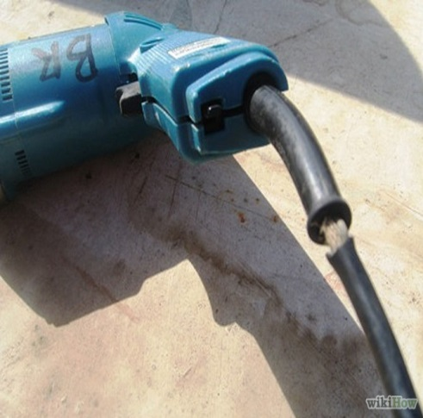
Question 2.
You discover the electrical cord for a drill has been damaged and some of the cord’s insulation is missing. You should?
Wrap tape around the damaged spot to prevent electrical shocks.
Check to see if the drill still works.
Tag the drill out of service and notify the department responsible for equipment maintenance.
Make sure that the cord does not come in contact with the floor.

Slide 60
You discover the electrical cord for a drill has been damaged and some of the cord’s insulation is missing. You should?
C. Tag the drill “out of service” and notify the department responsible for equipment maintenance.
If a power cord's insulation wears away just at the point where the cord enters the metal frame, contact between the current conductor and the metal frame could make the appliance energized. Touching the energized metal frame of the appliance while simultaneously touching a conductor causes the current to surge through the human body.

Slide 61
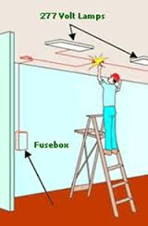
Question 3. The safest ladder to use around electricity is:
Wood
Fiberglass
Aluminum
Step stool

Slide 62
The safest ladder to use around electricity is:
Fiberglass
Wood ladders are non-conductive but rot in moist conditions. Fiberglass ladders offer the best choice for long life and safety from electrical conductivity.

Slide 63
Question 4. The earth, water, concrete and the human body are all conductors¹ of electricity.
True
False
¹Conductors allow electrons to flow freely.

Slide 64
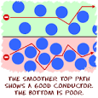
The earth, water, concrete and the human body are all conductors of electricity.
A. True

Slide 65
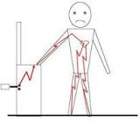
Question 5. The extent of an electrical shock on the body depend upon all of the following EXCEPT:
A. Current
B. Path
C. Duration
D. Body weight

Slide 66
The extent of an electrical shock on the body depend upon all of the following EXCEPT:
D. Body weight
The extent of an electrical injury is determined by current, voltage strength, resistance to flow, the duration of contact with the source, the pathway of flow, and the type of current – Direct Current (DC) or Alternating Current (AC).

Slide 67
Question 6. Injuries from electricity can include which of the following?
Electric shock that may or may not result in electrocution but can result in cellular damage
Falls
Burns
All of the above

Slide 68
Injuries from electricity can include which of the following?
D. All of the above: cellular damage, falls, and thermal or internal burns to organs and tissue.

Slide 69
Question 7. Open knock-outs on outlet boxes:
Must be reported and repaired as soon as possible.
Are permitted by OSHA.
Are common because replacing knock outs is expensive.
Pose no hazard as the electrical wiring has been rerouted.

Slide 70
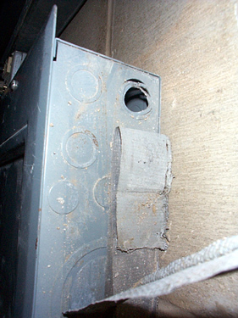
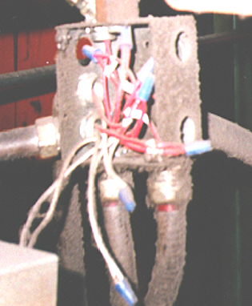
Open knock outs on outlet boxes:
A. Must be reported and repaired as soon as possible.
openings in cabinets, boxes and fittings

Slide 71
Question 8. Which of the following is acceptable by OSHA standards?
An unqualified employee flipping tripped breakers in a breaker box
Plugging an extension cord into a second extension cord
Removing a ground pin if needed to plug into a two prong outlet
A qualified person repairing an extension cord

Slide 72
Which of the following is acceptable by OSHA standards?
D. A qualified person repairing an extension cord.
To satisfy the requirements of the OSHA standards, a repair needs to restore the cord to its "approved" condition . “Approved" is defined as certified, listed, or labeled, or otherwise determined to be safe by a qualified testing laboratory.

Slide 73
Question 9. Flexible cords can be used in the workplace:
As a substitute for permanent wiring
If the cords are run behind walls to reduce the chance of abrasion and damage
If heavy or extra heavy duty cords are needed for temporary purposes
If any obvious splices are repaired with electrical tape

Slide 74
Flexible cords can be used in the workplace:
C. If heavy or extra heavy duty cords are needed for temporary purposes.

Slide 75
Question 10. Power strips can be energized by extension cords
True
False

Slide 76
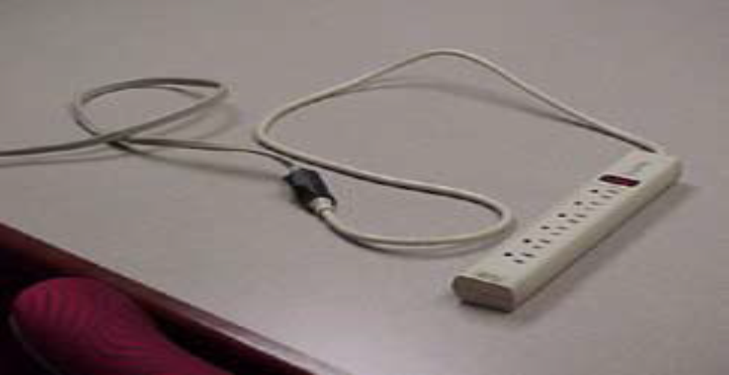
Power strips can be energized by extension cords.
B. False
A power strip power strip must be connected directly into a wall outlet rather than an extension cord. Using an extension cord with a power strip is a dangerous situation which creates a risk of equipment failure and fires.

Slide 77
Question 11. Every worker is responsible for recognizing electrical hazards and using electricity safely.
True
False

Slide 78
All workers are responsible to recognize electrical hazards they may be exposed to and to use electrical power safely everyday.
A. True

Slide 79
Question 12. Electrical components which are not properly grounded may create electrical shocks:
True
False

Slide 80
Electrical components which are not properly grounded may create electrical shocks.
A. True
No Grounding Conductor – Fault current in tool flows through the worker.
Hot conductor
Current
Neutral conductor

Slide 81
Question 13. Electrical current passes through body only when there is a potential difference:
True
False

Slide 82
Electrical current passes through the body only when there is a potential difference.
True
Electron flow is the current. Voltage is the force behind electron flow. Potential difference is a way of expressing the voltage. When there is a difference in potential difference, current flows.

Slide 83
Question 14. High voltage shocks cause electrical burns
True
False

Slide 84
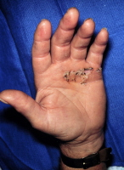
High voltage shocks cause electrical burns
A. True
Link to Facts about Electric Burns and other Electrical Injuries: http://dermaamin.com/site/atlas-of-dermatology/5-e/416-electric-burn-.html

Slide 85
Question 15. Electrical burn injuries are caused by electrical fires from a short circuit.
True
False

Slide 86
Electrical burn injuries to skin surfaces are caused by electrical fires from a short circuit.
B. False
Thermal burns cause injuries to skin surfaces; electrical burns can also cause internal burns to vital organs, arc flash burns, flame burns, contact burns (thermal burns) or a combination thereof.

Slide 87
Question 16. The severity of the injury caused by the electric shock:
Is independent of the magnitude of the electrical current passing into the body.
Depends on the voltage magnitude.
Depends only on the resistance of the skin surface.
Depends on the amount of current and length of time the current flows through the body.

Slide 88
The severity of the injury caused by the electric shock is:
D. Depends on the amount of current and length of time the current flows through the body.

Slide 89
Question 17. A severe shock can cause much more damage to the body than is visible.
True
False

Slide 90
A severe shock can cause much more damage to the body than is visible.
A. True
Persons may suffer internal injuries and long term adverse effects on tissues, nerves, and muscles for electrical shocks. Hidden injuries caused by electrical shock may result in a delayed response. Even if the electrical current does not cause immediate injury, reaction to the shock may cause one to fall, resulting in severe injuries.

Slide 91
Question 18. The correct order for the hierarchy of controls from best to worst is:
PPE, Administrative Controls, Engineering Controls, Substitution.
Administrative Controls, Engineering Controls, Administrative Controls, Elimination.
Elimination, Substitution, Engineering Controls, Administrative Controls, PPE.
Enforcement of Standards, Correction of Hazards, Elimination, Substitution.

Slide 92
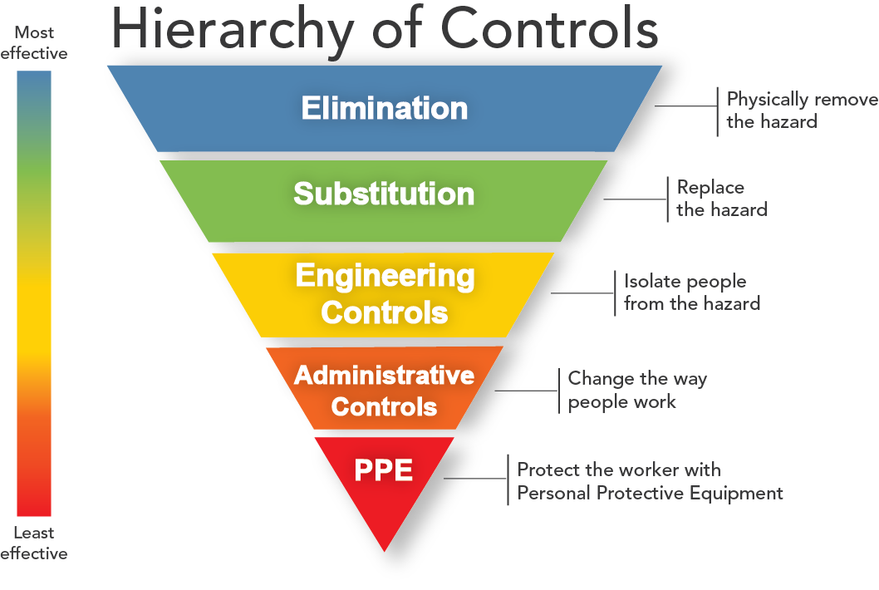
The correct order for the hierarchy of controls from best to worst is:
C. Elimination, Substitution, Engineering Controls, Administrative Controls, PPE

Slide 93
Question 19. A ground fault circuit interruptor (GFCI ) is used to protect equipment from over-current.
True
False

Slide 94
A ground fault circuit interrupter (GFCI ) is used to protect equipment from over-current.
False
Ground Fault Circuit Interrupters protect persons from receiving electric shocks from electrical circuit faults . GFCIs works by comparing the input current on the hot side to the output current on the neutral side. If there's the slightest difference in current, then there is current leaking out somewhere, possibly through somebody's body. To protect persons in this situation, the device very quickly cuts off the power supply within 20-30 milliseconds, reducing any possible injury from errant current.

Slide 95
Question 20. An electrically safe working condition:
Is required by OSHA for work on energized circuits.
Must be established before an unqualified persons can work on electrical equipment which is energized.
Can be established by locking out the power source.
All of the above

Slide 96
An electrically safe working condition:
D. All of the above
Is required by OSHA for work on energized circuits. Must be established before an unqualified persons can work on electrical equipment which is energized. And can be established by locking out the power source.

Slide 97
Certificate of Completion
THIS IS TO CERTIFY THAT
“Enter Name Here”
Has Completed Electrical Hazard Awareness Training
Nancy Vyas
Chair, DoD Electrical Safety Working Group
Safety Engineer
Army Research Laboratory

