Slide 1
Accident/Incident Investigations
OSHA VPP
October 2020
Notes:
This presentation outlines accident/incident investigation requirements for the purposes of the Occupational Safety and Health Administration (OSHA) Voluntary Protection Programs (VPP) recognition. OSHA refers to this sub-element as accident/incident and near-miss investigations, but we will refer to it as a “mishap” for consistency with Department of Defense (DoD) terminology.
The presentation provides information on the background and importance of mishap investigations, required documentation, and various levels of employee knowledge. It concludes with an action checklist and supplemental details to help with OSHA VPP implementation and sustainment efforts.

Slide 2
Objectives
In this presentation, you will learn to:
Summarize the background and importance of mishap investigations
List investigation-related documentation
Describe the knowledge leadership/management, key personnel, and the workforce should have regarding mishap investigations
Identify mishap investigation-related actions to implement and sustain OSHA VPP
Notes:
This presentation is beneficial to safety and health (S&H) professionals, OSHA VPP representatives, and designated mishap investigators.

Slide 3
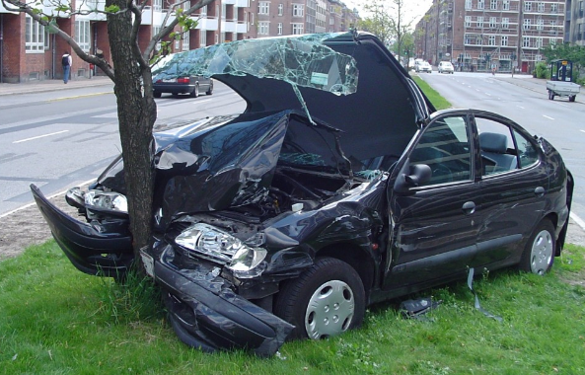
Background & Importance
Included in the WA criteria for VPP
Identifies root causes and causal factors
Determines mishap prevention measures
Emphasizes a near-miss reporting system
Image retrieved from Bing Images
Notes:
WA = Worksite Analysis
Mishap: An unplanned event or series of events resulting in damage to DoD property; occupational illness to DoD personnel; injury to on- or off-duty DoD military personnel; injury to on-duty DoD civilian personnel; damage to public or private property, or injury or illness to non-DoD personnel, caused by DoD activities.
Near-miss: An undesired event that, under slightly different circumstances, would have resulted in personal harm, property damage, or an undesired loss of resources.
Mishap investigations are an important component of a safety management system (SMS). The ultimate purpose of mishap investigations is preventing future accidents, incidents, and near-misses. These investigations identify root causes and help you determine controls to prevent the conditions and/or unsafe behaviors contributing to the mishap.
Image retrieved from Bing Images (free to share and use license) at:
http://fieldschiropracticclinic.com/wp-content/uploads/2016/02/fcc-car-wreck.jpg

Slide 4
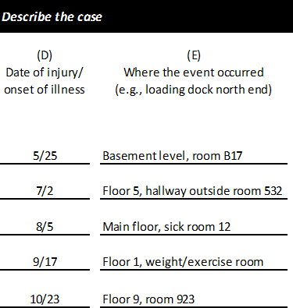
Documentation
Mishap investigation procedures
Completed investigation forms
Mishap trend analysis
Employee reports of hazards and near-misses
OSHA Forms 300, 300A, and 301
Completed JHA/risk assessments
Image created by the DoD SMCX
Notes:
JHA = job hazard analysis
An OSHA VPP assessment of your mishap investigation process includes a review of the documentation listed on this slide. This list is not an all-inclusive list of documentation.
Make sure you provide completed examples of forms and documents to your assessment team. Don’t just show them blank forms! They want to see the documents you filled out to assess the processes within your SMS.
Image created by the DoD SMCX. The image shows a snapshot of a site’s mishaps listed on an OSHA Form 300.

Slide 5
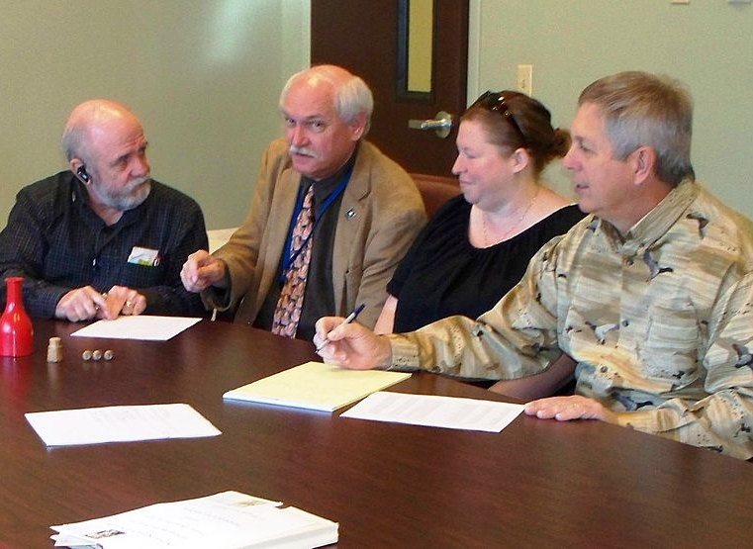
Leadership & Management Knowledge
Leaders should be knowledgeable about:
Information on the last mishap
Mishap and near-miss trends
Resources allocated to support investigations
How to demonstrate commitment and support for preventing mishaps and correcting hazards
Recognizing employees and promoting reporting
Image retrieved from Microsoft Clip Art
Notes:
Leaders must understand mishap investigation is a key element of any SMS and the VPP process. Leadership must be able to describe recent mishaps and mishap trends within their organizations (e.g. Classes A, B, C, D mishaps).
Leadership should also be able to discuss resources allocated for these investigations, especially when resources extend beyond the safety budget and available personnel. An organization may need to bring in subject matter experts (e.g., from the Service Safety Center or other organizations directed by higher authority) to serve on mishap investigation boards.
Additionally, leaders must demonstrate commitment and support for correcting mishaps, promoting the program, and recognizing employees who report near-misses. Ensure you promote near-miss reporting but do not encourage underreporting! Recognize employees or work areas who report significant near-misses, and then consider awarding everyone when you achieve an organizational goal. Provide feedback and recognition at both an individual and organizational level.
Image retrieved from Microsoft Clip Art. The image shows a group of senior leaders discussing mishaps and near-misses at their site.

Slide 6
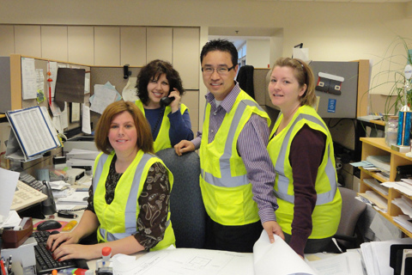
Key Personnel Knowledge
Mishap investigators should be knowledgeable of:
Timeline for initiating investigations
Mishap investigation methods and techniques
Process to correct or abate identified causal factors
Reporting near-misses and tracking corrections
Mishap and near-miss investigation trends
Image retrieved from Microsoft Clip Art
Notes:
Mishap investigators are normally S&H staff or other individuals with S&H responsibilities; however, the process may involve others at your organization, including supervisors, employees, and human resources personnel. Train these individuals on how to execute your mishap investigation process. Training must include root cause analysis and teach investigators to identify causal factors.
There are several different mishap investigation methods and techniques you can use. Remember, different factors (e.g., cost, property damage, type and severity of employees’ injury and or illness) may determine the complexity of the mishap investigation.
Image retrieved from Microsoft Clip Art. The image shows employees assisting the S&H Officer with a mishap investigation, a great way to encourage employee involvement in your organization, just remember to train them!

Slide 7
Workforce Knowledge
Employees should be knowledgeable about:
Steps to report a mishap or a near-miss
Ways to request mishap investigation information
Employee rights under OSHA and 29 CFR 1960
Lessons learned from mishaps
Mishap investigation responsibilities, if applicable
Image retrieved from Bing Images
Notes:
Ensure your employees understand the focus of mishap investigations is fact-finding, not fault-finding. Their cooperation and honesty is critical to complete a comprehensive investigation. Employees are generally involved in an investigation in one of two ways – either as the person involved in the mishap or as a witness of the event.
Employees must be able to answer “What is the process for reporting a mishap? ” and “What is the process for reporting a near-miss?” They should understand how to file a mishap report even if they have never been involved in a mishap. Mishap reporting and near-miss reporting may be the same process or follow the same procedure. If it is the case, employees should be able to communicate the procedure.
Employees must have knowledge of their employee rights under the OSH Act and 29 CFR 1960 related to mishap investigations. These rights include:
Participating in a mishap investigation
Reporting a mishap without fear of reprisal or discrimination
Receiving, upon request, the results of mishap investigations
Receiving an explanation of any mishaps in their work area and corrective actions
Receiving whistleblower protection
It’s important to share lessons learned from mishap investigations with your employees. Remember, your employees can also be involved in the investigation process as a form of employee involvement, too! If you use mishap investigation as a method of employee involvement, be sure these employees are trained and understand their responsibilities.
Image retrieved from Bing Images (free to share and use license) at: http://vcvoices.org/wp-content/uploads/2015/05/blue-collar-workers-400x300.jpg

Slide 8
Action Checklist
Review Service/Agency mishap reporting and investigation policies
Train investigators in mishap investigation requirements and techniques
Train employees on reporting procedures
Conduct mishap investigations
Develop corrective action plans
Communicate investigation results and corrective actions
Identify mishap-related trends
Notes:
Follow this action checklist to implement and sustain VPP expectations for mishap investigations. The presentation covers each of these action checklist items in more detail on the following slides.

Slide 9
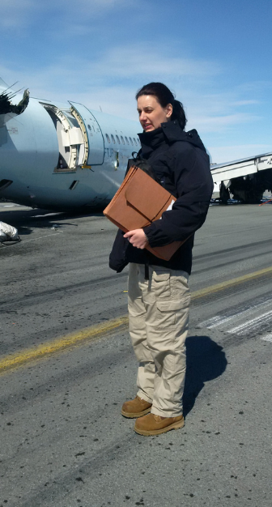
Review Reporting and Investigation Policies
Review applicable Service/Agency mishap reporting and investigation policies and procedures
Adopt or develop local mishap reporting and investigation policies
Identify a process for the reporting and investigation of near-misses
Image retrieved from Bing Images
Notes:
Each Service or Agency has its own mishap investigation requirements. S&H staff and others with S&H responsibilities must be aware of regulatory requirements governing mishap investigations within your organization.
Many Service/Agency regulations for mishap reporting and investigation do not cover near-misses, or only touch on near-misses briefly. Be sure you establish a clear process for reporting and investigating near-misses.
29 Code of Federal Regulations (CFR) 1960.29 requires all federal workplaces to investigate mishaps. For more information, visit: https://www.osha.gov/pls/oshaweb/owadisp.show_document?p_table=STANDARDS&p_id=11280
DoD Instruction 6055.01 requires each DoD Component to “establish procedures for identifying hazards from the results of mishap investigations and injury and illness reports.” DoD Instruction 6055.07 provides additional requirements related to mishap notification, investigation, reporting, and recordkeeping requirements within the DoD.
Service/Agency-specific guidance includes:
Air Force: AFI 91-204 – Safety Investigations and Reports
Army: AR 385-10 – Army Safety Program; and DA PAM 385-40 – Army Accident Investigations and Reporting
DLA: DLAI 6055.7 – Mishap and Near-Miss Reporting and Investigation
Navy/Marine Corps: OPNAVINST 5102.1D/MCO P5102.1B, Navy and Marine Corps Mishap and Safety Investigation Reporting and Record Keeping Manual
USACE: EM 385-1-1 Safety and Health Requirements Manual
The image shows a mishap investigator preparing to investigate an aircraft incident on a runway. Image retrieved from Bing Images (free to share and use license) at: https://c2.staticflickr.com/8/7597/16801190990_8e2e49d697_b.jpg

Slide 10
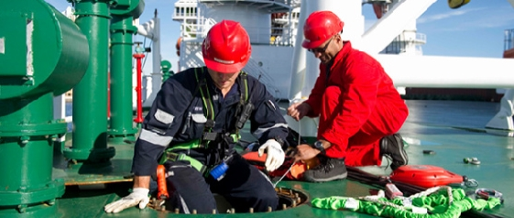
Train Mishap Investigators
Review Service/Agency investigator training requirements
Train new investigators prior to assignment
Determine the best method to train investigators
Consider refresher training to keep investigators knowledgeable
Image retrieved from Bing Images
Notes:
Service/Agency-specific regulations provide guidance for the roles and responsibilities of mishap investigators. Supervisors, for example, may have a role in securing the scene of a mishap and gathering preliminary information prior to the arrival of trained investigators.
You must properly train anyone who may conducts a mishap investigation beforehand! Determine the best method to teach your mishap investigators – examples can include: hands-on training, lecture, mock-investigations or mishap reenactments, and online training. Each individual’s role, including specific mishap investigator responsibilities, may influence the method you provide. Consider providing mishap investigation training in a hybrid format where employees attend a lecture and participate in a hands-on simulated type case study. The hybrid model allows employees to learn the key mishap investigation strategies and apply concepts learned in class to a real scene.
Most training for investigators is one-time, so consider retraining investigators periodically to refresh them on the local policies, current practices, and investigation techniques. Remember: design all training, regardless of the format, to identify the root causes of mishap.
Consider the following resources for mishap investigation training guidance:
National Safety Council, “How to Conduct an Incident Investigation” at: https://www.nsc.org/Portals/0/Documents/JSEWorkplaceDocuments/How-To-Conduct-An-Incident-Investigation.PDF
OSHA, “Incident [Accident] Investigations: A Guide For Employers” at: https://www.osha.gov/dte/IncInvGuide4Empl_Dec2015.pdf
Washington State Department of Labor & Industries, “Accident Investigation Basics” at: http://wisha-training.lni.wa.gov/training/presentations/AccidentInves.pps
The image shows a hands-on simulation for training purposes. Image retrieved from Bing Images (free to use and share license) at: https://officerofthewatch.files.wordpress.com/2015/07/2015-07-06-avoidable-accidents.jpg

Slide 11
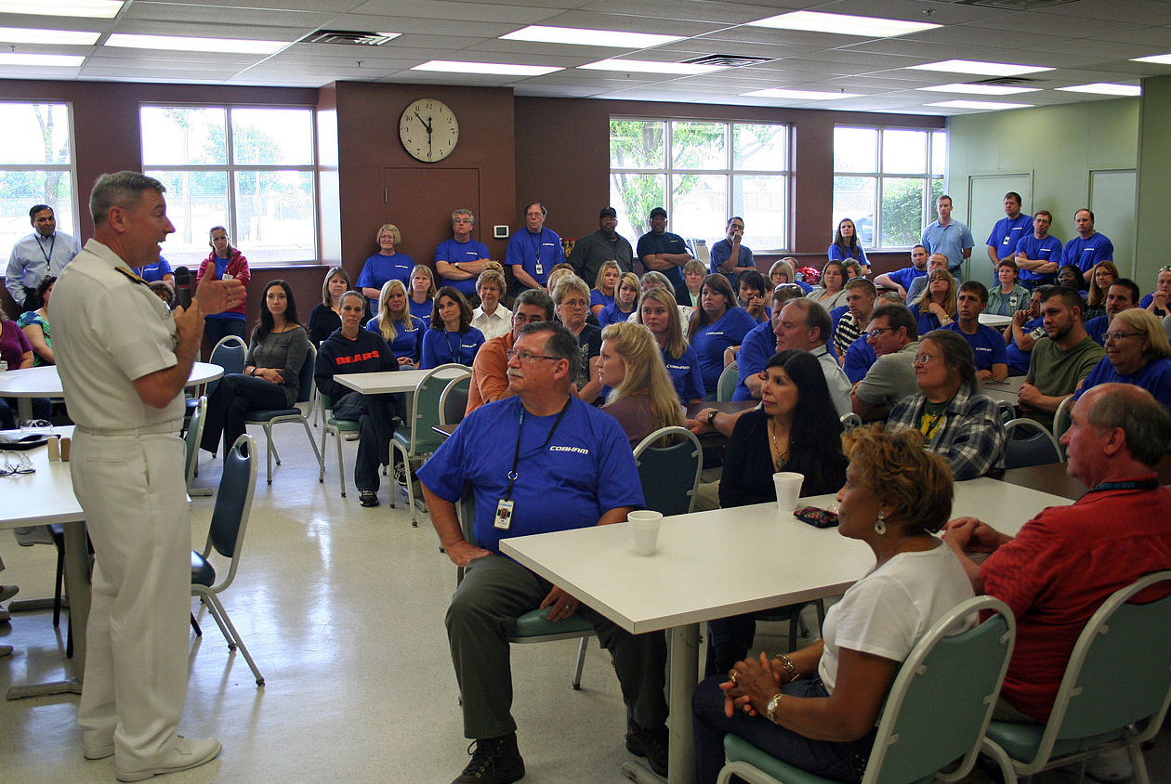
Train Employees
Employees need trained on:
Responsibilities should a mishap occur
Difference between mishaps and near-misses
Receiving medical attention post-mishap
Location of mishap and near-miss reporting forms
Reporting procedures for mishaps and near-misses
Importance of reporting
Image retrieved from Bing Images
Notes:
Train your employees on your reporting procedures and explain why it is important to report mishaps and near-misses. Often, lack of specific training or infrequent training is one reason employees do not submit reports. They either don’t understand what a near-miss is, or received the training a long time ago. It is a good idea to include near-miss and mishap reporting information during new employee orientation and provide refresher training on a periodic basis for current employees. Train your employee on how to use mishap reporting forms and systems, their responsibilities during a mishap, utilizing the chain of command to report mishaps, and how to receive medical attention.
Best Practice: Keep your near-miss and mishap reporting forms simple! Use simple language and avoid technical jargon. Your employees are less likely to report mishaps if you have complicated forms or take a long time to complete. You only need a minimal amount of information from the employee to begin an investigation.
The image shows an instructor training employees on how to report mishaps and why mishap reporting is important. Image retrieved from Bing Images (free to use and share license) at: http://upload.wikimedia.org/wikipedia/commons/thumb/6/61/US_Navy_110617-N-ZL585-202_Rear_Adm._Thomas_A._Cropper%2C_commander_of_Strike_Force_Training_Pacific%2C_meets_with_employees_of_Cobham_Mission_Systems.jpg/1280px-US_Navy_110617-N-ZL585-202_Rear_Adm._Thomas_A._Cropper%2C_commander_of_Strike_Force_Training_Pacific%2C_meets_with_employees_of_Cobham_Mission_Systems.jpg

Slide 12
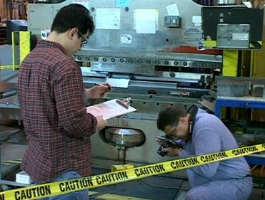
Conduct Investigations
Initiate the investigation
Secure the scene
Collect mishap information
Interview witnesses and involved employees
Identify causal factors, including root causes
Write the report
Image retrieved from Bing Images
Notes:
Initiate mishap investigations as soon as possible. An immediate investigation allows you to secure the scene and document the mishap site before removing potential evidence. Additionally, securing the scene helps protect employees from potentially uncontrolled hazards.
Thoroughly document all facts pertaining to the mishap. Document the date, time, and location of the mishap, take pictures of the mishap scene, and verify the names of employees involved in the mishap or who can serve as witnesses. Mishap investigations should capture worker and injury details, time factors, supervision information, and causal factors.
Select interview locations comfortable for employees. Not all employees feel comfortable with an interview at the mishap scene or around other employees. Be careful when asking questions. Avoid feeding information to the interviewee. Sometimes employees can provide answers they think the interviewer wants them to say. Try to provide open-ended questions interviewees cannot respond to with simple yes/no answers.
Consider all possible factors when determining the root causes of the mishap. Was it a result of inadequate policies and procedures? Ineffective controls? Lack of training? Poor management, leadership, or supervision? Ask yourself, “Why?”, whenever you determine a potential cause. In most cases, you will identify and need to address multiple causes. Unless gross negligence has occurred, avoid blaming employees for the cause of a mishap. If gross negligence is suspected, that cause should be thoroughly investigated to ensure discipline is not placed inadvertently. Request a copy of the police report, if applicable, and use it to help complete the mishap report.
The images shows investigators gathering and documenting information during a mishap investigation. Make sure your written mishap report is comprehensive. Image retrieved from Bing Images (free to share and use license) at: http://www.americantrainingresources.com/uploads/images/original/22.JPG

Slide 13
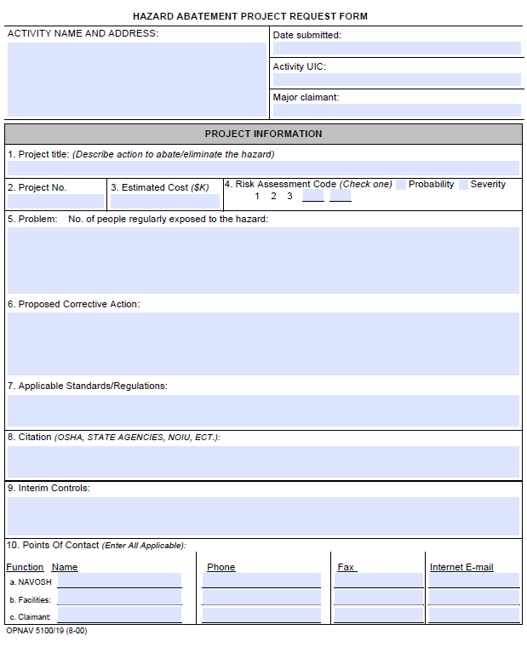
Develop Corrective Action Plans
Identify causal factors and root causes
Determine potential control measures or corrective actions
Assign priority, deadlines, and responsibility
Implement corrective actions
Conduct follow-up
Image retrieved from Office of the Chief of Naval Operations
Notes:
You need to implement solutions once you identify the root cause and causal factors. Remember, the goal is to provide maximum protection reasonable for employees. Sometimes Service/Agency-specific guidance or OSHA regulations specify exactly how to abate a particular hazard. Implemented solutions must satisfy applicable regulatory requirements, at a minimum. When varying requirements exist, always default to the most stringent requirement. Use the hierarchy of controls to determine the most effective control methods.
A corrective action plan addresses all identified causal factors and tracks the corrective measures to completion. The corrective action plan can also be referred to as a hazard abatement plan. Refer to your Service/Agency policies and procedures for abatement plans and corrective actions. Conduct follow-ups to ensure implemented actions are as effective as anticipated. You may find some corrective actions did not work out the way you wanted, which requires more/different ideas to control a causal factor.
A corrective action plan usually includes:
Date identified
Description of the deficiency
Assigned risk assessment code
Location(s)
Interim controls, if applicable
Who has responsibility for correction
Description of the corrective action
Estimated completion date
Final completion date
The image shows Form 5100, Hazard Abatement Project Request Form. Image retrieved from Office of the Chief of Naval Operations at: https://www.navfac.navy.mil/products_and_services/sf/products_and_services/hazard_abatement.html

Slide 14
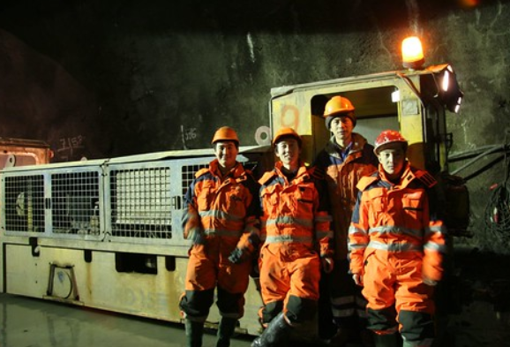
Communicate Results
Share investigation results with leaders, supervisors, and employees
Utilize appropriate communication methods:
Leadership meetings
Safety council, committee, and/or staff meetings
Toolbox talks, newsletters, websites
Posted incident report summaries or “lessons learned”
Image retrieved from Bing Images
Notes:
Communicate investigation findings with employees, supervisors, and managers. Present your information in context so everyone understands how the mishap occurred and the measures in place to prevent it from happening again. It is best to share this information across the entire organization, especially when the incident is not unique to a particular job. Do not include the names of individual’s involved in mishaps in your communications either – keep it to the high-level details so everyone knows what happened and how it can be prevented in the future!
Best Practice: Post a summary of the incident report in the workplace or on your internal website to inform employees of the incident details.
Communicate:
What happened, including essential background information
Your findings
The root causes and what you believe caused the mishap
Corrective actions taken
Lessons learned
The investigation results (to include, at a minimum, a description of the mishap and the corrections made to avoid recurrence) must be available to employees on request, although you do not need to provide the actual investigation records to them.
Image retrieved from Bing Images (free to share and use license) at: https://farm1.staticflickr.com/128/422047475_63a639bc19.jpg

Slide 15
Identify Mishap-Related Trends
Collect mishap and near-miss investigation data
Analyze the collected data for similarities
Use graphs, charts, and tables to display the data
Interpret the findings
Identify both positive and negative trends
Image retrieved from Microsoft Clip Art
Notes:
Creating graphical depictions of your mishaps helps everyone understand and interpret your trends. To analyze your data, think about what the data means. Think about how this data is important to your worksite and your site’s goals and objectives. Gather data over time so you can see how your trends develop.
Some trends to consider for both mishaps and near-misses can include, but are not limited to: which shops/work areas have the most mishaps/near-misses; what time of day or day of the week mishaps and near-misses occur; what season of the year mishaps and near-misses occur; what jobs or job series have the most mishaps/near-misses; what causal factors and root causes appear most often; the severity of injury during mishaps or potential severity during a near-miss; what types of injury/illness happen most often; what objects, tools, equipment, or other devices cause most mishaps or near-misses; and what part of the body is injured/ill most often.
Best Practice: Trend your data at the end of the calendar year so you can review injuries and illnesses based on OSHA’s recordkeeping requirements. Don’t forget to take a look at your near-misses. They can be insightful to the types of mishaps you have at your organization and may predict the next possible mishap – you can use your trend data to prevent these near-misses from turning into major mishaps!
For additional information, review the SMCX VPP slide deck on Trend Analysis.

Slide 16
Conclusion
In this presentation, you learned to:
Summarize the background and importance of mishap investigations
List investigation-related documentation
Describe the knowledge leadership/management, key personnel, and the workforce should have regarding mishap investigations
Identify mishap investigation-related actions to implement and sustain OSHA VPP

