Slide 1
Baseline Hazard Analysis
OSHA VPP
October 2020
Notes:
This presentation outlines baseline hazard analysis requirements for the purposes of Occupational Safety & Health Administration (OSHA) Voluntary Protection Programs (VPP) approval.
The presentation provides information on the background and importance of baseline hazard analyses, required documentation, and the various levels of employee knowledge. It concludes with an action checklist and supplemental details to help with OSHA VPP implementation and sustainment efforts.

Slide 2
Objectives
In this presentation, you will learn to:
Summarize the background and importance of baseline hazard analyses
List baseline hazard analysis-related documentation
Describe the knowledge leadership/management, key personnel, and the workforce should have regarding baseline hazard analyses
Identify baseline hazard analysis actions to implement and sustain OSHA VPP
Notes:
This presentation is beneficial to safety and health (S&H) professionals, VPP representatives, and others with baseline hazard analysis responsibilities.

Slide 3
Background & Importance
Included in the WA criteria for VPP
Identifies and documents common worksite hazards
Assesses the workplace for both safety AND health hazards
Involves IH assessment and monitoring
Develops sampling strategies to assess employee exposure to hazards
Evaluates S&H at each phase of construction projects, if applicable
Image retrieved from Bing Images
Notes:
WA = Worksite Analysis IH = industrial hygiene
Baseline hazard analysis: An assessment identifying and documenting all of the S&H hazards at a worksite.
Baseline analysis involves looking for S&H hazards associated with:
OSHA, American National Standards Institute (ANSI), Department of Defense (DoD), Service-specific, or other S&H regulations and requirements
State and local building standards or codes
Hazards in the workplace associated with controls already in place.
Baseline hazard analysis involves both safety and health hazards. IH assessment and surveys are a big part in not only identifying health hazards, but also in determining how to monitor employee exposures to health hazards.
Image retrieved from Bing Images (Creative Commons).

Slide 4
Documentation
Safety hazards baseline assessment
Health hazards baseline assessment
IH implementation plan
IH sampling strategy
Previous IH sampling results
Construction phase baseline studies
Image retrieved from Bing Images
Notes:
Make sure you provide completed examples of forms and documents to your assessment team. Don’t just show them blank forms! They want to see the documents you filled out to thoroughly assess the processes within your safety management system.
Use these documents to satisfy the baseline hazards analysis requirements of VPP.
The construction phase baseline assessments are only applicable to you if you perform construction work or are a construction company pursuing VPP Star recognition. You do not need construction phase baseline assessments for construction contractors who work on site at your organization.
Image retrieved from Bing Images (Creative Commons).

Slide 5
Leadership/Management Knowledge
Leaders and managers should know:
S&H hazards throughout the worksite
S&H hazards in contractor work areas
Most hazardous areas and operations at the worksite
Who provides S&H support to the organization
Process for hazard assessment and identification
Resources allocated to provide a safe and healthful workplace
Image retrieved from Bing Images
Notes:
It is the responsibility of leadership and upper management to provide their employees with a safe and healthful working environment. As such, leaders should know the hazards at the worksites, including the most hazardous areas and operations they own.
Leaders should be knowledgeable of employees working at an external site or alongside contractors. They must realize hazards created by contractor operations could affect their employees’ workplace S&H.
If you expect supervisors to conduct baseline assessments with S&H professionals, then the supervisors must understand how to identify S&H hazards – some organizations ensure supervisor have this knowledge through a hazard recognition and identification training course.
Image retrieved from Bing Images (Creative Commons).

Slide 6
Key Personnel Knowledge
Key personnel should know:
Procedures and processes to identify S&H hazards
S&H hazards at the worksite and in contractor areas
Process for determining risks associated with S&H hazards
S&H regulations, codes, requirements, and exposure limits
Sampling and surveying methods for health hazards
Employee health monitoring and surveillance
Image retrieved from Bing Images
Notes:
Key personnel may include: safety office staff, IH specialists, fire department officials, and occupational health personnel.
Safety personnel should be familiar with the processes and procedures used to identify hazards. These are generally documented in overarching DoD or Service-specific S&H regulations and local instructions.
Safety personnel should also be familiar with the process of assigning risk assessment codes to each identified hazard and work with key personnel to determine the best mitigation strategies.
IH specialists and occupational health staff should work with the safety professionals to identify health hazards during the baseline assessment.
Image retrieved from Bing Images (Creative Commons).

Slide 7
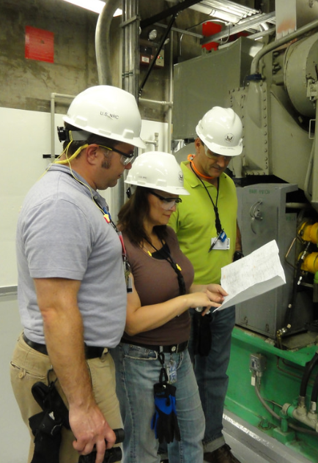
Workforce Knowledge
Employees should know:
S&H hazards associated with their job tasks/work areas
Location of S&H baseline surveys and identified hazards
IH sampling or survey results and identified hazards
Employee S&H rights and responsibilities under OSHA
Image retrieved from Bing Images
Notes:
Inform employees of baseline hazard assessments and the results of IH sampling or surveys conducted in the work areas, what those results mean, and how they are protected.
For additional information on OSHA rights and responsibilities, visit: https://www.osha.gov/Publications/osha3165-8514.pdf
The image shows several workers conducting an inspection on machinery prior to the start of work. Image retrieved from Bing Images (free to use and share license) at: https://www.flickr.com/photos/nrcgov/7741187290

Slide 8
Action Checklist
Develop or review baseline hazard analysis method(s)
Make a list of buildings and work areas where hazards need identified
Review S&H documentation
Perform the hazard assessment
Document the outcome of the baseline hazard analysis
Conduct and document IH sampling or survey data
Communicate the results to affected personnel
Train employees
Review and update existing baseline hazard analyses
Notes:
Follow this action checklist to implement and sustain VPP expectations for baseline hazard analysis. Each of these action checklist items will be covered in more detail.

Slide 9
Baseline Hazard Analysis Method(s)
Review the processes outlined in Service or Agency S&H instructions
Become familiar with:
Baseline assessment procedures
Who is responsible
When to conduct a baseline assessment
How to document each assessment
When and how to communicate the assessment results
What to do with the assessment results
Image retrieved from Bing Images
Notes:
Follow overarching S&H regulations and local instructions. Safety professionals generally conduct baseline safety hazard analyses, but other trained personnel can participate, if needed.
Image retrieved from Bing Images (Creative Commons).

Slide 10
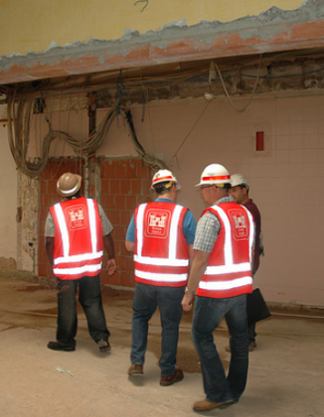
Work Area Identification
Think about all the work areas with potential hazards
Develop a list of areas to assess
List may be building-, work area-, or operation-specific
Include all work areas needing a baseline analysis performed
Make sure the list covers any work areas where employees may perform work
Image retrieved from Bing Images
Notes:
Identify all work areas with potential S&H hazards or where employees may perform work. Identify any known S&H hazards in each area – more hazards will be identified later during the site walkthrough. The key personnel and the leaders for each area should complete this step.
The image illustrates safety staff assessing a work facility under renovation. Image retrieved from Bing Images (free to share and use license) at: http://farm5.staticflickr.com/4100/4885136304_d910fe45f4_z.jpg

Slide 11
Safety & Health Documentation Review
Review existing S&H documents for:
Previously identified S&H hazards
Prior accidents and mishaps
Employee reported hazards
Workplace trends
Review S&H standards, regulations, and applicable codes
Image retrieved from Bing Images
Notes:
Documents to help you to complete a baseline hazard analysis may include:
Hazard tracking logs
Hazard or risk assessment reports
IH surveys and monitoring
Chemical inventories
Facility or equipment maintenance work orders
Employee hazard reports
Hazard control programs
Occupational health surveillance program documents
Building blueprints/design
Workplace inspection results
Accident investigation reports
Trend analysis results
Image retrieved from Bing Images (free to share and use license) at: https://farm8.staticflickr.com/7126/7537055320_8923026c93_z.jpg

Slide 12
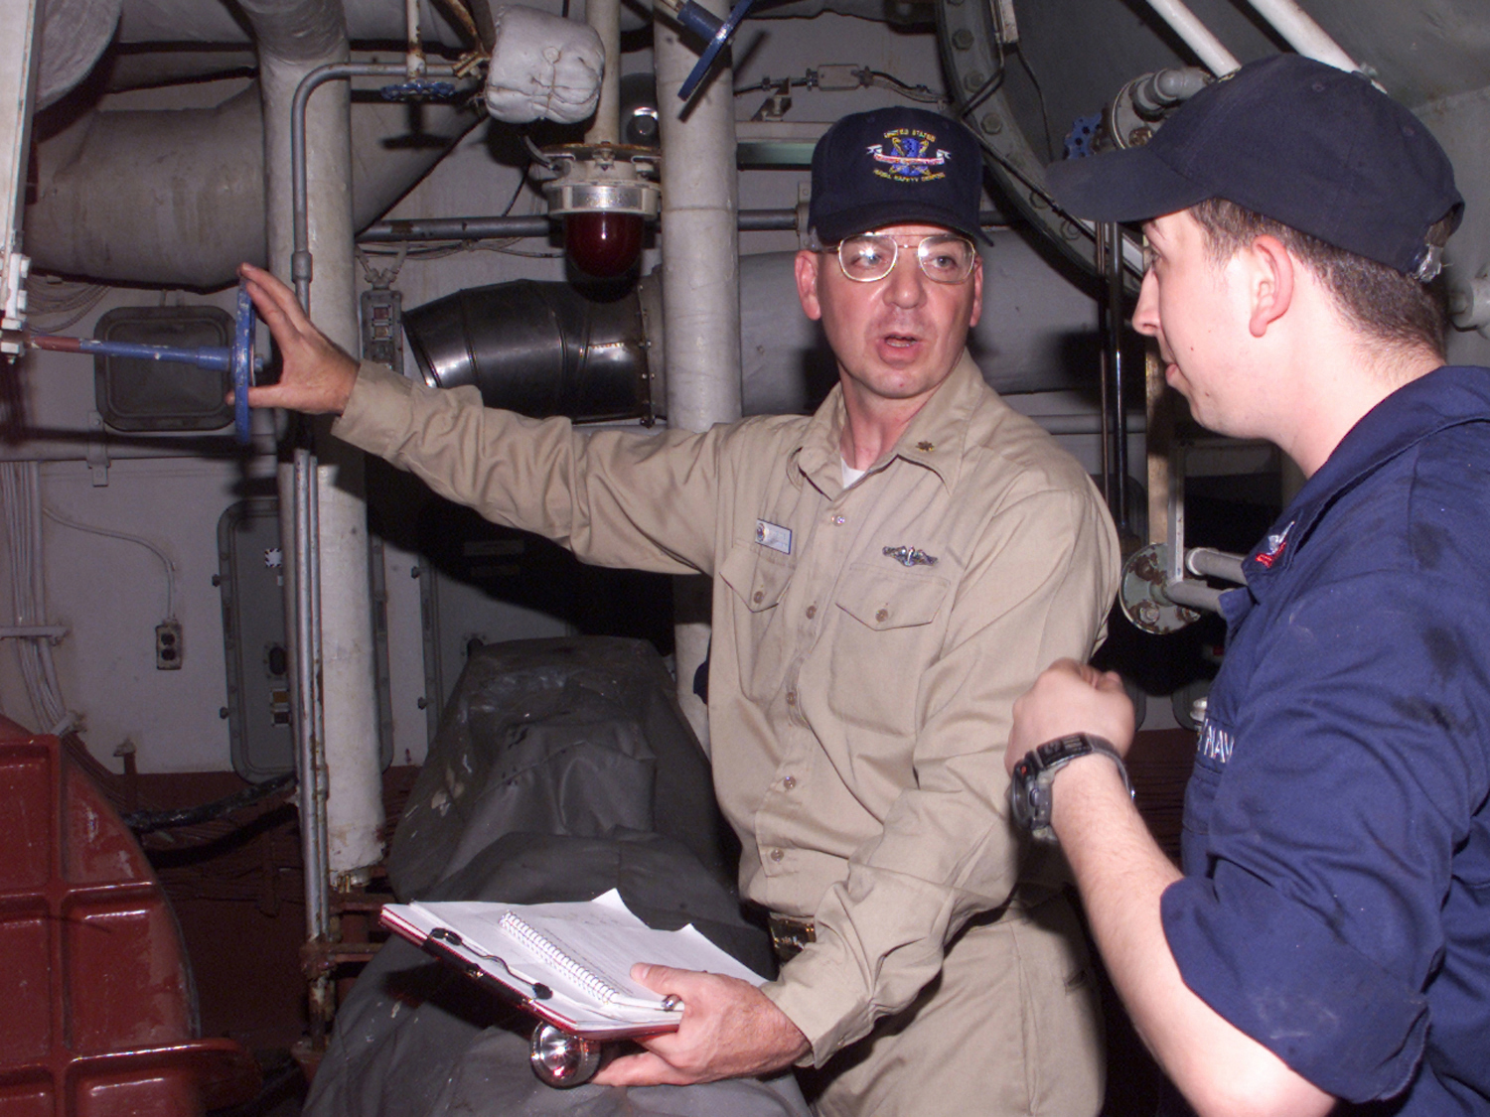
Baseline Hazard Analysis
Conduct a walkthrough inspection of the area, looking for:
Perceived or potential S&H hazards
Non-compliance with standards, regulations, codes, and instructions
Hazards for which controls already exist to mitigate
Processes or procedures needing follow-up assessments
Image retrieved from Bing Images
Notes:
Safety staff generally completes a baseline safety hazard analysis. IH specialists, and sometimes occupational health staff, complete a baseline health hazard analysis. It is recommended to complete these assessments together to minimize duplicated efforts.
Walk through and evaluate the work area. Look at the operations. Identify the hazards presenting a potential for occupational exposure to injury. Compare the facilities, operations, and surroundings to applicable building codes, S&H standards, and DoD, Service, Agency, state, and local regulations.
The image illustrates two personnel conducting baseline assessments. Image retrieved from Bing Images (free to use and share license) at: https://upload.wikimedia.org/wikipedia/commons/d/d5/US_Navy_020724-N-9802B-001_A_safety_Inspection_is_conducted_in_the_main_spaces_aboard_USS_Essex_%28LHD_2%29.jpg

Slide 13
Baseline Hazard Analysis
Perform management and employee interviews
Discuss job tasks, work processes, operations, and facility layout
Ask for opinions regarding S&H hazards present in the workplace
Review documentation relative to tasks, processes, and operations
Image retrieved from Bing Images
Notes:
Interview managers, supervisors, and workers – ask questions related to information discovered in the document review. Ask about previous accidents, injuries, and complaints. Scan their answers for useful information providing insight into the work processes in their work areas and any potential hazards. Ask detailed questions regarding the processes and operations. Have employees show you any additional documents to support their answers, such as safety data sheets, previous hazard analyses, operation manuals, and past sampling results.
Image retrieved from Bing Images (Creative Commons).

Slide 14
Industrial Hygiene Sampling
Conduct IH sampling or surveys to discover additional information on health hazards in each work area
Capture follow-up surveys or sampling needed to measure exposures
Benefits of IH Sampling
Further evaluates workplace health hazard exposure
Determines if exposures are hazardous in comparison to regulatory guidelines
May include full-shift sampling, initial screenings, or grab sampling
Sets an initial exposure for comparison to future exposure levels
Identifies the need for health hazard controls or workplace changes
Notes:
Health hazards are not always as straight forward as safety hazards. In many cases, you need additional surveying, sampling, or monitoring to determine if a health hazard is truly present.
Examples of IH sampling include: air, noise, dust swipe, mold swipe, and ergonomic evaluations.
Compare results of sampling against S&H standards to determine if the suspected hazard is at a hazardous level of exposure. Examples of government agencies with comparable exposure limits include: OSHA, the National Institute of Occupational Safety and Health (NIOSH), and the American Conference of Governmental Industrial Hygienists (ACGIH).

Slide 15
Document the Outcomes
Use a form or database to document the baseline results:
S&H hazards identified, including where and how the hazards occur
S&H hazards requiring further evaluation
Who conducted the baseline
When the assessment was completed
When recurring assessments or follow-up surveys occur
Assign a RAC to each uncontrolled hazard and track to closure
Image retrieved from Bing Images
Notes:
RAC = risk assessment code
Refer to your DoD, Service or Agency, and local instructions to determine how to document the baseline assessments. Additionally, document any identified S&H hazards on your hazard tracking log–these are hazards needing addressed or mitigated.
Be sure to list each identified hazard. Sometimes it is good to provide some additional notes regarding the hazard (e.g., specific areas, number of exposed personnel, process involved) to drive hazard mitigation.
Use DoDI 6055.01 to help you determine and assign RACs: http://www.esd.whs.mil/Portals/54/Documents/DD/issuances/dodi/605501p.pdf
Image retrieved from Bing Images (Creative Commons).

Slide 16
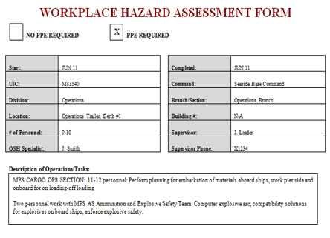
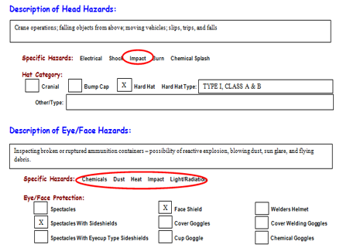
Example – Safety Hazards Assessment
Image courtesy of the DoD SMCX
Notes:
The image shows a sample baseline assessment form for safety hazards. In this case, the organization uses a Workplace Hazard Assessment Form to identify and document the safety findings, including the personal protective equipment (PPE) requirements for the work area.

Slide 17
Example – Health Hazards Assessment
 | 1 | 2
Location | Building 2715 | Site-wide
Hazard Description | Toluene & Other VOCs | Asbestos
Activity or Work Process | Application of lacquer products | Removing and replacing asbestos floor tiles
Hazard Evaluation | Monitoring conducted for use in the Building 2715 paint booth with mixed results | Exposure resulting from work with tiles and leveling compounds
Exposure Rating (0–4) | 2 | 2
Health Effect Rating (0–4) | 3 | 4
Qualitative Exposure Assessment Rating (0–16) | 6 | 8
Frequency of Contact | 3 | 1
Hazard Controls in Place | Paint booth Stay upwind from paint stream when spraying Respirators, chemical resistant gloves | See OI 321
Priority Rating | Low | Medium
Evaluation Needs | If lacquer-based products are used for >3 hours in one shift, contact IH for monitoring | Determine during planning if removal of asbestos-containing floor tiles requires monitoring
Notes:
Health hazard baseline assessment forms come in several formats. Document the location of the assessment, the identified health hazard, the related work activities or processes of the exposure, sampling results, and any hazard controls in place, which may help to reduce or eliminate the identified hazard.
The image shows a sample baseline assessment field evaluation form for health hazards. Make sure the information included on forms is clear so employees can understand their expectations. When you use numbers to classify ratings, employees must be able to know what these numbers indicate – in this current table, we can’t comprehend the ratings unless we are familiar with the rating scale.
Additionally, when referring them to hazard controls beyond those included in this document, make sure they know where to obtain their information so they can be safe and healthful while performing their jobs.

Slide 18
Communication
Inform affected management and employees of:
Baseline assessment results
IH surveys and sampling results
Expected timeline for recurring or follow-up assessments
Work with management and employees to select hazard controls, when needed
Provide documented assessment results in a readily available location
Image retrieved from Bing Images
Notes:
Notify employees when you are conducting a baseline assessment. Inform the employees of the identified S&H hazards in their work areas afterwards. Ensure employees have easy access to the documented baseline assessments for their reference. Choose an easily-accessible location, such as on a SharePoint or internal website.
Image retrieved from Bing Images (Creative Commons).

Slide 19
Training
Train management to notify key personnel when workplace changes occur
Train employees on:
Location of documented baseline assessments
Location of IH surveys and sampling results
Who to contact with questions
Hazard reporting process
Image retrieved from Bing Images
Notes:
You must have processes in place to baseline all new changes to the workplace. Change can include new materials, chemicals, facilities, equipment, or processes. Failing to notify key personnel of these changes beforehand potentially introduces new hazards to the workplace and can lead to injury or illness.
Train employees to ensure they understand the hazards identified through the baseline assessment, the location of any relevant documentation outlining the hazards of their work, who they can contact with questions, and how to report hazards they identify when working.
Image retrieved from Bing Images (Creative Commons).

Slide 20
Review & Updates
Review/update each baseline hazard analysis:
Annually
When significant workplace changes occur
If significant injuries occur due to unidentified hazards
Document the assessment review and updates
Notify the workforce whenever changes are made
Image retrieved from Bing Images
Notes:
Always document the reviews of each baseline assessment, even if you do not make any changes. You do not need to review or repeat the original baseline analysis unless there are changes in processes, equipment, and hazard controls. Communicate any baseline assessment changes to the workforce.
The IH staff conducts surveys based on the priority levels of the work areas and severity of the hazards. Include the Fire Department in the review and update of the baseline as well, as they assess buildings and facilities for compliance with building codes and fire regulations.
Image retrieved from Bing Images (Creative Commons).

Slide 21
Conclusion
In this presentation, you learned to:
Summarize the background and importance of baseline hazard analyses
List baseline hazard analysis-related documentation
Describe the knowledge leadership/management, key personnel, and the workforce should have regarding baseline hazard analyses
Identify baseline hazard analysis actions to implement and sustain OSHA VPP

