Slide 1
Hazard Analysis of Routine Activities
OSHA VPP
November 2020
Notes:
This presentation outlines hazard analysis requirements of routine activities for the purposes of Occupational Safety and Health Administration (OSHA) Voluntary Protection Programs (VPP) approval.
The presentation provides information on the background and importance of hazard analysis for routine activities, required documentation, and the various levels of employee knowledge. It concludes with an action checklist and supplemental details to help with OSHA VPP implementation and sustainment efforts.

Slide 2
Objectives
In this presentation, you will learn to:
Summarize the background and importance for hazard analysis of routine activities
List documentation related to hazard analysis of routine activities
Describe the knowledge leadership/management, key personnel, and the workforce should have regarding hazard analysis of routine activities
Identify hazard analysis actions for routine activities to implement and sustain OSHA VPP
Notes:
This presentation is beneficial to safety and health (S&H) professionals, VPP representatives, and others with hazard analysis responsibilities for routine activities, to include supervisors and facility managers.

Slide 3
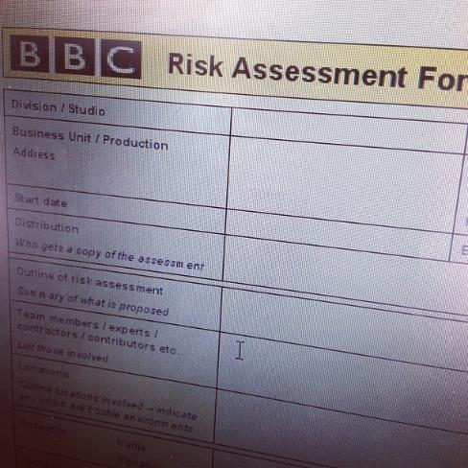
Background & Importance
Included in the WA criteria for VPP
Identifies S&H hazards associated with routine jobs and tasks
Assesses hazards related to routine task and activities
Reduces the likelihood of unknown hazards in workspaces
Image retrieved from Bing Images
Notes:
WA = Worksite Analysis
Hazard analysis: Also known as hazard assessment; the process of recognizing hazards that may arise from a system or its environment, documenting unwanted consequences and analyzing potential causes.
Hazard analysis reduces the risk of injuries and illnesses by identifying hazards and hazardous conditions associated with jobs so you can select and implement controls.
OSHA says you must have a “minimally effective” hazard analysis system in place for routine jobs and activities in order to qualify for VPP Star recognition. If you do not have an effective system in place, you cannot achieve VPP Star status.
Examples of routine activities you may perform hazard analysis on include: machine or equipment operation, welding, and sanding.
Examples of hazard analysis methods include: job hazard analysis (JHA), job safety analysis (JSA), hazard and operability study (HAZOP), what-if analysis checklist, fault tree analysis (FTA), failure mode effects analysis (FMEA), event tree analysis (ETA), health hazard assessments, hazard analysis critical control point (HACCP) studies, and process hazard analysis (PHA).
Image retrieved from Bing Images (Creative Commons).

Slide 4
Documentation
Hazard analysis forms
SOPs
Manufacturer operating manuals
Inspection checklists
Hazard tracking logs
Annual reviews or meeting minutes
Image retrieved from Bing Images
Notes:
SOP = standard operating procedure
Make sure you provide completed examples of forms and documents to your assessment team. Don’t just show them blank forms! They want to see the documents you filled out to thoroughly assess the processes within your safety management system.
Standard operating procedures: A set of step-by-step instructions to inform employees how to carry out a task.
Review inspection checklists, not because they are part of the hazard analysis of routine jobs, but because you may need to check if controls are in place and effective. Machine guarding is one example. Here you may use hazard analysis to identify the need for guards, but then use inspections to ensure guards are in place and not creating an additional hazard. When you discover uncontrolled hazards, or evaluate new jobs, document these hazards and track them until they are controlled. Review hazard tracking logs to make sure identified hazards are tracked to closure (e.g., until mitigation occurs).
Review all hazard analysis content annually. Evaluate jobs to ensure they have not changed, no new hazards are present, and all hazard analyses are current. It is highly recommended to document annual reviews. If you do not document the reviews on the hazard analyses themselves, incorporate the discussions and reviews into committee meeting minutes, if applicable.
Image retrieved from Bing Images (free to share and use license) at: https://media.istockphoto.com/photos/instruction-manual-bound-paperwork-document-on-white-picture-id504054619?k=6&m=504054619&s=612x612&w=0&h=XP2n9wbSCeIT-Hl9bb4uCkA4y01dgBWO7mhsVcun5Vw=

Slide 5
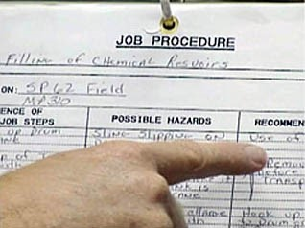
Leadership/Management Knowledge
Leaders and managers should know about:
S&H hazards present at the worksite
Process for analyzing hazards
Process for mitigating hazards
Location of hazard analysis documents
Who performs hazard analysis
Image retrieved from Bing Images
Notes:
Leaders should be familiar with the hierarchy of controls and understand it is their responsibility to provide a safe work environment. They are responsible for ensuring and obtaining adequate resources to protect employees from injury and illness. In addition, leaders must enforce the use of safety procedures and hazard controls to ensure employees abide by prescribed safety precautions.
Leaders should know who is responsible for conducting and documenting the hazard analysis of routine jobs and the location(s) of these documents. Safety professionals sometimes assist with hazard analysis, or at least approve each completed document, but many times supervisors and their employees are responsible for drafting hazard analyses.
Image retrieved from Bing Images (free to share and use license) at: http://www.ehs.ucsb.edu/files/images/gs/jha2.jpg

Slide 6
Key Personnel Knowledge
Key personnel should be knowledgeable about:
Methods used to conduct hazard analysis
Hazards identified throughout the organization
Location of hazard analysis documents
Process to track identified hazards to closure
Hazard analysis items included in inspections
Results of IH and OH survey results
Employee training on hazard analyses
Process of conducting annual hazard analysis reviews
Notes:
IH = industrial hygiene OH = occupational health
Key personnel may include: safety personnel, IH representatives, OH care personnel, supervisors, and anyone else involved in the hazard analysis process for routine activities.
Safety personnel generally train and involve others in the hazard analysis process. Though conducting hazard analysis and drafting documents may be a supervisor responsibility in some cases, safety staff should train supervisors and their employees how to carry out this process. Incorporate the results of IH/OH surveys into any hazard analysis, as applicable.

Slide 7
Workforce Knowledge
Employees should know about:
Hazards in their work areas
Routine job steps
Location of hazard analysis documentation
Safe work procedures
Hazard controls
Their involvement in conducting hazard analysis
Training provided to them to safely conduct tasks
Image retrieved from Bing Images
Notes:
The employees should be familiar with the hazards and the associated controls in their work areas. It is important for employees to know which jobs have a hazard analysis completed and where the documents are located. The documents must be readily accessible, meaning employees must be able to access it immediately, when needed.
If employees are involved in the development or review of hazard analyses, they should be able to communicate this involvement. In addition, involved employees may be expected to communicate how they conduct hazard analyses and what they review.
Image retrieved from Bing Images (free to share and use license) at: http://www.drillingcontractor.org/wp-content/uploads/2013/01/web_093_N5A8536.jpg

Slide 8
Action Checklist
Develop or review hazard analysis process(es)
Determine hazard analysis method(s)
Develop a list of routine jobs to analyze
Review S&H documentation
Analyze each routine job task or process
Document the outcome of the hazard analysis
Train employees
Review and update existing hazard analyses
Notes:
Follow this action checklist to implement and sustain VPP expectations for hazard analysis of routine activities. Each of these action checklist items will be covered in more detail on the following slides.

Slide 9
Hazard Analysis Process Development
Review existing hazard analysis processes in Service or Agency guidance
Determine which hazard analysis methodology to use
Identify the key personnel responsible for analyzing hazards
Determine how to document completed hazard analyses
Think about what will be done with the hazard analysis results
Notes:
Review your Service or Agency guidance for additional guidance on hazard analysis methodologies and responsible key personnel.
Personnel involved in these assessments may include: S&H staff, IH personnel, environmental personnel, OH personnel, and the fire department.

Slide 10
Hazard Analysis Process Development
Consider putting together a hazard analysis team at your worksite:
Involve key personnel, especially S&H personnel
Involve employees at all levels
Set up a recurring meeting time and place
Educate team members on performing hazard analysis process(es)
Image retrieved from Bing Images
Notes:
While forming a hazard analysis team is not a VPP requirement, it is a good form of employee involvement. Forming a team gets many individuals involved, including those with S&H expertise, those most familiar with the task, and outsiders who may have a different perspective on the task performed.
If you choose to set up a team, make sure it is composed of the essential individuals needed to conduct a hazard analysis (e.g., supervisors, S&H professionals), as well as employees. Set up a meeting time and place to discuss hazard analysis issues and questions, or findings repetitively found in the workplace. Before anyone conducts a hazard analysis, they need to be familiar with your hazard analysis processes and understand their roles and responsibilities in executing any task assigned to them.
Image retrieved from Bing Images (free to share and use license) at: http://pauldunay.com/wp-content/uploads/2013/04/Team.jpg

Slide 11
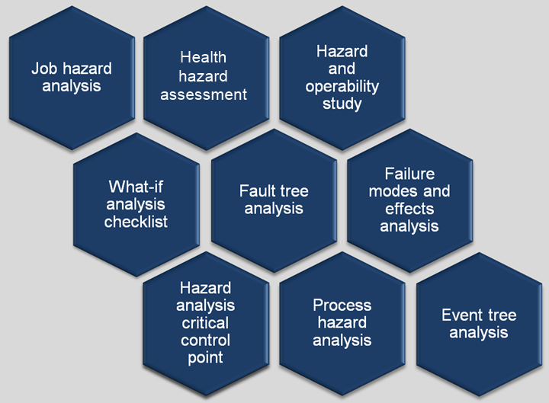
Hazard Analysis Methods
Other worksites use more specific tools, like those listed here, to analyze a job task
Some worksites use risk management worksheets to document job steps, hazards, and controls
Graphic courtesy of Concurrent Technologies Corporation
Notes:
Examples of hazard analysis methods include: JHA or JSA, HAZOP, what-if analysis checklist, FTA, FMEA, ETA, health hazard assessments, HACCP, and PHA.
Regardless of the hazard analysis method you select, identify hazards associated with each job and list the control measures to prevent or reduce exposure. Your Service or Agency guidance may provide you with direct information on the hazard analysis methods you are to choose when evaluating routine activities and tasks.
For additional information on job hazard analysis, view OSHA 3071 publication: https://www.osha.gov/Publications/osha3071.pdf
Graphic courtesy of Concurrent Technologies Corporation. The graphic shows potential hazard analysis methods you can use.

Slide 12
Tasks & Processes List
Think about routinely occurring workplace tasks
Develop a list of unanalyzed routine tasks
Interview supervisors to help identify these tasks
Conduct preliminary interviews to discover more about potential risks and hazards
Image retrieved from Bing Images
Notes:
Think about routinely occurring workplace tasks:
Is the task potentially hazardous?
Have the hazards been analyzed?
Utilize employees and supervisors to build a list of routine tasks and operations. They can help you identify potential risks and hazards related to the task so you can prioritize the completion of the hazard analysis.
Interview managers, supervision, and lead workers. Ask questions related to information discovered in the document review. Ask about previous accidents, injuries, and complaints. Scan their answers for useful information providing insight to the routine work processes in their work areas.
Image retrieved from Bing Images (Creative Commons).

Slide 13
Safety & Health Document Review
Review existing S&H documents for:
Known S&H hazards
Implemented hazard controls
Accident history
Root causes and contributing factors for incidents and near-misses
Reported hazards
Employee monitoring or surveillance requirements
Workplace trends
Image retrieved from Bing Images
Notes:
Documents that may help you to complete a hazard analysis for routine activities include:
Hazard tracking logs
Hazard or risk assessment reports
IH surveys
Chemical inventories
Facility or medical maintenance work orders
Employee hazard reports
Hazard control programs
OH surveillance program documents
Building blueprints/design
Past monitoring data
Workplace inspection results
Accident investigation reports
Trend analysis results
SOPs
These documents may help you prioritize your task list.
Image retrieved from Bing Images (free to share and use license) at: http://howelawfirm.com/wp-content/uploads/2015/02/Services-Document-Review-E-Discovery.jpg

Slide 14
Routine Task Analysis
Define the task to analyze
Interview the person conducting the task
Explain why the task is being analyzed
Identify the end goal of the task
Review task-specific documentation
Image retrieved from Bing Images
Notes:
Make the employee more comfortable by introducing yourself and explaining why you are observing them and the task performed.
Examples of task documents may include: operator manuals or SOPs.
Image retrieved from Bing Images (free to share and use license) at: https://c2.staticflickr.com/4/3672/11325450014_02d6a20d2d_z.jpg

Slide 15
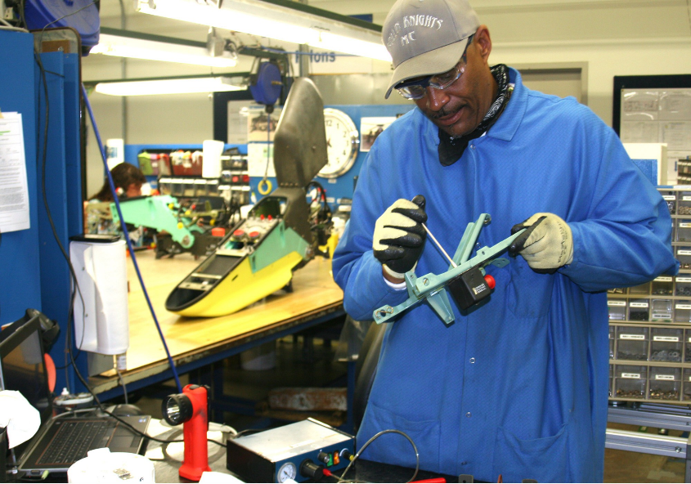
Routine Task Analysis
Observe the task performed
Watch every job step to see how it is performed
Evaluate the following:
Hazards in the work area
Hazards related to the task
Tools and equipment used
Physical forces
Human factors
Any other factors or risks
Image retrieved from Bing Images
Notes:
Take time to observe the task as the employee performs it – you should review each task about five or six times to get an accurate list of steps. There is no better way to determine how employees perform a job and identify hazards than to witness it firsthand. Allow multiple employees to complete the task to see if others perform the job differently.
Consider both existing and potential hazards when determining hazardous conditions or unsafe work practices.
Walk through and inspect the work area. Look at the operations. Identify the S&H hazards presenting a potential for injury or illness. The job may not be the only thing creating hazards, as the facility and environment surrounding the task can be hazardous as well.
Always follow guidance from the hazard analysis method you choose to use. Each has its own criteria and techniques to complete the hazard analysis process.
The image shows an employee completing a work process. Observe employees as they perform work to evaluate the task effectively.
Image retrieved from Bing Images (free to share and use license) at: http://cronkitenews.asu.edu/assets/images/12/09/13-defense-worker-horizontal-full.jpg

Slide 16
Hazards & Controls
Identify hazards and hazard controls using the information gained from the task analysis
If additional hazard controls are needed:
Gain employee input when selecting hazard controls
Use the hierarchy of controls to choose controls
Think about safe work practices and PPE
Implement selected hazard controls
Evaluate the effectiveness of the controls
Think about improvements to make the task safer
Notes:
PPE = personal protective equipment
Identify all hazards and make sure they are adequately controlled.
Think about improvements to make the task safer. Would it help to combine steps or change the sequence? Are safety equipment and other precautions needed?
If a safer way of performing the job is possible, list each new step, being as specific as possible about the new procedure.
If no safer way to perform the job is feasible, determine whether any physical changes may eliminate or reduce the danger. These might include: redesigning equipment, changing tools, adding machine guards, using PPE, or improving ventilation.

Slide 17
Hazard Analysis Documentation
Document completion of the hazard analysis, including:
Date of the analysis
Who conducted the analysis
The outcomes of the hazard analysis
Detailed steps performed to complete the task
All hazards associated with the task
Recommended and required hazard controls
Who was involved in the analysis
Notes:
Document the routine task on your Service- or Agency-specified form or in a manner associated with the hazard analysis methodology used.
Outcomes generally include a list of the steps taken to complete the task, hazards, and both recommended and required hazard controls.
Consider clarifying which hazard controls are recommended versus which are required – this helps employees understand their requirements and expectations. Be sure to include safe work procedures, required training topics (particularly for skill-related tasks), and personal protective equipment.
Make sure you date each hazard analysis to show which date you performed the analysis– this may be useful if you experience task-related process or equipment changes.
It is best practice to change the date after each annual review, regardless of any changes made or not made. Adding and updating dates to your documentation ensures the document is up-to-date and shows you completed an annual review of the content.
When documenting who completed a hazard analysis, include anyone who assisted in the analysis, including employees. This is a good way to show employee involvement.

Slide 18
Hazard Analysis Documentation
Gain input for completed hazard analyses from observed employees or those conducting the task
Attain approval from management, safety personnel, and IH personnel
Revise the hazard analysis, as needed
Store documents in an easily accessible location
Image retrieved from Bing Images
Notes:
Post this documentation in employee accessible locations (e.g., bulletin boards, site SharePoint or local computer folders, or a safety binder in a centralized area).
Image retrieved from Bing Images (free to share and use license) at: http://cdnll.marketlab.com/images/xxl/MSDSandSafetyBinders_a.jpg
The image shows a safety documents binder; a binder may be useful for you to store hazard analysis documents, as long as employees can easily access it.

Slide 19
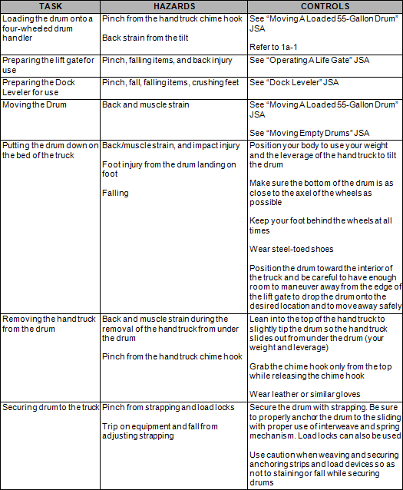
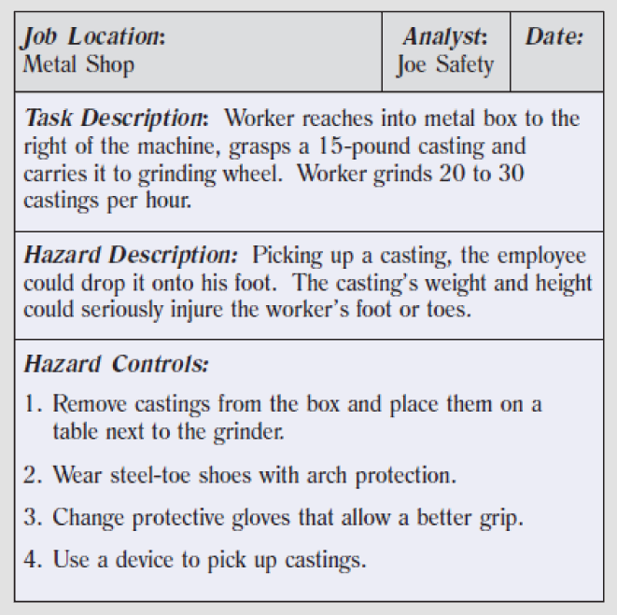
Examples – Job Hazard Analysis
Images retrieved from Washington State Department of Labor & Industries (left) and OSHA (right)
Notes:
Left image retrieved from the University of California, Los Angeles via the Washington State Department of Labor & Industries at: http://jsa.ehs.ucla.edu/
The left image shows an example of a completed hazard analysis. In this example, you can see a basic task description, the tasks listed step-by-step, hazard descriptions, and hazard control list.
Note the task steps give just enough information to evaluate the task, not overwhelming the employees with too many details. The listed hazards seem to be comprehensive and the hazard control list includes all levels of controls, including engineering, administrative, and PPE.
Right image retrieved from OSHA at: https://www.osha.gov/Publications/osha3071.pdf
The right image shows an example of a completed hazard analysis. In this example, you can see a task description, hazard description, and hazard control list.
Note the task description is very detailed – it not only includes the task itself, but also provides more information on the frequency and environmental factors related to this task.
The hazard description focuses on the weight of the casting. Consider expanding on the hazard description to include ergonomics (e.g., repetitiveness, strains) and other hazards. Oftentimes, each task step lists its own set of hazards.
Finally, go beyond PPE requirements for hazard controls – also include engineering and administrative controls. You can expand on several of the hazard controls on this list – be more detailed by including techniques to practice (e.g., two man lifts, lifting only so many per hour before a break), the specific type of protective glove employees need to wear, and the specific device name to assist in this task. You may also include additional administrative controls, such as taking breaks.

Slide 20
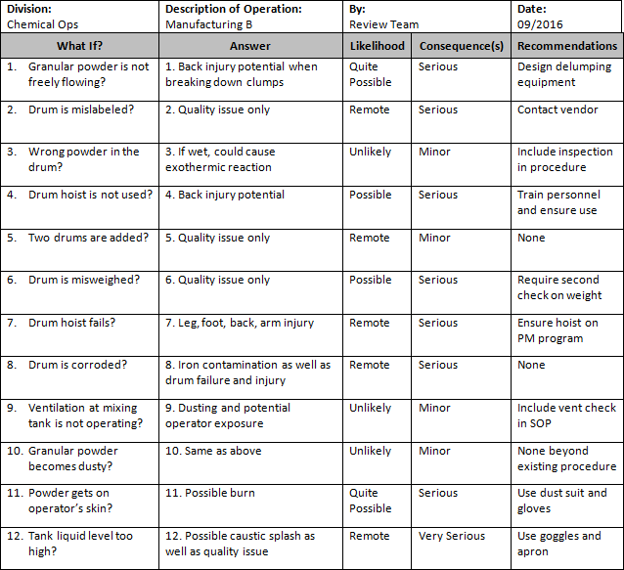
Example – What-If Analysis Checklist
Image retrieved from Massachusetts Institute of Technology
Notes:
The image shows an example of a completed hazard analysis. In this example, you can see the review team brainstormed the possible what-if scenarios possible during this operation.
Each situation is analyzed by including an answer to the outcome, or the possible hazards employees may experience. Some of these answers could be more detailed or expanded.
The likelihood and consequences of each possible scenario is also listed; however, make sure your employees understand what these terms mean. For example, is very serious the most severe consequence employees may experience? Or are there other levels?
There are also recommendations to move forward with making this operation safer for the workforce.
You can see this checklist was completed by a review team. It would be beneficial to know which employees specifically contributed to this review; especially for employee involvement purposes.
Image retrieved from Massachusetts Institute of Technology at: http://web.mit.edu/course/10/10.27/www/1027CourseManual/1027CourseManual-AppVI.html

Slide 21
Example – Failure Modes & Effects Analysis
ITEM | FAILURE MODES | FAILURE EFFECTS | FAILURE CAUSES | DETECTION MODE
What is the item, or step, being analyzed? | What could go wrong? | What is the consequence of each failure? | Why would the failure happen? | What controls are in place to detect, or prevent, the failure?
Tire stability to operate a vehicle | Flat tire Tire falls off vehicle | Stops vehicle Driver stranded, or have to change tire Spin out on the roadway Hit other vehicles, property, or even people | Puncture Bolts not tightened | Tire checks before vehicle use Feel steering pull to one side during driving Listen for excess noise during driving
A) Severity Rate 1-10 10 = Most Severe | B) Probability of Occurrence Rate 1-10 10 = Highest Probability | C) Probability of Detection Rate 1-10 10 = Lowest Probability | RISK PRIORITY NUMBER (RPN) A x B X C
How severe is the effect? | How likely is this to occur? | How easy is this to detect?
10 | 2 | 3 | 60
Notes:
The image shows an example of a completed hazard analysis. In this example, you can see the outcome of a flat tire on a vehicle. The analysis part shows what can go wrong if the vehicle gets a flat tire. Then, uses a numerical analysis to determine the overall risk.
You can use this information to put controls and actions in place. When you do this, you want to re-evaluate the situation with the new controls and actions, and re-calculate the risk – the risk priority number should be lower than it was before. If not, the controls and actions taken are not effective!

Slide 22
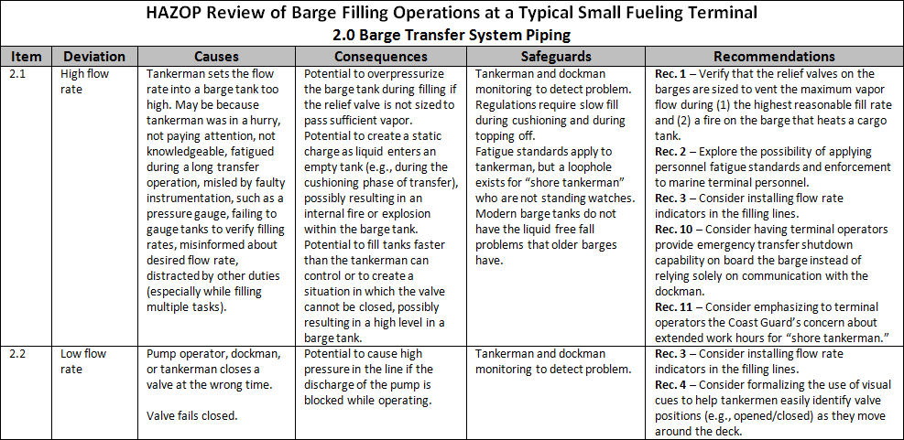
Example – Hazard & Operability Study
Image retrieved from Bing Images
Notes:
The image shows an example of a completed hazard analysis. In this example, you can see the team lists potential deviations from the process and the causes for these deviations. The analysis uses the causes to evaluate the potential consequences of failure during this process.
While it is not wrong to list the information as they did in the table, it may be better to use bulleted lists in these sections so the employees can read the information easier.
This study also lists several safeguards. Consider expanding these safeguards to follow the hierarchy of controls. Many of these are administrative safeguards (e.g., regulations), where you may possibly be able to implement engineering controls to permanently reduce the likelihood of the deviation.
The recommendations give a good starting point to make this process safer.
Image retrieved from Bing Images (free to share and use license) at: http://www.oshatrain.org/images/hazop4.gif

Slide 23
Employee Training – Topics
Train supervisors on:
Process for conducting hazard analysis
Using hazard analyses as a training tool
Train employees on:
How to conduct/assist with the hazard analysis process
Location of hazard analysis documentation
Task-related steps, hazards, controls, and safe work procedures
Notes:
Train employees on the hazards and control measures associated with the jobs they perform.

Slide 24
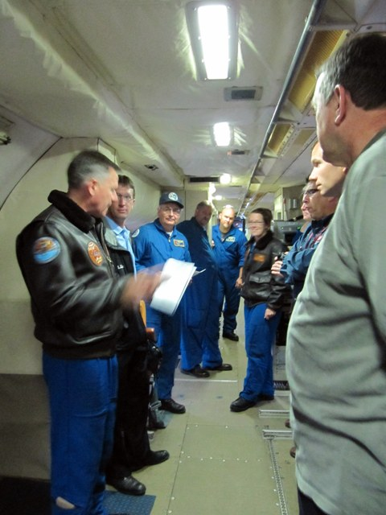
Employee Training – Frequency
Review hazard analyses with each employee when:
Initial hazard analysis is developed
Initial assignment to a job with an applicable hazard analysis
The hazard analysis content is revised
Image retrieved from Bing Images
Notes:
Train employees each time you discover new hazards or you put new controls in place. Train employees on any changes you find during the hazard analysis process too – it is important they are aware of these changes so they can continue to safely perform their tasks.
Image retrieved from Bing Images (free to share and use license) at: https://teacheratsea.files.wordpress.com/2011/05/pre_brief.jpg
The image shows a work leader reviewing a hazard analysis with employees prior to performing a job task.

Slide 25
Reviews & Updates
Review and update each hazard analysis of routine activities when:
The task process or work environment changes
Annually
Document the reviews of each assessment
Notify the workforce whenever changes are made
Image retrieved from Bing Images
Notes:
Always document each hazard analysis review, even if you make no changes to the documentation. You can update the date on the hazard analysis document itself, or document the review in meeting minutes, if applicable.
Encourage employees to assist in these reviews and updates; they have great knowledge on the subject and its great way for them to participate in safety. Additionally, communicate any changes made to a non-routine hazard analysis to the workforce.
Image retrieved from Bing Images (free to share and use license) at: http://www.peertechz.com/images/review.jpg

Slide 26
Conclusion
In this presentation, you learned to:
Summarize the background and importance for hazard analysis of routine activities
List documentation related to hazard analysis of routine activities
Describe the knowledge leadership/management, key personnel, and the workforce should have regarding hazard analysis of routine activities
Identify hazard analysis actions for routine activities to implement and sustain OSHA VPP

