Slide 1
Hazard Analysis of Significant Change
OSHA VPP
October 2020
Notes:
This presentation outlines hazard analysis requirements of significant changes for the purposes of Occupational Safety & Health Administration (OSHA) Voluntary Protection Programs (VPP) approval.
The presentation provides information on the background and importance of hazard analysis of significant changes, required documentation, and the various levels of employee knowledge. It concludes with an action checklist and supplemental details to help with OSHA VPP implementation and sustainment efforts.

Slide 2
Objectives
In this presentation, you will learn to:
Summarize the background and importance of hazard analysis of significant changes
List hazard analysis of significant change(s)-related documentation
Describe the knowledge leadership/management, key personnel, and the workforce should have regarding hazard analysis of significant changes
Identify hazard analysis actions for significant changes to implement and sustain OSHA VPP
Notes:
This presentation is beneficial to safety and health (S&H) professionals, VPP representatives, and others with hazard analysis responsibilities for significant changes, to include supervisors, facility managers, industrial hygienists, and the fire department.

Slide 3
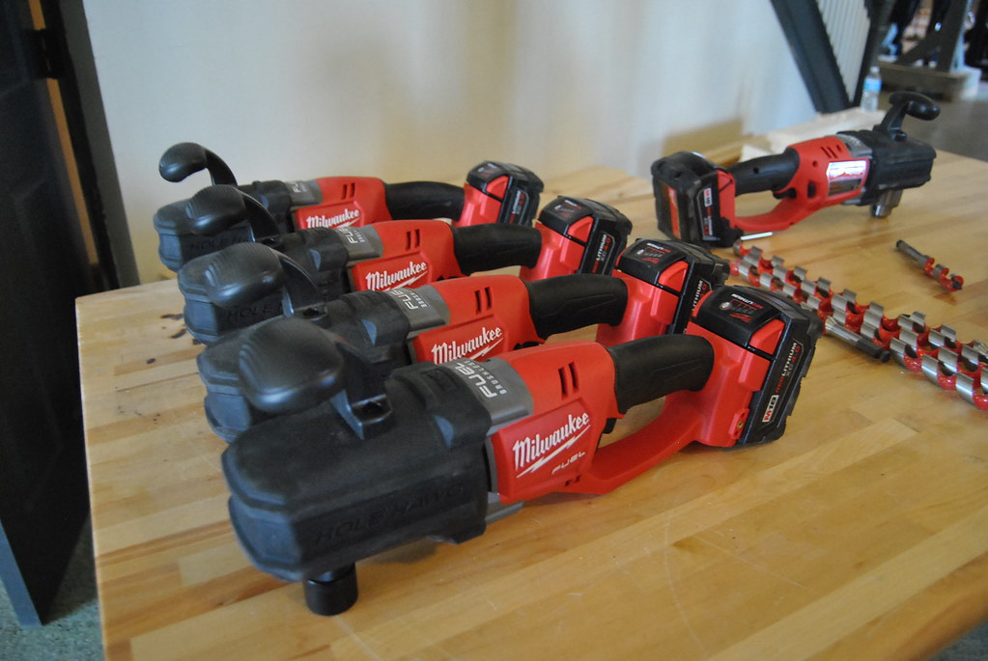
Background & Importance
Included in the WA criteria for VPP
Identifies hazards associated with changes to:
Processes
Equipment
Chemicals
Facility layouts
Assesses hazards related to non-routine tasks
Reduces the likelihood of unknown hazards in workspaces
Image retrieved from Bing Images
Notes:
WA = Worksite Analysis
Hazard analysis of significant changes identifies hazards associated with new processes, equipment, chemicals, or facilities, as well as non-routine tasks.
Examples of significant activities include moving to a new or different facility, implementing a new type of welding process, or introducing new chemicals.
Non-routine tasks include those: you never performed before, carrying a high level of risk, or performed infrequently, outside of normal job duties, or in a different way than documented in procedures. These tasks generally do not have a documented procedure. Non-routine work is often unscheduled and unplanned, and immediately completed as its need arises.
Images retrieved from Bing Images (Creative Commons). The images show new chemicals and new equipment purchased for use in the workplace. It is important to analyze new items that may pose hazards to employees.

Slide 4
Documentation
Pre-use analysis procedures
Pre-use analysis forms
Risk management worksheets
Hazard analysis forms
SOPs
Manufacturer operating manuals
Image retrieved from Bing Images
Notes:
SOP = standard operating procedure
Make sure you provide completed examples of forms and documents to your assessment team. Don’t just show them blank forms! They want to see the documents you filled out to thoroughly assess the processes within your safety management system.
Risk assessment worksheets and documentation may include: job safety analysis (JSAs), job hazard analysis (JHAs), bow tie analyses, what-if checklists, process hazard analyses, failure mode and effect analyses, fault tree analyses, hazard analysis and critical control points identification, and hazard and operability studies.
Manufacturers supply manuals or safety data sheets which list hazards and safety precautions related to chemicals and machinery.
Image retrieved from Bing Images (free to share and use license) at: http://www.allenrefrigeration.com/images/C/Instruction%20Manual-02.png

Slide 5
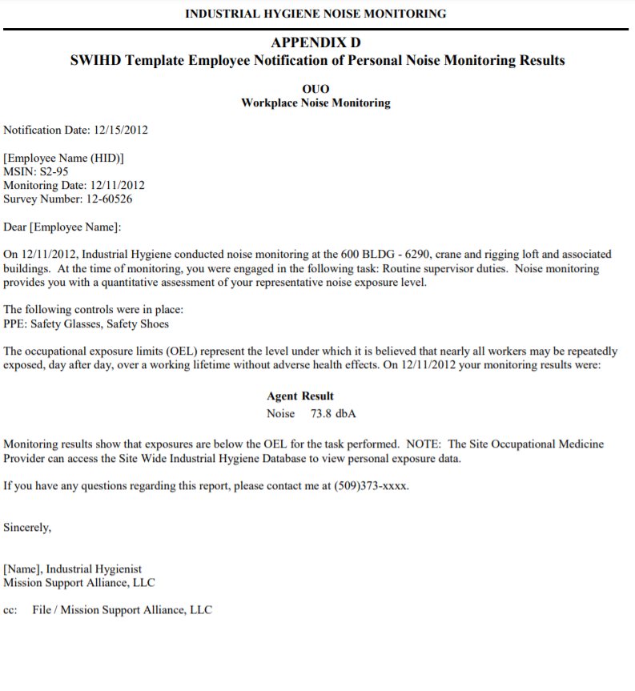
Documentation
S&H inspection checklists
Hazard tracking logs
Meeting minutes records
Training needs assessments
Industrial hygiene reports
Image retrieved from Hanford Mission Support
Notes:
Other documents (e.g., SOPs) may list the procedural steps to perform a task, but do not always identify hazards or safety precautions. Be wary when considering a SOP to serve as a hazard analysis document.
Image retrieved from Hanford Mission Support at: https://www.hanford.gov/pmm/files.cfm/MSC-PRO-WP-409.pdf. The image shows a template for employee notifications of personal sampling results (e.g., industrial hygiene report) for noise. Remember to provide actual copies of your completed documentation though to assessment teams, not templates; this action helps show how you exercise your practices and procedures.

Slide 6
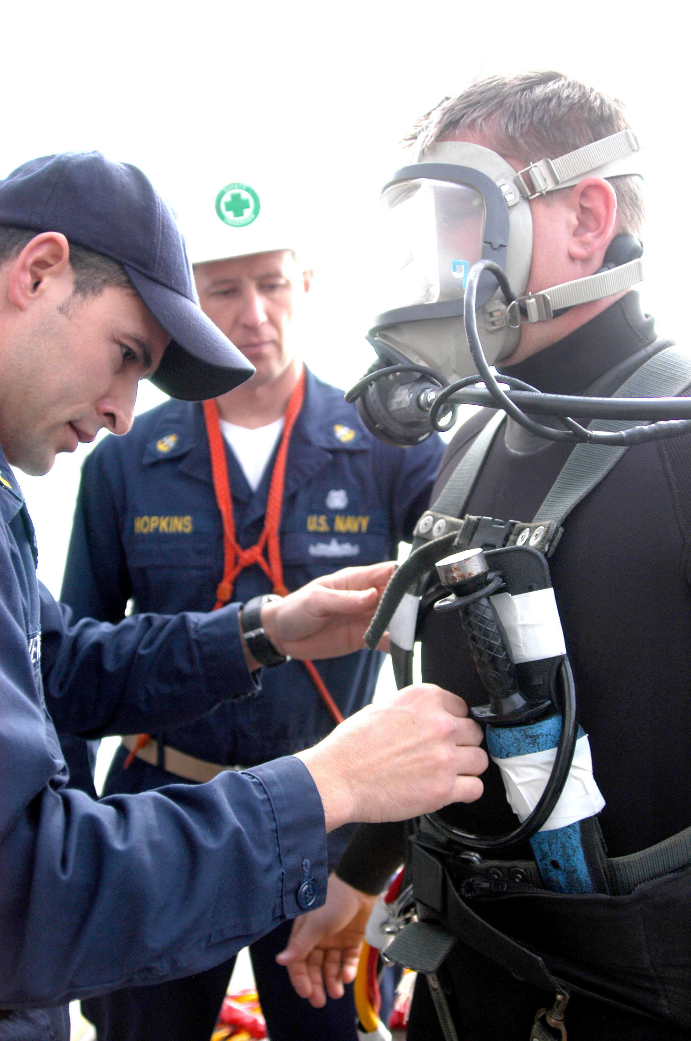
Leadership/Management Knowledge
Leaders and managers should know:
Hazards present at the worksite
Processes for analyzing significant changes and non-routine tasks
Location of hazard analysis documents
Who is responsible for hazard analysis of significant changes
Image retrieved from Bing Images
Notes:
Leadership should understand the process of identifying hazards during significant change. Ensure they understand whom to contact in order to conduct a hazard analysis whenever these changes occur.
Image retrieved from Bing Images (free to use and share license) at:
https://upload.wikimedia.org/wikipedia/commons/9/9e/US_Navy_060207-N-7848T-002_-_A_diving_Supervisor_facilitates_pre-dive_checks_on_a_junior_sailor%2C_while_the_Diving_Safety_Chief_supervises_aboard_the_submarine_tender_USS_Emory_S._Land_%28AS_39%29.jpg. The image shows a supervisor making sure the diver is following SOPs and conducting a safety inspection prior to his dive.

Slide 7
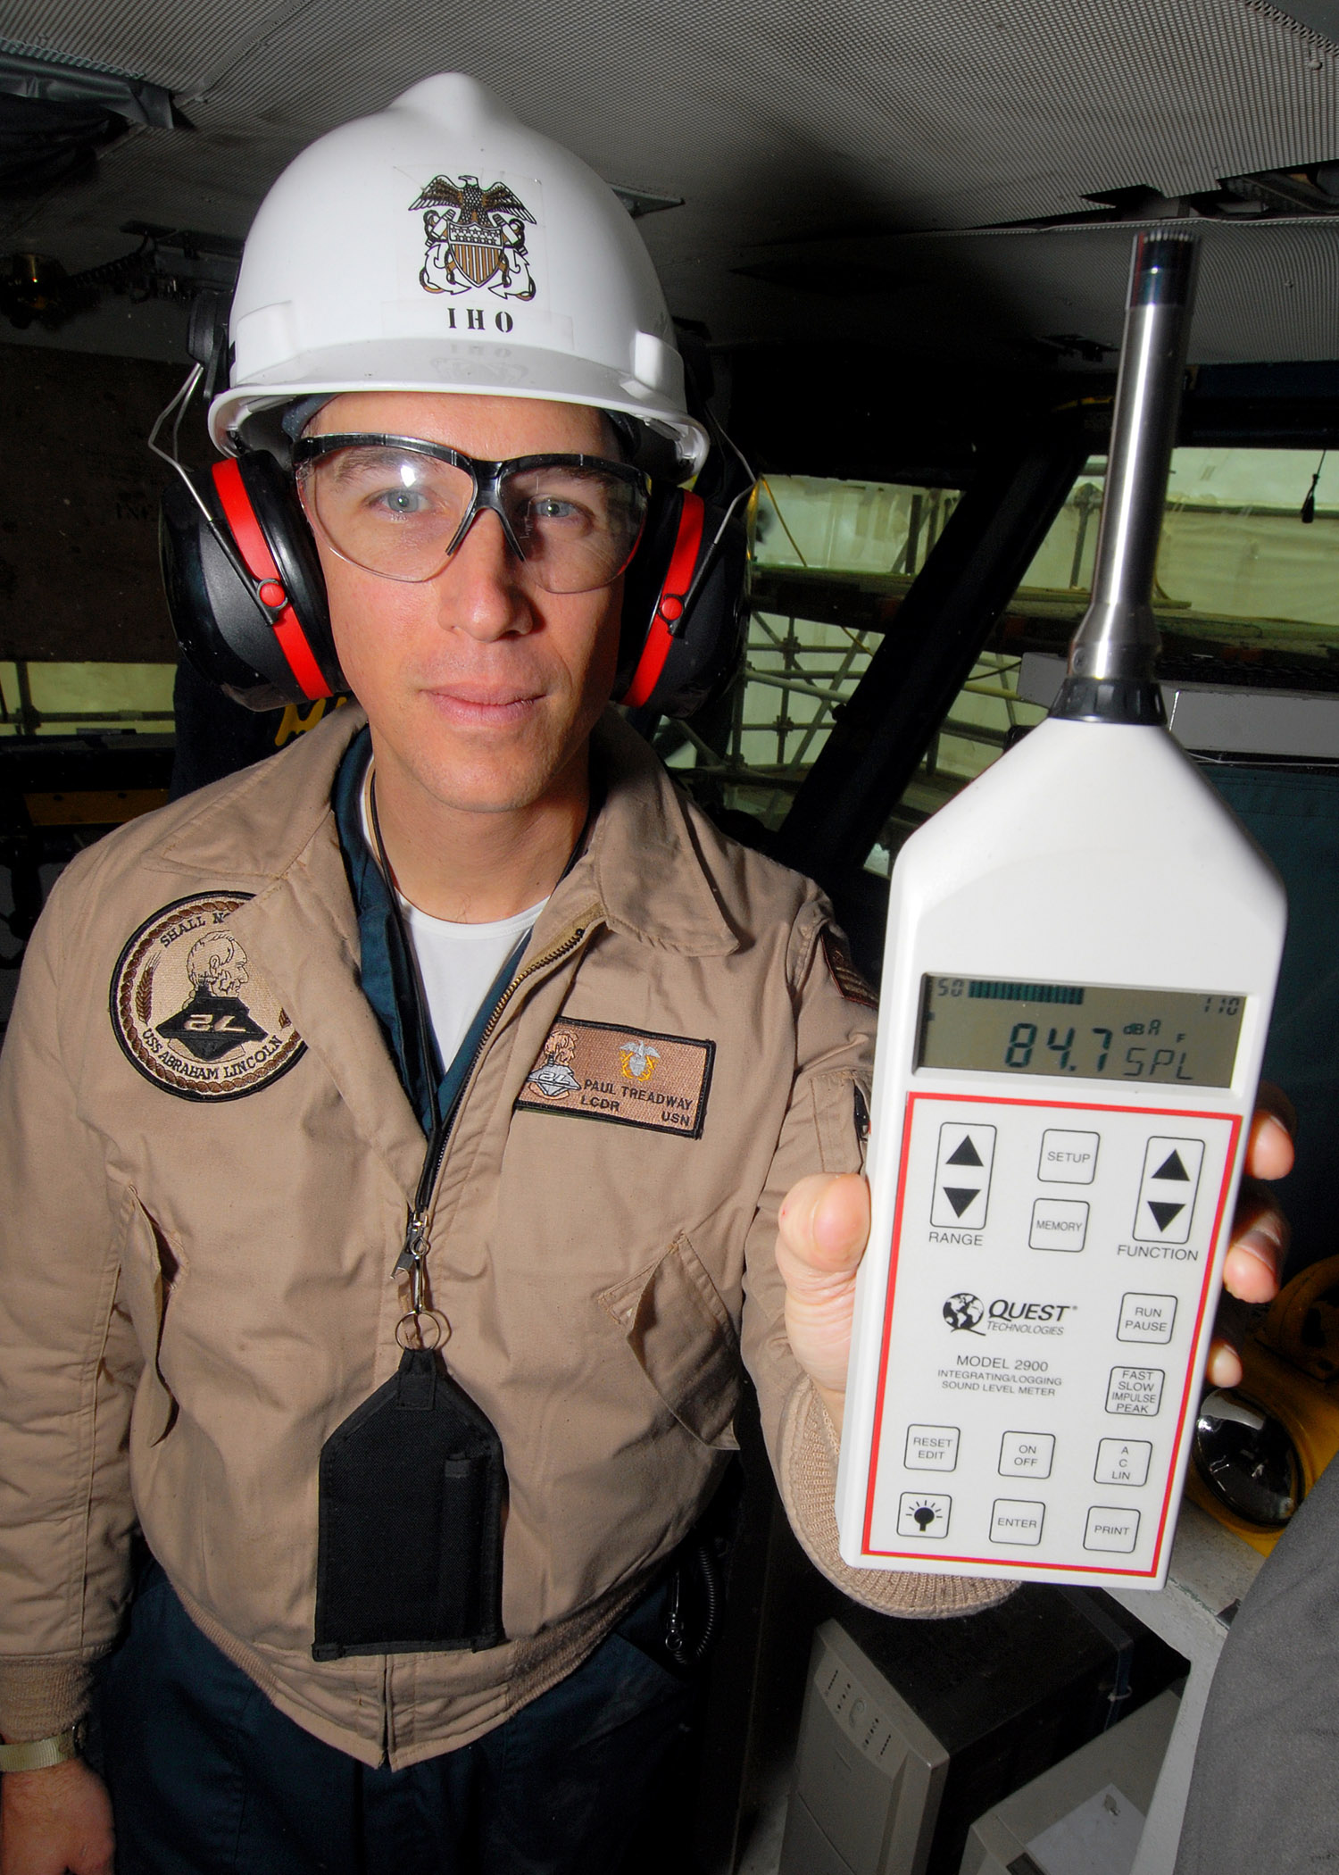
Key Personnel Knowledge
Key personnel should be knowledgeable about:
Methods used to conduct hazard analysis of significant changes and non-routine tasks
Examples of analyzed significant changes
Hazards identified from anticipated significant changes
Required employee training, if applicable
Assigned person(s) to annually review completed hazard analyses
Image retrieved from Bing Images
Notes:
Key personnel include both safety staff and industrial hygiene representatives. They should be familiar with the overarching S&H regulations (i.e., Army Regulation 385-10) or the site’s local instructions.
Image retrieved from Bing Images (Creative Commons). The image shows an industrial hygienist taking noise measurements, showing that a new piece of equipment is too loud and requires hearing protection. Had this piece of equipment been reviewed prior to purchase, something less noisy could have been purchased.

Slide 8
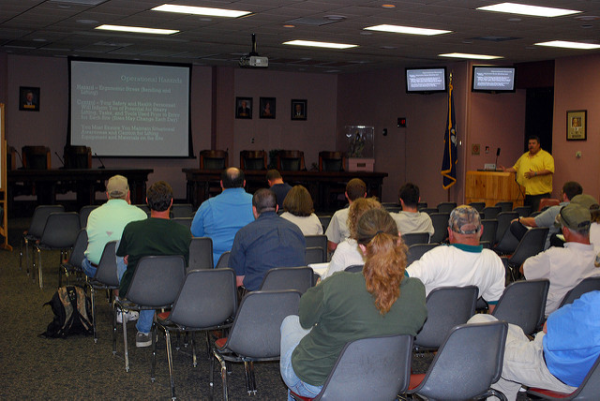
Workforce Knowledge
Employees should know:
Hazards of their work areas
Non-routine job steps
Significant workplace changes
Location of hazard analysis documentation
Safe work procedures
Training provided to them to safely conduct tasks
Image retrieved from Bing Images
Notes:
Regardless of a non-routine task or a new task, employees need to understand the proper working procedures and hazard controls for the task. Review existing documentation outlining the hazards and the controls with all affected employee.
Ensure hazard analysis and safe work procedures are readily available and provide information on workplace hazards, especially if you have not performed the task for a long time.
Image retrieved from Bing Images (free to use and share license) at: https://c1.staticflickr.com/5/4035/4579940996_cc71920108_z.jpg. The image shows a supervisor training his employees on S&H hazards.

Slide 9
Action Checklist
Develop or review hazard analysis process(es)
Identify significant changes prompting an analysis
Make a list of non-routine job tasks and processes to analyze
Review S&H documentation
Utilize a pre-use analysis process, when applicable
Analyze the significant change and/or non-routine job task or process
Document the outcome of the hazard analysis
Train employees
Review and update existing hazard analyses
Notes:
Follow this action checklist to implement and sustain VPP expectations for hazard analysis of significant changes. Each of these action checklist items will be covered in more detail on the following slides.

Slide 10
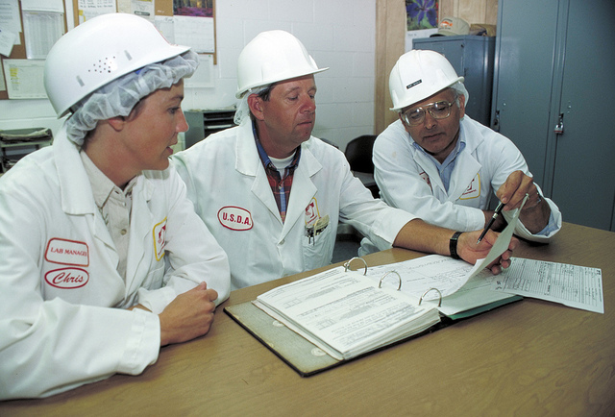
Hazard Analysis Process Development
Review existing hazard analysis processes in Service or Agency guidance
Determine which hazard analysis methodology to use
Identify the key personnel responsible for analyzing hazards
Determine how to document completed hazard analyses
Think about what will be done with the hazard analysis results
Image retrieved from Bing Images
Notes:
Examples of hazard analysis processes include: JSAs, JHAs, bow tie analyses, what-if checklists, process hazard analyses, failure mode and effect analyses, fault tree analyses, hazard analysis and critical control point identification, and hazard and operability studies.
The hazard analysis method you select must identify hazards associated with each job and list the control measures preventing or reducing exposure.
Review your Service- or Agency-specific guidance for additional information and direction on hazard analysis methodologies and responsible key personnel.
Personnel involved in these assessments may include: safety staff, industrial hygienists, environmental personnel, occupational health personnel, and the fire department.
Image retrieved from Bing Images (free to share and use license) at: http://farm9.staticflickr.com/8307/7880870312_ed079689b1_z.jpg. The image shows a supervisor and employees working together to formalize a hazard analysis process.

Slide 11
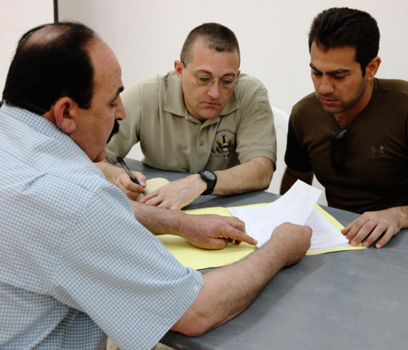
Significant Changes Identification
Review Service, Agency, or installation guidance related to:
Procurement or exchange of chemicals
Procurement or replacement of equipment
Approval of significant process changes
Moves to new or different facilities
Include appropriate key personnel in review or approval of changes
Conduct hazard analysis PRIOR to use, change, or purchase of materials
Image retrieved from Bing Images
Notes:
First, review existing documents (e.g., baseline assessments, inspection checklists, safety data sheets, and older hazard task/process analyses). Then, observe the tasks and processes to confirm there is a significant change. After, conduct a walkthrough. Inspect the work area to identify other jobs needing a hazard analysis performed.
If there is construction or change in facility, it is good practice to review the blueprints and design to denote the changes and develop the hazard analysis.
Have industrial hygienists, occupational health personnel, and safety staff review changes in chemicals or a change in processes involving chemicals to ensure there are no new health hazards and existing hazards are reduced or eliminated.
Image retrieved from Bing Images (Creative Commons). The image shows key personnel reviewing potential purchases to discuss possible risks beforehand.

Slide 12
Non-Routine Job Task List
Think about non-routine job tasks that occur outside of normal day-to-day operations
Reach out to supervisors and technical personnel to identify these tasks
Create a list of non-routine job tasks and prioritize them based on the most hazardous/most frequently performed
Maintain and update an inventory list of these tasks
Images retrieved from Bing Images
Notes:
Involve personnel performing non-routine tasks to make a comprehensive non-routine job task list.
Alternatives to completing a formal, documented hazard analysis for non-routine tasks include: performing a quick risk assessment prior to conducting the task, developing an SOP, conducting a pre-job discussion with the supervisor and everyone involved, and informing everyone about the non-routine job task hazards and the precautions to take while performing the job.
Bottom image retrieved from Bing Images (free to share and use license) at: https://62e528761d0685343e1c-f3d1b99a743ffa4142d9d7f1978d9686.ssl.cf2.rackcdn.com/files/70500/width668/image-20150129-22325-2ut9lo.jpg. The image shows a potential non-routine task your organization may experience – shoveling snow.
Top image retrieved from Bing Images (free to share and use license) at: http://i.telegraph.co.uk/multimedia/archive/02960/manager-employee_2960857b.jpg. The image shows a supervisor and an employee discussing a non-routine task before work is performed.

Slide 13
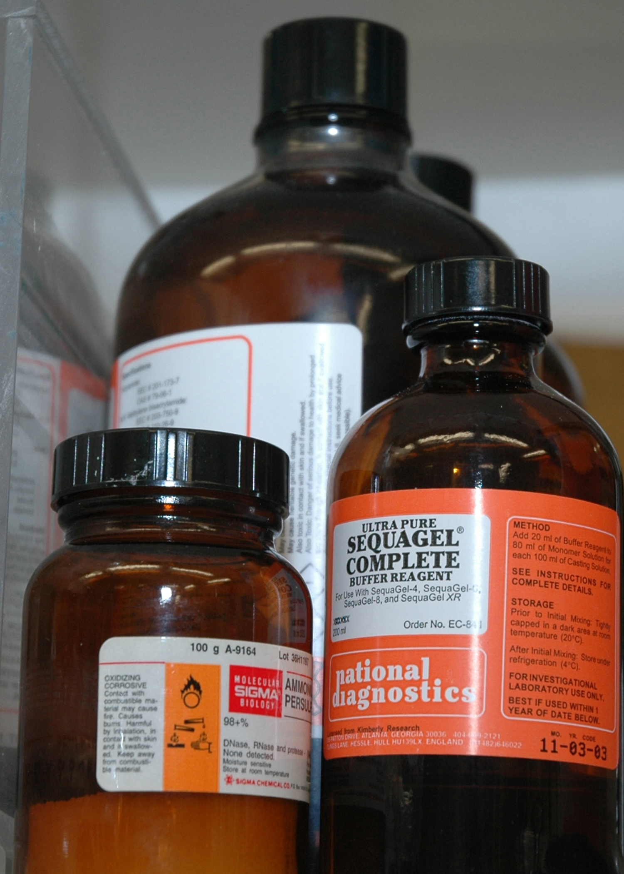
Pre-Use Analysis Process
Gather information on new processes, equipment, and materials
Review documents
Determine potential hazards
Explore ideas to reduce or mitigate hazards
Consider safer alternatives
Obtain proper approvals for new equipment and materials
Image retrieved from Bing Images
Notes:
The purpose of the pre-use analysis process is to capture and mitigate hazards before employees are exposed.
Conduct pre-use analysis before any new workplace equipment, chemicals, or processes arrive at your site. Integrate this process into the procurement design phase of your planning to maximize the opportunity for proactive hazard elimination and control.
Gain the proper approvals to proceed with purchasing and using the new process, equipment, or material. Know your Service or Agency guidance, which may provide more details on this process. Safety staff, industrial hygienists, occupational health personnel, and other subject matter experts (e.g., engineers, fire department) conduct and sign off on pre-use analyses.
Image retrieved from Bing Images (free to share and use license) at: https://upload.wikimedia.org/wikipedia/commons/4/4b/Bottles_of_chemicals_%281%29.jpg

Slide 14
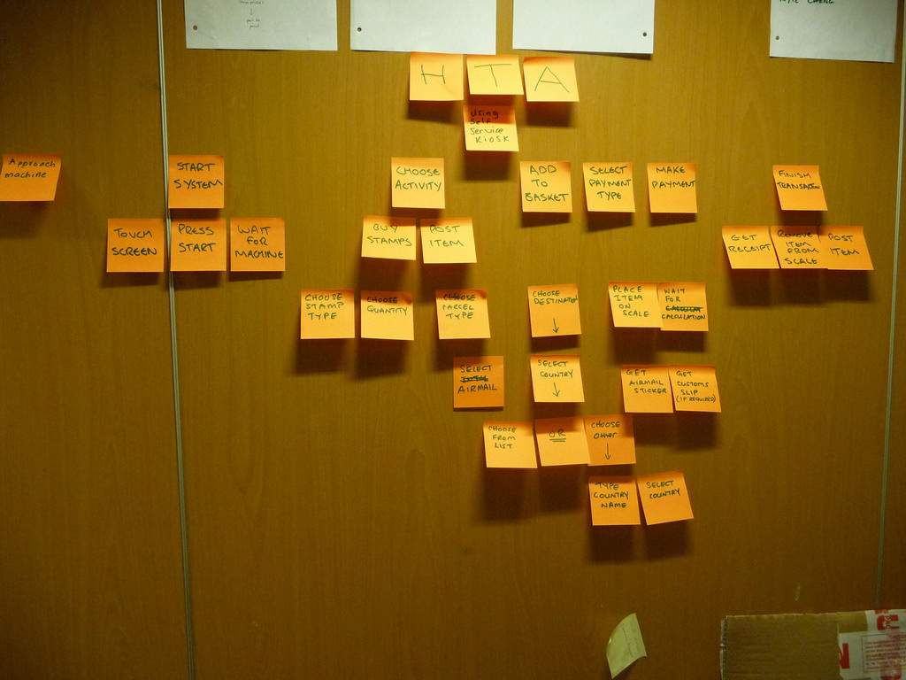
Non-Routine Task Analysis
Define the task to analyze
Interview the person who typically conducts the task
Know the end goal of the task – what is done or to be done?
Run a mock exercise of the task if it does not currently need done
Image retrieved from Bing Images
Notes:
When analyzing non-routine tasks, the first step is to define the task you are analyzing. Formally name and identify it, interview the employee(s) that usually performs the tasks, and if the task doesn’t need to currently be completed, consider conducting a mock exercise to demonstrate it.
Image retrieved from Bing Images (free to share and use license) at: https://c2.staticflickr.com/6/5005/5291318582_b81736d25b_b.jpg

Slide 15
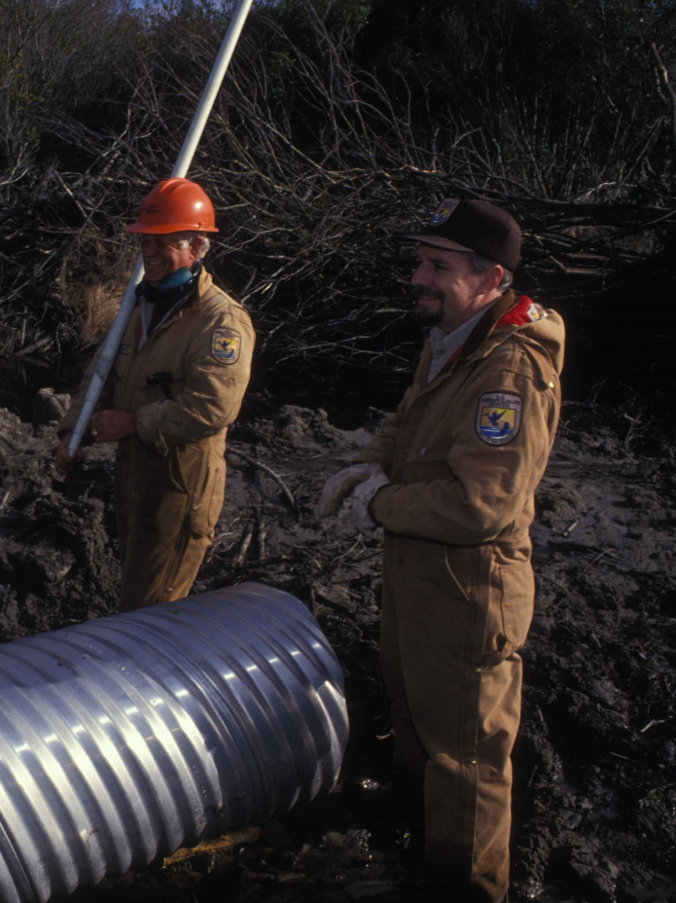
Non-Routine Task Analysis
Observe the task performed
Examine the work area for hazards
Watch the steps taken to complete the job
Evaluate any tools or equipment used
Look at the physical forces and human factors used to complete the task
Evaluate any other factors or risks which may influence the task
Image retrieved from Bing Images
Notes:
If the non-routine tasks needs performed at it’s regular interval, you can actually observe the task being performed. Consider these key items while observing a non-routine task. Non-routine analysis will be very similar to analyzing routine tasks, just know that they occur much less often, so there’s often need to change the process, equipment, materials, tools, or other factors in accomplishing the task. These changes may introduce new risks.
Image retrieved from Bing Images (free to use and share license) at: https://upload.wikimedia.org/wikipedia/commons/e/e2/Employees_work_together_to_install_a_water_control_pipe.jpg. The image shows employees heading to a job site; you should have briefed them on any non-routine tasks they may encounter.

Slide 16
Hazards & Controls
Identify hazards using the information gained from the pre-use analysis or task analysis
Gain employee input when selecting hazard controls
Use the hierarchy of controls to choose controls
Think about safe work practices and PPE
Implement selected hazard controls
Evaluate the effectiveness of the controls periodically
Notes:
PPE = personal protective equipment
Identify all hazards and make sure they are adequately controlled. Evaluate the effectiveness of controls by conducting industrial hygiene surveys to evaluate employee exposures.

Slide 17
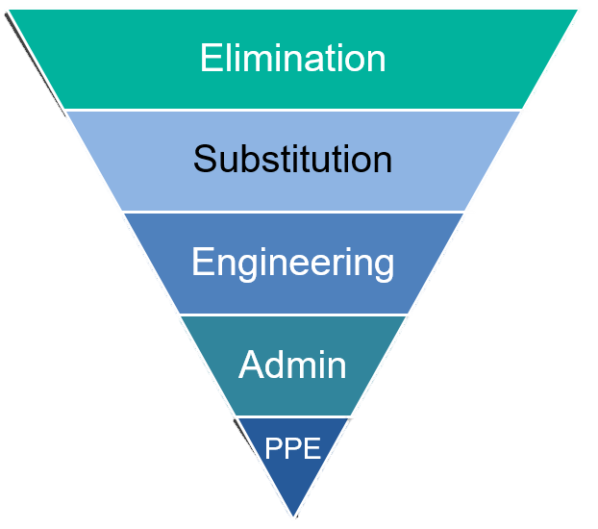
Hazard Analysis Documentation
Document the outcomes of the hazard analysis
Define detailed steps to complete the task
Identify all types of hazards associated with the task
Clearly define recommended and required hazard controls
Include the date
Identify who conducted the analysis
Most Effective
Least Effective
Image courtesy of DoD SMCX
Notes:
Document the non-routine or significant changes on your Service- or Agency-specified form or in a manner associated with the hazard analysis methodology used.
Outcomes generally include a list of the steps taken to complete the task, hazards, and both recommended and required hazard controls.
The list of steps taken to complete the task may be more general for non-routine tasks, where the actual steps may vary from job to job.
Consider clarifying which hazard controls are recommended versus which are required – doing so will help employees understand their requirements and expectations. Be sure to include safe work procedures, required training topics (particularly for skill-related tasks), and personal protective equipment.
Image courtesy of the DoD SMCX. The image illustrates the hierarchy of controls.

Slide 18
Hazard Analysis Documentation
Gain input for completed hazard analyses from observed employees or those conducting the task
Attain approval from management, safety personnel, and industrial hygienists
Review and revise the hazard analysis, as needed
Store documents in an easily accessible location
SAFETY
DOCUMENTS
Company ZZYX
Image retrieved from Bing Images
Notes:
Post this documentation in employee accessible locations (e.g., bulletin boards, site SharePoint or local computer folders, or a safety binder in a centralized area).
Image retrieved from Bing Images (Creative Commons). The image shows a safety documents binder; a binder may be useful for you to store hazard analysis documents, as long as employees can easily access it.

Slide 19
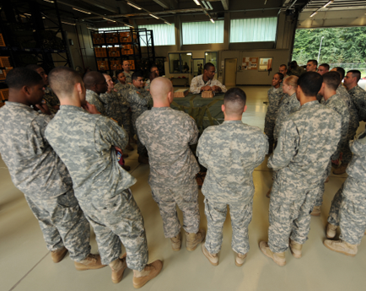
Employee Training – Topics
Location of hazard analysis documentation
Task-related steps, hazards, controls, and safe work procedures
Significant workplace changes:
New processes, equipment, and materials
Anticipated significant changes, such as upcoming facility changes
Non-routine tasks expected to be performed
Approval process for procuring new equipment and materials
Image retrieved from Bing Images
Notes:
Train employees on the hazards and control measures associated with the jobs they perform.
Image retrieved from Bing Images (Creative Commons).

Slide 20
Employee Training – Frequency
Include hazard analysis review in site-specific new employee orientation
Review the details of hazard analysis documents at least annually
Consider periodic refreshers on the approval processes for significant changes to the workplace
Image courtesy of CTC
Notes:
CTC = Concurrent Technologies Corporation
Many Services and Agencies require each affected employee to sign off on the applicable hazard analysis after you review it with them.
Image courtesy of CTC.

Slide 21
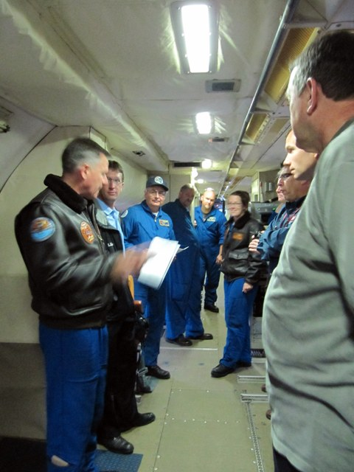
Employee Training – Frequency
Review hazard analyses with each employee when:
Initial hazard analysis is developed
Initial assignment to a job with an applicable hazard analysis
Contents of the hazard analysis change
Processes for analyzing hazards and significant changes are revised
Image retrieved from Bing Images
Notes:
Image retrieved from Bing Images (free to share and use license) at: https://teacheratsea.files.wordpress.com/2011/05/pre_brief.jpg. The image shows a work leader reviewing a hazard analysis with employees prior to performing a job task.

Slide 22
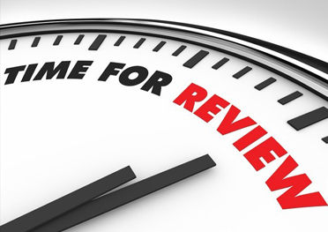
Reviews & Updates
Review and update each hazard analysis of significant change when:
Contents of the hazard analysis change
There are changes to the circumstances of the significant change
Document the reviews of each assessment
Notify the workforce whenever changes are made
Image retrieved from Bing Images
Notes:
Always document each hazard analysis review, even if you make no changes to the documentation. You can update the date on the hazard analysis document itself, or document the review in meeting minutes, if applicable.
Encourage employees to assist in these reviews and updates; they have great knowledge on the subject and its great way for them to participate in safety. Additionally, communicate any changes made to a non-routine hazard analysis to the workforce.
Image retrieved from Bing Images (free to share and use license) at: http://www.peertechz.com/images/review.jpg

Slide 23
Conclusion
In this presentation, you learned to:
Summarize the background and importance of hazard analysis of significant changes
List hazard analysis of significant changes-related documentation
Describe the knowledge leadership/management, key personnel, and the workforce should have regarding hazard analysis of significant changes
Identify hazard analysis actions for significant changes to implement and sustain OSHA VPP

