Slide 1
Hazard Reporting
OSHA VPP
October 2022
DISTRIBUTION STATEMENT D: Distribution authorized to the DoD and U.S. DoD contractors only; October 1, 2022. Other requests shall be referred to: Director, Operational Safety, OUSD(P&R), 4000 Defense Pentagon, 2E580, Washington, DC 20301.
WARNING: This document contains technical data whose export is restricted by the Arms Export Control Act (Title 22, U.S.C., sec. 2751, et seq.) or the Export Administration Act of 1979, as amended, Title 50, U.S.C., App. 2401 et seq. Violation of these export laws are subject to severe criminal penalties. Disseminate in accordance with the provisions of DoD Directive 5230.25.
Notes:
This presentation outlines hazard reporting requirements for the purposes of the Occupational Safety and Health Administration (OSHA) Voluntary Protection Programs (VPP) recognition.
The presentation provides information on the background and importance of hazard reporting, required documentation, and the various levels of employee knowledge. It includes an action checklist and supplemental details to help with OSHA VPP implementation and sustainment efforts.

Slide 2
Objectives
In this presentation, you will learn to:
Summarize the background and importance of hazard reporting
List hazard reporting-related documentation
Describe the knowledge leadership/management, key personnel, and the workforce should have regarding hazard reporting
Identify hazard reporting actions to implement and sustain OSHA VPP
Notes:
This presentation is beneficial to safety and health (S&H) professionals, VPP representatives, and others with hazard reporting responsibilities, to include supervisors and occupational health care personnel.

Slide 3
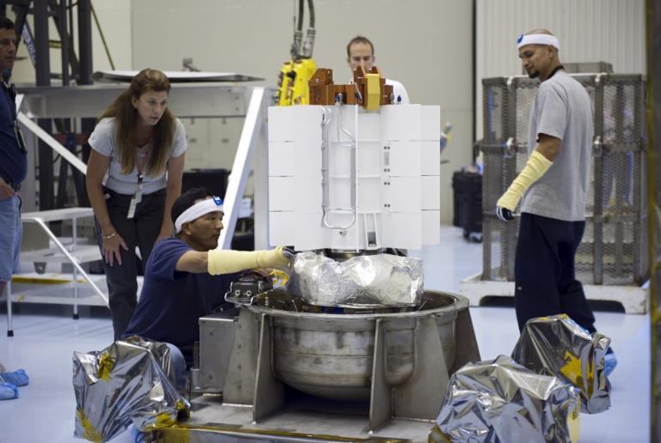
Background
Included in the WA criteria for VPP
Used to capture employee-identified S&H hazards in writing
Must meet the requirements of:
EO 12196
OSHA 29 CFR 1960.28
DoDI 6055.1
Service/Agency-specific safety instructions
Image retrieved from Bing Images
Notes:
WA = Worksite Analysis
EO = Executive Order
CFR = Code of Federal Regulations
DoDI = Department of Defense Instructions
A hazard reporting system allows for employees, at all levels, to report identified S&H hazards. This system tracks basic information for each identified hazards. This system helps S&H professionals or other responsible persons when they address the hazard reports. Hazards are a correctable occurrence -- only if you know about them.
Ultimately, the hazard reporting system works in tandem with a hazard tracking system.
The image shows a group of employees and their supervisors working safely – be sure to report signs of unsafe or unhealthful acts or conditions immediately.
Image retrieved from Bing Images (free to share and use license) at: https://upload.wikimedia.org/wikipedia/commons/0/0b/DOE_employees_work_at_the_MMRTG.jpg

Slide 4
Importance
Allows employees to report S&H concerns anonymously and in writing
Holds management responsible for addressing S&H concerns
Identifies hazards before they result in illness or injury
Complies with employee rights to report hazards
Feeds hazard tracking and trend analysis processes
It’s best to have a proactive focus rather than a reactive response
Notes:
A reliable hazard reporting system lets employees notify appropriate managerial personnel, in writing, about potentially hazardous acts and conditions. This system must include an option for employees to report hazards anonymously and allow them to report without fear of reprisal. It also requires employees to receive timely and appropriate feedback in response to any hazards they report.
View these websites for more information on hazard reporting requirements:
EO 12196: http://www.gsa.gov/portal/content/103012
OSHA 29 CFR 1960.28: https://www.osha.gov/pls/oshaweb/owastand.display_standard_group?p_toc_level=1&p_part_number=1960
DoDI 6055.01: https://www.esd.whs.mil/Portals/54/Documents/DD/issuances/dodi/605501p.pdf?ver=2018-11-19-110543-180
Air Force, AFMAN 91-203: https://static.e-publishing.af.mil/production/1/af_se/publication/dafman91-203/dafman91-203.pdf
Army, 385-10: https://armypubs.army.mil/ProductMaps/PubForm/Details.aspx?PUB_ID=1002884
Marine Corps, NAVMC 5100.8: http://www.safety.marines.mil/Portals/92/Docs/NAVMC%20DIR%205100.8.pdf
Navy, S&H Manual: https://www.secnav.navy.mil/doni/Directives/05000%20General%20Management%20Security%20and%20Safety%20Services/05-100%20Safety%20and%20Occupational%20Health%20Services/5100.23H.pdf
Defense Logistics Agency Instruction 6055.01: https://govtribe.com/file/government-file/sp330020r5001-dla-i6055-dot-01-aug-10-2018-dot-pdf

Slide 5
Documentation
S&H rights and responsibilities posters
New employee and refresher training records
Hazard reporting procedures
Hazard reporting forms
Hazard tracking/abatement log
Trending data and results related to submitted hazard reports
Image retrieved from Bing Images
Notes:
Make sure you provide completed examples of forms and documents to your assessment team. Don’t just show them blank forms! They want to see the documents you filled out to thoroughly assess the processes within your safety management system.
Examples of S&H Rights and Responsibilities posters include: OSHA Federal Agency Occupational S&H Protection for Employees Poster or a DoD Service or Agency form.
Educate all employees on hazard reporting procedures. Oftentimes, worksites refer to the overarching DoD Service or Agency Safety Instruction. You may also use local instructions, if applicable. Note, each Service or Agency utilizes a similar reporting process.
Hazard reporting forms generally describe the nature and location of the hazard, who reported it, an explanation of the hazard, and whether you took any actions to correct it. Be prepared to show examples of submitted hazard reporting forms and/or the electronic hazard reporting system to on-site assessment teams. As a best practice, keep these forms simple – employees are more likely to report hazards if the forms are quick and easy to complete.
Hazard reporting feeds the hazard tracking and trending processes you may have in place. Be sure to have copies of your abatement log to show how submitted hazards are monitored and addressed, as well as any trending data or trending results that includes information on submitted hazard reports at your organization.
Image retrieved from Bing Images (free to share and use license) at: http://upload.wikimedia.org/wikipedia/commons/e/ef/Legal_clinic_-_case_files.JPG

Slide 6
Leadership/Management Knowledge
Leaders and managers should be knowledgeable of:
The hazards in their organization and within their purview
Their responsibilities in the hazard reporting system
Hazard reporting forms and procedures
Anonymous components to reporting hazards
The process for submitting and handling hazard reports
The procedures for addressing formal appeals from employees
Image retrieved from Bing Images
Notes:
Leaders and managers are responsible for providing a safe and healthful workspace for their employees. Hold them accountable to ensure reported S&H hazards are corrected in a timely fashion. Employees have the right to report up the chain of command if you do not reasonably address their concerns.
Leaders and managers should know the process in place to submit a hazard report, including verbally, in writing, and anonymously. Many times employees require direction on the hazard reporting submission process. Leaders and managers must be ready to provide guidance when needed by talking through the processes in place.
The image shows an office supervisor and the management team. Image retrieved from Bing Images (free to share and use license) at: http://careers.stateuniversity.com/article_images/Office_manager.jpg

Slide 7
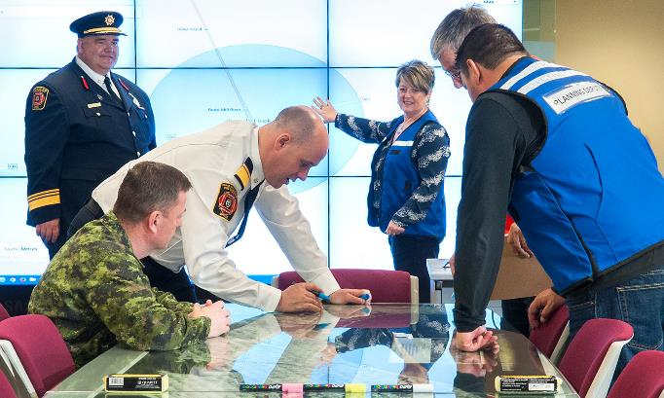
Key Personnel Knowledge
S&H professionals should know:
Their hazard reporting program responsibilities
The last few hazard reports submitted
Whether the hazard reporting system is operating properly
The process for responding to employee reports and providing feedback
The process for tracking and trending hazard reports
The procedures for addressing formal appeals from employees
Image retrieved from Bing Images
Notes:
S&H professionals are generally the responsible persons for the hazard reporting program. Whoever leads the hazard reporting efforts must evaluate the program to see if employees utilize it and whether the overall program is effective. Additionally, S&H professionals often act as the bridge between employees and management when addressing hazards, so it is important they have visibility of all reported hazards.
Some common concerns for S&H professionals may include a lack of reporting due to employee knowledge or a fear of reprisal.
It is also the S&H professionals’ job (unless otherwise delegated) to track all hazards to completion. Finally, you must respond to reports within the appropriate amount of time (as defined by the DoD, Service, or Agency instructions) and conduct trend analysis on the identified hazards.
Image retrieved from Bing Images (free to share and use license) at: https://flickr.com/photos/peigov/17313706585

Slide 8
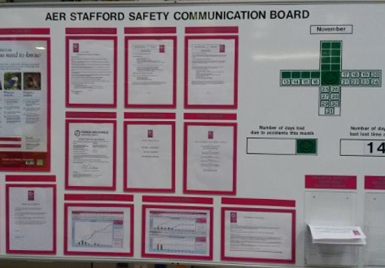
Workforce Knowledge
Employees should know:
Locations of S&H rights and responsibilities posters
Methods of reporting S&H concerns or hazards, including anonymously
Common hazards of their work areas
Results of the last hazard they reported, if applicable
How to appeal the results of a hazard report
Image retrieved from Bing Images
Notes:
In addition to knowing the location of their rights and responsibilities, employees need to understand their rights and responsibilities related to hazard reporting. First, employees need to understand it is their responsibility to report hazards. Second, they need to know it is their right to report hazards without fear of reprisal.
Employees must be able to answer: “What is one method of reporting a hazard? What was the last hazard you reported and/or corrected?”
Even if employees have never submitted a hazard report, they should be knowledgeable of the process to file a hazard report, especially on how to do it anonymously.
Best Practice: Test your employees’ knowledge during self-inspections. Ask: Do they know it is their responsibility to report hazards? Do they know how to file a hazard report? Do they know what happens when they file a report?
The image shows a safety bulletin board; a location you may choose to make hazard reporting forms accessible to your employees. Image retrieved from Bing Images (free to share and use license) at: http://quality-graphics.co.uk/wp-content/uploads/2014/04/healthsafety600x4200001.jpg

Slide 9
Action Checklist
Develop written hazard reporting procedures
Post S&H rights and responsibilities posters
Make hazard reporting forms available
Train employees
Encourage reporting
Conduct report-related investigations
Review deficiency notices
Track and trend hazard reports
Evaluate the effectiveness of the process
Image retrieved from Bing Images
Notes:
Follow this action checklist to implement and sustain VPP expectations for hazard reporting. Each of these action checklist items will be covered in more detail.
Image retrieved from Bing Images (Creative Commons).

Slide 10
Hazard Reporting Procedures
Review the processes outlined in Service/Agency guidance
Become familiar with:
Hazard reporting and abatement procedures
Individual responsibilities
The forms to use
How to submit a hazard report
What to do after reports are received
Image retrieved from Bing Images
Notes:
Service or Agency overarching safety instructions provide the specific process to develop a hazard reporting and tracking program.
They provide specific instructions on:
Individual responsibilities
Required forms
Proper reporting procedures
What to do after the reports are received.
In the event your worksite does not have overarching guidance, develop a formalized process identifying personnel responsibilities, the forms to use, how to report a hazard, and the follow-up process.
Image retrieved from Bing Images (Creative Commons).

Slide 11
S&H Rights and Responsibilities Posters
Post S&H rights and responsibilities posters:
OSHA Federal Agency Occupational S&H Poster
Service or Agency-specified forms
OSHA Job S&H: It’s the Law
Review the information on these postings:
Annually
When leadership changes
When contact information changes
OSHA It’s the Law
Image retrieved from OSHA
Notes:
Post S&H rights and responsibilities poster(s) at your workplace:
Federal Agency Occupational S&H poster, Occupational Safety and Health Protection for Employees
Service and/or Agency distributed posters
OSHA Job Safety and Health: It’s the Law.
Include current contact information (within the last year) on each poster. Update the names on these documents when there is a change of command. Post these documents in high visibility or high traffic areas, such as on official bulletin boards in break rooms or on internal websites (if all employees have access to computers).
Image retrieved from OSHA at: https://www.osha.gov/publications/poster

Slide 12
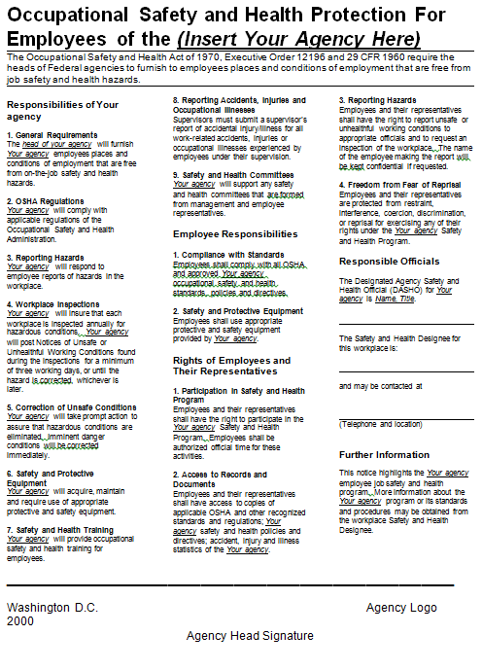
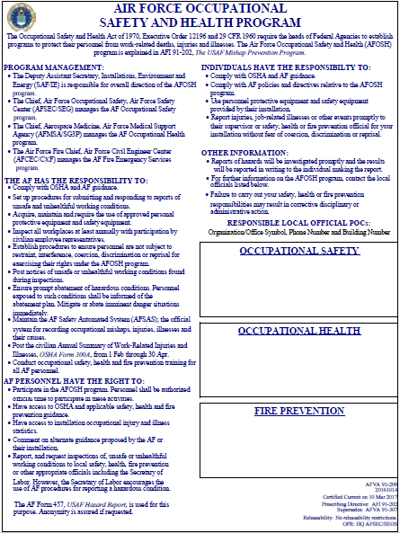
S&H Rights and Responsibilities Posters
OSHA Federal Agency Poster
Air Force Occupational S&H Program
OSHA It’s the Law
Image retrieved from OSHA (left) and the Air Force (right)
Notes:
The Federal Agency Occupational Safety and Health Protection for Employees poster is for federal employees. It describes the responsibilities for the agency, employees, and their representatives under EO 12196 and 29 CFR 1960. These posters designate the agency name and officials responsible for S&H at your organization. View the Federal Agency Occupational Safety and Health Protection for Employees poster at: https://www.osha.gov/Publications/fedposter.html
The slide also shows the Air Force Occupational S&H Program poster, an example of a Service-specific posting. Images retrieved from the Air Force at: http://static.e-publishing.af.mil/production/1/af_se/publication/afva91-209/afva91-209.pdf
The slide also shows the OSHA Job Safety and Health: It’s the Law poster. Image retrieved from OSHA at: https://www.osha.gov/Publications/poster.html
You must display the OSHA poster if you have non-federal employees working at your site (e.g., non-federal civilians and contractors). It describes the basic S&H rights for non-federal workers under the Occupational Safety and Health (OSH) Act. View the requirement for posting the OSHA poster at: https://www.osha.gov/laws-regs/regulations/standardnumber/1903/1903.2

Slide 13
Hazard Report Forms & Systems
Service/Agency | Title | Form | Electronic System
Army | Alleged US/UH Condition Report | DA 4755 | Various*
Marine Corps | US/UH Report | NAVMC 11401 | ESAMS
Navy | Employee Report of US/UH Conditions | OPNAV 5100/11 | ESAMS
Air Force | Hazard Report | AF 457 | AFSAS
Defense Logistics Agency | Near Miss/Hazard Report | DLA 1404 | ESAMS
Notes:
AFSAS = Air Force Safety Automated System
ESAMS = Enterprise Safety Application Management System
US/UH = unsafe/unhealthful
* The Army is rolling out a standardized system for tracking and monitoring safety and health information, to include hazard reports, called the Army Safety Occupational Health Enterprise Information Management System (ASOHEIMS): https://safety.army.mil/Portals/0/Documents/ON-DUTY/WORKPLACE/WhatsNew/The_Army_Safety_and_Occupational_Health_Management_System.pdf?ver=2017-02-15-155911-800
Be careful where you post your hazard report forms – posting them where no one sees them is counterintuitive and discourages reporting.

Slide 14
Employee Training
Communicate S&H rights and responsibilities and S&H postings
Include the hazard reporting process in new employee orientation
Provide retraining after system or procedural changes
Image retrieved from Bing Images
Notes:
Make hazard report forms readily available for use. Ensure employees understand how to complete these forms. Electronic forms are acceptable, but may not be an acceptable means of anonymous reporting depending on the data it captures. S&H personnel must follow established procedures to protect the employee’s identity when an employee requests anonymity.
Incorporate your hazard reporting requirements into your new employee orientation. Cover hazard reporting processes and procedures, how to submit a formal appeal, and the methods on reporting hazards. Be sure to cover the anonymous component of your hazard reporting system.
Employees may report workplace hazards in several ways, such as: a verbal report to a supervisor; completing a hazard report form, either on paper or using an electronic form; contacting the safety office or safety representatives; or raising the issue at a staff meeting. Also, know employees have the right to appeal a decision for their reported unsafe/unhealthful working condition.
Best Practice: Consider retraining employees annually on your hazard reporting process.
The image shows a supervisor training employees on how to report hazards. Image retrieved from Bing Images (free to share and use license) at: https://c1.staticflickr.com/7/6224/6250603738_8174e13cc8_z.jpg

Slide 15
Hazard Reporting Encouragement
Tie hazard reporting to the awards and recognition program
Have leaders and management emphasize hazard reporting
Create campaigns to promote reporting
Image retrieved from Bing Images
Notes:
Example of hazard reporting tied to an awards and recognition program: Safety Through Awards and Recognition (STAR) initiative establishing recognition criteria for personnel for a broad range of safety-related efforts.
Examples of hazard reporting promotion campaigns include:
Good Catch: Gives special recognition for personnel who identify hazards
Stop Me: Focuses on personnel being aware of each other during work operations and speaking up when a safety item is missing, PPE is not worn, unsafe acts are being committed, or a safety-related process is overlooked
Don’t Do It Until It’s Safe: Creates a culture where supervisors and employees are trained and conditioned to develop a “if it’s not safe, we won’t do it until it’s made safe” attitude.
Leadership emphasis is the most effective promotion of a positive hazard reporting culture—what is important to leadership is important to the employees.
The image shows a campaign a leader may use as a form to encourage hazard reporting. Image retrieved from Bing Images (free to share and use license) at: http://upload.wikimedia.org/wikipedia/commons/1/10/Amerika_Haus_K%C3%B6ln_-_Town_Hall_Meeting_Peter_Ammon-8873.jpg

Slide 16
Investigation Reports
Investigate all reported hazards:
Identify the hazards
Characterize hazards and level of risk
Secure areas of imminent danger immediately
Develop a plan of corrective action
Notify the reporter of the report status
Image retrieved from Microsoft Creative Commons
Notes:
Investigate each reported hazard. Each Service or Agency has specific guidelines for this process.
Best Practice: Include the employee who reported the hazard in investigations, if applicable.
During these investigations, identify all hazards, characterize and assess their level of risk, and notify employees of hazards by posting signage or securing the area until corrected, whichever is appropriate. Always secure access to areas of imminent danger. Again, refer to your specific Service or Agency S&H instructions.
If you can correct a hazard immediately, do so. If not, develop a plan of corrective action. Track this information in your hazard tracking log. Each Service or Agency has specific guidance for this process.
Notify hazard reporters when you receive the report, investigate the report, close the report, and the corrective actions you take to address the hazard.
The image shows a sign alerting employees of a hazard. Image retrieved from Microsoft Creative Commons.

Slide 17
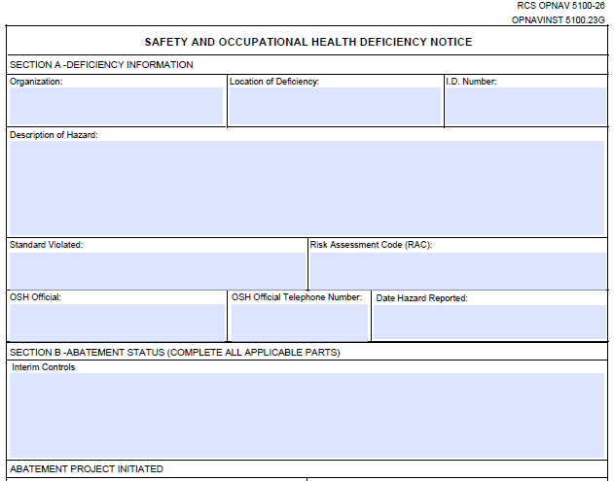
Deficiency Notice Reviews
Update employees on the status of hazards in their work areas
Post deficiency notices where:
Significant hazards are reported
Hazards cannot be controlled immediately
Document and track the abatement process
Image retrieved from Bing Images
Notes:
A deficiency notice is an item you may post at the identified hazard when a significant hazard exists and you cannot control it immediately. It lists the hazard description, interim controls, abatement project description, deficiencies corrected, and other comments. You may also use this form to document and track the deficiency correction process.
Realize your process may differ if you have an electronic reporting and tracking system – each Service or Agency has specific procedures for meeting this requirement.
Let the employees know about the use of any interim, or temporary, controls. Be sure to provide feedback to the employee submitting the hazard report throughout the correction phase.
The image shows a copy of a Navy OPNAV 5100/12, Safety and Occupational Health Deficiency Notice.
Image retrieved from Bing Images (Creative Commons).

Slide 18
Tracking & Trending
Enter employee-reported hazards into the hazard tracking log
Identify lessons learned
Conduct trend analysis:
A comparative analysis between past and current data
Identifies patterns or trends in the data reviewed
Predicts future performance
Helps develop new S&H goals and objectives
Image retrieved from Bing Images
Notes:
Trend analysis helps to identify commonly reported hazards, common causes of hazards, and work areas reporting a lot of hazards or not reporting any hazards at all. Analyzing trends helps you target educational efforts, corrective action efforts, and develop goals towards eliminating systematic problems.
The OSHA VPP requirements for hazard tracking systems and trend analysis are discussed in more detail in separate presentations.
Image retrieved from Bing Images (Creative Commons).

Slide 19
Process Evaluation
Look at the system to ensure all hazard reporting components are in place
Compare submitted hazard reports against inspection findings found by S&H professionals
Review submitted hazard reports:
Are they coming from one work area?
Why aren’t other work areas reporting hazards?
Why are employees missing hazards the S&H professionals are finding?
Image retrieved from Bing Images
Notes:
An effective reporting system needs:
A policy encouraging employees to report S&H concerns
Timely and appropriate responses to the reporting employee
Timely and appropriate action where valid concerns exists
Tracking of required hazard correction
Protection of reporting employees from any type of reprisal or harassment.
Image retrieved from Bing Images (Creative Commons).

Slide 20
Conclusion
In this presentation, you learned to:
Summarize the background and importance of hazard reporting
List hazard reporting-related documentation
Describe the knowledge leadership/management, key personnel, and the workforce should have regarding hazard reporting
Identify hazard reporting actions to implement and sustain OSHA VPP

