Slide 1
Hazard Tracking
OSHA VPP
January 2021
Notes:
This presentation outlines hazard tracking requirements for the purpose of Occupational Safety and Health Administration (OSHA) Voluntary Protection Programs (VPP) approval.
The presentation provides information on the background and importance of hazard tracking, required documentation, and the various levels of employee knowledge. It concludes with an action checklist and supplemental details to help with OSHA VPP implementation and sustainment efforts.

Slide 2
Objectives
During this presentation, you will learn to:
  Summarize the background and importance of hazard tracking
  List hazard tracking-related documentation
  Describe the knowledge leadership/management, key personnel, and the workforce should have regarding hazard tracking
  Identify hazard tracking actions to implement and sustain OSHA VPP
Notes:
This presentation is beneficial to safety professionals, VPP representatives, and others with hazard tracking responsibilities.

Slide 3
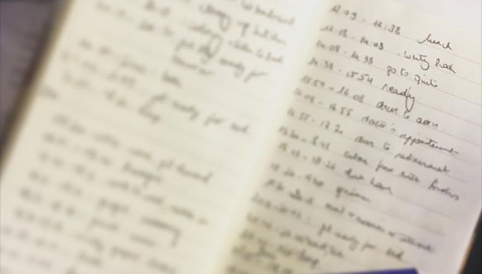
Background
Included in the WA criteria for VPP
Assigns identified hazards to personnel responsible for correction
Tracks hazards to closure
Monitors the effectiveness of hazard controls
Includes a feedback process on
the status of tracked hazards
Image retrieved from Bing Images
Notes:
WA = Worksite Analysis
EO = Executive Order
CFR = Code of Federal Regulations
DoDI = Department of Defense Instructions
DoD = Department of Defense
Hazard tracking closely monitors safety and health (S&H) hazards or concerns. Users input basic information regarding identified hazards into these systems. Then, the safety staff or other responsible person(s) use this information to address and eliminate the hazards. Ultimately, the hazard reporting system works in tandem with a hazard tracking system. It has information to evaluate and prioritize each risk and recommend hazard control methods. The tracking log also covers inspection findings, results of mishap and near-miss investigations, findings from hazard baselines and follow-up analyses, preventative maintenance, and identified trends.
The following list of documents contains provisions for hazard tracking requirements:
EO 12196: http://www.gsa.gov/portal/content/103012
OSHA 29 CFR 1960.28: https://www.osha.gov/laws-regs/regulations/standardnumber/1960/1960.28
DoDI 6055.01: https://www.esd.whs.mil/Portals/54/Documents/DD/issuances/dodi/605501p.pdf
Air Force Instruction (AFI) 91-203: https://static.e-publishing.af.mil/production/1/af_se/publication/afman91-203/afman91-203.pdf
Army Regulation (AR) 385-10: https://armypubs.army.mil/epubs/DR_pubs/DR_a/pdf/web/ARN16777_ARN16343_AR385_10_FINAL.pdf
Navy Marine Corps (NAVMC) Directive 5100.8: http://www.safety.marines.mil/Portals/92/Docs/NAVMC%20DIR%205100.8.pdf
Navy Safety and Occupational Health (SOH) Manual: https://www.med.navy.mil/sites/nepmu2/Documents/industrial_health/5100.19E%20-%20Volume%20I%20Part%20I.pdf
Image retrieved from Bing Images (Creative Commons). The image shows informal notes taken when doing an inspection. You want to make sure you formally capture and track all hazards you identify.

Slide 4
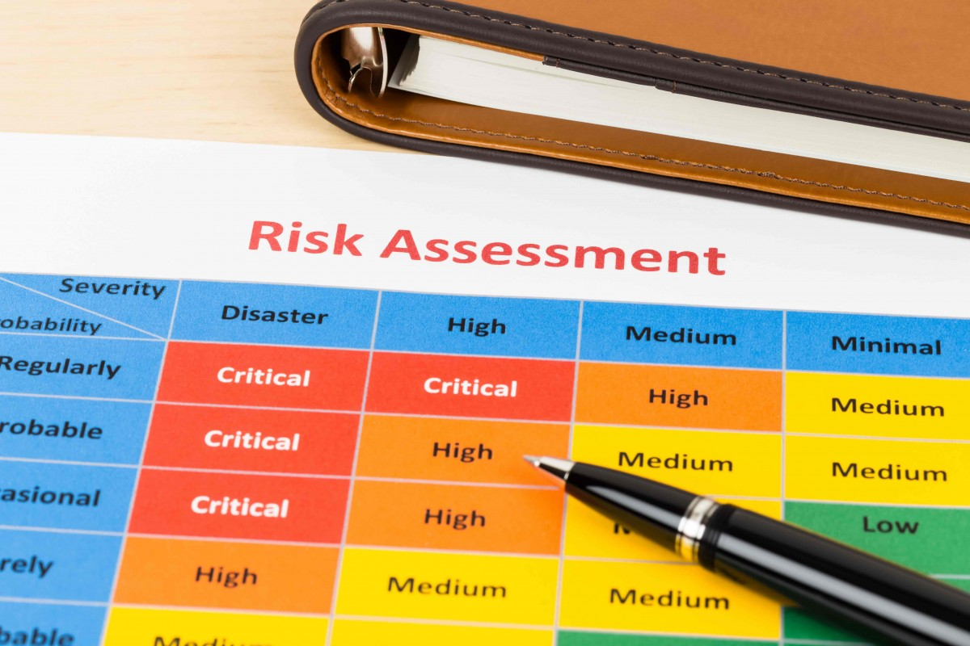
Importance
Collectively captures all identified hazards
Documents interim control measures
Facilitates follow up evaluations on implemented hazard controls
Holds management responsible for addressing S&H concerns
Prioritizes hazards to allocate
resources accordingly
Provides trending data and identifies repeat issues
Image retrieved from Bing Images
Notes:
Hazard tracking helps you maintain an organized list of all identified hazards and the status of abatement. This log captures any employee reported hazards, near-miss or mishap investigations, and industrial hygiene (IH) survey information specific to your worksite.
Having an organized list allows you to priority your hazards and identifies who is responsible for mitigating the hazard; it may be the first-line supervisor or the Commanding Officer, if necessary. Documenting key personnel ensures direct responsibility and the availability of adequate allocations and resources.
Image retrieved from Bing Images (Creative Commons). The image shows a risk matrix used to assign a priority to hazards identified based on the amount of risk they pose to employees. This is where risk assessment codes come into play.

Slide 5

Documentation
Hazard tracking and abatement procedures
Hazard tracking/abatement log
Abatement plans
Hazard report forms
Near-miss and mishap investigations
Hazard analysis forms
IH survey reports
Trend analysis from tracked hazards
Image retrieved from Bing Images
Notes:
Make sure you provide completed examples of forms and documents to your assessment team. Don’t just show them blank forms! They want to see the documents you filled out to thoroughly assess the processes within your safety management system.
Refer to your overarching DoD or Service/Agency instruction for detailed hazard tracking procedures.
Have copies of completed hazard reporting forms and completed mishap or near-miss investigations. Compare these reports to the hazard tracking log to ensure all hazards are being tracked to closure.
You may have more than one tracking log utilized in your workplace. For example, you may have a system tracking findings from mishap investigations, and then a separate log tracking hazard reports and safety inspection findings.
Image retrieved from Bing Images (Creative Commons).

Slide 6

Leadership/Management Knowledge
Leaders and managers should know about:
  The process for tracking reported or
  identified hazards
  Their hazard tracking log responsibilities
  Status of hazard tracking log items or abatement plans
  Their role in ensuring hazards are
  corrected
  How employees are informed of
  existing or abated hazards
Image retrieved from Bing Images
Notes:
Senior leaders and supervisors are responsible for providing a safe and healthful workspace for their employees. Leadership must be aware of how the hazard tracking log operates, as well as any open items on the hazard tracking log, especially items assigned risk assessment codes (RACs) of a 1, 2, or 3. Hold leaders accountable for correcting reported S&H hazards in a timely fashion. Ensure leadership is aware of the timeline to initiate assigned corrective actions to mitigate hazards.
Leadership may reach out to you or other individuals in your organization and request additional support to abate a hazard. For example, facilities maintenance may have a reported hazard to address at the end of their to-do list, but the safety office indicates this hazard may lead to a serious injury. Engage your leadership enough to expedite this support, if necessary.
Image retrieved from Bing Images (Creative Commons).

Slide 7
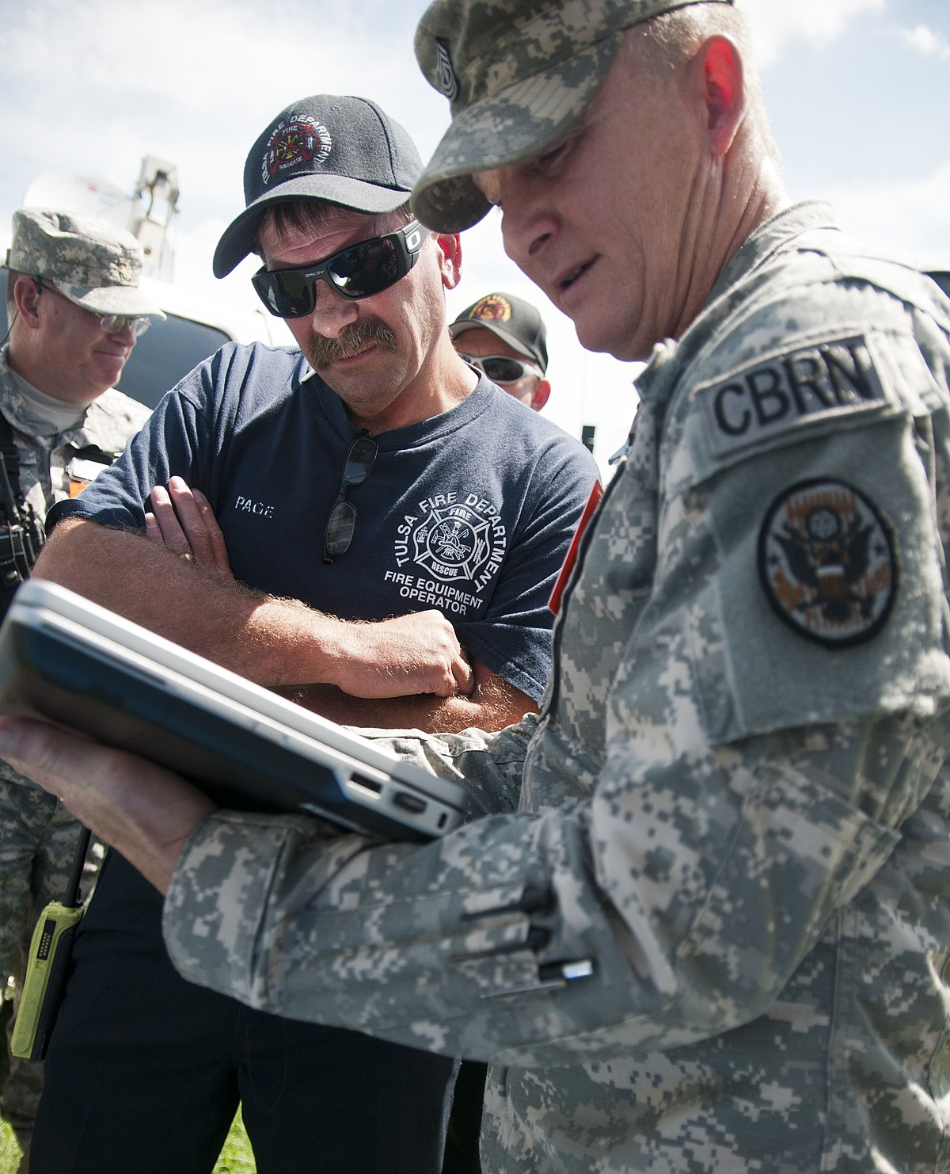
Key Personnel Knowledge
Key personnel should be knowledgeable about:
  Hazard tracking log responsibilities
  Items included on the hazard tracking log
  Accident/incident investigation results
  Status of open hazards
  Current abatement plans
  Hazard trends
Image retrieved from Bing Images
Notes:
Key personnel are generally S&H staff; however, other personnel, such as business analysts, industrial hygienists, or fire department representatives may have a separate hazard tracking system for deficiencies identified through their own inspections or audits.
Image retrieved from Bing Images (Creative Commons). The image shows an emergency response team identifying hazards and other safety deficiencies found during an exercise.

Slide 8

Workforce Knowledge
Employees should know about:
  Process for reporting S&H hazards
  Results and status of the last hazard they reported
  Process to follow-up on a reported hazard
Image retrieved from Bing Images
Notes:
Encourage employee reporting and encourage leaders to recognize employees for their efforts whenever they participate. You must have a system in place to provide feedback to employee who report hazards. During interviews, employees should know the status of any hazards they have reported.
Best Practice: One organization had a contest where the employee who submitted the most hazards with an accompanying potential corrective action received a time-off award.
Image retrieved from Bing Images (free to use and share license) at: https://www.tuffaproducts.com.au/wp-content/uploads/2014/09/IMG_00000081.jpg. The image shows an employee filling out paperwork for a S&H concern.

Slide 9
Action Checklist
Determine how to track identified hazards
Identify and prioritize the hazards
Create an abatement plan
Implement interim protection, as needed
Provide feedback to employees
Provide status updates to leadership
Close and follow-up
Trend hazard tracking results
Notes:
Follow this action checklist to implement and sustain VPP expectations for hazard tracking. Each of these action checklist items will be covered in more detail.

Slide 10
Hazard Tracking
Refer to Service/Agency hazard tracking procedures
Utilize an electronic database or spreadsheet
Track:
Tracking number | Description of how the hazard is discovered | Date the hazard was identified | Employee name who reported the hazard
Location of the hazard | Description of the hazard | Priority of the hazard | Date employee feedback is provided
Date of last briefing to Commander/ Executive Agent | Description of the corrective action | Person(s) responsible for corrective action | Status of corrective action
Interim and/or permanent control measures taken | Due date for corrective action(s) | Close date | Follow-up date
Notes:
Refer to your Service or Agency guidance to find out more about applicable hazard tracking procedures and requirements. Regulations such as Executive Order 12196, 29 CFR 1960, and DoDI 6055.01 also have some generic requirements regarding the tracking of identified hazards.
Document all identified hazards and track them to closure. Collect specific types of data to effectively document identified hazards; you can see the data to collect listed in the table on the slide. Assign a tracking number to each hazard and provide detailed descriptions and locations of each hazard. You can use the corresponding tracking number for all investigations and follow-up actions to categorize reports.
Assign a responsible person to all reported hazards. Include a description of the corrective action and the actions performed to mitigate the hazard, including any interim actions taken until final abatement. Track the status of the corrective action until completion. Assign all identified corrective actions a due date to ensure timely mitigation of the reported hazard. Annotate the last follow-up date, the date of the last briefing to the Commanding Officer or Executive Leadership Team, the close date, and any other pertinent remarks.
Perform follow-up actions to evaluate the selected controls and mitigation measures for effectiveness and feasibility. Sometimes a control or mitigation measure may seem appropriate for the identified hazard; however, you may discover it is ineffective once implemented.

Slide 11
Example – Hazard Tracking Log
HAZARD TRACKING LOG
Organization Name:
Maintained By: |  |  |  | Log Year:
Log No. | Hazard Description | Hazard Location | Date | Source (How Reported) | Reported By | Employee Feedback Date | RAC
Responsible Person(s) | Recommendation | Due Date | Interim Measures in Place | Abatement Actions | Follow-Up Evaluation Date | Closed Date
Image courtesy of Concurrent Technologies Corporation
Notes:
Services and Agencies utilize several different methods to track hazards, such as a Microsoft Excel spreadsheet or a commercial tracking system.
Hazard reporting and near-miss or mishap forms generally describe the nature and location of the hazard, who reported it, an explanation of the perceived hazard or situation where a mishap almost occurred, what actions were taken (if any), and whether it has been fixed. Use the information from these forms to populate the hazard tracking log.
Image courtesy of Concurrent Technologies Corporation. The image shows an example of a hazard tracking log.

Slide 12
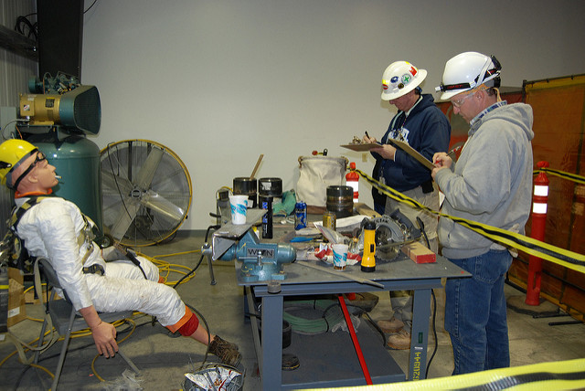
Hazard Identification
Collect and track hazard information from:
  Hazard analysis of routine and non-routine activities
  Mishap and near-miss investigation results
  Safety culture or perception surveys
  Baseline S&H hazard analysis
  Employee hazard reports
  Safety inspections
  IH surveys
  Preventive maintenance
  Trend analysis findings
Image retrieved from Bing Images
Notes:
Identify hazards at your workplace. The list on the slide is not all-inclusive, but lists potential sources to collect hazard information at your worksite.
Best Practice: Though sometimes required, it’s a best practice to conduct safety culture or perception surveys when a new Commanding Officer arrives. Add any S&H findings to your hazard tracking log.
Image retrieved from Bing Images (free to use and share license) at: http://farm9.staticflickr.com/8251/8488533071_a29537d587_z.jpg. The image shows employees conducting hazard recognition training; they use this knowledge to identify hazards in their workplaces.

Slide 13
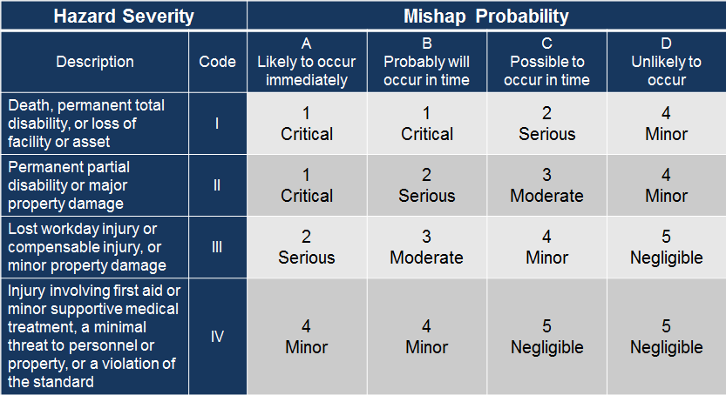
Hazard Prioritization
Assign a RAC to each hazard
Prioritize each hazard based on assigned RACs
Image retrieved from DoDI 6055.01
Notes:
RACs represent the degree of risk associated with the hazard and combines elements of hazard severity and mishap probability, taking into account potential S&H effects. The purpose of assessing risks and establishing prioritization of hazards is to identify the significance of the hazard and to apply a process to focus attention to the most hazardous receiving attention first. This process ensures you abate high risks hazards immediately and exhaust available resources of those risks first.
According to DODI 6055.01, “making risk decisions is a Commander’s determination of which risks are acceptable and unacceptable from the standpoint of balancing the benefit against the potential for losses or harm (severity and likelihood of occurrence).” Commanding Officers generally delegate this responsibility to S&H professionals. Refer to your Service or Agency guidance to help assign RACs.
Evaluate and assign RACs to prioritize hazards. For more information on assigning RACs, view: https://www.esd.whs.mil/Portals/54/Documents/DD/issuances/dodi/605501p.pdf
Add ALL hazards to your hazard tracking log, even those you correct on-the-spot or fix immediately after reporting it.
Image retrieved from DODI 6055.01 at: http://www.dtic.mil/whs/directives/corres/pdf/605501p.pdf

Slide 14
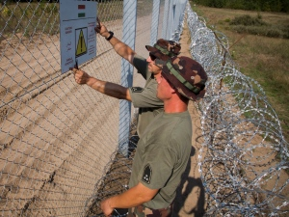
Hazard Abatement
Develop an abatement plan for RACs 1, 2, and 3
Post notices of unsafe/unhealthful conditions, when required
Document both interim and permanent corrective measures on the hazard tracking log
Image retrieved from Bing Images
Notes:
Create a formal abatement plan for hazards you cannot resolve immediately. A hazard abatement plan ties a corrective action(s) to an identified hazard. Each Service and Agency has specific requirements identified for tracking hazards included in hazard abatement plans. The plan includes date of hazard identification, location of the hazard, description of the hazard, references to applicable standards, interim control measures, description of the abatement action, estimated cost, anticipated completion date, abatement priority, and a closeout statement.
DoDI 6055.01 requires the correction of hazards assigned a 1, 2, and 3 RAC within 60 days; if not, you must develop a hazard abatement plan and notify all affected personnel. Some Services or Agencies may prescribe shorter timeframes, such as 30 days. Many times, Service or Agency regulations may require you post a notice communicating the unsafe or unhealthful conditions in the workplace (especially for RACs 1 and 2). You must post this at the hazard itself and train employees on the uncontrolled hazard (while awaiting abatement) and any interim control measures.
Image retrieved from Bing Images (free to share and use license) at: http://i.cbc.ca/1.3230864.1442428427!/cpImage/httpImage/image.jpg_gen/derivatives/original_300/hungary-soldiers-put-up-warning-sign-against-migrants.jpg. The image shows employees posting a warning sign, an interim corrective measure, to notify affected personnel of a hazardous situation.

Slide 15
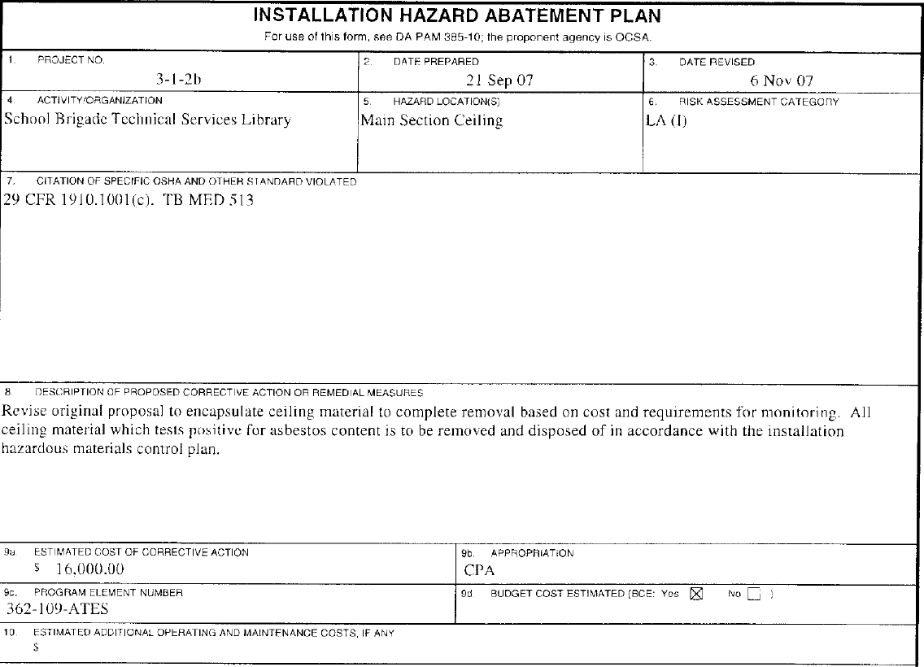
Example – Abatement Plan
Image retrieved from DA PAM 385-10
Notes:
You may group individual deficiencies, which are identical in nature, together into a single abatement plan or into an associated abatement project. For example, you can add two different buildings with exit signs not in compliance with OSHA, National Fire Protection Association, or local requirements to the same abatement plan.
A close out statement indicates the completed abatement action, cost, and date of completion. You may use a computerized file as long as it contains all the required information. Make the hazard abatement plan available for review locally by recognized employee organizations, where applicable. Some Services and Agencies require Commanders to sign abatement plans and to close items on the log.
The image shows a snapshot of DA Form 4756, the Installation Hazard Abatement Plan.
Image retrieved from DA PAM 385-10 at: https://armypubs.army.mil/epubs/DR_pubs/DR_a/pdf/web/p385_10.pdf

Slide 16
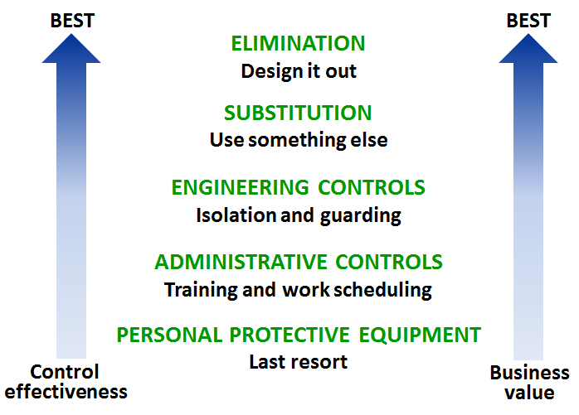
Interim Controls
Choose temporary solutions, or interim controls, to control hazards
Monitor interim controls frequently
Document interim controls on the hazard tracking log
Follow the hierarchy of controls
when implementing any control
measure
Image retrieved from Bing Images
Notes:
Interim control: A temporary control measure taken until you can implement a permanent fix.
Often, hazards change in nature due to ongoing operations. Check open items, particularly those of a serious nature, to make sure interim controls remain effective and the hazard has not become more of a problem. In some cases, you may correct hazards by eliminating a process or piece of equipment.
Ask affected employees for feedback. They understand their jobs best and can tell you if the interim control is working properly, or, if additional changes are needed.
Management and the safety office should review self-inspection results. Obvious hazards and repeat findings indicate a need for management intervention in the work area.
Encourage employees to question anything they suspect may be hazardous, improper, obsolete, or out of place to discourage checklist blindness. Checklist blindness occurs when inspectors simply follow the checklist without questioning items not included on it.
Image retrieved from Bing Images (free to use and share) at: https://upload.wikimedia.org/wikipedia/commons/c/cf/Hierarchy_of_Controls.PNG. The image shows the hierarchy of controls; utilize the hierarchy to help select the best interim control until you can implement a permanent solution.

Slide 17

Employee Feedback
Record employee reported hazards
Deliver feedback to affected
employees
Provide feedback to area supervisors
when receiving anonymous reports
Document follow-up responses and
reports
Image retrieved from Bing Images
Notes:
Acknowledge all employee or supervisor submitted hazards reported. Your Service or Agency guidance tells you how long you have to respond to an employee report. Provide feedback to the area supervisor for anonymously reported hazards. Ask them to brief employees in the work area on the submitted hazard and provide feedback on it.
Inform the employee or supervisor when you are assessing, identifying, and characterizing the hazard. Providing feedback shows employees their concerns matter and upper management is addressing the issue. Let them know when you assign interim controls. It’s important they understand the interim controls and receive training, if necessary, on why the interim control is in place and how to use it. Finally, inform affected personnel of abated hazards.
Image retrieved from Bing Images (free to use and share license) at: http://2012books.lardbucket.org/books/a-primer-on-communication-studies/section_12/b5f880108104041455645090412fba37.jpg. The image shows a supervisor discussing the status of an employee reported hazard.

Slide 18

Leadership Involvement
Hold status review meetings
  Can occur weekly, monthly, quarterly, or
  as needed
  Include various levels of
  leadership/management
Invite employee representatives or
bargaining units
Promote leadership visibility and awareness
Image retrieved from Bing Images
Notes:
Status reviews are essential meetings with leadership and management to provide them with updates on identified hazards and any associated abatement plans. Choose a frequency allowing you to assign actions and implement corrective actions.
The severity of the hazards dictates the level of management participation you need to discuss. At times, leaders involve themselves so they can hold personnel accountable for implementing assigned responsibilities and corrective actions.
Soliciting participation from collective bargaining units as stakeholders in this process accomplishes two things. First, they may be able to recommend a corrective action based on experience at another location. Second, dialogue between leadership and labor representatives improves the relationship and overall safety culture.
The leadership team should be responsive to any negative shifts in performance. An effective technique is to implement corrective controls in a timely manner so employees feel as though the leadership is responsive to their concerns. Another suggestion is to recognize employees for their efforts. One organization had a contest where the employee who submitted the most hazards with an accompanying mitigation or remediation strategy received a time-off award.
Image retrieved from Bing Images (free to use and share license) at: https://c1.staticflickr.com/7/6097/6378251475_f9ab96a413_z.jpg. The image shows a leadership status review meeting.

Slide 19

Follow-Up and Closure
Perform follow-up evaluations to validate controls are effective
Change written procedures, as needed
Add hazard control validations to inspection checklists
Train affected personnel on changes
Close out entries on the hazard tracking log
Review closed entries with leadership during next status review
Image retrieved from Bing Images
Notes:
When closing a hazard, physically inspect the hazard, ensure the hazard is corrected, and be sure the situation is safe. Write a close out statement in the abatement plan indicating the hazard is resolved. Be sure to identify any required follow-up measures you may need to take.
Include the hazard in safety inspection checklists or preventive maintenance the hazard has the potential to reoccur, to help you identify these hazards immediately when they do reoccur and prevent long-term exposure.
Ask personnel for feedback on the effectiveness of the correction. Not only is it a good way to validate the correction, but it also increases employee involvement, helps reinforce an active S&H program, and gives employees a voice.
Image retrieved from Bing Images (Creative Commons). The image represents an employee using new controls to perform work.

Slide 20

Trend Analysis
Review all identified hazards on
the hazard tracking log
Look for repeat occurrences between past and current data
Identify common patterns
Identify areas of focus based on trend analysis
Revise and establish new S&H goals and objectives
Image retrieved from Bing Images
Notes:
Trending compares past and current data and helps predict future performance. Preventive effort is far less costly than repairing or healing after an incident. It also helps develop new S&H goals and objectives and areas of focus.
Some common examples of tracking and trending hazards include:
Frequent early failure of auxiliary light batteries in multiple lights over a group of buildings
Anti-slip treads on some high usage stairways require more frequent replacement than routinely planned
Buildings or areas have chronic exit and egress deficiencies due to excess material or overcrowding
Personal protective equipment is not used as required due to user discomfort
Image retrieved from Bing Images (Creative Commons). The image shows an analyst conducting trend analysis on a set of data.

Slide 21
Conclusion
In this presentation, you learned to:
  Summarize the background and importance of hazard tracking
  List hazard tracking-related documentation
  Describe the knowledge leadership/management, key personnel, and the workforce should have regarding hazard tracking
  Identify hazard tracking actions to implement and sustain OSHA VPP

