Slide 1
Routine Inspections
OSHA VPP
January 2021
Notes:
This presentation outlines routine inspection requirements for the purposes of the Occupational Safety and Health Administration (OSHA) Voluntary Protection Programs (VPP) recognition.
The presentation provides information on the background and importance of routine inspections, required documentation, and the various levels of employee knowledge. It concludes with an action checklist and supplemental details to help with OSHA VPP implementation and sustainment efforts.

Slide 2
Objectives
In this presentation, you will learn to:
Summarize the background and importance of routine inspections
List routine inspections-related documentation
Describe the knowledge leadership/management, key personnel, and the workforce should have regarding routine inspections
Identify routine inspection-related actions to implement and sustain OSHA VPP
Notes:
This presentation is beneficial to safety and health (S&H) professionals, VPP representatives, and designated routine S&H inspectors, and all employees involved in the completion of routine inspections.

Slide 3
Background & Importance
Included in the WA criteria for VPP
Monitors recurring worksite hazards and regulatory non-compliance
Identifies and abates worksite hazards
Encourages employee involvement in S&H
Educates employees in fundamental safety of their work environment
Notes:
WA = Worksite Analysis
Routine inspection: A worksite evaluation completed in a repetitive fashion, such as annually, quarterly, or monthly.
A robust routine inspection program is a vital part of a safety management system (SMS).
Involving more than just the supervisor or S&H personnel in these inspections enables your employees to be more aware of their work environment and feel more responsible for their own S&H.

Slide 4
Documentation
S&H inspection system or process
Hazard identification training records for designated inspectors
S&H inspection checklists and records
Hazard tracking log submissions for S&H inspection findings
S&H inspection finding trend analysis
Image retrieved from Bing Images
Notes:
Make sure you provide completed examples of forms and documents to your assessment team. Don’t just show them blank forms! They want to see the documents you filled out to thoroughly assess the processes within your SMS.
S&H inspection records capture the weekly, monthly, quarterly, or annual inspections performed by various levels of personnel (outside of S&H staff). Be sure to have these inspection records on hand to support how your worksite identifies hazards.
Provide the training records for personnel performing routine S&H inspections (e.g., on the process and what to look for). OSHA VPP expects personnel responsible for performing S&H inspections receive adequate hazard recognition training. It is a good practice to document all hazard recognition training you provide to your inspectors.
Perform your routine inspections frequently. VPP requires monthly inspections at worksites – covering the entire worksite at least once per quarter. This requirement means you can complete your inspections on a weekly, monthly, or quarterly basis (whatever works for your organization), but you must inspect all your work areas at least one time each quarter. For construction sites, make sure you are inspecting the entire site on a weekly basis.
Image retrieved from Bing Images (free to share and use license) at: https://www.rabobank.com/en/images/A%20Kerndocumenten.jpg

Slide 5
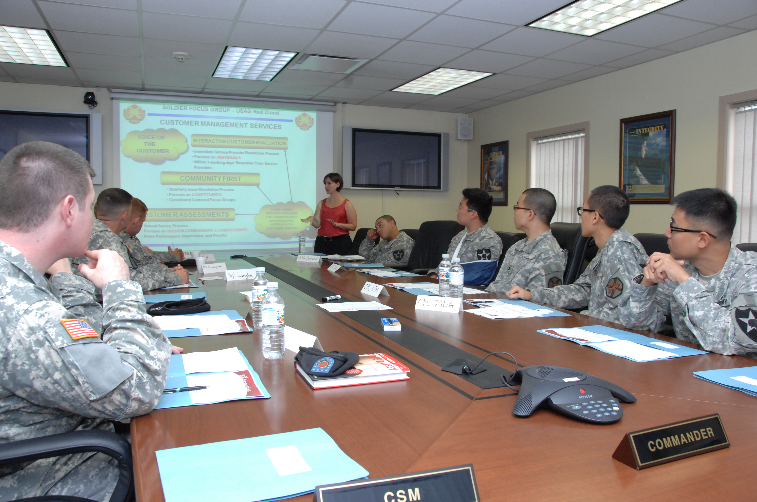
Leadership/Management Knowledge
Leaders and managers should know:
Their roles and responsibilities in the inspection program
Routine inspection process(es)
Frequency of inspections
Resources allocated toward the inspection program
Hazard abatement process
Accountability process for completing inspections
Image retrieved from Bing Images
Notes:
Leaders and managers must support your inspection program to make it effective. Finding hazards alone is not enough. You must have a system in place to identify, document, and track hazards and use interim controls until mitigated. An accountability process ensures those assigned to complete inspections do so, and in a timely manner.
Image retrieved from Bing Images (free to use and share license) at: https://upload.wikimedia.org/wikipedia/commons/1/15/US_Army_51550_Soldiers_and_Family_speak_out_for_focus_group.jpg

Slide 6
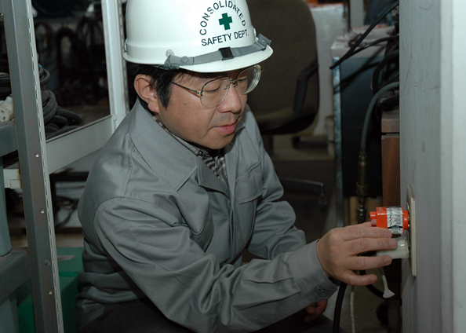
Key Personnel Knowledge
Key personnel should be knowledgeable about:
Routine inspection process(es)
Frequency of inspections
Who participates in S&H inspections
Required training for inspectors
Location of completed inspection documents
Revision/review process for inspection program
Inspection-related trends
Image retrieved from Bing Images
Notes:
Key personnel may include: S&H representatives, other personnel assigned to perform S&H inspections, and others leading and tracking inspection efforts.
Key personnel should know:
How to document inspection findings
Number of areas needing inspected, or inspection area jurisdiction
Who performs S&H and routine self-inspections and who may participate
Training for routine self-inspectors
How inspection findings will be submitted/collected and by who
Process for notifying affected personnel of identified hazards in their work area that cannot be immediately corrected
Tracking and trending S&H inspection findings
S&H inspection process review process.
Image retrieved from Bing Images (free to use and share license) at: https://upload.wikimedia.org/wikipedia/commons/e/eb/US_Navy_070216-N-2970T-001_Safety_Inspector_Hirofumi_Tokunaga_conducts_an_open_ground_test_on_an_electrical_outlet.jpg

Slide 7
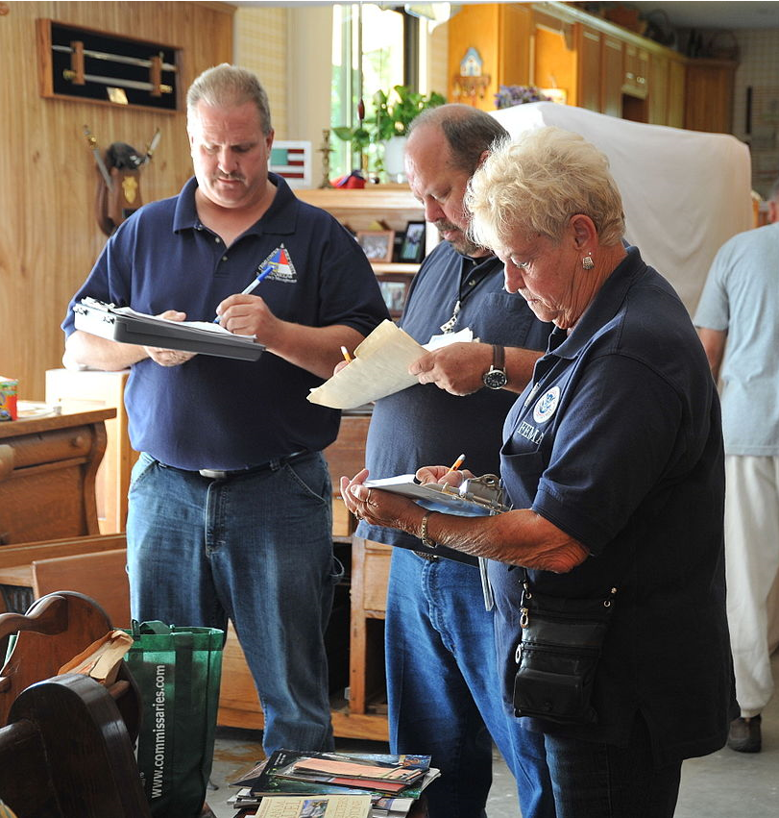
Workforce Knowledge
Employees should know:
Potential S&H hazards in their work area
Results of S&H inspections in their work area
Their involvement in S&H inspections, if applicable
Training received to participate in inspections
Image retrieved from Bing Images
Notes:
A system for identifying S&H hazards is most effective if your employees have an opportunity to participate in all facets of the inspection process.
Image retrieved from Bing Images (free to use and share license) at: https://upload.wikimedia.org/wikipedia/commons/thumb/e/e0/FEMA_-_45587_-_Flood_damage_inspections_continue_in_North_Carolina.jpg/1280px-FEMA_-_45587_-_Flood_damage_inspections_continue_in_North_Carolina.jpg

Slide 8
Action Checklist
Develop a written S&H inspection program
Create an inspection schedule
Make self-inspection checklists
Select S&H inspectors
Train S&H inspectors
Conduct and document self-inspections
Notes:
Follow this action checklist to implement and sustain VPP expectations for routine inspections. Each of these action checklist items are covered in more detail.

Slide 9
Written Routine Inspection Program
Review existing Service/Agency guidance on inspections
Write a local-level routine S&H inspection program
Include written inspection procedures and responsibilities
Have leadership review and approve the written routine inspection program
Notes:
Review and follow existing Service/Agency guidance on inspections (e.g., Army Regulation 385-10, Naval Operations Instruction 5100.23H, Marine Corps Order 5100.29C, Air Force Instruction 91-202). These regulations and instructions usually provide guidance on inspections, abatement, and guidance on specific tracking systems.
See if you have any local procedures in place to govern your S&H inspection programs. Developing a local-level inspection program at your worksite may make the execution of S&H inspections easier and more effective overall.
Written inspection programs can include, but are not limited to:
Work areas covered
Inspector qualifications and training requirements
Responsibilities
Frequency of inspections
Inspection schedule
Documentation for inspection findings and results
Submission of inspection findings
Tracking and trending of inspection findings
Inspection program reviews
Employee access to inspection findings and results
For an example of a written inspection program, visit: https://www.ccohs.ca/oshanswers/prevention/effectiv.html, http://www.sfasu.edu/safety/documents/safety-inspection.pdf, and https://www.wnins.com/losscontrolbulletins/SelfInspectionProgram.pdf

Slide 10
Inspection Schedule
Create a documented self-inspection schedule
Include all areas where employees perform work
Set a completion frequency for each work area
Consider the types of hazards and work environment when determining frequencies
BUILDINGS | MONTH/DATE
Software Maintenance Administrative Area | March 6, June 6, September 6, December 6
Machine Shop A | Every month (January 5, February 5, March 5….)
Break Area C | January 10, April 10, July 10, October 10
Metallurgical Lab | March 21, June 21, September 21, December 21
Shipping & Receiving | February 18, May 18, August 18, November 18
Notes:
VPP requires monthly inspections at worksites, to cover the entire worksite at least once per quarter. This requirement means you can complete inspections at whatever frequency works best for your organization, but you need to inspect all of your work areas at least one time each quarter. Include a self-inspection schedule as a part of your written routine inspection program. Review/update this schedule at least annually, but check your Service/Agency guidance for any other requirements.
Include all work areas in your S&H inspection schedule. Be sure to include every area where your employees perform work, as well as other areas covered by your VPP application. This may include administrative work areas, recreational areas, and child development centers.
Knowledge of the hazards, risks, and work environment helps determine frequencies for conducting inspections. You want to inspect more hazardous work areas more frequently than less hazardous work environments. For example, you may designate quarterly inspections for your administrative areas, but then have your welding shops complete monthly inspections. See the chart on the slide for an example.

Slide 11
Inspection Schedule
Remember, at a minimum VPP requires self-inspections:
Be performed at least monthly
Cover the entire organization at least quarterly
Cover entire worksites weekly in construction sites
Image retrieved from OSHA
Notes:
VPP requires routine inspections to be done at least monthly, with your entire organization inspected at least quarterly (construction sites require inspecting your entire site weekly). You should be completing at least one inspection somewhere in your organization each month. If you have 12 work areas, for example, you can inspect four of them each month. By the end of the third month (first quarter), you will have completed all 12 areas. Then, just repeat this process each following quarter.
Image retrieved from OSHA at: https://www.osha.gov/dcsp/vpp/newlogo.html

Slide 12
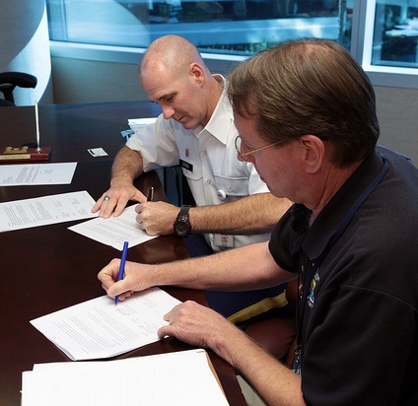
Inspection Checklists
Develop checklist(s) to aid documenting inspections and findings
Consider making checklists unique to the work areas inspected
Ask S&H staff to review the checklist(s) before implementation
Revise the checklist(s) over time
Image retrieved from Bing Images
Notes:
Checklists can be a useful guide to remind inspectors what to look for during a self-inspection. Remember, inspectors should also know to go beyond the items on the list and document any additional hazards they identify.
Instead of having one general inspection checklist for every work area, consider tailoring self-inspection checklists to the workplace. For example, machine guarding may not be applicable in all areas. You may want to remove it from the checklist for those areas without guarded machinery, like administrative areas. Removing unnecessary items makes it easier for the inspectors. Once a checklist is developed, consider having a S&H professional review the content. They are the subject matter experts and can help you develop or modify self-inspection checklists.
Revise the checklist over time. It’s a good idea to review each checklist at least annually. Use inspection trends, accident investigation results, employee hazard reports, preventive maintenance information, and injury and illness trends to identify items to include on the checklist and in your inspection program.
Consider adding these items to checklists:
Description of the finding
Location of the finding
Date of the inspection
Inspector’s name(s)
Suggested corrective action
Interim actions taken, if any
Areas to indicate if the item is: not applicable to the work area; acceptable/not acceptable throughout work area; or corrected on the spot
Space to describe findings not included in the checklist
Image retrieved from Bing Images (free to share and use license) at: http://farm9.staticflickr.com/8073/8291370301_4af64fd66f_z.jpg

Slide 13
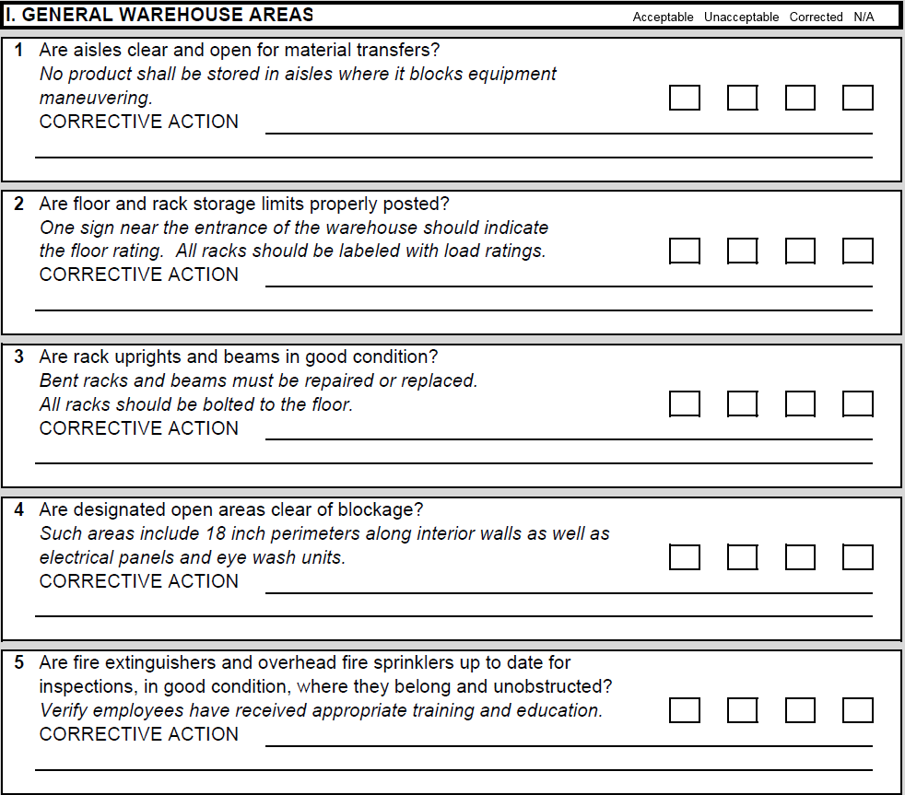
Example – Inspection Checklist
Image retrieved from the International Warehouse Logistics Association
Notes:
See an example self-inspection checklist at: https://www.osha.gov/Publications/smallbusiness/small-business.html#check and http://labor.hawaii.gov/hiosh/home/training/checklist/
You can use these examples to create your own area-specific self-inspection checklist.
Image retrieved from the International Warehouse Logistics Association at:
https://www.iwla.com/wp-content/uploads/2020/10/IWLA-Safety-Self-Inspection-1.29.08.pdf

Slide 14
Inspector Selection
Ask for self-inspection volunteers
Determine inspector qualifications and training requirements
Extend self-inspections beyond supervisors
Consider rotating inspectors or assisting employees on a periodic basis
Image retrieved from Bing Images
Notes:
Determine inspector qualifications. Some worksites want inspectors with several years of experience in their work area so they are familiar with the hazards, tasks, and processes.
Depending on service guidance, supervisors are typically responsible for self-inspection completion. If possible, extend your self-inspections beyond supervisors. Ask for employee volunteers. You might consider non-supervisory employees, union representatives, directors or department heads, and even top leaders. You can also have supervisors choose an employee to go along with them to complete self-inspections.
It is a good idea to rotate self-inspectors, to give each work area a new perspective. For example, assign self-inspectors to inspect a work area for three months. During the last month, the current inspector can take the new inspector around and show them what they look for, what they find, and how to document and submit the results.
For more hazardous areas, it may be better to keep the same inspector in place since they know what the hazards are and what to look for. You can pair other inspectors with this continuous inspector to have a new set of eyes on the area.
Image retrieved from Bing Images (free to use and share license) at: http://farm7.staticflickr.com/6084/6053462016_952e206378_z.jpg

Slide 15
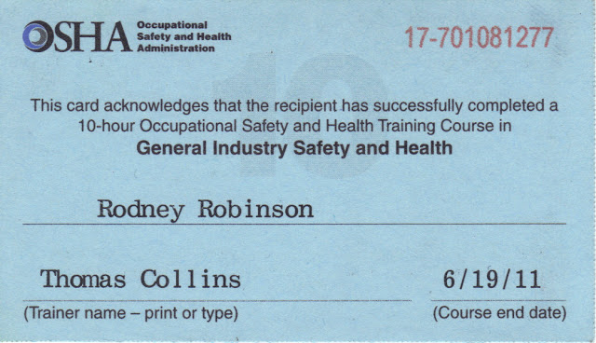
Inspector Training
Train all self-inspectors on:
Inspection processes
Inspection checklist use
Documentation processes
Hazard recognition
Process for submitting inspection findings
Image retrieved from Bing Images
Notes:
Train all inspectors on hazard recognition, particularly hazards related to the work area they are inspecting, and on your inspection processes. Sometimes, you may find inspectors did not understand an item on the checklist and have been inaccurately inspecting it.
Best Practice: Provide OSHA 10- or 30-hour General Industry training course to train your inspectors.
Best Practice: Have your supervisors train employees on the inspection process and hazard recognition as they complete their scheduled inspections.
Image retrieved from Bing Images (free to share and use license) at: http://2.bp.blogspot.com/-eWvbC_fHFYc/T3k4nhF30JI/AAAAAAAAAH0/yGsC6tx2Xok/s640/4-2-2012+12;20;20+AM.JPG

Slide 16
Inspection Completion
Review inspection documents from each area
Add submitted inspection results to hazard tracking/abatement
Inform employees of hazards not immediately corrected
Track the completion of assigned inspections
Submit inspection findings for trend analysis
Image retrieved from Bing Images
Notes:
Your inspectors should know which self-inspection documents to complete and the process for submitting those documents to key personnel trough their training. Designate a location to maintain self-inspection documents. Many worksites utilize a SharePoint site or internal network location where inspectors can scan their inspection documents and upload them to the network. This approach offers visibility to the completion of the inspections and findings so a responsible person(s) can then check to make sure inspectors enter all findings into your hazard tracking system, and a designated party can later trend the data.
Review each submitted inspection to make sure all the fields are fully completed or determine if the inspectors are simply “pencil whipping” the results. A good determination is if the form has no findings from inspection to inspection. Inspectors should always find something in their areas. Prioritize finding and provide an interim control for items identified as highly hazardous. When you cannot control hazards immediately, or you identified and implemented interim actions, inform all affected employees of the presence of the hazard.
Track the completion of assigned inspections. Follow up when you notice an inspection is not completed. A good practice to start with self-inspectors is to have them notify you when they will be out of the office and cannot complete an assigned inspection on time. This process allows you to find another trained self-inspector to complete the inspection. Hold inspectors accountable when they don’t meet their designated responsibilities.
Once you review and address inspection findings, conduct trend analysis, or submit them to the person responsible for conducting trend analysis.
Image retrieved from Bing Images (free to use and share license) at: https://c2.staticflickr.com/4/3672/11325450014_02d6a20d2d_z.jpg

Slide 17
Conclusion
In this presentation, you learned to:
Summarize the background and importance of routine inspections
List routine inspections-related documentation
Describe the knowledge leadership/management, key personnel, and the workforce should have regarding routine inspections
Identify routine inspection-related actions to implement and sustain OSHA VPP

