Slide 1
Trend Analysis
OSHA VPP
March 2020
Notes:
This presentation outlines trend analysis requirements for the purposes of Occupational Safety and Health Administration (OSHA) Voluntary Protection Programs (VPP) recognition.
The presentation provides information on the background and importance of trend analysis, required documentation, and the various levels of employee knowledge. It concludes with an action checklist and supplemental details to help with OSHA VPP implementation and sustainment efforts.

Slide 2
Objectives
In this presentation, you will learn to:
Summarize the background and importance of trend analysis
List trend analysis-related documentation
Describe the knowledge leadership/management, key personnel, and the workforce should have regarding trend analysis
Identify trend analysis actions to implement and sustain OSHA VPP
Notes:
This presentation is beneficial to safety professionals, VPP representatives, business or assigned trend analysts, and others with trend analysis responsibilities.

Slide 3
Background & Importance
Included in the WA criteria for VPP
Identifies patterns in S&H data to prevent mishaps
Develops plans of action to combat negative trends
Images created by the DoD SMCX
Notes:
WA = Worksite Analysis
S&H = safety and health
OSHA requires VPP Star sites to have a minimally effective system for identifying and assessing S&H trends. This includes the trending of OSHA log information, accident or mishap data, near-miss incidents, employee hazard reports, and S&H inspection findings.
Trend analysis programs will identify both positive and negative trends in your safety management system (SMS). The goal of the program is to not only highlight your successes (positive trends), but uncover negative trends or recurring S&H concerns, which may be causing mishaps.
Minimally effective trend analysis programs not only identify recurring S&H concerns, but also put plans of action in place to address them, hopefully permanently!
The image shows injury and illness trends, showing the types of injuries or illnesses that have occurred, as well as the number of each injury or illness experienced.
Graphs created by the DoD SMCX. These graphs show examples of ways to display trend data and information. These graphs show injury and illness types in 2016 and 2015, and show a decrease across the board, in general, for all injuries and illnesses.

Slide 4
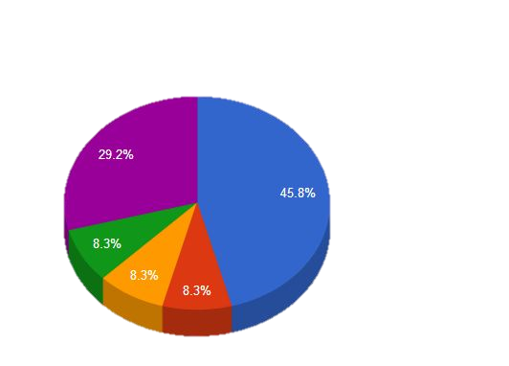
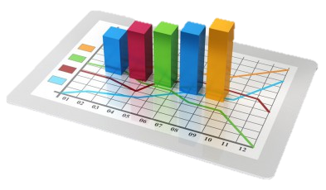
Background & Importance
Directs resources, controls hazards, and plans training
Helps establish S&H goals and objectives
Shares S&H performance with the workforce
Images retrieved from Bing Images
Notes:
You can use any trends you identify to help direct resources, prioritize hazard controls, and plan for additional S&H training needs. If you have many repeat findings or findings of the same type, for example, you may be able to direct more resources to address a systemic issue, or identify a need for more funding to implement a more permanent control measure in several areas. You can also train inspectors or other members of the workforce to better identify and report similar issues.
A functional and effective trend analysis program helps measure SMS performance overall and identify opportunities for SMS improvement. You can use these improvement opportunities to help shape your S&H goals and objectives around any weaknesses uncovered.
Finally, your trend analysis program should also share trend results with personnel throughout the organization. It is important for all levels of personnel to understand what trends you identify, but also how they can help turn negative trends to desirable trends.
The Service-specific documentation listed below also requires some level of trend analysis:
DODI 6055.1 (will provide trend information...)
OPNAVINST 5100.23 (to include conducting and compiling information on trends)
AFI 91-301 (Include identified trends and problem area)
AR 385-10 (analyze loss cause factors, systemic origins, and trends…)
NAVMC 5100.8 (potential unsafe trends or tendencies)
Images retrieved from Bing Images (free to share and use license) at: http://www.entomofago.eu/wp-content/uploads/2016/04/trend-analysis-393x230.jpg and http://i.stack.imgur.com/7p7Lt.jpg
The images show some more common examples of graphs or charts used to display identified trend information.

Slide 5
Documentation
Trend analysis program, if applicable | S&H inspection findings
Hazard tracking log | First aid logs or reports
Injury and illness records | Trend reports
Employee hazard reports | Trend action or abatement plans
Mishap and near-miss investigations | S&H goals and objectives
Notes:
An OSHA VPP assessment of your trend analysis program typically includes review of the documentation listed on the slide. This is not an all-inclusive list of applicable documentation. Provide completed forms and documents to your assessment team – do not only show blank forms!
Trend analysis includes a comprehensive analysis of the trends, not solely graphs that display data, but also an informative report or narrative to ensure you use the data gathered to make improvements.
Review trends for the last three years. Smaller sites may not have enough incidents, events, or data to identify a trend. Larger sites though, can review trends quarterly or even monthly sometimes; however, larger sites should trend year-to-year data to show overall improvement or lack of improvement.
Injury and illness records include OSHA Forms 300, 300A, and 301. Other documentation may relate to OSHA’s minimum trend analysis expectations, such as accident/mishap and near-miss data, employee hazard reports, first aid logs, and S&H inspection findings. Assessment teams may review these to ensure your program identifies all important trends.

Slide 6
Leadership/Management Knowledge
Leaders and managers should be knowledgeable about:
How trends are incorporated into planning
Trends identified in the last three years
Plans in place to address trends and any status on progress
Image retrieved from Bing Images
Notes:
Leadership should be aware of current S&H trends and implemented actions to correct any issues. Leadership should understand how they use trends in the S&H planning processes to direct resources and develop S&H goals and objectives.
Image retrieved from Bing Images (free to share and use license) at: http://orlandoelt.wikispaces.com/file/view/business_men.jpg/33553415/business_men.jpg

Slide 7
Key Personnel Knowledge
Key personnel should be knowledgeable about:
What trend data is collected and reviewed
Process for tracking trend data
How to analyze data for trends
Positive and negative trends over the last three years
Plans of action to combat negative trends
How trends are incorporated into S&H planning
Methods for sharing trends with management and employees
Notes:
Key personnel could consist of: S&H staff, human resources personnel, business analysts, industrial hygiene staff, OSHA recordkeepers, S&H trainers, occupational health staff, and managers and supervisors.
Key personnel should know of any system(s) used to assess workplace trends, such as Enterprise Safety Applications Management System (ESAMS) or Reserve Component Automation System (RCAS). You may have an internally developed system or use Excel to record and calculate the trending data too. They should also know what workplace trends are assessed and what data is gathered to assess these trends.
Most importantly, key personnel should know about past trends. They should have an understanding of how those trends were addressed, or what actions are currently in place to address them.
Explain the trends and abatement solutions to employees and management so they are aware of potential hazards or injuries that are on the rise. By making this data useful to employees, they can help reduce the risk of a negative or undesired trend.

Slide 8
Workforce Knowledge
Employees should be knowledgeable about:
Hazard and near-miss reporting procedures
S&H goals and objectives
Current S&H trends
Actions they can take to combat undesired workplace trends
Image retrieved from Microsoft Clip Art
Notes:
Employees should be knowledgeable of how to report hazards and near-misses, as this information is valuable for trend analysis. Employees should also have an understanding of the S&H goals and objectives. Trend findings are incorporated into goals and objectives for improvement, so this helps employees understand how you plan to combat trends.
Communicate trends, when identified, so employees are aware of negative impacts to S&H and can assist in eliminating these trends from the workplace.
Image retrieved from Bing Images (free to share and use license) at: http://englishfinalprojectsummer2012.wikispaces.com/file/view/employees.jpg/350188224/employees.jpg

Slide 9
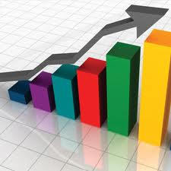
Action Checklist
Develop a written trend analysis program
Determine which S&H indicators to trend
Identify and train a program manager/trend analyst
Collect S&H data for trending
Analyze S&H data to identify trends
Incorporate trends into S&H planning
Share trends with the workforce
Image retrieved from Bing Images
Notes:
Follow this action checklist to implement and sustain VPP expectations for trend analysis. Each of these action checklist items will be covered in more detail on the following slides.
Image retrieved from Bing Images (free to share and use license) at: https://surveyanalytics.files.wordpress.com/2011/04/trend-analysis12.jpg

Slide 10
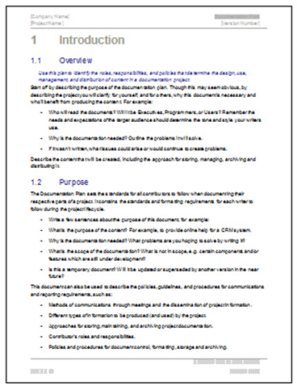
Trend Analysis Program
Outline the purpose
Establish responsibilities
Identify indicators to trend
Distinguish how and when to collect data
Identify how often data will be trended
Determine how to track data
Summarize how to use identified trends
Image retrieved from Bing Images
Notes:
It is recommended to develop a written trend analysis program. The goal of a trend analysis program is to analyze S&H data to determine patterns and S&H impacts across the organization.
As with all written S&H programs, a written trend analysis program ensures ownership, execution, and continuity in analyzing trends. While not required, a written program will help you set expectations and keep focus on what your analysis program needs to accomplish.
The elements of a trend analysis program on the slide are not all-inclusive, but a good start in developing a program from scratch.
The image shows a generic program document, similar to how you should document your written trend program.
Image retrieved from Bing Images (free to share and use license) at: https://c1.staticflickr.com/3/2628/3704109690_2cb035109d.jpg

Slide 11
Indicators to Trend
Minimum OSHA VPP Trending Requirements
✓
Mishaps and near-miss investigations
✓
Injury and illness history
✓
S&H inspection findings
✓
Employee reports of hazards
Notes:
The VPP Policies and Procedures Manual, Cooperative and State Programs (CSP) Chapter III, requires trend analysis on injury and illness history, employee hazard reports, mishap and near-miss investigations, and S&H inspections findings, at a minimum. In addition to the requirements listed in the CSP, some additional data points valuable to trend include first-aid cases (which coincide with your injury/illness history), work orders, emergency drill critiques, and employee perception surveys.
This data can come from many of the different S&H processes already in place. Injury and illness history for example, already exists in OSHA recordkeeping forms, mishap reports, first-aid logs, and occupational health visits by employees.
Inspection findings should be analyzed for trends from all sources of inspection data. This includes periodic safety office inspections, monthly or quarterly supervisors safety inspections, spot inspections or spot checks, fire extinguisher/eye wash/AED inspections, industrial hygiene surveys, or any other S&H inspections that occur.
Think about the indicators beyond this list that will be the most valuable for you to track at your worksite. Include them in your written trend analysis program.

Slide 12
Leading Indicators
Review activities and behaviors, which is proactive
Measure activities/behaviors that lead to improvement
Identify positive activities that enhance safety performance
Dictate plans of action to combat deficiencies
Pair with lagging indicators to adjust performance
Predict Future Performance
Notes:
Leading indicators assess the actions, activities, and behaviors that occur in an effort to prevent injuries and illnesses or improve S&H performance. They include safety initiatives, safety activities, or reported safety concerns with the goal of preventing incidents. We use leading indicators to predict future events before they occur, correcting issues before the incident. Leading indicators are necessary to achieve the excellence in S&H.
Essentially, leading indicators help to determine our plans of action in S&H performance. They identify weaknesses so we can identify preventive measures and abate deficiencies. Many workplace S&H programs focus most of their efforts on lagging indicators that report on the outcomes (incidents), but do not utilize leading indicators that measure proactive activities.

Slide 13
Leading Indicator Examples
S&H training records | S&H inspection and audit findings
Workplace S&H meetings | Employee hazard reports
S&H committee participation | Employee involvement
Employee perception surveys | Preventive maintenance activities
Notes:
The slide lists some examples of common leading indicators; this list is not all-inclusive.
It is important to break your trend data down into smaller pieces of data. This helps to evaluate and identify trends. For example, S&H training records are an example of leading indicator data, but you must measure more detail related to S&H training records. This can include information such as:
What is the percentage completion of the different individual trainings?
What percentage of was complete on time (within XX days)?
How many training classes were available for employees to attend?
How many employees failed the post-test quiz and needed retraining?
These are only a few examples. You can measure an almost endless list of specific measures for each group of documents or trend data you collect. Not all specific measures may apply to what you want to know about your own S&H performance, though. Too many measures of performance may also become a burden or exhausting. Pick a few key indicators of S&H performance that you wish to measure for each set of trend data.

Slide 14
Lagging Indicators
Review data after the fact, which is reactive
Quantify incident or mishap data
Identify results of poor workplace safety practice
Measure the effectiveness of implemented actions
Help support performance of leading indicators
Analyze Past Performance
Notes:
Lagging indicators are also commonly referred to as trailing indicators. Lagging indicators help evaluate your S&H performance by relating performance to incident or injury information, which is reactive and measures data on incidents already occurring. They provide information on how many employees were injured or ill, how severe injuries or illnesses were, or how many different incidents occurred, to name a few examples. They will not provide information on how you perform when taking actions to prevent accidents and incidents.
Lagging indicators are very useful still and necessary. In combination with lagging indicators, leading indicators are useful in showing S&H performance and whether efforts to proactively reduce injuries and illnesses have been effective.

Slide 15
Lagging Indicator Examples
OSHA recordable injuries/illnesses | Reports of injury/illness symptoms
Lost time injuries/illnesses | Injury/Illness costs
Workers’ compensation claims | First-aid cases
Experience modification rate | Near-misses
Notes:
The slide lists some examples of common lagging indicators; this list is not all-inclusive.
As you can see, most lagging indicators revolve around injuries and illness or other incidents that occur. Once an incident occurs, we have failed to prevent it, making the data gathered about the incident “lagging” indicators of S&H performance.
It is important to again identify the specific measures to evaluate when trending lagging indicators. For example, OSHA recordable injuries and illnesses are an example of lagging indicator data, but you can identify many measures to evaluate, such as:
What parts of the body do employees injure most often?
What types of injuries or illnesses occur most often?
What is the average age of injured or ill employees?
During what seasons or in what months do most injuries or illnesses occur?
These are only a few examples again, as you could continue identifying many more measures to track or trend.

Slide 16
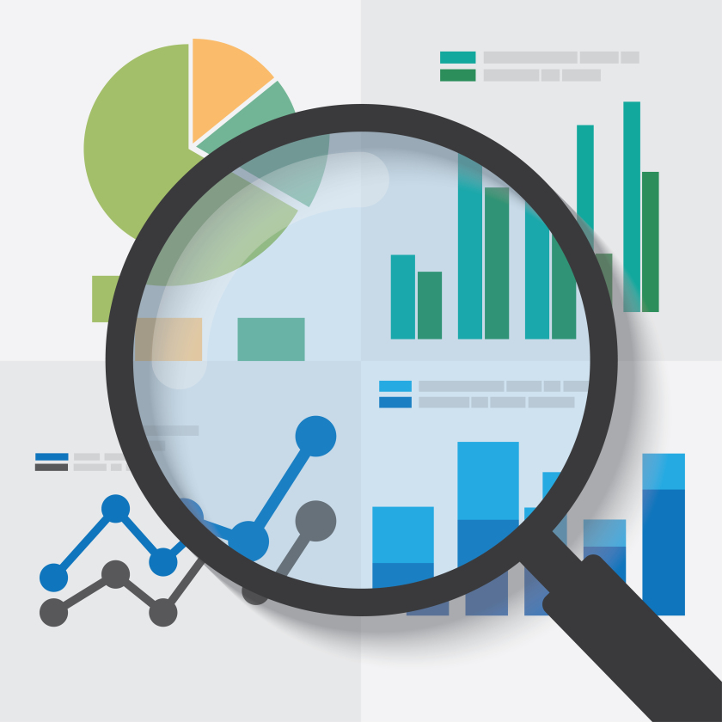
Program Manager/Trend Analyst
Choose a program manager familiar with:
Trend analysis techniques
Statistical analysis
Train program manager on:
SMS requirements
Trend analysis program
Indicators to measure
When to report or brief trend analysis findings
Image retrieved from Bing Images
Notes:
Assign a person responsible for conducting the trend analysis for your program. The person who is responsible for trending should be familiar with how to conduct trend analysis, or different trend analysis techniques. Conducting trend analysis is not always an easy task. It takes an understanding of what to trend and how to trend it, and can include the need for knowledge or education in statistics. Many organizations attempt to get business analysts or other analytically skilled personnel involved in conducting trend analysis. If this person is not already familiar with conducting trend analysis, consider training to help with understanding the expectations.
In addition to a background in trending or statistics, trend analyzers should also be trained on their expectations. This can include what the SMS requires from the trend program, what the trend program itself outlines, what performance indicators should be measured, and when or how often to report findings from trend analysis.
The image represents digging deeper into trending than charts a graphs; explain what trends are, why they are occurring, and show and how they can affect workplace S&H.
Image retrieved from Bing Images (free to share and use license): https://cassandrajohn.files.wordpress.com/2016/07/data_analysis.jpg?w=840

Slide 17
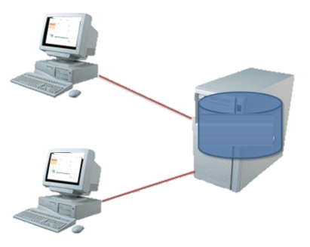
Data Collection
Assign a responsible person(s) for collecting trend data
Identify trend data to collect
Collect and analyze trend data periodically
Consider a tracking system or tool to compile gathered data
Image retrieved from Bing Images
Notes:
Assign responsible persons to gather the data you will need to conduct trend analysis. Know it may be too cumbersome to have one person responsible for collecting all of the data their self.
Identify what data to collect and how often to collect it. Some examples of data to collect include OSHA 300 logs, first-aid logs, inspections records, employee report forms, and mishap/near-miss reports. Collect this data periodically for analysis. Often times, too many organizations wait until the end of the year, or only report trend data annually. This allows for significant, undesired changes to occur that you could identify sooner, rather than later.
Best Practice: Some sites that do not have tracking systems utilize VPP Representatives, Unit Safety Representatives (USRs), or Additional or Collateral Duty Safety Officers (ADSOs/CDSOs) to collect their trend data for them – they collect inspection records; gather information from first-aid logs; or pull together work order request information. They also coordinate with maintenance personnel, recordkeepers, or other personnel who collect relevant data to collect this information for the program manager.
Many sites utilize tracking software or systems to collect trend data, and in some cases, even perform basic trend analysis. This is not available or prevalent in all DoD Services and Agencies, though. If you utilize a software program to collect trend data, it makes much of this work easier. Personnel with advanced knowledge of Microsoft Excel can also create an easier system to capture and analyze trend data.
The image shows how databases allow for easy compiling, tracking, trending, and sharing of information. Image retrieved from Bing images (free to share and use license) at: http://i.stack.imgur.com/vZhSH.jpg

Slide 18
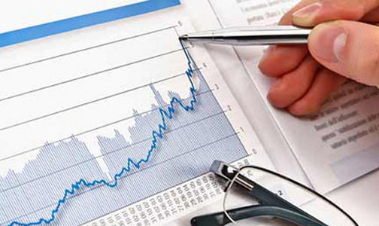
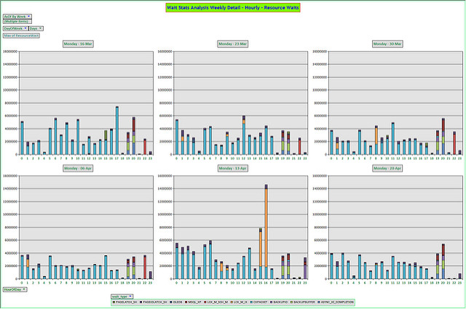
Data Analysis
Create graphs, charts, or tables to display data
Explain information on display
Investigate why changes in data occur
Conduct statistical analyses
Compare to leading and lagging indicators
Images retrieved from Bing Images and Microsoft Clip Art
Notes:
The most common way to display trend data is by graphs, charts, or tables. Though important for displaying your trend data in an easy to see or interpret way, graphs and the like alone do not constitute “analysis” and are not always so straightforward.
In addition to determining what information is shown when looking at trend data, you also need to determine why. Investigate the potential causes behind increasing or decreasing trends, or even the lack of a trend in an area. Similar to investigating mishaps, you should identify a few factors that may have caused change, including key factors with the most influence on changes, both good and bad. Be able to answer the question “Why” when you have fluctuations in data.
Conducting statistical analysis helps identify how confident you are that a potential cause in a change is the reasons why. It also helps better explain what the information or data in a chart or graph represents.
Compare the trends to the leading and lagging indicators you outline in your trend analysis program. Use inspections as an example. Let’s say you wanted inspection completion to increase and find more hazards. Some questions you might ask could be:
Did inspection completion increase or decrease? If it increased, then why? If it decreased, what caused this?
Are inspectors doing a better job at identifying hazards? If yes, then why are they doing better? What contributed to better inspections? If no, why did they not identify more hazards?
Top image retrieved from Microsoft Clip Art.
Bottom image retrieved from Bing Images (free to share and use license) at: https://farm4.staticflickr.com/3537/3481674520_a1bf6ec00b_z.jpg

Slide 19
Incorporate Trends into Planning
ACHIEVED
Revise S&H goals and objectives
Develop corrective action plans
Direct budget and resources
Prioritize hazard controls
Identify areas of excellence
Lower slip, trip, and fall injuries by 50% in 2016
NEW GOAL
Complete 95% of assigned self-inspections each month
Notes:
It is important to use your trend analysis data to improve the level of safety within your organization. Using the data to drive SMS improvements will keep you on track and focused on a prioritized approach to meeting long-term goals and objectives.
One of the most important planning changes, based on your identified trends, is goals and objectives. Rewrite or revise your goals and objectives each year to help improve upon any undesired trends you identify. You should always write your goals and objectives to attack weaknesses, and trend analysis is done to find the weaknesses for you!
Develop corrective action plans for any undesired trends that you do not incorporate into goals and objectives. The corrective action plan will serve to combat the weaknesses and turn them into more desired trends and outcomes.
Once you identify your weak areas, you can control how you allocate resources, time, and energy towards correcting S&H issues within your SMS. You may also prioritize your hazard controls and decide a big budget project across the organization due to an organization-wide undesired trend being more important than hazard abatement log findings you currently have.
Don’t forget, there will be good trends you find as well! Identify areas where trend data shows you are excelling.

Slide 20
Share Trend Results
Periodically monitor trends
Discuss trend outcomes with leadership
Communicate goals and objectives to workforce
Post identified trends and plans of action
Inform employees immediately of concerning trends
Image retrieved from Bing Images
Notes:
It is equally important to communicate the trends you identify across the organization. When leaders and employees understand the trends that exist and the plans to correct negative trends, it is much easier to improve your SMS.
There are several ways to consider communicating trends, which should start with communicating identified trends to leadership. Monitor trends continually, whether it be monthly, quarterly, or some other frequency. When you identify undesirable trends, you can put plans in place to correct them before they worsen.
Communicate trends (typically via goals and objectives) to the workforce, as well. Employee should understand what trends exist and how they can help to combat the trends. More importantly, as you analyze trends periodically, if you discover negative trends that could impact employee S&H, it may be best to communicate them as soon as possible. For example, you may identify a trend in serious back injuries in the past three months; it is best to communicate this to employees and develop a corrective action plan as soon as possible versus waiting to establish a new goal at the end of the year.
Another effective part of communicating trends is to provide them visually. This can be in the form of posting trends and goals and objectives to safety bulletin boards, sending emails, discussing during supervisor safety meetings, or posting in other conspicuous locations. Avoid simply posting what the trend is, and ensure these communications include what actions employees can take to help.
Image retrieved from Bing Images (free to share and use license) at: https://www.bing.com/images/search?view=detailV2&ccid=oetHpYoO&id=50AA710FFF9161835578459FE313F22AC3D8382D&thid=OIP.oetHpYoOFnOevz3vZyimaAEsEs&q=sharing&simid=608019151531282195&selectedIndex=100&qft=+filterui%3alicense-L2_L3_L4_L5_L6_L7

Slide 21
Conclusion
In this presentation, you learned to:
Summarize the background and importance of trend analysis
List trend analysis-related documentation
Describe the knowledge leadership/management, key personnel, and the workforce should have regarding trend analysis
Identify trend analysis actions to implement and sustain OSHA VPP

